Slide 1
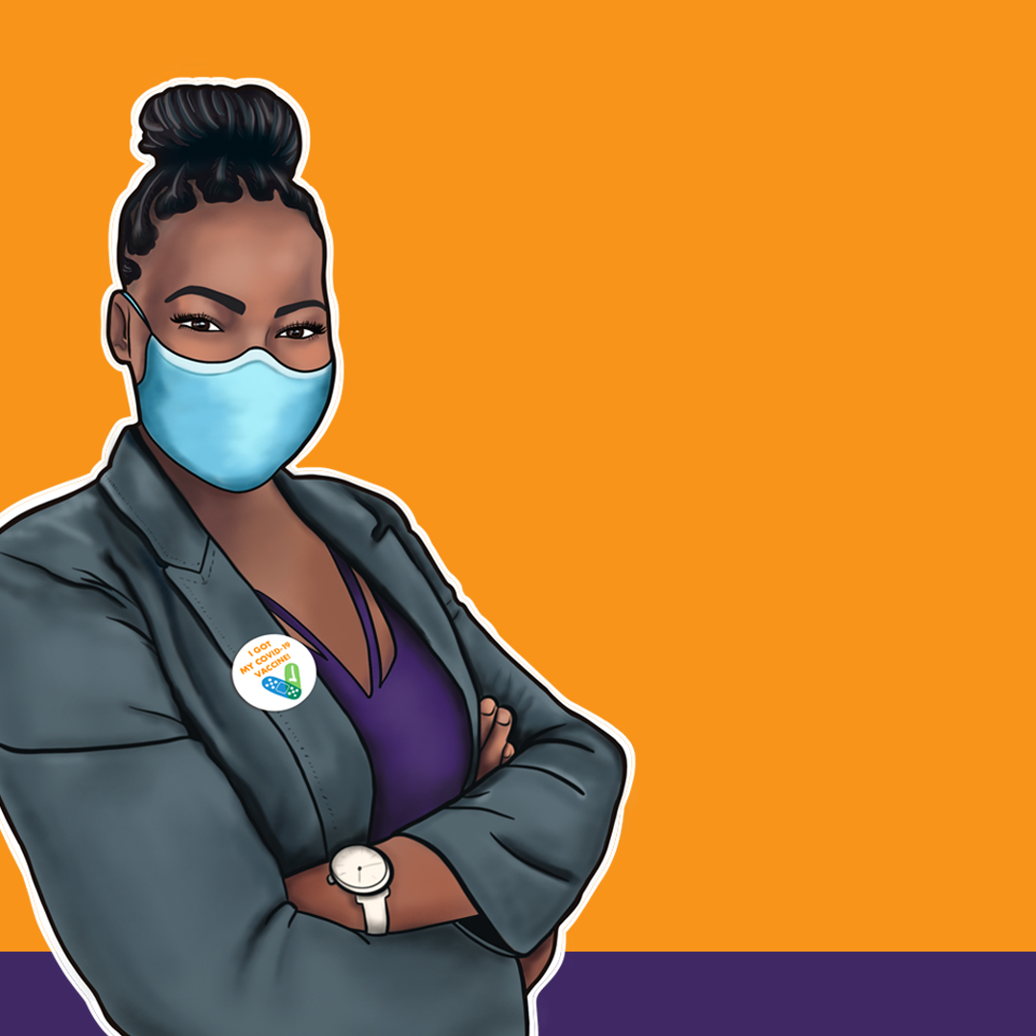
Take the Next Step to a Future with COVID-19 Under Control
Please,get
Vaccinated
and Boosted

Slide 2
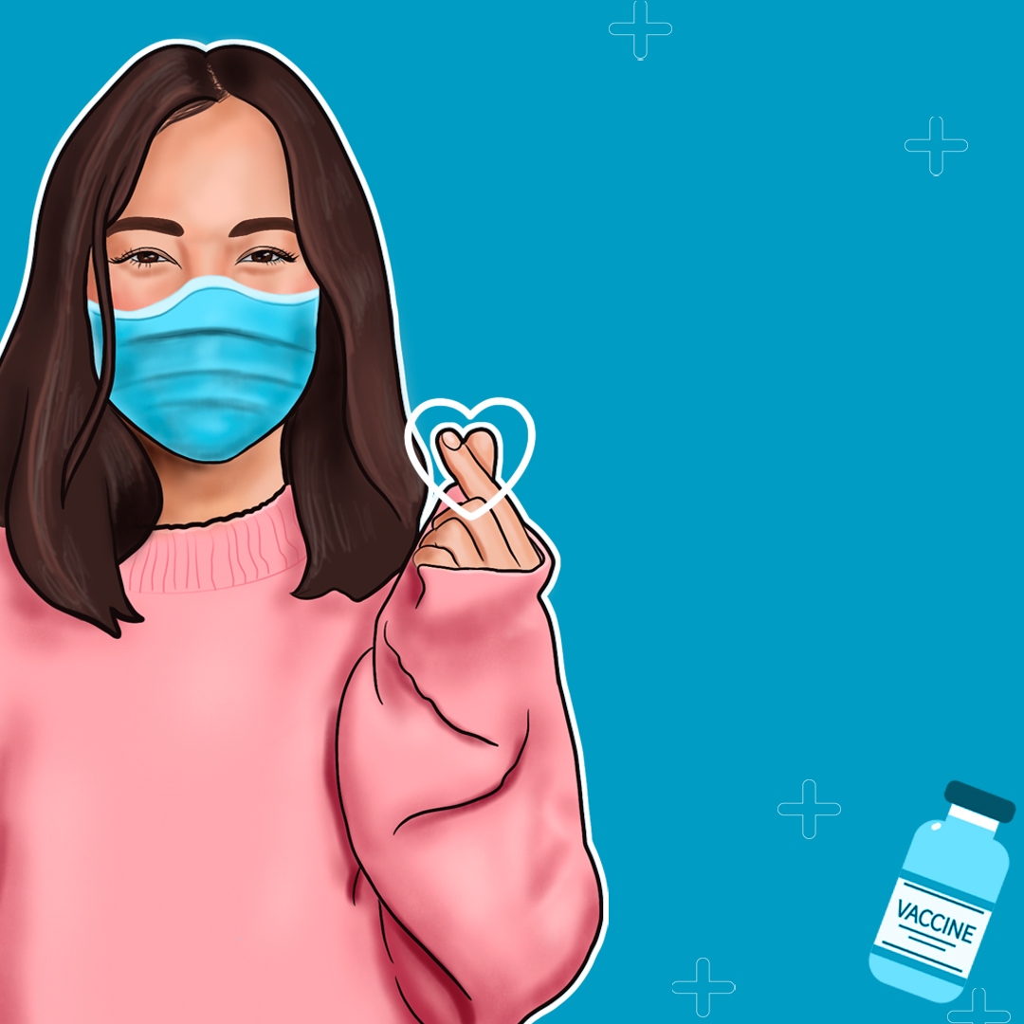
PROTECT VIRGINIA
Please. Get the COVID-19 Vaccine and Booster.

Slide 3
Now’s Your Chance to Take Back Your Life.
GIVE YOURSELF EXTRA PROTECTION AGAINST COVID-19
CHOOSE TO GET VAXED and BOOSTED

Slide 4
Let’s Get Back to
Quality Time Together
When it’s your turn, please, get vaccinated and boosted.

