Slide 1

Elevating the Voice of Virginia’s
Health Centers
Kemi Alli, MD | Elona Deprez, Ed.D.

Slide 2


2
Kemi Alli, MD
Co-founder & Managing Partner, allied executive solutions
A health center leadership perspective
25+ years in executive and medical leadership
A personal journey
New York, West Africa, New Jersey
The people behind the work
Wife, mother, sister, daughter, niece

Slide 3


3
Elona Deprez, Ed.D.
Co-founder & Managing Partner, allied executive solutions
Development and strategic marketing
20+ years in fundraising, marketing, and leadership
A personal journey
Albania, Philadelphia, New Jersey
The people behind the work
Wife to Nick, mama to Ben, Isaac AND Sally

Slide 4
4
What we hope you will take away from our presentation today
The model and its purpose
Describe the FQHC movement’s history and the policy intent of the FQHC model.
The evidence and current pressures
Data trends, Medicaid changes, and workforce challenges.
Three actions for your health center
Develop an executive message, a board advocacy action, and a community visibility plan.

Slide 5

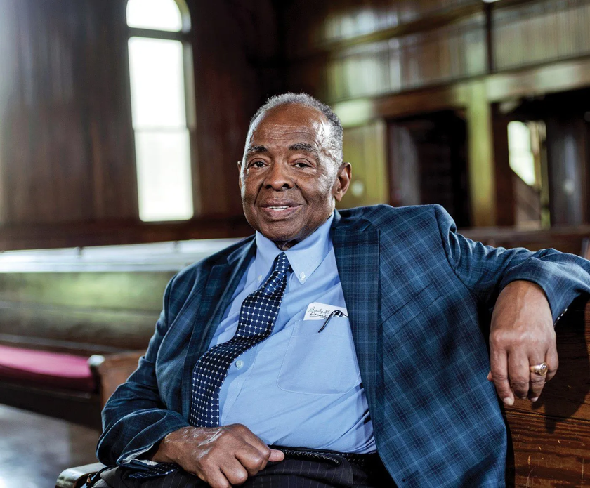
Freedom Summer and the roots of the FQHC movement
5
1964
Civil rights organizing exposed exclusion from medical care.
Medical volunteers and local leaders pursued a more lasting response to the needs they saw in Mississippi.
Freedom Summer volunteers, Oxford, Ohio, June 1964
Photo: Ted Polumbaum Collection / Newseum
[2] CHC Chronicles, America’s First Community Health Centers (2024)

Slide 6
Community voice shaped the health center model
6
1965
Community priorities
Residents helped define what care and support their communities needed.
The federal neighborhood health center program began.
Health beyond the exam room
Early leaders addressed food, sanitation, housing, and economic opportunity.
Leadership lesson: listening to the community belongs inside the strategy.
[1] CHC Chronicles historical timeline [2] CHC Chronicles, America’s First Community Health Centers (2024)

Slide 7
The policy purpose of the health center model
7
Access to comprehensive care in communities that face barriers
Access and affordability
Serve people regardless of ability to pay. Adjust fees using income and family size.
Comprehensive care
Provide required services and coordinate care around community needs.
Patient governance
Generally, at least 51% of governing board members must be patients.
Specified exceptions and HRSA-approved waivers apply to the patient-majority requirement.
[3] HRSA, What is a Health Center? [4] HRSA Compliance Manual, Chapter 9 [5] HRSA Compliance Manual, Chapter 20

Slide 8
What 25 years of leadership has taught me
8
Kemi Alli, MD
The mission must remain clear
when conditions change.
Relationships need attention before a crisis.
Operational decisions have human consequences.
Who already trusts you enough to listen when the stakes rise?
How will the decision affect patients, staff, and access to care?

Slide 9


9
What do people outside our walls understand?
If you asked a policymaker, employer, or donor what your health center contributes, what would they say?
What they understand
The people you serve and the care you make possible
What they can do next
The specific decision, partnership, or investment you need

Slide 10
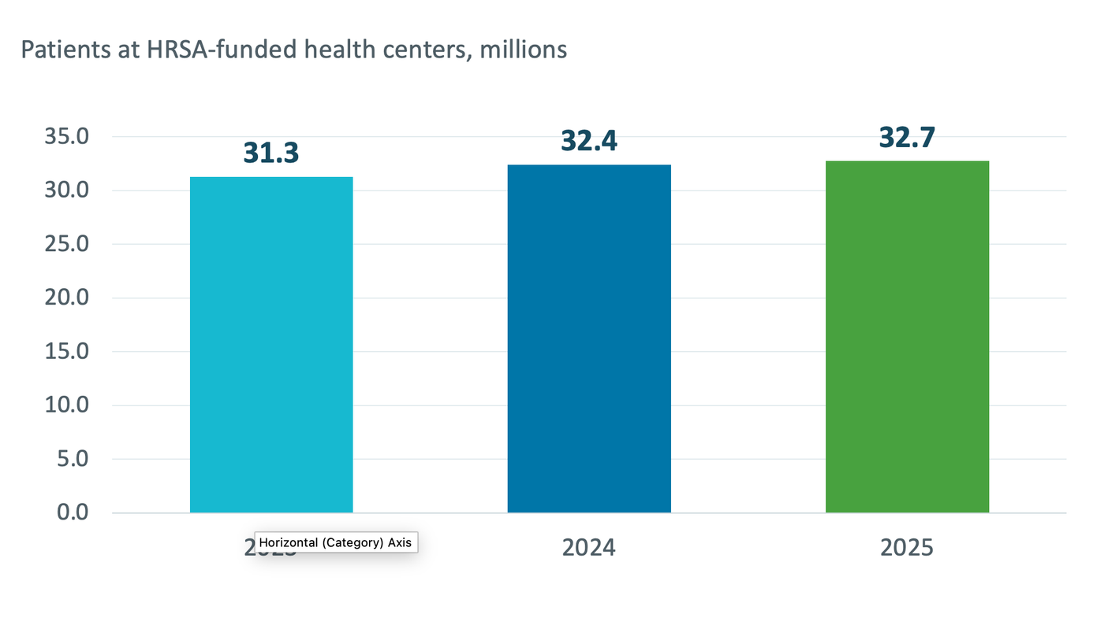
National annual patient volume continues to grow
10
+1.47 million
patients from 2023 to 2025
Utilization measures care received. It does not measure everyone still seeking access.
[6] HRSA, national UDS awardee data, 2025

Slide 11
National reach includes care beyond medical visits
11
HRSA-funded health centers, 2025
32.7M
144.1M
3.1M
90%
patients served
total visits
mental health
patients
of patients with known
income at or below
200% of poverty
A different measure of reach: NACHC estimates 52.3 million people, nearly 1 in 7 Americans, over three years.
[7] HRSA, Impact of the Health Center Program, 2025 [6] HRSA, national UDS awardee data, 2025 [12] NACHC, three-year reach estimate, Aug. 27, 2026

Slide 12
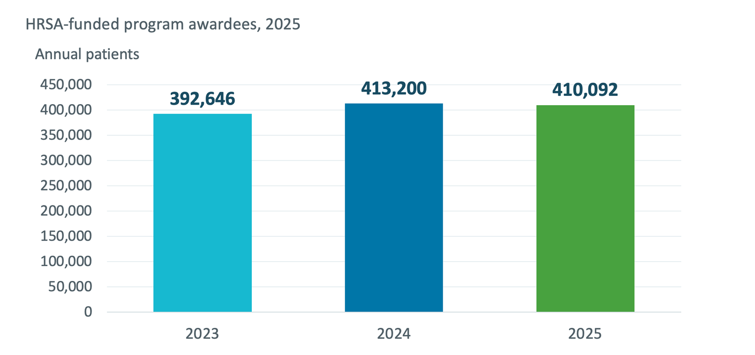
Virginia health centers served 410,092 patients
12
26
reporting health center
organizations
Virginia’s 2025 patient count was slightly below 2024. Local trends need their own explanation.
[8] HRSA, Virginia UDS awardee data, 2025

Slide 13
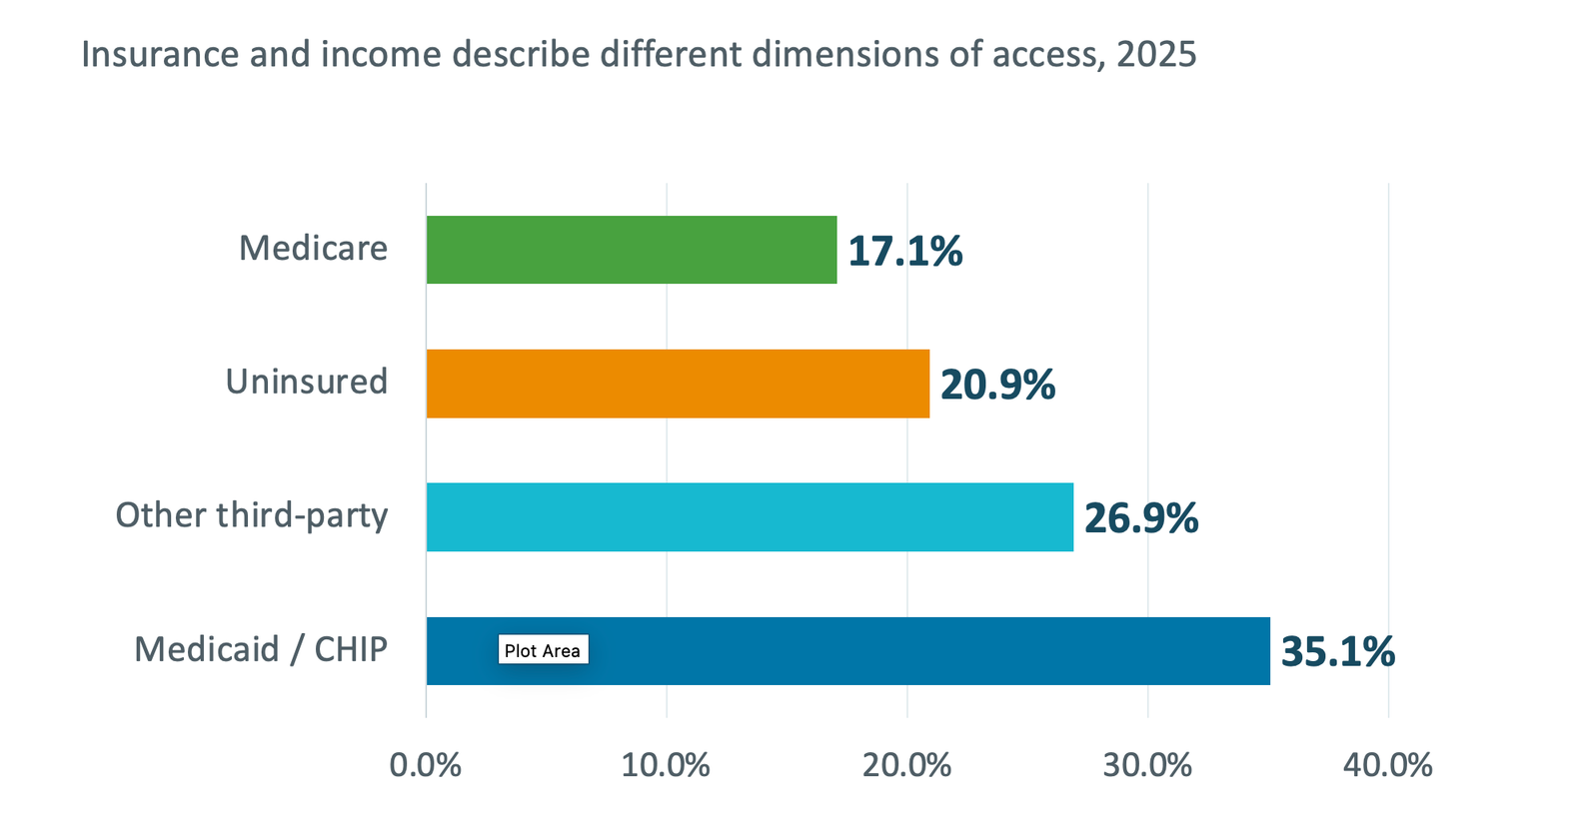
Who Virginia health centers serve
13
90.9%
at or below 200% of the federal poverty guideline
Among patients with known income only
Insurance: share of all 410,092 patients. Income: 192,062 patients with reported income.
[8] HRSA, Virginia UDS awardee data, 2025

Slide 14
Virginia’s clinical measures show care delivered
14
HRSA-funded health centers, 2025
69.7%
75.3%
50.2%
56.4%
blood pressure controlled
among eligible patients
with hypertension
depression screening
with a follow-up plan
when positive
appropriate colorectal
cancer screening
breast cancer
screening
A credible impact message describes both progress and remaining gaps.
Each percentage uses its own eligible patient population. Screening measures describe care processes.
[8] HRSA, Virginia UDS awardee data, 2025 [9] HRSA, Virginia UDS Table 6B, 2025

Slide 15
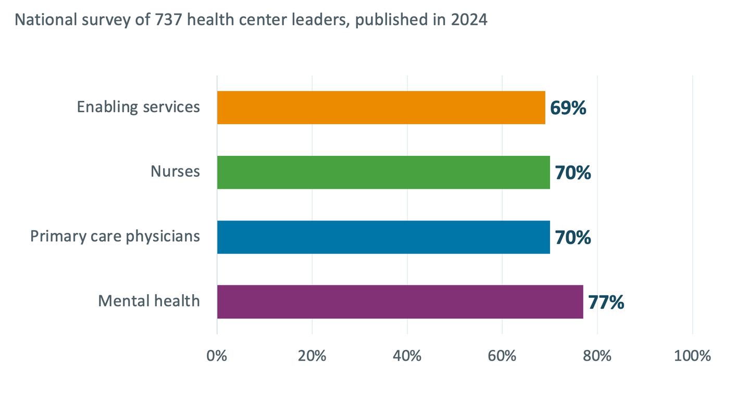
Workforce shortages constrain service capacity
16
Share reporting a shortage at their largest site
Enabling services include support such as transportation and language assistance.
Survey conducted in fall 2023 and spring 2024. These percentages are not vacancy rates or Virginia estimates.
[11] Commonwealth Fund, 2024 FQHC survey, Exhibit 7

Slide 16
Medicaid changes create a concrete planning need
15
Virginia policy status as of September 17, 2026
January 1, 2027
Some Medicaid expansion adults will face work requirements and eligibility reviews every six months.
Exemptions apply. These requirements do not apply to everyone with Medicaid.
Leadership response: prepare enrollment support, clear patient communication, and a local coverage dashboard.
[10] Virginia DMAS, Federal Work Requirements, accessed Sept. 17, 2026

Slide 17

What does this mean when you are trying to amplify your message?
17
Policy
How will this affect patients’ ability to get care?
Partnerships and workforce
What can we offer that others should know about?
Philanthropy
What specific need or project could a funder help support?

Slide 18
A strong message connects evidence to a request
18
1
2
3
4
NEED
RESPONSE
EVIDENCE
REQUEST
What is happening in the community?
What does the health center do?
What verified fact shows the contribution?
What should this listener do next?
The listener should leave knowing why the issue matters and how to help.

Slide 19
19
Working together to help patients
understand Medicaid changes
Situation
Worked message
A health center CEO wants to work with local organizations to help patients understand Medicaid changes.
“Some adults covered by Virginia’s Medicaid expansion will have new requirements starting in January 2027. Let’s work together to explain the changes and connect patients with help. Can you choose someone from your team to join a planning meeting this month?”
[10] Virginia DMAS, Federal Work Requirements, accessed Sept. 17, 2026

Slide 20




















20
The facts stay consistent across audiences
Audience
What to focus on
What to ask
How a policy affects patients' ability to get care
Meet with us about the issue and visit the health center.
Policemaker
Foundation or donor
What patients need, how we can help, and what it will cost
Consider funding a project with a clear goal.
A problem we can solve together and how each organization can help
Choose someone from your team to join a planning meeting.
Employer or partner
Adjust the message for your audience. Keep the facts the same.

Slide 21
Practice the message you will use
21
Seven minutes in groups of three
2 minutes to prepare
3 minutes to practice
2 minutes for feedback
Name a real person. Write the need, response, one verified fact, and specific request.
Each person delivers a 60-second message addressed to that listener.
Ask: “What am I asking you to do, and why does it matter for patients?”
Revise the request until your listener can repeat the next step.

Slide 22
Three deliverables for the next 90 days
22
Proposed leadership commitments: assign a name to each lead role
BY WHEN
DELIVERABLE
SUGGESTED LEAD
EVIDENCE OF COMPLETION
7 days
Executive message
A one-page brief with one verified fact and one clear request
CEO + communications lead
Brief ready for a named decision maker
30 days
Board advocacy
A board-supported conversation with that decision maker
CEO + board chair
Conversation held; response and next step recorded
90 days
Community visibility
One joint action with a community partner
Named executive sponsor
First agreed task completed; result reviewed together
Track the response to your request and what it enables for patients.

Slide 23
Before you leave: name your first conversation
23
By [date], I will ask [person] to [specific action] so that
[patient or community benefit].
Illustrative commitment
“By next Friday, I will ask our board chair to introduce us to a local transportation partner for a meeting about helping patients reach appointments.”
Tell a colleague your plan. Schedule when you will report back.

Slide 24

Thank you
Kemi Alli, MD
kemi@alliedexecsolutions.com
Elona Deprez, Ed.D.
elona@alliedexecsolutions.com

Slide 25

References: history and the health center model
28
Select a source title to open the supporting page
[1] Community Health Center Chronicles: historical timeline
www.chcchronicles.org/histories
[2] Community Health Center Chronicles: America’s first community health centers
www.chcchronicles.org (direct page link in title)
[3] HRSA: What is a Health Center?
bphc.hrsa.gov/about-health-centers/what-health-center
[4] HRSA Compliance Manual: Chapter 9, Sliding Fee Discount Program
bphc.hrsa.gov/compliance/compliance-manual/chapter9
[5] HRSA Compliance Manual: Chapter 20, Board Composition
bphc.hrsa.gov/compliance/compliance-manual/chapter20

Slide 26
References: national and Virginia data
29
Annual HRSA figures cover funded program awardees. NACHC’s reach estimate uses a different scope.
[6] HRSA: National UDS awardee data, 2025 reporting year
data.hrsa.gov/topics/healthcenters/uds/overview/national
[7] HRSA: Impact of the Health Center Program, 2025 results
bphc.hrsa.gov/about-health-centers/health-center-program-impact-growth
[8] HRSA: Virginia UDS awardee data, 2025 reporting year
data.hrsa.gov/topics/healthcenters/uds/overview/state/VA
[9] HRSA: Virginia UDS Table 6B, Quality of Care Measures
data.hrsa.gov/topics/healthcenters/uds/overview/state/VA/table?tableName=6B
[12] NACHC: Annual patients and estimated three-year reach, Aug. 27, 2026
www.nachc.org/chcs-served-34-4-million-patients-in-2025-reaching-more-than-52-3-million-over-3-years/

Slide 27
References: policy, workforce, and advocacy
30
Policy status: September 17, 2026. Workforce survey published in 2024.
[10] Virginia DMAS: Federal Work Requirements
www.dmas.virginia.gov/news-updates/new-federal-requirements/federal-work-requirements/
[11] Commonwealth Fund: 2024 national health center survey
www.commonwealthfund.org (direct page link in title)
[13] Virginia Community Healthcare Association: Take Action
vcha.org/take-action/

