Slide 1
The Impact of Unconscious Bias in
Healthcare Delivery
Monica “mOe” Anderson, DDS, DBA, FICD
Notes:
Their mission is advocating for, educating, and elevating member health centers so they can provide affordable, accessible, quality care regardless of ability to pay. 2025 UDS (HRSA) has dropped and the numbers are astounding
Last year, Virginia health centers served 410,092 patients in 2025; 55.8% of patients with known race/ethnicity were racial and/or ethnic minorities, about 91% of patients with known income were at or below 200% of poverty, 20.94% were uninsured

Slide 2
DISCLAIMER
The views expressed in this presentation are the personal views of the speaker and may not be understood or quoted as being made on behalf of or reflecting the position of her employer or any organizations with which she is affiliated.
Reproduction is permitted provided the source is acknowledged.

Slide 3


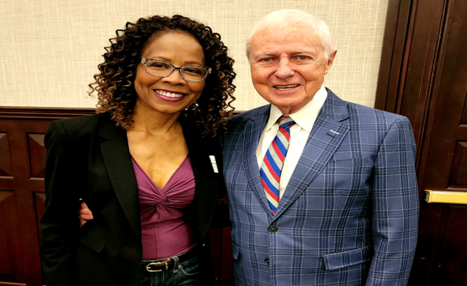
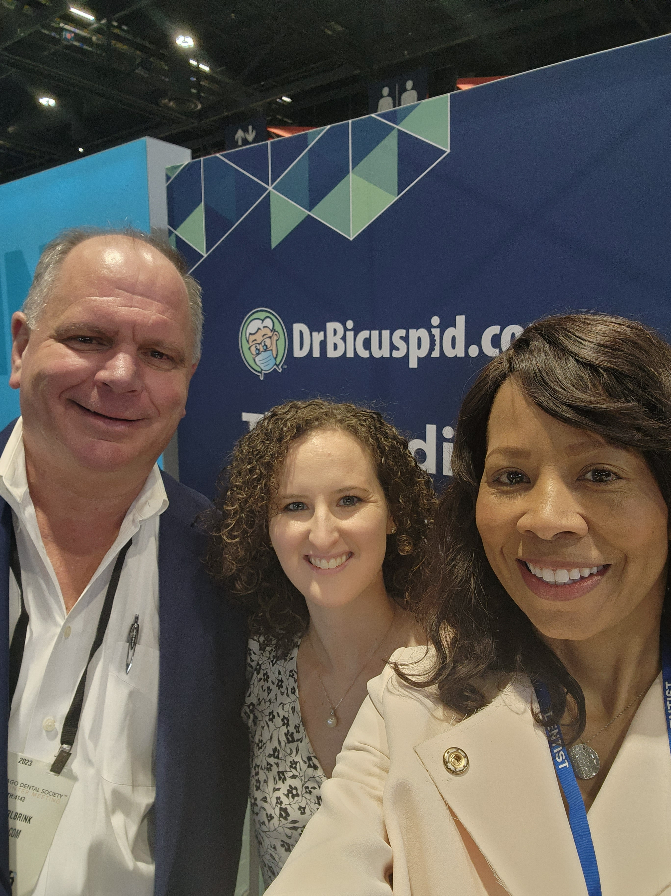
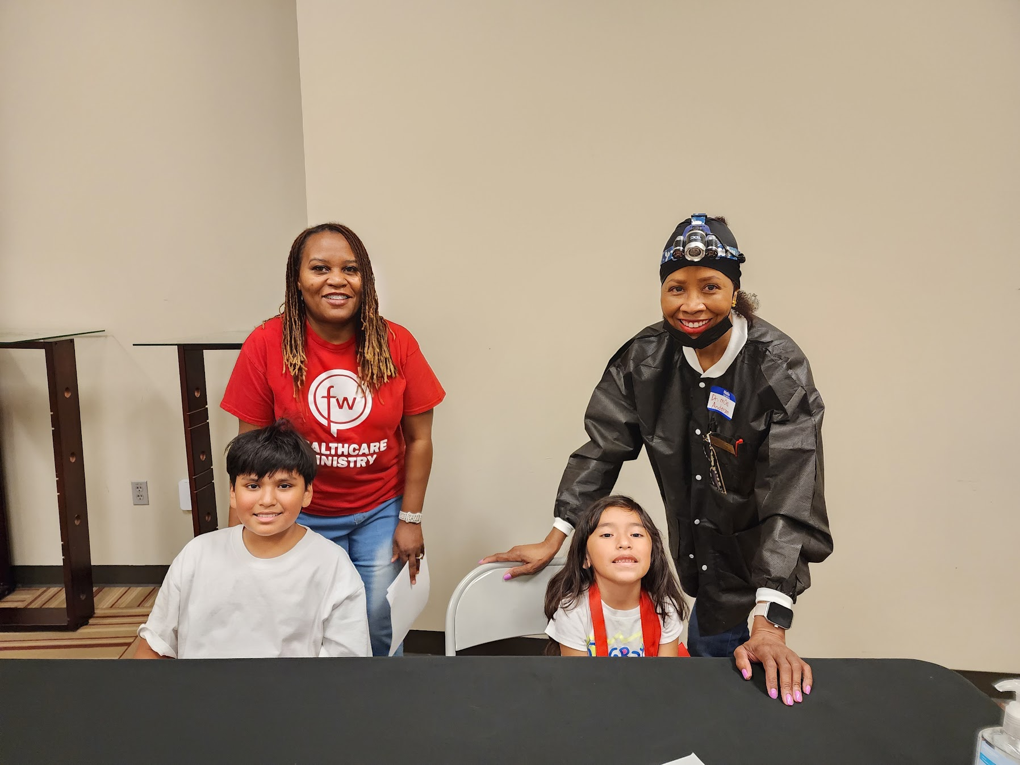
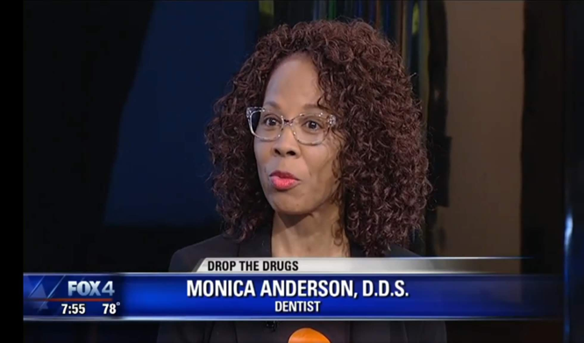
What I do
Notes:
I haven’t always been a Dental Consultant. In addition to my own private practice and working in a multidisciplinary clinic at the University of MN for many years, I have been a writer and editor for multiple healthcare publications, served as Director of an FQHC in FW, founded a nonprofit to deter prescription drug misuse and abuse, volunteered countless hrs providing dentistry to people with limited access to care, and worked for a Foundation providing school-based care for children at Title 1 schools in Central Texas.
This is not just a profession for me, it’s a ministry and it’s very personal.

Slide 4
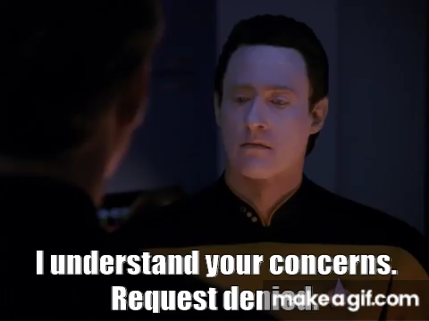
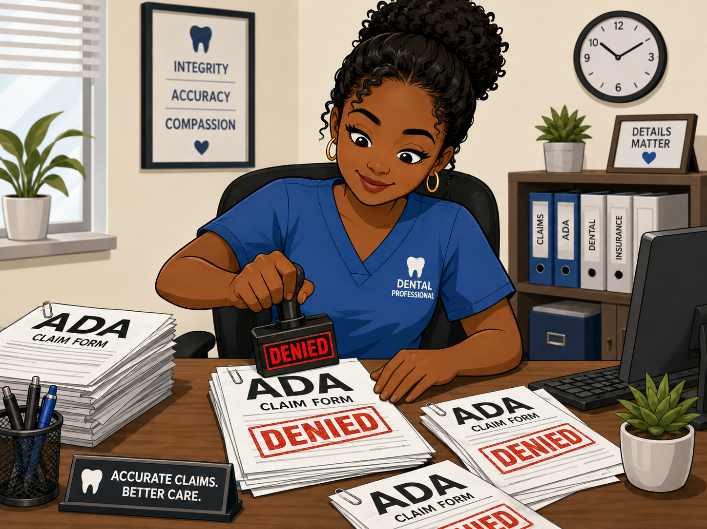
What people think I Do
Notes:
Now, that I work in benefits administration which I enjoy because I can use my extensive clinical experience and continue my other pursuits, but my friends say I joined the Dark Side and this is what people think I do. Unlike technology and accounting, there is a lot of gray in healthcare and that’s where experience matters.

Slide 5

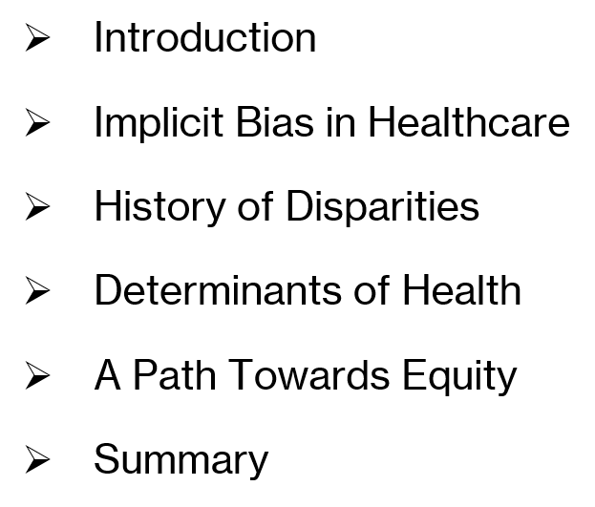
Notes:
So now that we’re acquainted. Let’s get into the reason we are here.
Increasingly we are using social drivers of health to emphasize modifiable conditions

Slide 6
“If not us,
who? If not
now, when?
-Dr Caswell Evans, Advocate for Health Equity
Notes:
If providers and public health advocates fail to speak out and provide leadership regarding discrimination, what other entity will?
If not us, who?
If not now, when?”
While Dr. Evans intended this message for an audience of oral healthcare provider, one would be hardpressed not to see how this charge applies to medicine, behavioral health, pharmacy and other disciplines in community health care. If not us, who?

Slide 7

Health equity is a state in which everyone has a fair and just opportunity to attain their highest level of health and explicitly recognizes historical and contemporary injustices and social/economic barriers.
Centers for Disease Control and Prevention
CDC: About Health Equity - 2024
Notes:
Equity is not equality. Simply put, equity means everyone gets what they need to reach the same outcome.
Equality is Giving everyone the same thing because we’re assuming everyone starts from the same place.
Example: Giving every patient the same prescription regardless of their individual circumstances such as their weight, impaired liver, or other medications.
Equity (data driven, strategic and analytical) is giving people what they need based on their individual circumstances, recognizing that different starting points require different support. (Women’s tee and the men’s tee)
Example: Tailoring care to address a patient's specific social, cultural, and economic barriers.

Slide 8
What Is Implicit (Unconscious) Bias
"Attitudes or stereotypes that affect our decisions and actions — outside our conscious awareness."
Can be favorable OR unfavorable toward a group
Discrimination = unfair treatment stemming from unfavorable bias
Awareness is the first step toward change.
Notes:
The quote is from Dr. Mahzarin Banaji, a Harvard psychologist and pioneering researcher in implicit bias.
Everyone has bias — this is documented fact, not a character flaw

Slide 9
BIAS SHOWS UP IN
CLINICAL DECISIONS
Transplant Decisions — Race and geography influence who gets referred and listed
Knee Replacement — Black patients referred at lower rates despite equal need
Pain Treatment — Undertreated pain in minority patients is well-documented
Referral Patterns — Age, gender, and race shape who gets referred for specialty care
.
Notes:
The result: eroded access, eroded trust, worse outcomes

Slide 10
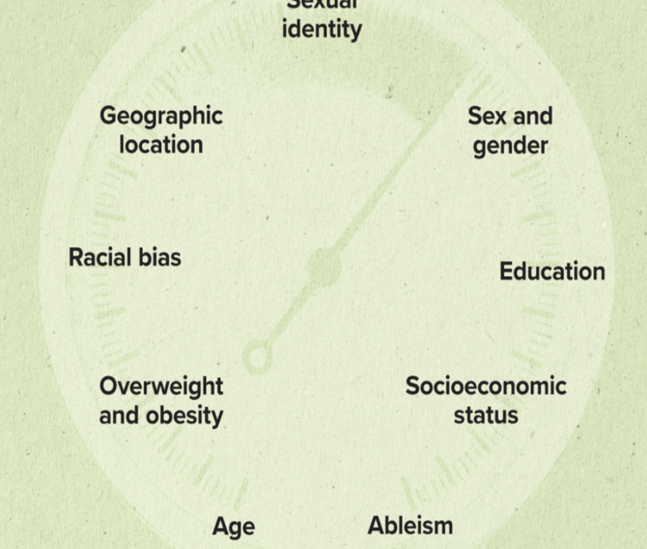
BIAS STEMS FROM
PROCESSES & SYSTEMS
A major 2024 systematic review of 77 healthcare studies found substantial weaknesses in how implicit-bias training is designed and evaluated.
Many programs lacked specificity about whether they were targeting prejudice versus stereotyping, and evidence of knowledge translation was inconsistent.
https://pubmed.ncbi.nlm.nih.gov/39141723/
Notes:
Awareness of bias is a necessary first step, but awareness alone isn't enough; organizations must change behaviors, processes and systems. The review was published in Science Advances and included researchers from UVA, VCU and Old Dominion. The primary training target was race/ethnicity (49.3%); trainings commonly lack specificity on addressing implicit prejudice or stereotyping (67.5%).
They involved a combination of hands-on and didactic approaches, lasting an average of 343.15 min, often delivered in a single day (53.2%).
The takeaway from this review is not that implicit-bias training is useless. It’s that training alone is not enough. Researchers reviewed 77 studies and found wide variation in what was taught, how training was measured, and whether what people learned translated into actual behavior. Awareness matters—but lasting change also requires us to examine the processes and systems where bias can influence decisions.

Slide 11
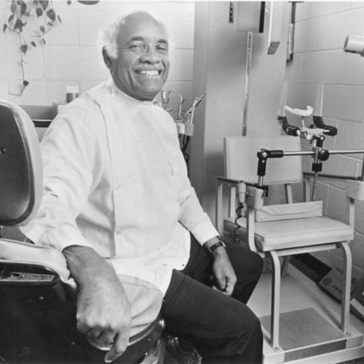
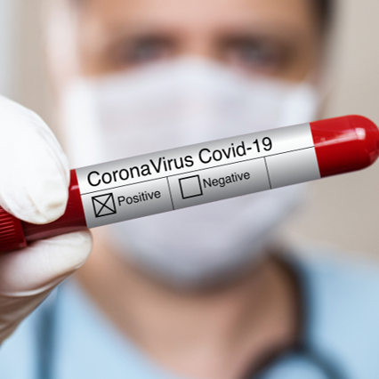
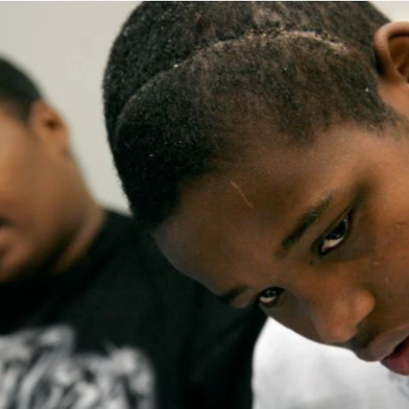

Discrimination's IMPACT
On HealthCare Delivery
SIMPKINS V MOSES H. CONE HOSPITAL
1963
MEDICAL UNIVERSITY
OF S. CAROLINA
1989-1994
DEAMONTE DRIVER
MARYLAND
2007
LOVELACE WOMEN’S
HOSPITAL, NM
2020
Notes:
The AHRQ 2024 National Healthcare Quality and Disparities Report is an excellent current umbrella source showing continuing differences in access, affordability, care coordination, treatment, safety and person-centered care by race/ethnicity, income and other social factors. https://www.ahrq.gov/research/findings/nhqrdr/index.html?utm_source=chatgpt.com.
To be clear, mistrust can arise from both historical mistreatment and contemporary experiences of discrimination and unequal treatment.
Mistrust is NOT just something inherited from history. The safety net exists because of true stories like these and ….it still has holes

Slide 12

KING COUNTY, WASHINGTON
Seattle Children's Hospital (December 2024)
Dr. Benjamin Danielson, a Black pediatrician, led the Odessa Brown Children's Clinic for two decades
A King County jury awarded him $21 million after finding the hospital tolerated racial harassment and retaliated against him as a whistleblower
One of the largest jury awards in a healthcare racial discrimination case in recent history
Notes:
This isn't history. It's happening now — and juries are holding institutions financially accountable. And just this May 2026, the Washington Court of Appeals upheld that $21 million verdict. So when I say this is not ancient history, I mean it literally.
If you are witnessing things like this in the workplace and not speaking up, you may not be implicit but you are complicit and the outcome can impact your organizations reputation and funding.

Slide 13
BIAS RUNS IN EVERY DIRECTION
8 IN 10
Nurses reported experiencing racism
or discrimination from patients. Bias in clinical
encounters isn’t only clinician to patient.
Source: NORC National Survey
Notes:
Providers are not immune to the harm of discrimination.
Patients assuming my assistant was the doctor. Walking out when they learned I was the practice owner.
See GAMMA “The Compounding Effect”

Slide 14



Determinants of Health
Maternal Health
Childhood
Health
Mental Health
Preventive & Self Care
nutrition
Prenatal Care
Early Childhood Development
Public Health Crisis
Reduced Risks
Food Apartheid
Health may generally be organized into five broad categories known as determinants of health: genetics, behavior, environmental and physical influences, medical care and social factors.
- U.S. Centers for Disease Control and Prevention
Notes:
What shapes our health? Clinical care is only one contributor to health outcomes. Much of what ultimately determines health happens before a patient ever walks through our doors—where they live, what they can afford, what they can access, and what opportunities their communities provide.
Virginia's current Rural Health Plan identifies seven priorities: education, broadband, nutrition/food security, healthy moms and babies, healthcare access, behavioral health/SUD/recovery, and employment/workforce development. these aren't theoretical determinants; they're priorities Virginia itself has identified.
https://www.vdh.virginia.gov/health-equity/state-office-of-rural-health/?utm_source=chatgpt.com

Slide 15
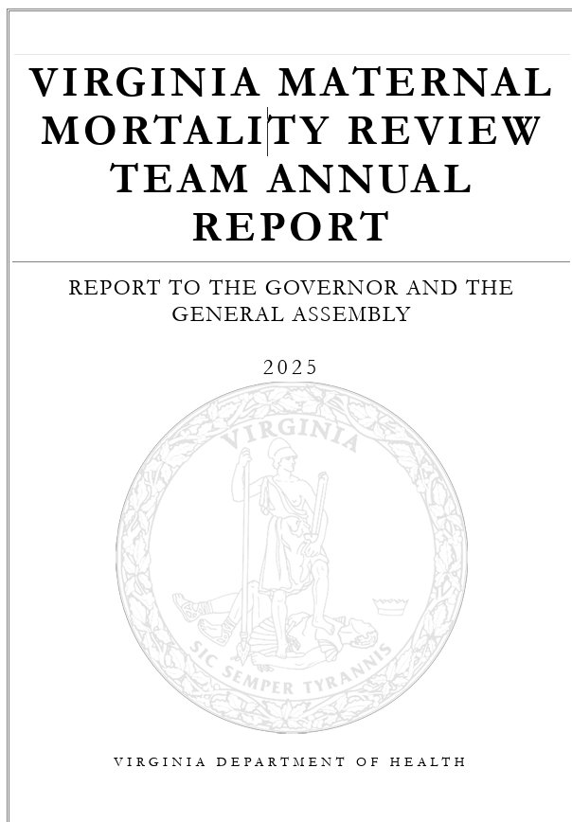
Maternal Health
VDH notes that U.S. maternal mortality rose substantially through 2021 BUT…
Notes:
Virginia now publishes annual Maternal Mortality Review Team reports, including a 2024 report published in 2025 and a 2025 report published in January 2026. https://bit.ly/4xjjxyW
VDH notes that U.S. maternal mortality rose substantially through 2021
BUT subsequently declined, reaching 18.6 deaths per 100,000 live births in 2023. Maternal mortality, disparities, and poor continuity of care are preventable and community based care is at the forefront of reversing this TREND.

Slide 16
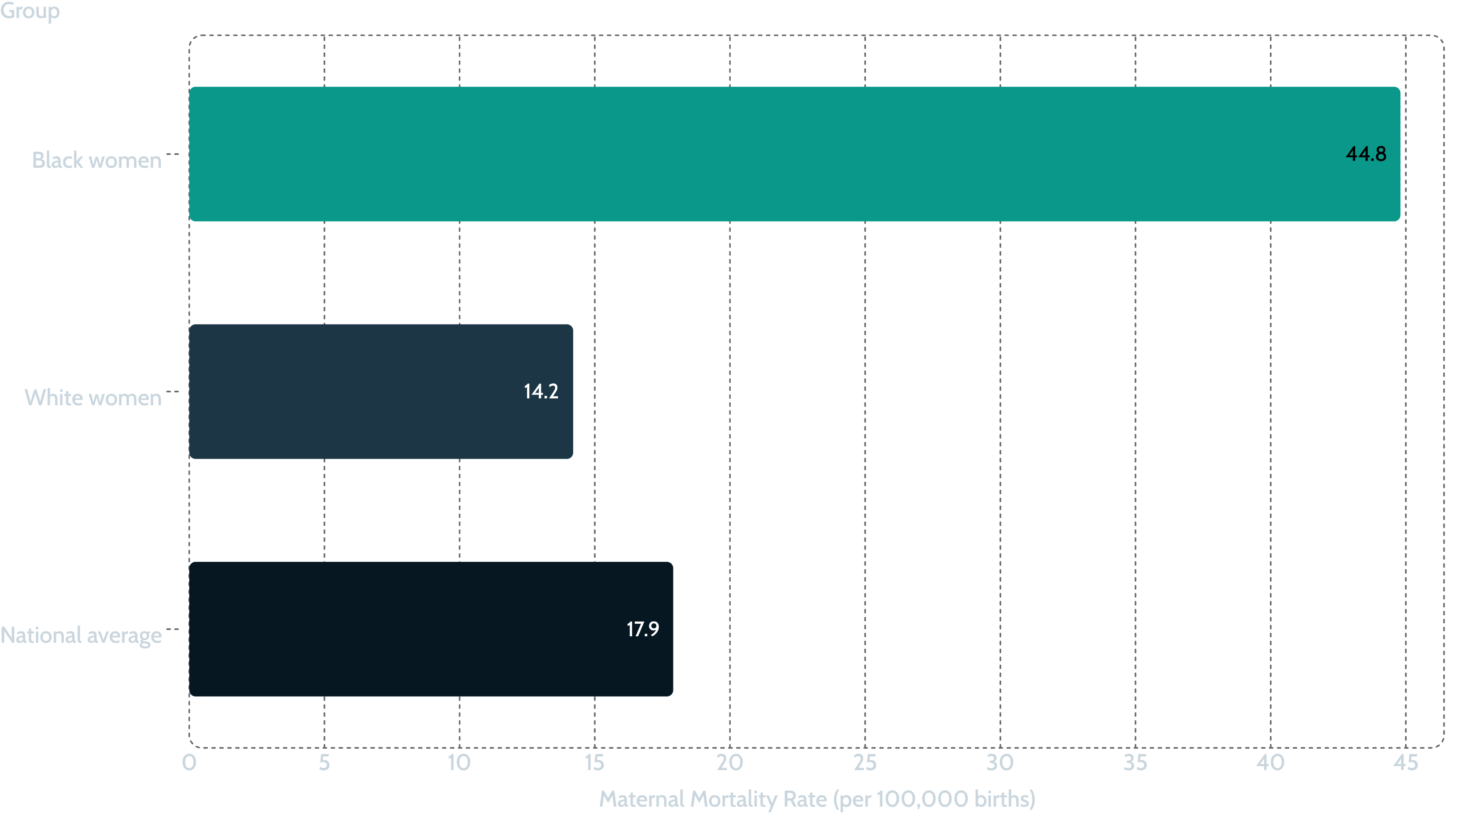
The Starkest Gap:
Maternal & Infant Mortality
Notes:
Black women die in maternal causes at roughly 3x the rate of white women
Black infants die at 2.5 times the rate of white infants (CDC, 2024 data)
Black women's rate did not significantly improve — the only group that didn’t
And this is not outdated pandemic-era data. The latest final CDC numbers for 2024 still show Black women dying from maternal causes at more than three times the rate of White women. The overall rate has improved, but this racial gap persists. (CDC released March 2026)
This is not a mystery. It is a measurable, preventable consequence of systemic inequity.
Source CDC 2024\ CDC 2024

Slide 17

Childhood Health
Notes:
VCHA-specific statistic: 103,381 Virginia health-center patients in 2025 were children under 18 — which is about a quarter of all patients served.
HRSA also reports nationally that the Health Center Program serves 1 in 8 U.S. children. https://data.hrsa.gov/topics/healthcenters/uds/overview/state/VA?utm_source=chatgpt.com
Community Health Centers are uniquely positioned to deliver this care where it’s needed most.

Slide 18


Mental Health
Notes:
Virginia's Rural Health Plan specifically identifies behavioral health, substance-use disorder and recovery as one of its seven priorities.
In 2024, Virginia CHCs treated 29,509 mental-health patients.
Stigma, language, culture, geography and provider assumptions can affect whether behavioral-health symptoms are recognized and treated.

Slide 19
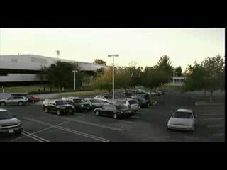
Is It Time To Make Some Changes?
Notes:
The demands on the healthcare workforce remain substantial.
Balance, self-care and overall well-being are not merely individual responsibilities; they are organizational challenges as well.

Slide 20

Nutrition
Notes:
Nutrition and food security are explicitly included in the Commonwealth's Rural Health Plan. https://www.vdh.virginia.gov/blog/2025/02/28/program-highlight-state-office-of-rural-health
"Food deserts" are not natural phenomena — they are the product of zoning decisions, redlining, disinvestment, and policy choices
A zip code should not determine whether a family has access to a nutritious meal
We don't have food deserts. We have food apartheid. We have communities that were deliberately underinvested. Resulting in Food insecurity which is directly linked to chronic disease, poor oral health, and higher healthcare utilization.
There is peer-reviewed evidence connecting historic redlining and discriminatory housing policy with present-day reduced food access. Researchers have specifically argued that “food apartheid” better conveys that these environments arose from policy and structural conditions rather than occurring naturally. Ref https://pmc.ncbi.nlm.nih.gov/articles/PMC9303837/?utm_source=chatgpt.com

Slide 21

OVERCOMING BARRIERS
Notes:
Overcoming barriers. Introduce the important 2026 distinction: individual bias reduction + organizational/process redesign.
One-off implicit-bias education has limitations, so solutions need to include standardized clinical processes, measurement, accountability, community engagement and review of disparities in outcomes.
https://pubmed.ncbi.nlm.nih.gov/39141723/

Slide 22

A Path Towards Equity
Promoting Health EquitY education
IMPROVE
ACCESS
ADVOCACY/
ALLYSHIP
Develop and expand a culturally competent workforce
Encourage STEM careers
More Research
Implicit bias training
Health coaching
Policy/Legislation
Partnerships
Medical-dental integration
Promote telehealth
Expand health insurance coverage
Expose your family to diverse communities
Be active in professional associations
Support community orgs
Disaggregated data
Notes:
As of 2026, 10 states, including Texas- have not expanded Medicaid under the ACA.
Thankfully, Virginia expanded Medicaid in 2019.
However, in 2025 –the most recent data show: 20.94% of Virginia health-center patients were uninsured —. And 35.07% were covered by Medicaid/CHIP. SOOO???? That tells us Medicaid expansion mattered—but it did not eliminate the access gap.---- CHCs exist to serve the people this system leaves behind.
Advocacy/data: HRSA's current UDS allows health centers to examine outcomes and patient characteristics by demographics, poverty and insurance status — exactly the kind of data infrastructure you're advocating.
Partners should contribute resources, not just statements. Partnership isn't philanthropy; it can be part of the operating model of community health. https://vcha.org/group-purchasing/?utm_source=chatgpt.com.
VCHA itself operates a Group Purchasing Organization built around collaborative vendor partnerships, savings and reinvestment in healthcare access.

Slide 23
Advocacy: What You Can Do — Starting Today
Diversify Your World
Demand Disaggregated Data
Intentionally expand what you read, watch, and who you listen to. Bias shrinks when our circles grow.
Push for data broken down by race, ethnicity, and zip code in every policy conversation you're part of.
Partner with Community
Hold Partners Accountable
Faith-based organizations, schools, and community groups are already doing this work. Join them.
Real investment in equity looks like funding, hiring, and policy change — not statements.
Notes:
Sometimes the enormity of the problem leads to a feeling of hopelessness. That’s why I want to end with these CTA’s because here’s what you can do right now.
Health disparities have existed for centuries and cannot be eliminated instantly, but we must continue to be catalyst for change.
Let’s work together to increase access to care and address inequities in the health care system.
And going forward be vigilant as you dig deep and ask yourselves Where could bias be hiding in your health center's systems, not just its people? How can I, How can we promote continuous improvement.

Slide 24

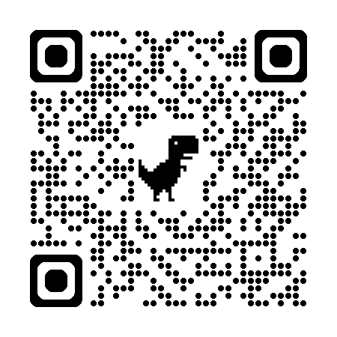
Thank you!
QUESTIONS?
Let’s Connect
info@drmoeanderson.com
Let’s connect on sm! @Dr mOe Anderson
Notes:
I’ll take a couple of questions but since we’re short on time, please note my contact information and email me or connect with me on LinkedIn for questions I don’t get to today.

Slide 25
Thank You!
Notes:
Ty. It’s been a pleasure. Enjoy the conference.

