Slide 1
Practical AI for CHCs:
Data to Quality
Presented on September 18, 2026 by:
Johanna Heller, Managing Director

Slide 2

About Johanna
Graduated from University of Puget Sound with a degree in Chemistry and Gonzaga University with an MBA in Healthcare Management
Career in FQHCs
    Joined Community Link Consulting in June 2008
    Clinic Administrator at CHAS Health from 2012-2021
    Back to CLC in 2021, Consultant, Consulting Department Director, COO / Integrator
    May 2026, Managing Director at VMG Health
  Me: Husband, 3 kids, 9, 6, and 3, dog. We love swimming, camping, and skiing.

Slide 3


Who Is
VMG Health?
Welcome to VMG Health, the leading consultancy dedicated to improving healthcare business performance.
With offices around the nation, we help healthcare organizations solve key strategic, regulatory, and operational challenges—so they can achieve their business and quality-of-care goals.
© VMG Holdings LLC. All Rights Reserved. | vmghealth.com

Slide 4
Introduction about CLC, now Part of VMG Health
Our team works daily with the complexities of FQHCs
Founded as a niche service to FQHCs in 1999 by Joel Hughes
FQHC consulting and full-service and special projects billing support
Annually serves over 200 FQHCs, Look-Alikes, and PCAs

Slide 5
Agenda
Session Overview
AI for FQHCs
Practical AI Use Cases for Quality & Operations
Governance & Responsible AI Use
Interactive Scenarios & Group Discussion
Key Takeaways & Getting Started
Q&A

Slide 6
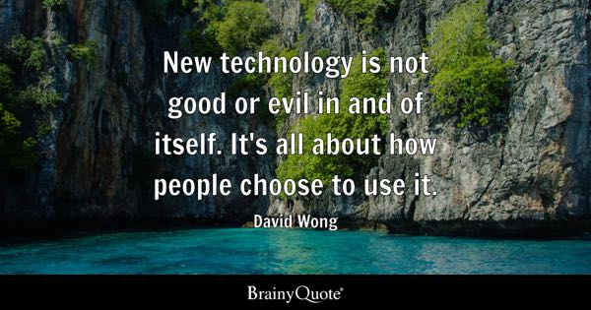

Slide 7
AI for FQHCs

Slide 8

The Challenge
Health centers generate large amounts of data:
    UDS reporting
    Quality metrics
    Revenue cycle metrics
    Operational reports
    Financial reports
    Compliance documentation
  The challenge: turning this data into insights quickly enough to guide action

Slide 9

What is AI

Slide 10
Definition
Artificial Intelligence refers to the theory and development of computer systems capable of performing tasks that historically required human intelligence. These tasks include recognizing speech, making decisions, and identifying patterns.
Fields within AI:
  Machine Learning (ML): A subset of AI where algorithms are trained on data to produce models capable of specific tasks.
  Deep Learning: A subset of ML using artificial neural networks for complex reasoning.
  Natural Language Processing (NLP): Focuses on interpreting human communication.
Notes:
Narrow AI (Weak AI): Specialized systems designed for specific tasks (e.g., voice assistants, image recognition).
General AI (Strong AI): Hypothetical systems with human-like cognitive abilities across various domains (still a theoretical concept).
A large language model (LLM) is a type of deep learning algorithm that excels at various natural language processing (NLP) tasks. Here are the key points about LLMs:
3Blue1Brown
What is Artificial Intelligence (AI) ? | IBM
https://www.ibm.com/topics/artificial-intelligence
Explained: Generative AI | MIT News | Massachusetts Institute of Technology
https://news.mit.edu/2023/explained-generative-ai-1109

Slide 11





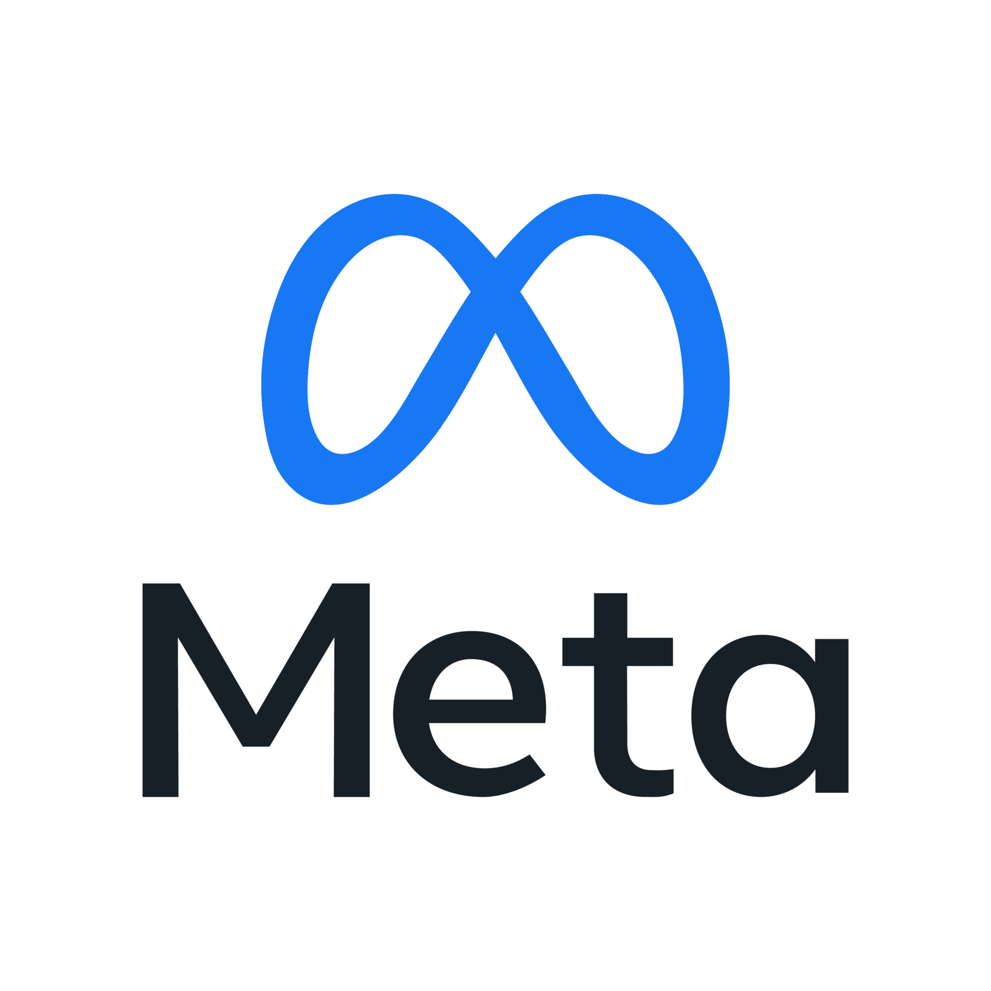
Popular Platforms

Slide 12
HIPAA-Aware/Enterprise-Safe Tools
Microsoft Copilot (HIPAA-enabled w/ BAA under M365 E5/G5)
Google Gemini for Workspace Enterprise (HIPAA-compliant tier)
ChatGPT Enterprise (No training, SOC2, secure data zone)
DAX Copilot / Epic AI tools for clinical-financial crossover
Azure OpenAI for custom models
© 2025 Community Link Consulting, Inc. All rights reserved​

Slide 13

AI Platforms in Use
What platforms do you currently use?
  ChatGPT
  Bing
  Copilot
  Bard
  Claude
  Other
  A combination

Slide 14

AI Adoption Trends in FQHCs
Increasing AI Adoption
  FQHCs are progressively integrating AI tools to improve operational efficiency across various healthcare functions.
Budget Constraints Challenges
  Limited budgets present significant challenges for FQHCs in implementing advanced AI solutions effectively.
Data Privacy Concerns
  Protecting patient data privacy remains a critical concern influencing AI adoption in healthcare centers.
Tailoring AI Strategies
  Understanding adoption trends enables the development of effective AI strategies tailored to FQHC needs.
Notes:
---
FQHCs are increasingly adopting AI tools to enhance operational efficiency despite challenges such as budget constraints and data privacy concerns. Understanding these trends helps tailor AI strategies effectively.
Image source: Microsoft 365 content library

Slide 15

Why AI Matters Today
Workforce shortages & turnover
Rising reporting and compliance demands
Increasing volume and complexity of financial data
Pressure for faster decision-making
Industry shift toward automation & predictive analytics
AI enables speed, accuracy, and capacity, when used safely
Notes:
Image source: Microsoft 365 content library
AI addresses workforce shortages and turnover by automating routine tasks and enhancing efficiency. It meets rising demands for reporting and compliance, while managing increasing volumes and complexity of financial data. By enabling faster, more accurate decision-making and supporting industry shifts toward automation and predictive analytics, AI boosts speed, accuracy, and operational capacity when used safely.

Slide 16
Debunking the Fears of AI
Common Fear | Reality | What This Means for Finance Teams
“AI will replace jobs.” | AI automates tasks, not leadership. | Teams shift from manual work → strategy, forecasting, decision support.
“Outputs can’t be trusted.” | Accuracy improves with good data + oversight. | AI becomes a second analyst that enhances consistency and explanations.
“AI increases compliance and audit risk.” | Proper guardrails reduce risk. | Standardized documentation, anomaly detection, and stronger audit trails.
“AI is too complex for our staff.” | Modern AI tools are no-code and intuitive. | Natural-language workflows that save time without technical skills.
“AI is unsafe or unethical to use.” | Policies + governance ensure safe use. | Transparent, compliant, evidence-based decision support.
© 2025 Community Link Consulting, Inc. All rights reserved​
Notes:
Prompt team for input

Slide 17
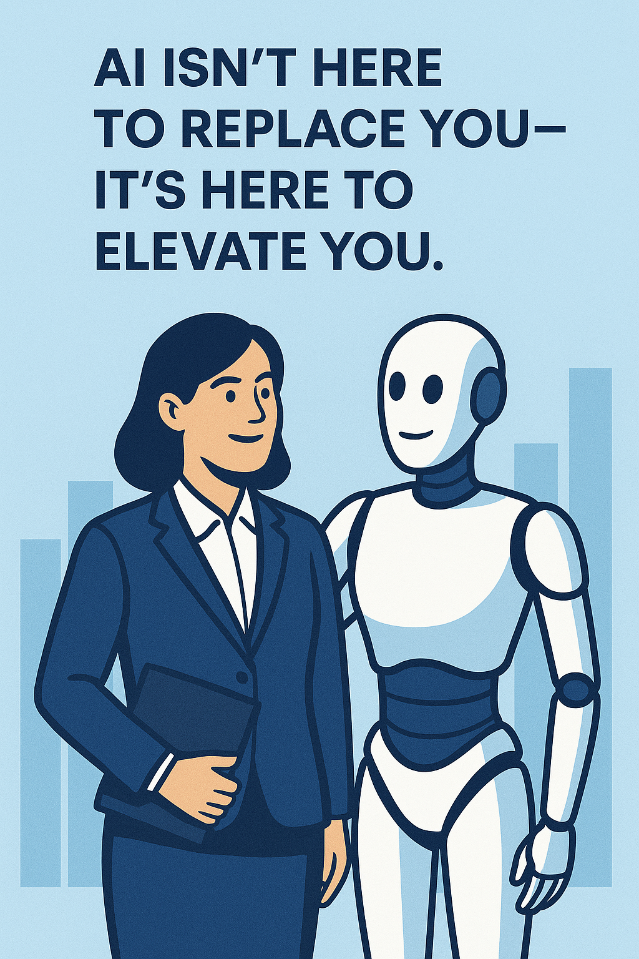
Think of AI as another member of your team, not just a tool.
© 2025 Community Link Consulting, Inc. All rights reserved​
Notes:
Prompt team for input

Slide 18
Reframing AI for CHCs
AI can help you:
    Summarize complex reports
    Turn raw data into actionable data
    Analyze large datasets
    Identify patterns and risks
    Highlight improvement opportunities
    Translate data into clear insights
    Draft reports, summaries, and presentations faster
    Compare performance against benchmarks or targets
    Reduce time spent on manual analysis and reporting
    Ask better questions of your data

Slide 19
Why AI Fails in Health Centers
AI struggles come from:
    Dirty or inconsistent data
    Too many dashboards, no interpretation
    Lack of operational ownership
    Fear of compliance risk
    No workflow integration
  Let’s discuss: “Which of these is the biggest barrier at your organization?”

Slide 20
Governance and Responsible AI Use

Slide 21

Policy Before Productivity
An internal AI use policy
Clear user permissions
Guardrails for PHI, PII, and financial data
Approved tools list
Explicit language regarding HIPAA and data disclosure
Review/approval workflow for AI-generated content
Notes:
---
Developing comprehensive internal policies guides responsible AI use, addresses ethical considerations, and ensures adherence to regulatory requirements within FQHC financial operations.
Image source: Microsoft 365 content library

Slide 22
Internal AI Use Policies — Questions To Ask
Are staff allowed to use AI? If so, for what tasks?
What tools are permitted?
Is PHI/PII explicitly prohibited?
How is financial data protected?
Do we require peer review? Manager review?
Do we track AI use cases?
What data leaves the organization?
Who owns the output?
Notes:
---
Developing comprehensive internal policies guides responsible AI use, addresses ethical considerations, and ensures adherence to regulatory requirements within FQHC financial operations.
Image source: Microsoft 365 content library

Slide 23

Ensuring HIPAA Compliance with AI Systems
HIPAA Compliance Importance
  AI systems must strictly follow HIPAA to protect patient health information and maintain privacy standards.
Designing for Compliance
  AI solutions should integrate HIPAA requirements in their architecture to ensure data security and privacy.
Balancing Insights and Privacy
  Effective AI management enables valuable financial insights without compromising protected health information.
Notes:
---
AI systems must be designed and managed to comply with HIPAA regulations, safeguarding protected health information while enabling data-driven financial insights.
Image source: Microsoft 365 content library

Slide 24

Implementing Robust Data Security Protocols for AI
Encryption Importance
  Encryption safeguards sensitive data, making it unreadable to unauthorized users.
Access Controls
  Access controls ensure only authorized personnel can access sensitive financial and patient data.
Regular Security Audits
  Periodic audits identify vulnerabilities and ensure compliance with data protection standards.
Notes:
---
Strong data security measures, including encryption, access controls, and regular audits, are critical to protect financial and patient information processed by AI systems.
Image source: Microsoft 365 content library

Slide 25
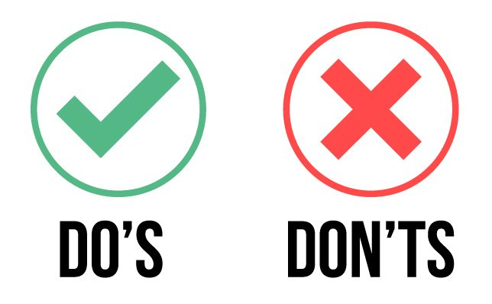

Guidelines for Safe Use
  Use enterprise or HIPAA-aware platforms
  Keep data de-identified
  Review every output
  Limit AI to draft creation, not final decisions
  Document financial assumptions
  Enter PHI/PII
  Copy/paste unapproved data
  Upload raw patient or payroll datasets into public models
  Treat AI as authoritative without verification

Slide 26
Practical AI Use Cases for Quality & Operations

Slide 27
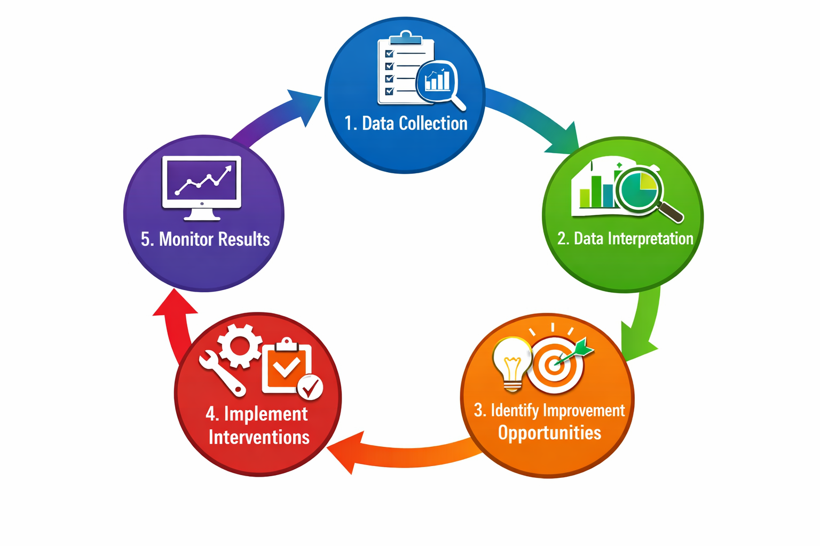
Quality Improvement Cycle
Data Collection
Data Interpretation ← AI is helpful here
Identify Improvement Opportunities ← AI is helpful here
Improvement Interventions
Monitor Results

Slide 28
Data Collection
EHR
UDS
Revenue cycle
Operational reports
Data Interpretation
Summarize reports
Identify patterns
Detect anomalies
Identify Improvement Opportunities
Root cause hypotheses
Performance comparisons
Emerging risks
Improvement Interventions
Prioritize interventions
Prepare leadership briefings
Identify improvement projects
Monitor Results
Use AI here
AI Data-to-Decision
Framework
Use AI here

Slide 29
AI Prompting: Good Prompts vs. Bad Prompts
AI results are only as useful as the instructions you give it.
Clear prompts lead to clearer, more actionable insights.
Weak Prompt (Too Vague): Analyze this report
Problems:
  No context
  No focus area
  No guidance on what insights are needed
Result: AI produces generic summaries that are not helpful for decision-making.
Better Prompt (Clear Context): Review this health center operational report and summarize key trends.
Improvements:
  Provides context
  Identifies the type of report
Result: AI produces more relevant observations

Slide 30
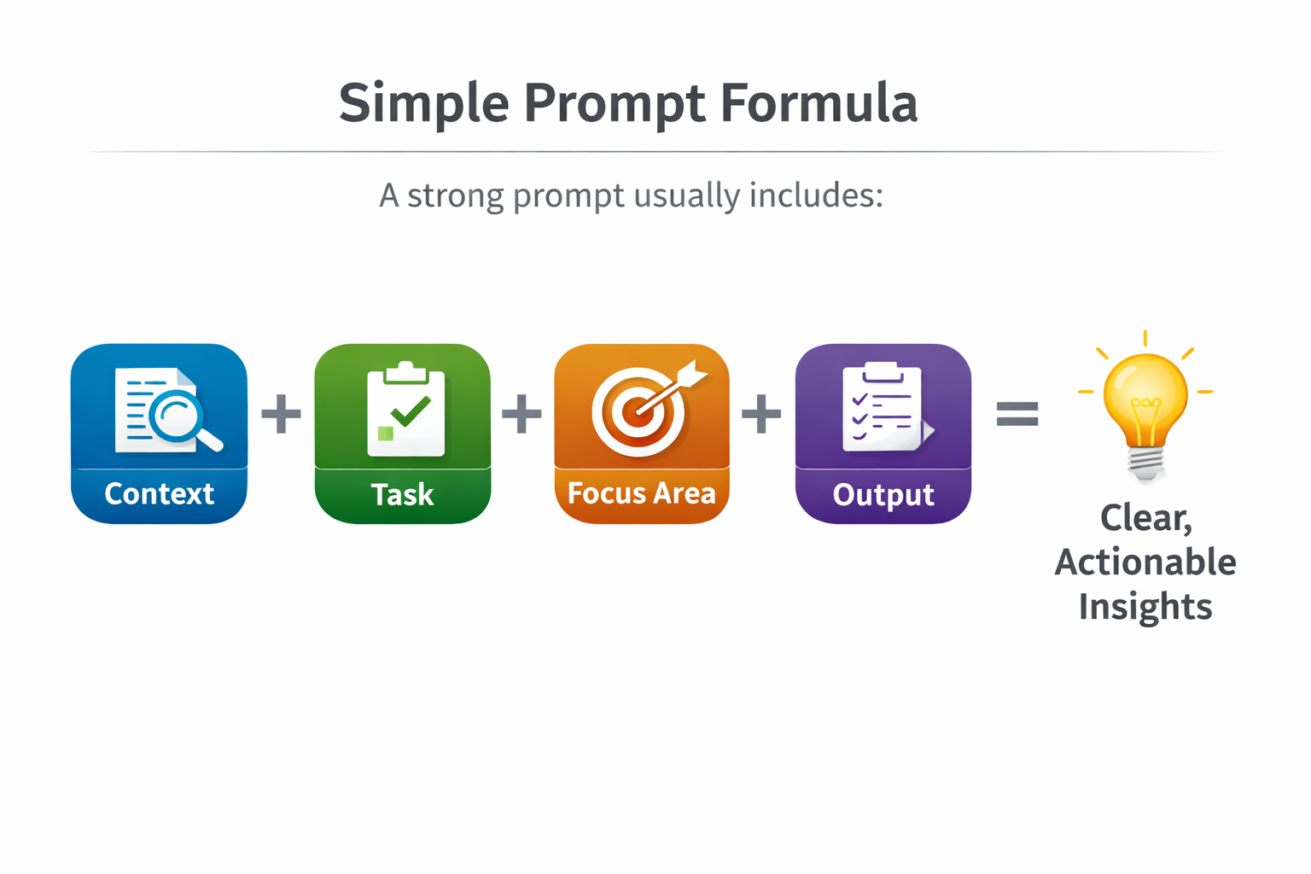
AI Prompting: Good Prompts vs. Bad Prompts
Strong Prompt (Specific & Action-Oriented): Review this health center operational dashboard and identify trends that could indicate operational risks, including rising no-show rates, provider productivity changes, or revenue cycle delays. Summarize the top 3 insights leadership should review and suggest possible causes to investigate.
Why this works:
  Defines the data source
  Specifies what to look for
  Identifies the audience (leadership)
  Requests actionable insight
Notes:
The CHC Prompt Formula
Context
What dataset is this?
Objective
What insight do you want?
Focus Areas
What should AI look for?
Output Format
How should results be structured?

Slide 31
Use Case: Interpreting Quality Reports
Example: A quality director receives a large UDS report.
AI Can:
  Summarize key trends
  Identify declining measures
  Highlight clinic variations
  Suggest areas for investigation
Example Prompt: Review this UDS performance report and summarize the top 5 areas where performance declined compared to last year.

Slide 32
Use Case: Identifying Operational Risks
AI can help identify patterns such as:
  Rising no-show rates
  Productivity changes
  Revenue cycle delays
  Access challenges
Example Prompt: Analyze this health center operations report and identify trends that may indicate operational risks such as rising no-show rates, productivity changes, revenue cycle delays, or access challenges. Summarize the key issues and recommend areas leadership should investigate.

Slide 33
Use Case: Translating Data for Leadership
AI can help teams translate complex reports into:
  Board summaries
  Leadership briefings
  Operational insights
  Quality improvement priorities
Example Prompt: Review the following health center operational and quality report and translate the key findings into a clear summary appropriate for executive leadership. Highlight the most important trends, potential operational risks, and areas that may require leadership attention. Present the information in plain language and focus on insights that support decision-making.
Example Prompt – Creating a Board Summary: Review this quality and operational dashboard and prepare a short summary appropriate for a health center board of directors. Focus on the most important performance trends, any areas of concern, and key improvements since the previous reporting period. Avoid technical language and clearly explain what the data means for the organization.

Slide 34
Use Case: Supporting Root Cause Analysis
Quality teams often ask – why did this measure decline?
Example Prompt 1: Review the following quality performance data and identify trends that may explain why this measure declined compared to previous reporting periods. Highlight any patterns related to patient access, care delivery processes, documentation practices, or data capture that may be contributing factors.
Example Prompt 2: Analyze this health center quality dashboard and suggest possible operational, clinical, or documentation factors that could contribute to the decline in this measure. Identify areas where additional investigation or data review may be needed.
Example Prompt 3: Based on this dataset for [measure name], identify potential root causes that could explain the decline in performance. Consider factors such as patient access barriers, staffing changes, workflow issues, documentation practices, and population health trends.

Slide 35
Examples from
the Audience

Slide 36
Interactive Scenarios and Group Discussion

Slide 37
UDS Scenario
Situation: One key UDS clinical measure declines compared to last year.
Discuss:
  List 3 likely driver categories: access/workflow, documentation, data capture/definition, population shift
  Identify what data you’d pull first
  Draft one strong AI prompt to summarize trends and propose investigation paths

Slide 38
No-Show Rate Scenario
Situation: No-show rate creeps up, third-next-available worsens, staff feel “busier” but visits aren’t rising.
Discuss:
  Pick two leading indicators you’d monitor weekly
  Identify one operational change you’d test
  Draft one strong AI prompt to translate messy operational stats into a decision brief

Slide 39
OSV Prep Scenario
Situation: The upcoming OSV requires fast assembly of policies, evidence, reconciliations, and a narrative response.
Discuss:
  How would you use AI to support your preparation?
  Draft one strong AI prompt that helps organize and summarize documentation without inventing facts

Slide 40
Identifying Care Gaps Scenario
Situation: Your health center receives a monthly quality report showing low colorectal cancer screening rates compared to national benchmarks.
Discuss:
  What additional data would you want to review to better understand the screening gap?
  How could AI help summarize the report and highlight the most important patterns?
  Draft a strong AI prompt you could use to upload the report and ask AI to identify key trends, risks, and improvement opportunities.

Slide 41
Quality Metric Performance Scenario
Situation: Quality metrics for diabetes control vary widely across providers within the same clinic and you want to understand the variances.
Discuss:
  What additional information would help explain variation across providers?
  How could AI help to identify variances not only in the data, but also review workflows and approaches by provider?
  Draft a strong AI prompt that could help analyze provider-level quality data and summarize potential drivers of variation.

Slide 42
Data Integrity Mismatch Scenario
Situation: EHR dashboard ≠ billing report ≠ UDS output; teams argue about which is ‘right.’
Discuss:
  How would you use AI to support figuring out what is right?
  Draft one strong AI prompt that helps identify the discrepancies and help identify the “source of truth”

Slide 43
Discussion Questions
Where does “data-to-decision” break down most often at your health center?
Where does your organization spend the most time interpreting data?
When you see a metric move, what’s your first reaction?
Which dataset do you trust the least right now and why?
Which reports are the most difficult to analyze?

Slide 44
Actions and Resources

Slide 45
AI for Health Centers – 12 Domains
Quality Improvement
Population Health
Patient Access and Operations
Financial Analytics
Revenue Cycle
Workforce Strategy
Reporting and Compliance
Decision Support
Documentation Management
Strategic Planning
Data Interpretation
Administrative Support

Slide 46
AI Uses in FQHCs
Quality Improvement
  Identifying drivers of declining UDS measures
  Detecting care gaps across patient populations
  Prioritizing quality improvement interventions
  Analyzing care team workflow patterns
  Translating quality dashboards into improvement priorities
  Generating QI project plans
Population Health
  Identifying high-risk patients needing outreach
  Predicting missed appointments
  Prioritizing care management lists
  Identifying patients overdue for screenings
  Risk stratification for chronic disease populations
  Outreach campaign planning
Patient Access and Operations
  No-show prediction models
  Appointment access optimization
  Scheduling pattern analysis
  Identifying appointment slot utilization issues
  Access bottleneck identification
  Clinic flow analysis

Slide 47
AI Uses in FQHCs
Financial Analytics
  Variance analysis explanations
  Trend detection
  Seasonality and risk identification
  Forecasting models (PPS, RVU, volume, payer mix)
  Cash flow projections
  “Board-ready” visual narratives
Revenue Cycle
  Denial pattern analysis
  Coding variation detection
  AR aging trend analysis
  Charge capture review
  Payer reimbursement pattern detection
  Claims processing bottlenecks
Workforce Strategy
  Staffing productivity benchmarking
  Workforce modeling for new service lines
  Provider panel size analysis
  Visit demand forecasting
  Burnout risk indicators
  Recruiting strategy support

Slide 48
AI Uses in FQHCs
Reporting and Compliance
  Drafting UDS variance responses
  Audit prep: summarizing findings, policies, reconciliations
  Organizing schedules, binders, working papers
  OSV preparation
  Grant support
  Reviewing written reports with compliance requirements
Decision Support
  Scenario modeling (e.g., workforce increases, new sites, PPS changes)
  What-if forecasting for Medicaid rate shifts
  Multi-year projections for strategic planning
  Translating analytics into leadership-ready storytelling
Documentation Management
  Drafting policies & procedures
  Training materials creation
  Procedure documentation
  Knowledge base development

Slide 49
AI Uses in FQHCs
Strategic Planning
  Community needs analysis
  Service line expansion modeling
  Competitor landscape summaries
  Demographic trend analysis
  Grant opportunity identification
  Partnership strategy analysis
Data Interpretation
  Turning dashboards into plain-language summaries
  Explaining data trends to non-technical leaders
  Board and executive briefing preparation
  Translating analytics into operational insight
Administrative Support
  Job descriptions & interview questions
  Communications to staff
  Meeting agendas, summaries, and follow-ups
  Task and project tracking
  Calendar optimization

Slide 50


Important AI Reminders
AI supports decision-making, it does not replace leadership judgment.
Outputs are only as good as the data and prompts provided.
Always review and validate AI-generated insights before acting.
Do not enter PHI, PII, or sensitive financial data into unapproved tools.
Use AI to assist with analysis, summarization, and idea generation, not final conclusions.

Slide 51
Important AI Reminders
Clear prompts produce clearer, more actionable results.
Treat AI as a thinking partner that helps interpret data faster.
Strong governance and internal policies must guide AI use.
Start small with practical use cases before expanding AI adoption.
The goal is better insight and faster understanding, not more technology.

Slide 52
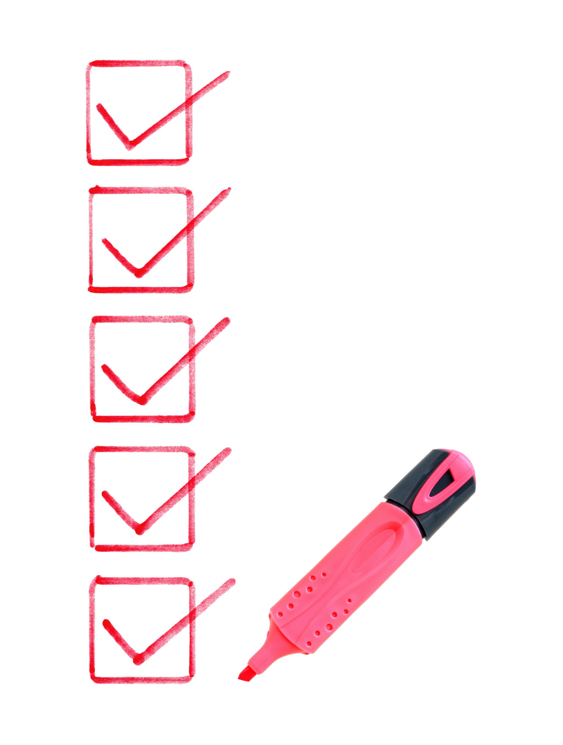
Key Action Items
If not currently using, work with Leadership Team on deciding how to start.
Create or update your internal AI use policy.
Define approved tools.
Pick 3–5 low-risk AI pilot use cases.
Build an approved prompts library.
Set a review process for all AI-generated content.
Train your team on safe use, prompting basics, and validation steps.
Document SOPs for AI-assisted workflows.

Slide 53

What action will you take next?

Slide 54

Questions

Slide 55

Contact Information
Johanna Heller, Managing Director
Johanna.Heller@VMGHealth.com
509-209-9491

Slide 56
Johanna Heller, Managing Director
Johanna.Heller@vmghealth.com
509-209-9491

