Slide 1

Built with CHCs, Not for Them
The value-based care architecture that respects Community Health Centers' mission

Slide 2
Your Presenters
A joint session from the two organizations that built the integration
MP
Michael Poku, MD, MBA, FACP
LK
Luann K. Kimker, RN, MSN, PCMH-CCE
Chief Clinical Officer
Equality Health
Senior Vice President of Clinical Innovation
Azara Healthcare
45 minutes — about 30 of content, 15 of Q&A. Ask as we go.

Slide 3
What We’ll Cover Today
1
The Distinct Medicaid Reality
Why this population needs a different playbook
2
The Core Challenges
Data fragmentation, engagement, churn, and social risk
3
From Challenges to Opportunity
What we built with CHCs to tackle real Medicaid challenges
4
Results in Action
How the DRVS system integrates VBC insights to deliver better whole-person care

Slide 4

Azara provides population health solutions to community health centers, critical access hospitals, care delivery networks, and the ecosystems that support them.
14+
Years
1,000+
Clients
WHAT THE PLATFORM DOES
Risk, cost, and utilization analysis
Quality measurement
Care gap identification
Care management and coordination
Provider and patient engagement
60K
Providers
230+
Employees
50M+
Patients
2M
Member Lives
50
States
40+
Health Plans
Best in KLAS 2023, 2024, 2025, 2026 — Population Health Management
NCQA validated · HITRUST certified

Slide 5


Focused on Medicaid and dedicated to those who need us the most
We are embedded in underserved communities, and our population-specific insights address historic inequities and break down barriers to care. We enable providers to treat the whole person through a cultural lens.
Percentage of Attributed Lives by Program
Equality Health (All Markets), 2025

Slide 6
The Quintuple Aim of the Partnership
“To deliver coordinated care efficiently, healthcare systems must eliminate data silos, unleash the power of information through analytics, and communicate in frictionless ways with providers and patients.”
Population Health
Care Team Well Being
Reducing Cost
Patient Experience
Equity &
Inclusion
Notes:
Foundational to where we are going in our ability to have 100% medicare and majority of Medicaid in VBC. And to make sure you have the resources –financial, people and technology to do so.
20 yrs ago – many of you were just implementing your Electronic health record.
“Population health management replaces "one size fits all" care with tailored, cost-effective interventions based on patients' risk levels.”
Focus on prevention, physical, social and economic conditions
https://www.modernhealthcare.com/patient-care/role-population-health-value-based-care
“To deliver coordinated care efficiently, healthcare systems must eliminate data silos, unleash the power of information through analytics, and communicate in frictionless ways with providers and patients.”
Interoperability
Predictive and Prescriptive Analytics
Patient Engagement Solutions

Slide 7
The Core Challenges
SECTION 2

Slide 8

A Day in the Life of a Medicaid CHC…
80% of patient panel below 100% federal poverty level
55% of patients are covered by Medicaid
Average reimbursement of $48 per visit
Needs to see 25+ patients/day to break even
12+ managed care contracts – each with unique quality programs
50% of attributed MCO members have never established with practice
Sees patients 9a-5p, begins charting at 7pm
Dr. Robertson | 56 years old
Primary Care Physician, Composite

Slide 9

Members like Maria, by the numbers
Maria, 34 | Composite Medicaid member
1
2
90%+
52%
of people below 138% FPL have at least one unmet social need
of Medicaid/CHIP enrollees have incomes below 138% FPL
3
4
25%+
28%
“I just want to keep my kids healthy and not miss work to do it.”
of missed clinic appointments are due to transportation barriers
of working-age adults on public insurance have multiple chronic conditions

Slide 10
Five Challenges Define the Work
1
Data Fragmentation
2
Attribution
Member data is siloed across plans, EMRs, and claims, often incomplete and stale. You can't manage what you can't see.
Attribution creates gaps that break continuity of care and reset measurement windows.
3
Engagement Barriers
4
Social Risk
Transient phone numbers, addresses, and well-earned distrust make the member genuinely hard to reach.
Non-medical drivers — housing, food, transportation — are primary causes of outcomes and cost, not a footnote.
5
UDS and VBC as One Panel
UDS reporting and value-based quality measures come off the same panel — capture every incentive the work already earns.

Slide 11
Three Structural Mismatches
Real gaps between the existing platforms and the VBC operating model
1
2
3
Data continuity
Payment cadence
Engagement bandwidth
UDS reporting and value-based quality measures run as two parallel workflows off two different data sets.
Shared savings arrive 12+ months after the work; CHC operations are funded quarterly.
The members hardest to reach are the ones the panel has the least capacity to chase.
Each one has an architectural fix. None of them is a training problem.

Slide 12


Integrating Equality Health & Azara
Reducing the administrative burden on providers
Current State:
Providers are required to swivel chair between DRVS and CareEmpower
Future State:
Providers can leverage the benefits of CareEmpower within Azara
DRVS is utilized by providers to leverage data from EHRs, Payers, Claims and Health Plans
All patient data needed for care coordination will be centralized within Azara’s platform
Practices that adopt Azara Care Connect will no longer need to use CareEmpower
CareEmpower is used to prioritize patient care and develop treatment plans aligned with value-based care
Identified gaps will be surfaced and tracked within Azara Care Connect and incorporated into care plans
Completion of tasks and gap closures must be tracked within CareEmpower for ECIP eligibility
Data needed to track completion of tasks for ECIP* will be embedded within Azara Care Connect
ECIP - Equality Health Incentive Program

Slide 13
The Value of Integrating the Data
One platform, one workflow, one data spine
One population health platform
Practice-level platform with direct EHR connection plus care coordination tools
Streamlined workflows
Built to support the EH Program Pillars end to end
Population health analytics
Actionable insight across your EH member population
Automated data transfer
Data moves between the practice and EH automatically*
*All ECIP program incentives will be administered based on EH provided quarterly reports.

Slide 14
The Goal: One Population Health Program
Azara DRVS as the single spine for EH population health management
Attributed Member Reporting
Azara DRVS
for EH Population Health Management
Point of Care Engagement
Care Gap Reconciliation
Care Coordination

Slide 15
From Challenges to Opportunity
SECTION 3
Notes:
3

Slide 16
Three Levers Address the Challenges
Stratify the population, target the intervention to the need, and execute in the field where members actually are.
1
2
3
STRATIFY
TARGET
EXECUTE
Risk Stratification
Targeted Intervention
Field-Level Execution
→
→
Segment the panel so finite resources land on the members who move outcomes and cost.
Match intervention intensity to member need, closing care and quality gaps deliberately.
Put Care Specialists and Community Health Workers where members live to build trust and reconnect them to a PCP.

Slide 17
EH + Azara Data Lifecycle
1
EH SENDS DATA
2
AZARA INGESTS + MATCHES
• Calculates care gaps and prioritization
• Member roster monthly (2nd Friday)
• Care gap file weekly (Friday)
• Loads care gap data into DRVS
• Matches member to patient (DOB, policy #)
• Matches EH gaps to member roster
DATA
LIFECYCLE
4
DATA FLOWS BACK
3
PRACTICE TAKES ACTION
• Azara sends supplemental data* to EH
• EH ingests the data with claims
• Cycle restarts
• Care gaps sent to ACC nightly
• Outreach and care team closes gaps in DRVS
• Practice collaborates with EH supports
EH activities
Azara activities
Practice
*Supplemental data includes all clinical records in DRVS for members on the most recent roster file.
Notes:
general recommendation is to suggest creating a scorecard and focusing on the measures with the largest gaps/gaps with greatest financial impact and then looking for EHR compliant patients with records older than 3 months

Slide 18
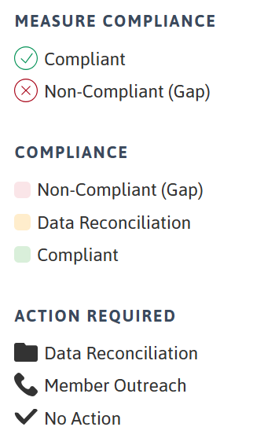
Integrated EH-Identified Gaps
Combine EH and EHR data to surface every gap
EH
Delivers care gaps for each EH measure
AZARA
Ingests denominator, numerator and result
DRVS
Blends EHR data to visualize every gap
HOW GAPS ARE CLASSIFIED
Compliant
Non-compliant – Gap
Non-compliant – Data Reconciliation
Data exists with the plan but not in the EHR — needs data reconciliation
Neither plan nor EHR has the data — a true gap
Data to close the gap exists in the EHR or with the plan — needs reconciliation

Slide 19
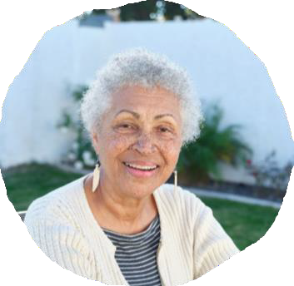


EH-deployed Member Engagement
Complex Care Team
CHW, NP, Clinical Coordinator, Chaplain
In-home and telemedicine
Specialist support
Pharmacist support
'SDoH First' approach
(CHW, Care Specialist and Chaplain)
Telephonic Care Navigation (SDOH & Quality)
In-home Clinical Care
(Complex Care Team)
High risk, disconnected members
Avoidable IP and ED utilization
Uncontrolled chronic conditions
Polypharmacy and poly-prescriber
Home services and DME needed
Digital Member Engagement
(Wellness Visits & SDoH)
Connection to Services
(CBO Network)
Getting work done
Chronic condition management
De-prescribing
Coordination of care and services
Wellness visit completion, Life Plan visit
Self-management support
(Digital Programming)
Re-patriation to Long-Term Provider
(PCP, BH and Palliative)

Slide 20
Results in Action
SECTION 4

Slide 21
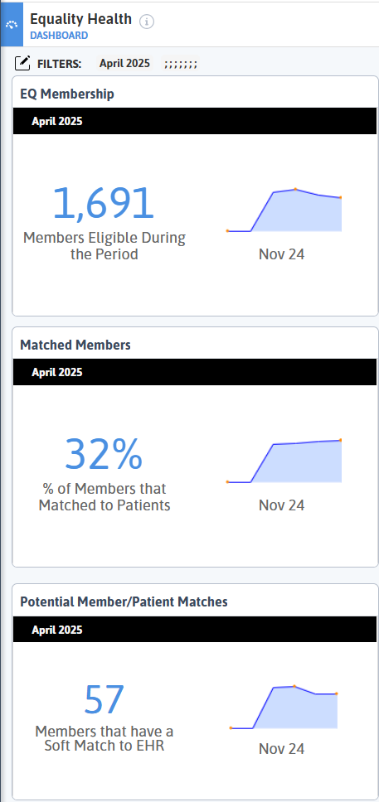
Attribution | Member Matching
Understand member activity at your practice
EH MEMBERSHIP DASHBOARD
Total EH Membership
1,691
Matched Member Rate (members that are patients)
32%
Potential Member/Patient Matches
57
Clean up potential Soft Matches using Force Match functionality.

Slide 22
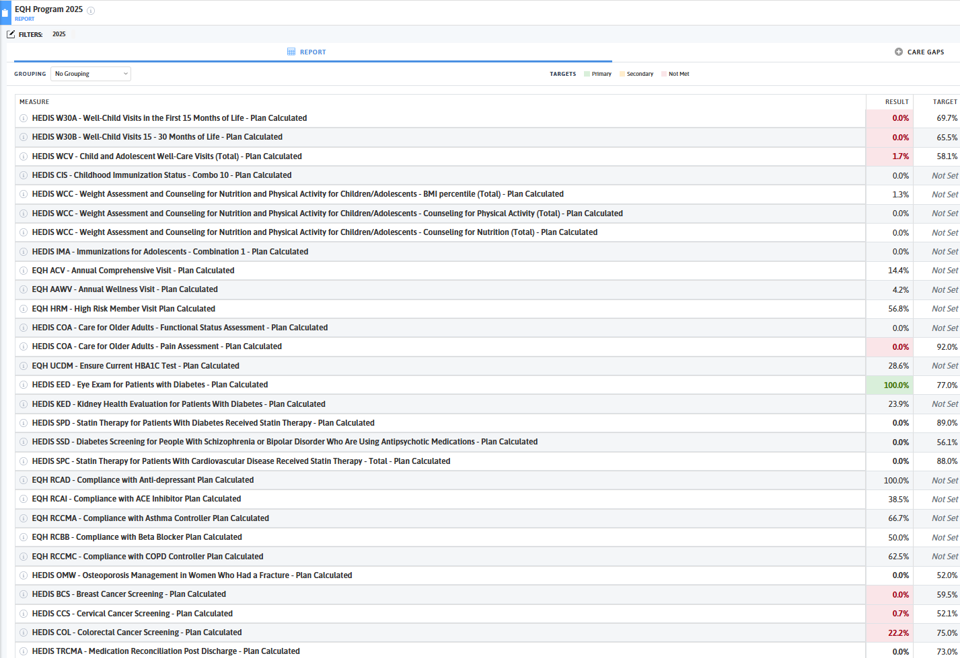
Measure Scorecard
Key priority alignment across the EH program measures
Pediatric
Well / Annual Visits
Chronic Care / High Risk
Cancer Screening
Hospital Follow-up
Notes:
Update with practice-specific scorecard

Slide 23
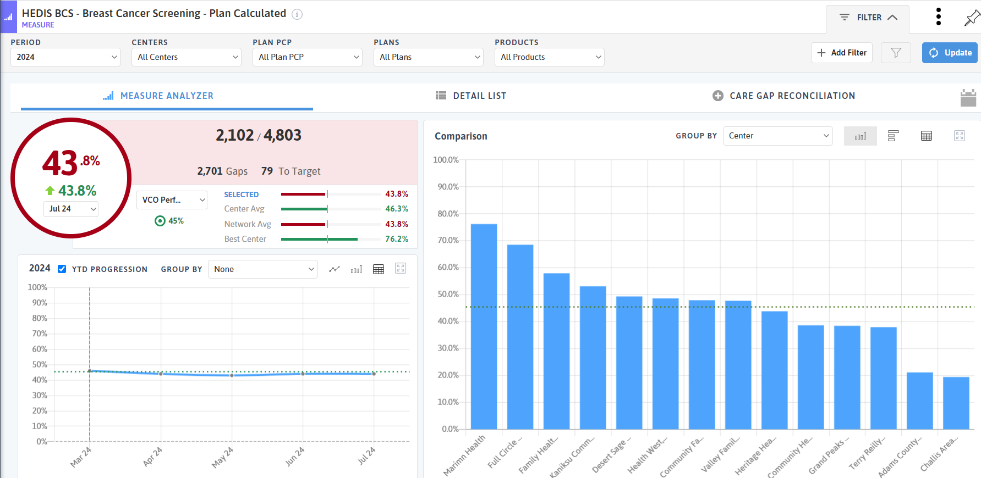
Year-to-Date Period for Plan-Calc Measures
Track performance as each month’s care gap file lands
HOW TO READ IT
Performance builds through the year from each monthly care gap file.
SETUP
Set Period Type to Year for this view to appear.

Slide 24
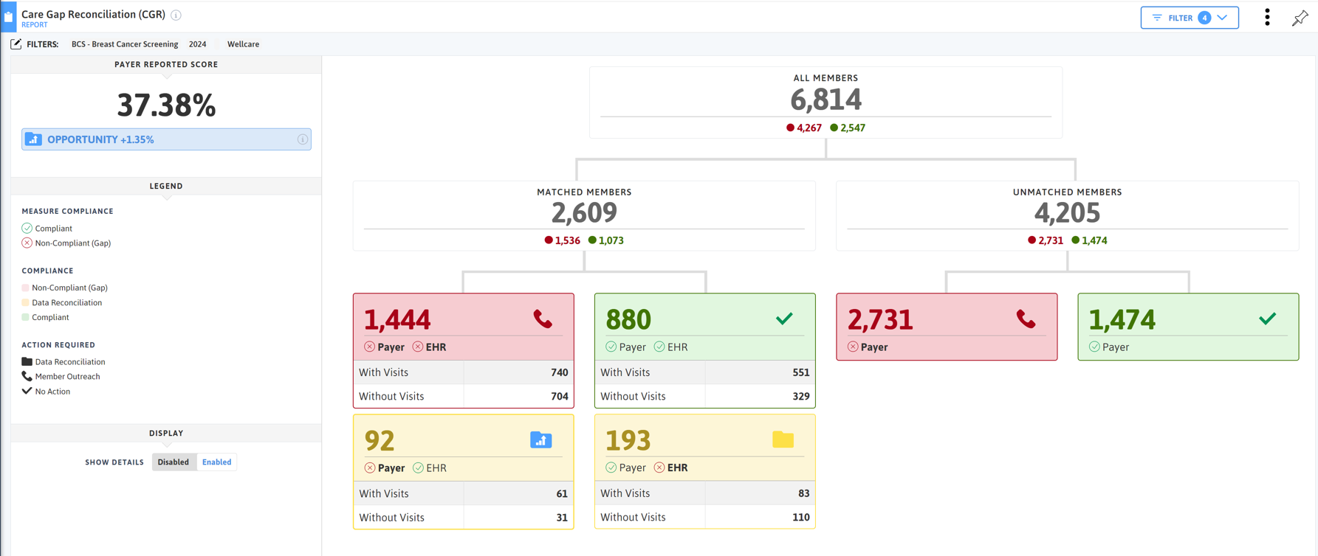
Care Gap Reconciliation Report
Payer view, matched members, and the gaps that can be closed from the EHR
Payer Performance
These members need to be matched
Legend &
Action Steps
Patients’ records can be updated with results from location where claim was filed
EHR data can be sent back to the plan to close the gap
Visit Info looks for a UDS QE 12 months from period end
e.g., If period = CY 2024, appointment must be in 2024
Notes:
In future if there is no EHR back up you will not get access to this

Slide 25
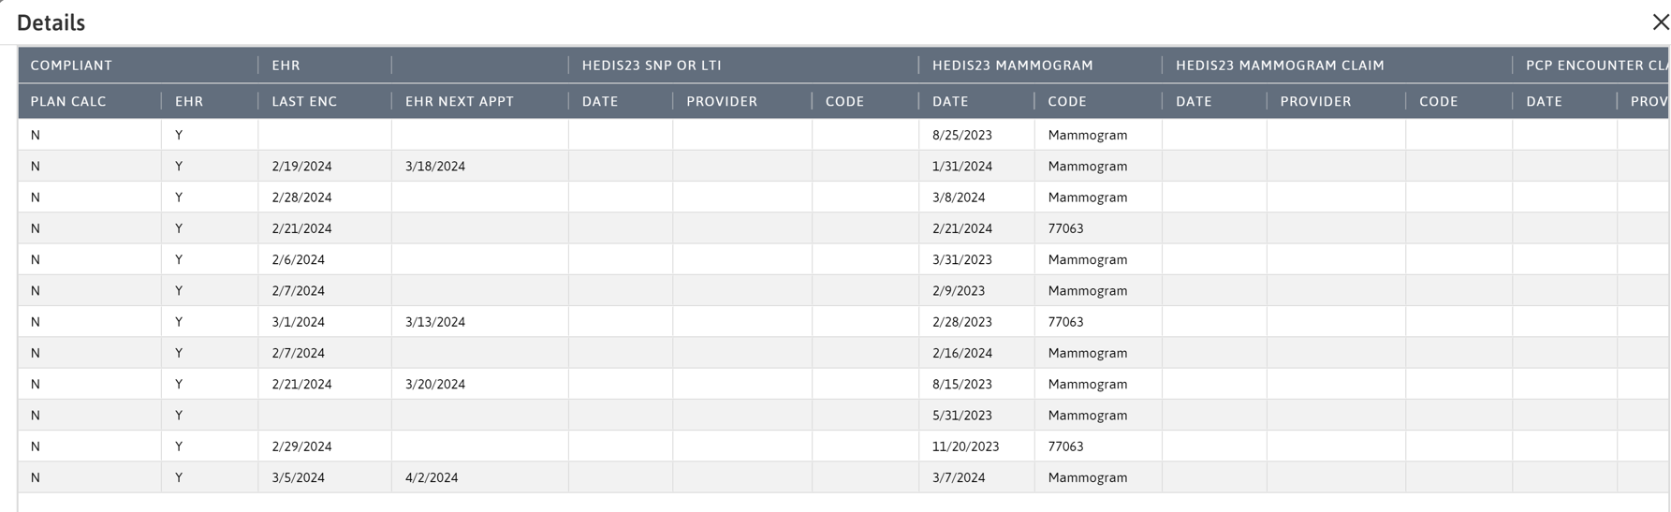
Drill Down to See the Opportunity
From measure to member — the EHR record behind each gap
WHAT YOU’RE SEEING
Member-level detail with the EHR record indicating compliance — the evidence a care gap needs to close.

Slide 26
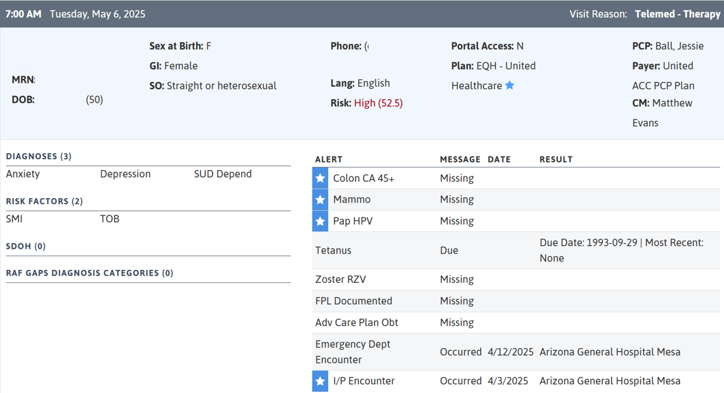
Patient Visit Planning | Closing Gaps at POC
Starred Plan
Starred Alerts
Note: I/P is from HIE data
Starred Alerts
Note: I/P is from HIE data

Slide 27
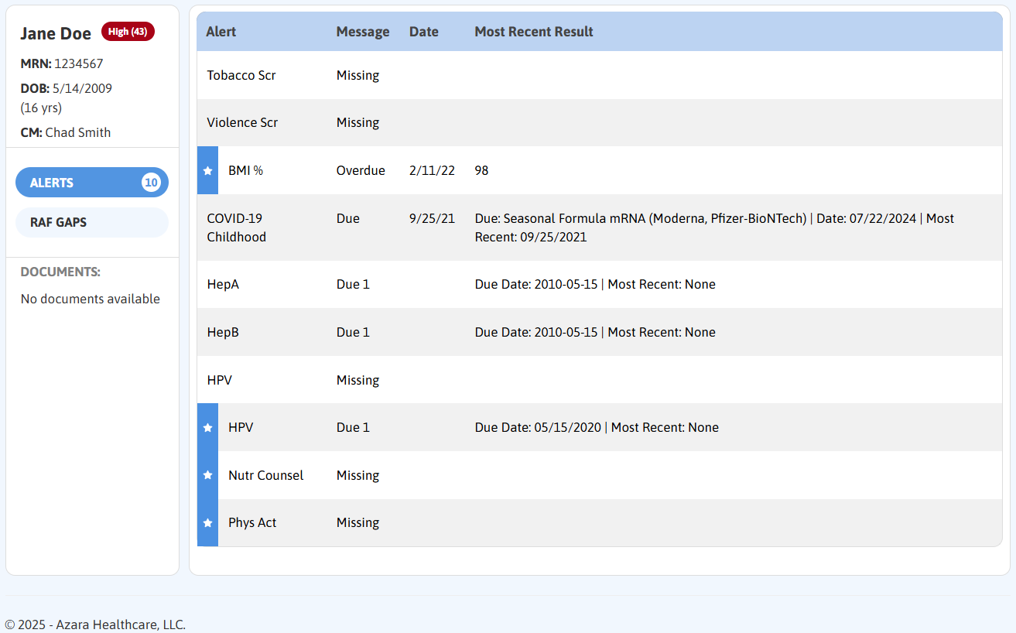
EHR Plug-In | Putting the Gaps in the EHR
Care gaps surface inside the clinician’s existing workflow

Slide 28
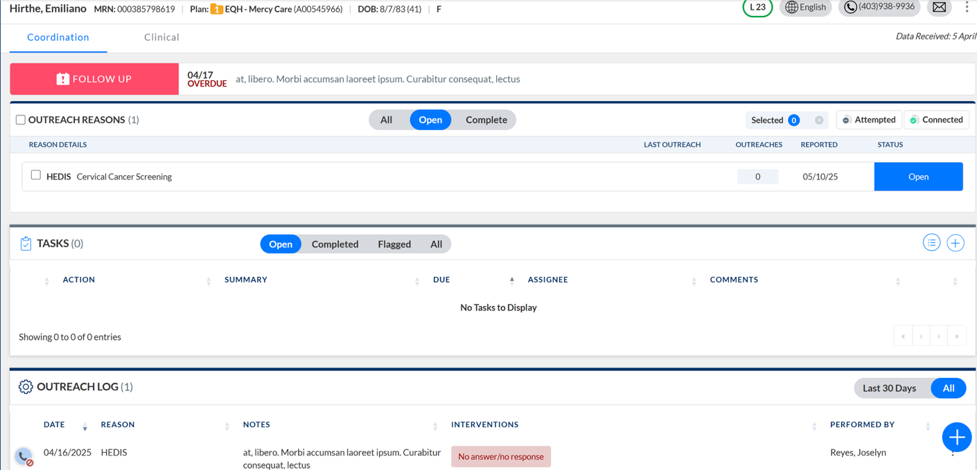
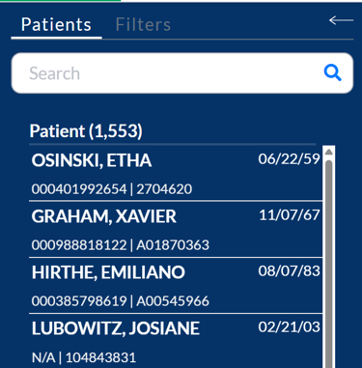
Record, Track, and Follow Up
Every outreach touch documented against the open gap
OPEN GAP(S)
PATIENT LIST
Work the prioritized list, log the touch, and follow up — all against the same record.
PREVIOUS OUTREACH

Slide 29
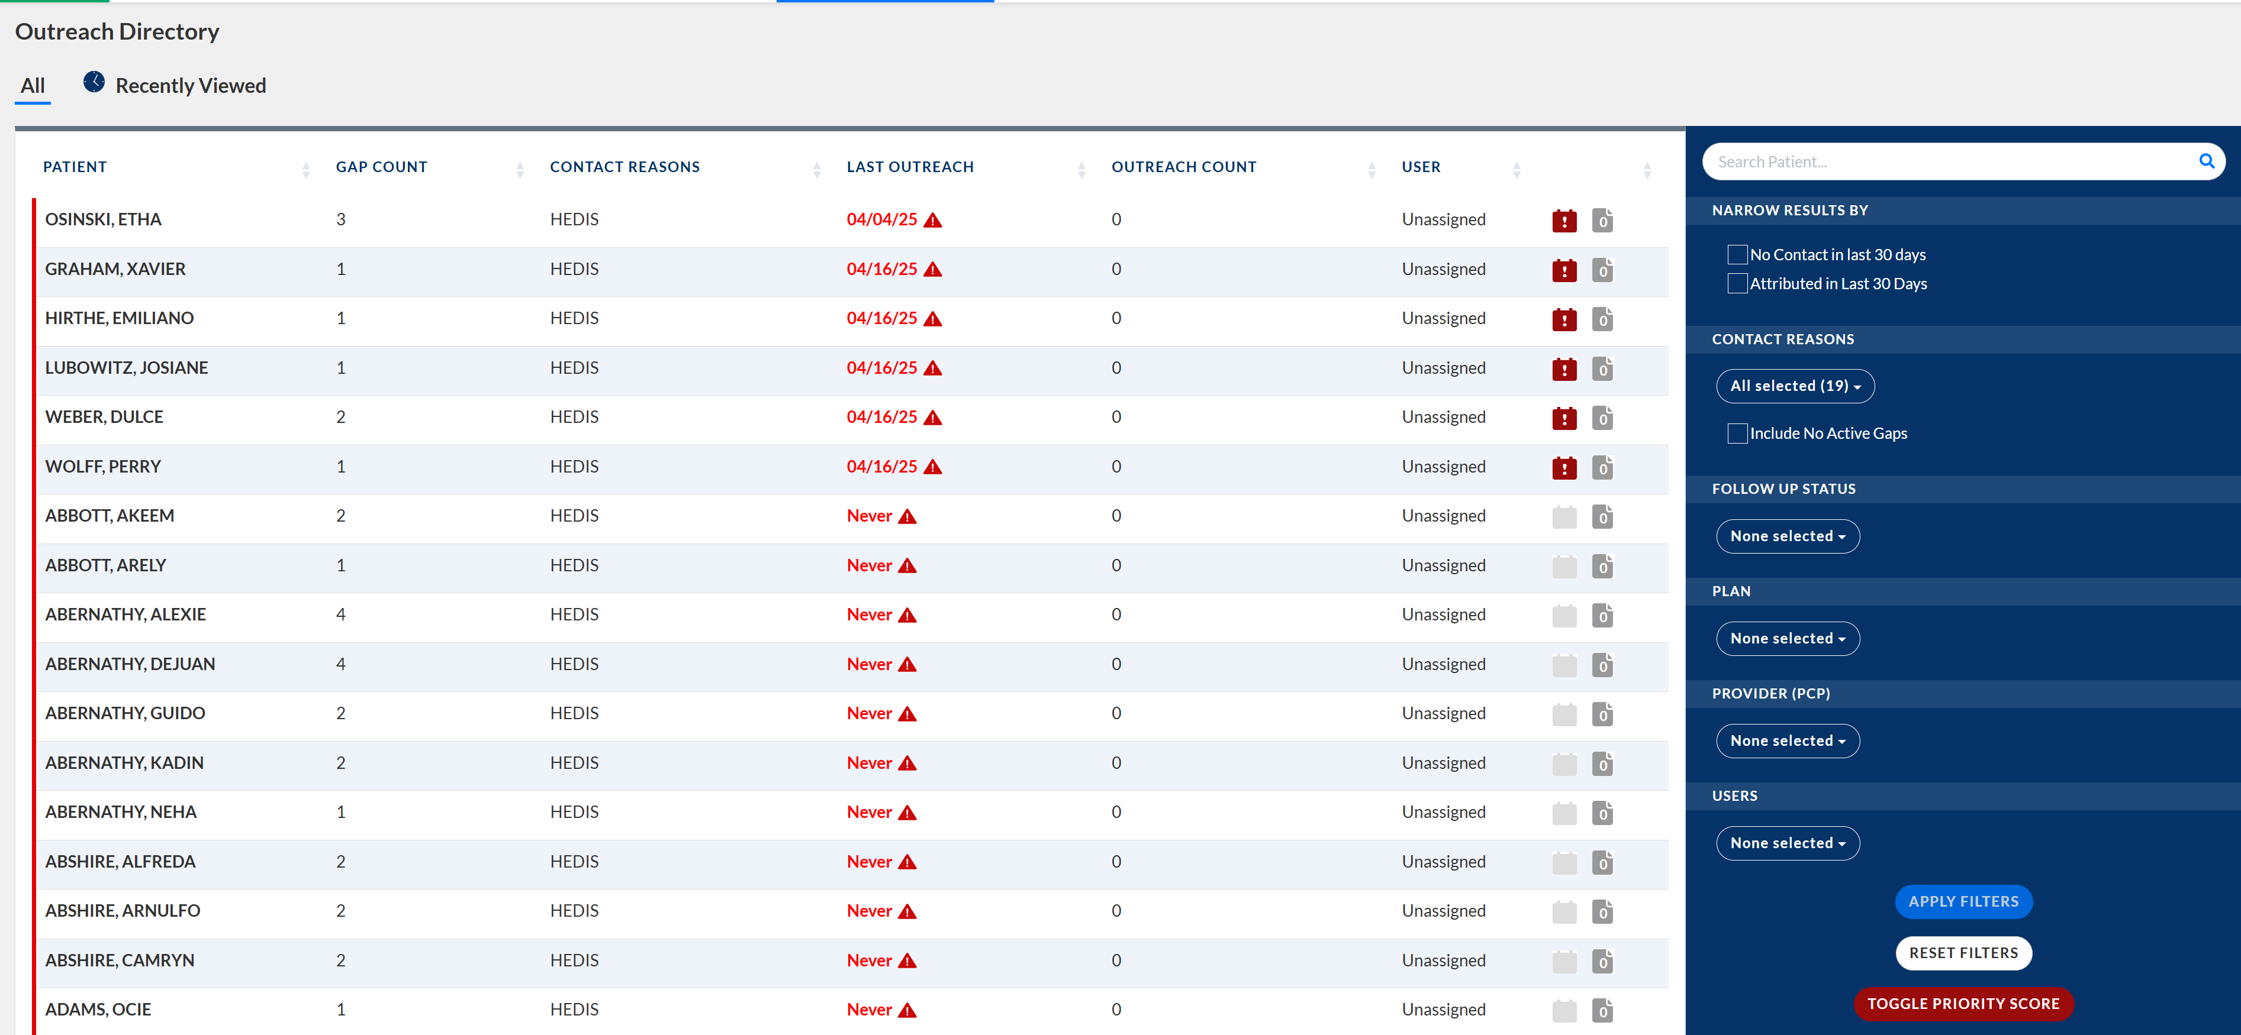
Manage the Workload | Prioritization & Assignment

Slide 30
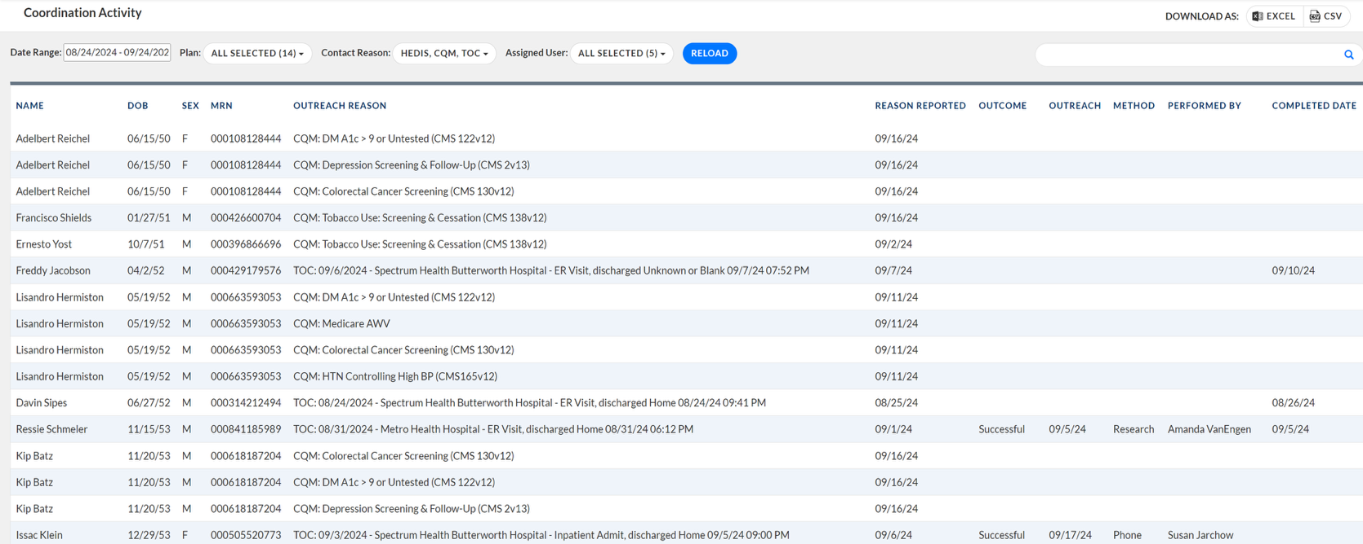
Manage the Work and the Team
Assignment, status, and outcomes across the coordination team
WHAT TO LOOK FOR
Every outreach reason, method, outcome, and owner in one Coordination Activity view — exportable for team huddles and supervisor review.

Slide 31
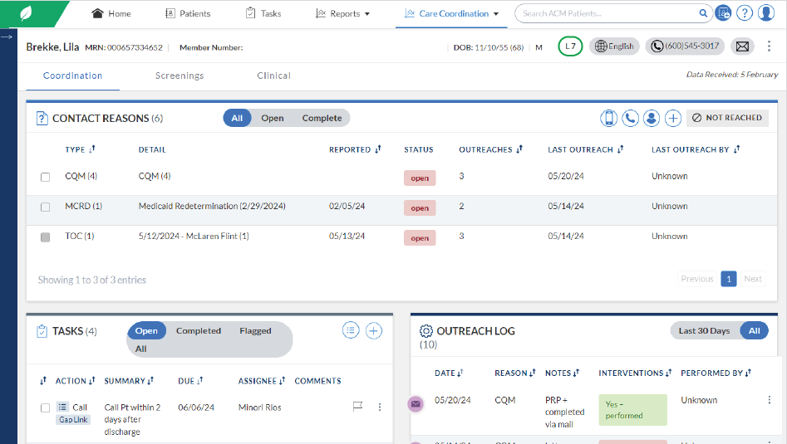
Centralized Solution to Coordinate Care
Document outreach, prioritize patients, and close care gaps from one workspace
Centralized Data View
Organize Outreach
Medical history
Outreach notes
Active gaps
Screen and prioritize patients
Coordinate outreach
Document and track activities
User Interface
Build Care Plans
Organized data
Tools to track metrics
Leverage integrated data
Coordinate care activities
Built on the full data set
Clinical, claims, HIE, and practice management data in Azara DRVS.
Tracked to VBC metrics
Monthly plan gaps ingested automatically; tasks, interventions, and follow-ups tracked across the panel.
Notes:
Leveraging the DRVS/EHR data in a combined system

Slide 32
What Field Execution Actually Moved
Reconnecting "Lost" Members to Care
Results among members re-engaged after 18+ months away from their attributed PCP. Field teams, not call centers.
+104%
+121%
+46%
-39%
Well-child (W15)
improvement, AZ
HbA1c control
improvement, TX
Cervical cancer
screening, AZ
Plan all-cause
readmissions, AZ
Source: Equality Health re-engagement results, Arizona and Texas markets (Feb 2026).

Slide 33
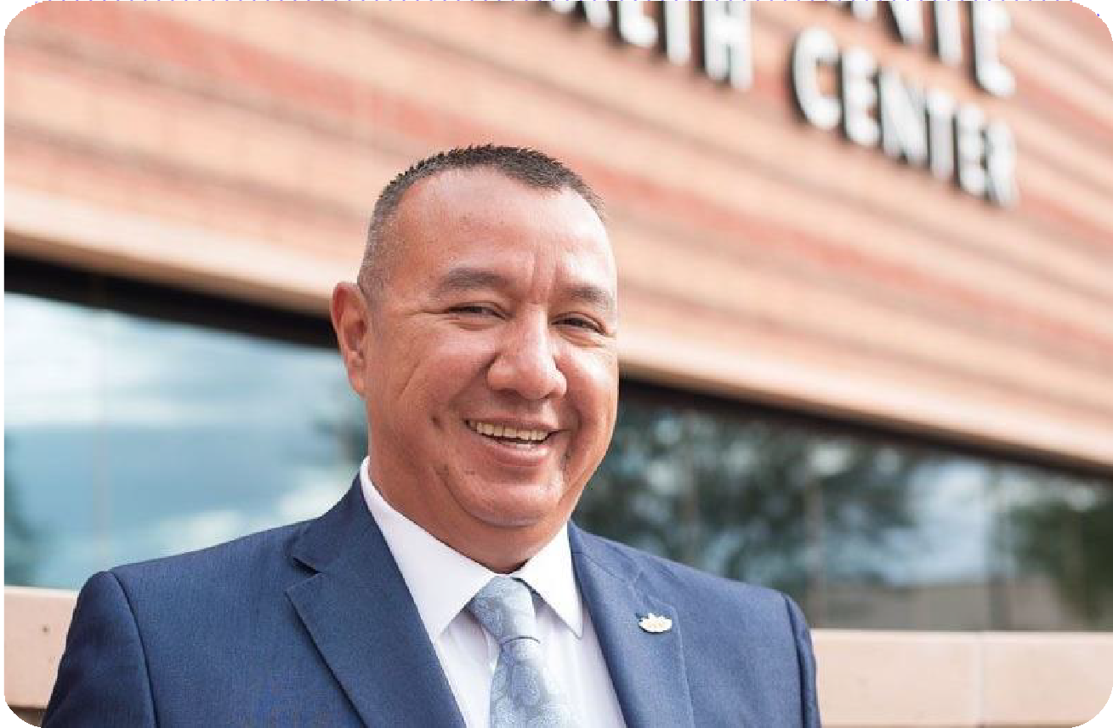

Real People.
Real Stories.
"Our value-based partner, Equality Health, has enabled us to accelerate our APM strategy while helping us remain grounded in our shared mission of promoting health equity."
Meaningful cultural connections to member audiences push higher satisfaction and retention, and improved appointment adherence and navigation success.
Pedro Cons, CEO Adelante Healthcare
9 locations across Phoenix, AZ

Slide 34
What to Take Back to Your CHC
Three questions worth asking your current VBC partner
Does our UDS reporting and our value-based quality reporting come off one data set, or two? If two, we are paying for the same abstraction twice.
?
When does money from this program actually arrive — this fiscal year, or after next year's reconciliation? Cadence determines what we can staff.
?
Who is chasing the members we have not seen in 18 months, and are they working our list or their own?
?

Slide 35
Managing Medicaid population health demands a fundamentally different CHC playbook than commercial or Medicare.
Key Takeaway
Higher social risk, member churn, and complex comorbidities collide with quality and cost accountability under value-based arrangements. The practices and plans that succeed treat that collision as the design problem, not an excuse.

Slide 36
Thank You

