Slide 1
Quality Made Practical: How We Turned Challenges Into Success
Presenters:
Alexa Williams and Karen Koch
Notes:
Karen: Hi and welcome to Quality Made Practical: How we turned Challenges into Success.
Before we dive in, we will do some quick introductions. My name is Karen Koch, I am the Director of Quality and Compliance at Rockbridge Area Health Center in Lexington Viriginia, and I am here today with Alexa Williams who is our Quality and Compliance Specialist.
Today we are going to share how our organization improved quality measures by changing how we educated and engaged clinical staff.
Rather than focusing on more training sessions, meetings, and education videos, we focused on making quality practical, understandable, and part of everyday work.
If you are wondering how many slides there are – we have 20 so we do not plan to run over today, we will have plenty of time to ask questions and for people to share ideas and thoughts on projects they could do at their health centers.

Slide 2
Why Quality Measures Are Often Missed
Measures are complex and are constantly changing
Staff feel overwhelmed with daily clinical demands
Time restraints on education
Teams don't always see how their actions impact scores
Notes:
Karen:
One of the biggest challenges we identified is that quality measures are complex and constantly changing. Keeping up with those changes can be difficult, especially in a busy clinical environment.
At the same time, staff are balancing full schedules and daily patient care responsibilities, leaving very little time for education or ongoing training. Even when education is provided, it can be hard to retain and apply that information in the moment.
We also found that teams don't always see how the work they do each day directly affects quality scores. When that connection isn't clear, it's harder to understand why certain workflows or documentation requirements are so important.
These challenges aren't about a lack of commitment, they're about creating systems that make it easier for staff to understand expectations, incorporate them into their workflow, and see the impact of their efforts.

Slide 3
Common Gaps Across Our Clinic
Lack of understanding for adult and child weight screenings
Confusion around tobacco screening and cessation counseling
Missing blood pressure rechecks
Missed documentation for screenings
Notes:
Karen:
As we dug deeper through chart audits, data reviews, and conversations with our clinical teams, we started to see consistent patterns across our clinics.
One of the most common gaps was around adult and child weight screenings. In many cases, the screening itself was completed, but required elements, such as nutrition counseling or the appropriate diagnosis for overweight or obesity—were missing, preventing the measure from being met.
We also found confusion around tobacco screening and cessation counseling. Staff were often completing the tobacco screening, but the required cessation counseling wasn't documented. In other cases, the screening was entered as free text instead of using the structured field that maps to our reporting.
Another recurring gap was with blood pressure rechecks. When an initial blood pressure was elevated, the repeat reading was often not documented, even when it had been completed.
Finally, we identified missed documentation for preventive screenings. Providers often believed that ordering a mammogram, colonoscopy, or cervical cancer screening was enough to satisfy the measure. We also found that some completed screenings were not being captured because inconsistent naming conventions were used in the electronic health record.
All of this pointed to the same conclusion: the biggest barriers weren't a lack of effort or commitment, they were gaps in knowledge, education, and consistent application of the UDS requirements

Slide 4
Why Traditional Training Wasn’t Working
Information overload
Hard to apply in real time
Lack of consistency
Low engagement
General lack of understanding
Passive learning
Notes:
Karen: Like many organizations, our first approach was to use traditional education methods to improve quality performance.
We met one-on-one with clinical teams to review commonly missed care gaps, discussed completed chart prep forms, and regularly sent quality education through email.
While these efforts were well intentioned, we found they weren't producing the results we expected. Staff were experiencing information overload. They were expected to understand the quality measures, know exactly how to meet them, document them correctly, and remember when each measure applied based on the appointment type. That's a lot to keep track of while also providing patient care.
As a result, many staff members still didn't have a clear understanding of what was needed to consistently meet the measures.
Transition:
That's when we realized we needed a different approach

Slide 5

What If Learning Quality Was Engaging?
Instead of more meetings… we tried something different
Notes:
Alexa:
So we asked ourselves a simple question: what can we do differently to help our clinical staff truly understand and succeed with quality measures?
We realized we needed to step back and start from the beginning because we found that our traditional training methods weren’t effective.
We also recognized a bigger issue: quality measures needed to be part of the day-to-day conversations, not just during a training session randomly throughout the year.
Just as importantly, we needed to shift the perception of UDS. We found that UDS was often seen as the Quality Department goals rather than basic patient care. So, we stopped using the "UDS" language and focused on "Clinical Quality Measures" and "Patient Care" instead.
That leads to the question you’re probably asking: Well, what new training did we conduct?
Well, like I said before.. We did take a step back. Why was our trainings not effective? It's easy.... Everyone learns differently, right? So, we made the next training sessions based of the four learn styles- visual, auditory, reading/writing, and kinesthetic.
We led two one-hour sessions then continued on that momentum throughout the year.
In the next slides, we’ll walk you through each of those approaches.

Slide 6

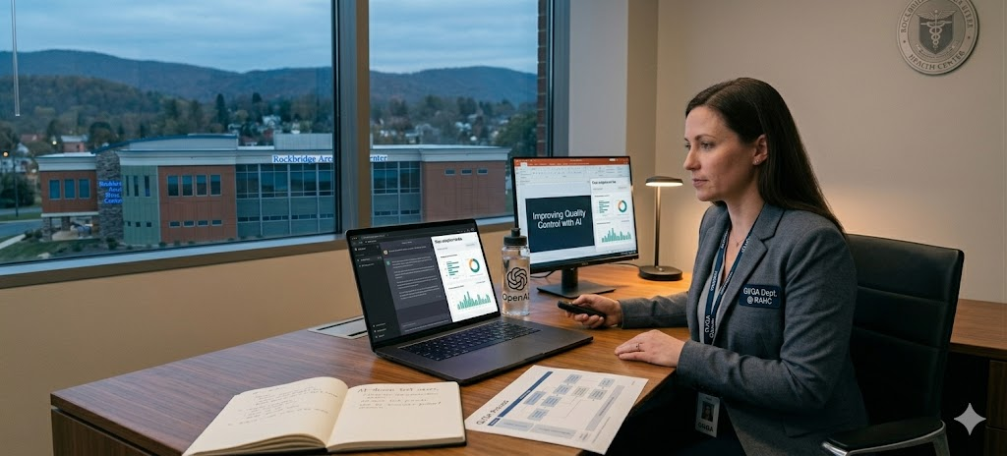
Podcast: Open AI
Podcast Creation: Google Notebook
Notes:
Alexa:
First, we are going to listen to a sample clip from our audio portion of our trainings.
We had a few 3-4 minute clips throughout our 'new style' training PowerPoints that we created and played, while also having a visual on the screen to help engagement.
This is an AI created podcast based off the information from a UDS sheet that we will show you in a few more slides.
------
Pathway: Google notebook -> Create new -> add sources (upload your own PDF, Video, or attach a website link) -> Find "Studio" then change to "deep dive" and finally generate.

Slide 7
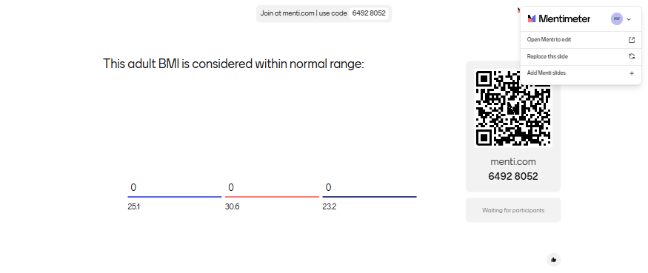
Let’s Test Your Quality Knowledge!
Notes:
Alexa:

Slide 8

Notes:
Alexa

Slide 9


Slide 10
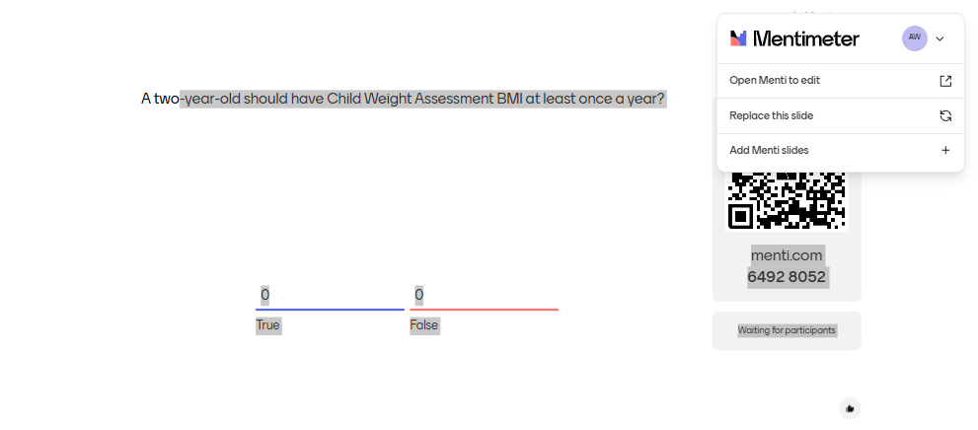

Slide 11
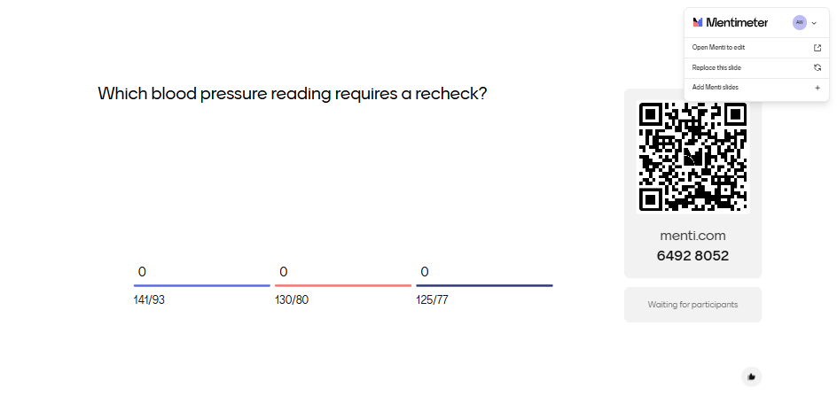

Slide 12
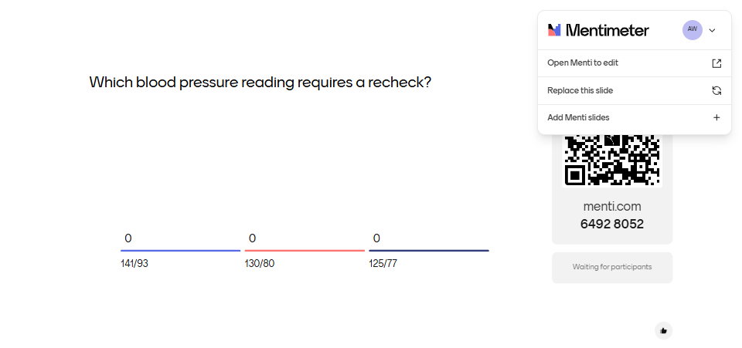

Slide 13
From One Game to Continuous Training
Monthly quality challenges
Provider Scorecards
Real-time feedback
PDF Cheat Sheets
Notes:
Alexa:
Moving from one-time training to ongoing engagement meant we had to rethink how we were keeping things top of mind.
The feedback from our two one-hour training sessions was overwhelmingly positive.
Staff were engaged, involved, and even had fun, which showed us we were moving in the right direction.
So, after our training day, we built on that momentum by launching monthly challenges, distributing UDS cheat sheets, sharing provider scorecards, and providing real-time feedback on performance through chart audit.

Slide 14
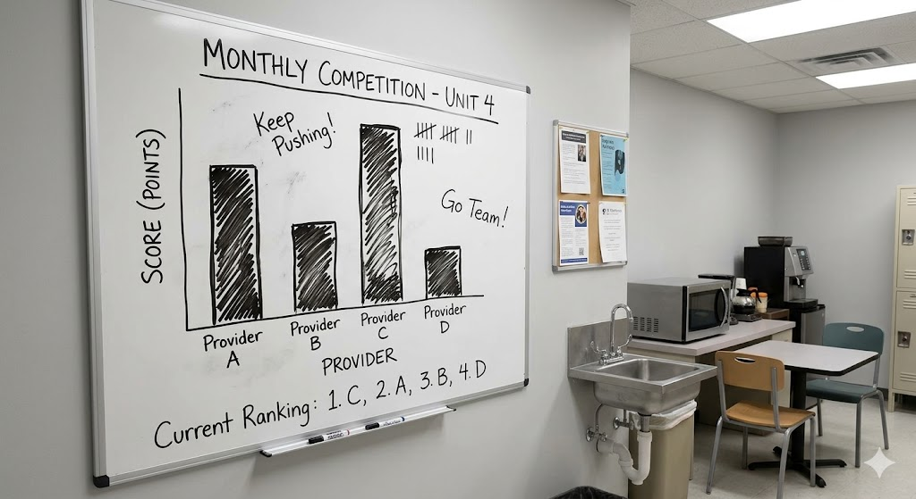
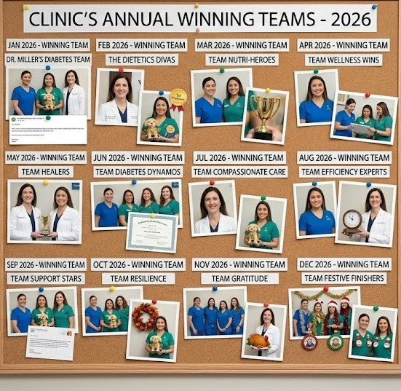
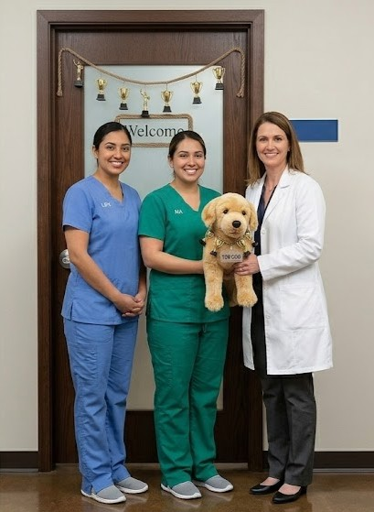
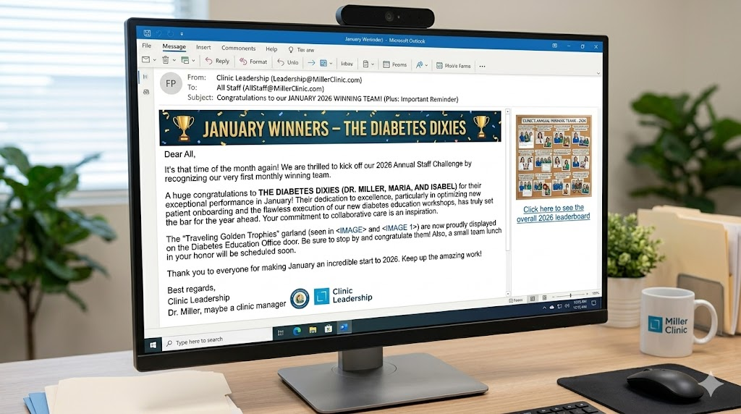
Monthly Challenges
Notes:
Alexa:
We had monthly challenges that each team competed in. (Our teams consists of one provider, one LPN, and one MA, but you could break the teams however is easiest).
At the beginning of each month, our Quality Department would send an email to the clinical team on what Measure we were focused on improving for the month.
In the staff breakroom, we would give weekly updates through bar graphs on where each team stood.
At the end of the month, we would send an email identifying the winning team and would post their staff photos on the bulletin boards.
To save cost, the trophy was a stuffed animal with a "Top Dog" collar and trophy ribbons (from the Dollar Tree) that would be passed around each month.
--
From February- August each team competed to be the most improved in a single measure.
From September-December, we looked at each provider’s data at an individual level to determine which areas needed improvement.
The winner each month had their staff photo added to the break room bulletin board, a Top Dog trophy, and hanging trophies on their pod door as recognition.

Slide 15
UDS CHEAT SHEET EXAMPLES
UDS: CHILD WEIGHT SCREENING AND FOLLOW UP Template: RAHC Child Weight Assessment/ Physical Activity/ Nutritional
Documentation | Exceptions & Exclusions
Age 3 – 17 years of age Height, weight, BMI percentile recorded with nutritional and physical activity counseling at least once a year documented under Preventive Medicine Child weight assessment differs from adults because they must have physical and nutritional counseling at least once a year despite their BMI. | Must be documented in problem list: Diagnosis of pregnancy (Z33.1) Documentation of hospice care (Z51.5)
UDS: TOBACCO CESSATION COUNSELING MEASURE RAHC Tobacco Cessation Template
Documentation | Counseling in Preventative Medicine
Patients aged 12 years and older who were screened for tobacco use If + tobacco user, then received cessation intervention during the measurement period or in the six months prior to the measurement period Please note: “Tobacco Use:” must be answered from the smart form or structured data. Free texting “nonsmoker” or “tobacco user” will not qualify as compliant. | 1. Patient counseled on the dangers of tobacco use and urged to quit. 2. Counseled the patient on tobacco use/cessation provided. 3. Counseled the patient on pregnancy smoking effects, education provided. 4. Counseled the patient on smoking cessation, education provided. 5. Counseled the patient on smoke effects, education provided. 6. Referral given to patient to a stop-smoking clinic. 7. Smoking cessation assistance provided. 8. Referral to smoking cessation advisor was given to patient.
Notes:
Alexa:
Here are two examples of our UDS Cheat Sheets.
We created 1 per UDS Clinical Measure, but for the purposes of this training session, we will just be showing Child Weight Screening and Tobacco Cessation Counseling.
Starting with the child weight screening and follow-ups, on the left-hand side we detailed briefly what the measure, listed the template name clearly, and included the exceptions and exclusions.
Looking over at the tobacco cheat sheet, again we started with a brief description of what the measure is.
We also ensured that the age was clearly listed because that was a change from the previous year, going from 18 years old to 12 years old. We stated that the tobacco use must be used in the smart form and not free texted. Then, on the right-had side we listed the types of counseling that were applicable for meeting the measure.

Slide 16
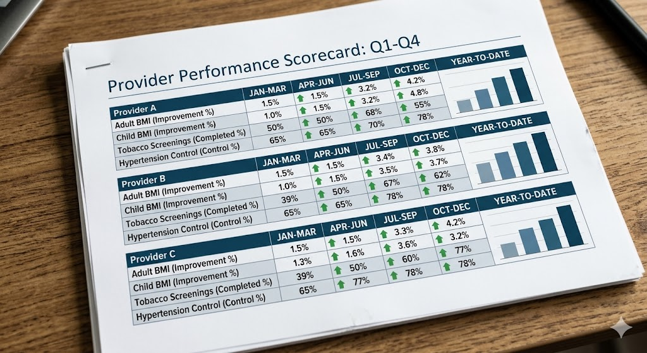
Provider Scorecards
Notes:
Alexa:
Throughout the quality challenge initiatives, we found that sharing and reviewing Scorecards with providers and teams were highly effective in increasing engagement and understanding.
Each month, providers receive individualized scorecards that display both RAHC's overall monthly performance and their own provider-level data. This allows providers to compare their performance with organizational results and established quality targets while tracking their progress throughout the year. It also allows providers to learn from each other.

Slide 17
What Happened Next
Child weight assessment increased by 10.9%
Adult BMI screening increased by 8.2%
Colorectal cancer screenings increased by 8.0%
HIV Screenings increased by 8.0%
Hypertension increased by 5.8%
Depression screenings increased by 5.3%
Tobacco screenings increased by 5.1%
Breast cancer screenings increased by 3.5%
Notes:
Karen:
The results validated the approach.
We saw improvements across multiple quality measures. Child weight assessment increased by nearly 11 percent. Adult BMI screening improved by over 8 percent. We also saw meaningful gains in colorectal cancer screening, HIV screening, hypertension management, depression screening, tobacco screening, and breast cancer screening.
While no single intervention was responsible, we believe ongoing education, engagement, and reinforcement played a significant role in these improvements.

Slide 18
The Key Drivers of Success
Simplified education
Repetition over time
Fun + accountability
Clear connection to patient care
Interdepartmental support and teamwork
Notes:
Karen: Looking back, there were several factors that drove our success.
First, we simplified the education.
We reinforced learning consistently.
We added accountability while keeping it fun.
We helped staff understand how their actions directly impact patient care.
And most importantly, we worked together across departments.
Overall, Quality improvement became a team effort rather than the responsibility of one department

Slide 19
Steps to Implement in Your Organization
Identify top missed measures
Create short interactive learning
Reinforce and review regularly
Share progress visibly
Work together
Notes:
Karen: If your organizations are interested in trying something similar, our recommendations are simple.
Start by identifying the measures that are most frequently missed. Create short, interactive learning opportunities.
Reinforce the information often rather than annually. Make progress visible. And most importantly, involve multiple departments in the process.
Quality improvement doesn't have to be complicated.
Sometimes small, consistent efforts create the biggest impact.

Slide 20
Thank You!

