Slide 1
Getting Paid Right: Medicare Advantage Contracting and Wrap-Around Payments for FQHCs
September 17, 2026

Slide 2

Adam J. Falcone
Partner
afalcone@feldesman.com
Based in Pittsburgh, Pennsylvania, Adam counsels community-based organizations that render primary and behavioral health care services.
He advises clients on a wide range of health care issues, with a focus on fraud and abuse, reimbursement and payment, and antitrust and competition matters.
Adam regularly speaks to groups across the country on managed care contracting and value-based payment methodologies.
Adam is licensed to practice law in the District of Columbia, Massachusetts, New York, and Pennsylvania.

Slide 3
Federal law entitles FQHCs to a Medicare Advantage wrap-around payment up to the Medicare PPS rate
A separate “pay not less than” rule puts FQHCs on equal footing when negotiating with MA plans
CMS administers the wrap very differently from how health centers might assume
Some health centers are leaving recoverable wrap dollars uncollected, including retroactively

Slide 4
FOUR QUESTIONS TO ASK WHEN YOU GET BACK
Are we asking MA plans to pay our Medicare PPS rates directly?
Are we requesting MAC wrap payments for every below-PPS plan, including retroactively?
Are we billing the wrap even when the MA claim is denied?
Do we have the documentation to back our per-visit rate estimate for each plan?
The rest of this session explains the legal basis for each question — we return to this checklist at the close.

Slide 5
SECTION 330 REQUIREMENTS
The health center must make and continue to make every reasonable effort to collect appropriate reimbursement for its costs when providing health services to persons who are entitled to:
  Medicare [42 U.S.C. 1395 et seq.];
  Medicaid [42 U.S.C. 1396 et seq.]; or
  Other public, grant, or private coverage (e.g., CHIP).
on the basis of the full amount of fees and payments for health center services without application of any discount.
Leaving Medicare Advantage wrap dollars uncollected is a Section 330 compliance issue, not just lost revenue.
PHSA 330(k)(3)(F); HRSA, Health Center Program Compliance Manual, Chapter 16

Slide 6
MEDICARE ADVANTAGE (MA) PROGRAM
55% of eligible Medicare beneficiaries are enrolled in MA plans in 2026, compared with 45% in traditional Medicare; MA has covered more than half of eligible beneficiaries since 2023 and CBO projects 64% by 2034
FQHCs served 3.6 million Medicare patients in 2024; because health center patients are overwhelmingly low-income and low-income beneficiaries enroll in MA at roughly 60-65%, an estimated 2.2 million or more are likely MA enrollees
Medicare Advantage (formerly Medicare+Choice) offers health plans operated by private companies that contract with Medicare to provide Medicare-covered services
Sources: KFF, “Medicare Advantage in 2026: Enrollment Update and Key Trends” (Mar. 2026 data); HRSA 2024 Uniform Data System, Table 4; Medicare Current Beneficiary Survey (MCBS), enrollment by income.

Slide 7
Legal Requirements

Slide 8
Three protections, one framework
1. The supplemental “wraparound” payment
  Medicare pays the difference between the MA plan’s payment and the FQHC PPS rate, less cost-sharing — the health center is made whole.
  SSA 1833(a)(3)(B); 42 C.F.R. 405.2469
2. The “pay not less than” requirement
  MA plans must pay an FQHC at least what they pay a non-FQHC for the same services — equal footing at the negotiating table.
  SSA 1857(e)(3)(A); 42 C.F.R. 422.527
3. The related payment rules
  CMS pays the wrap directly and does not cut the MA plan’s capitation to offset it — the wrap is CMS’s obligation, not the MA plan’s.
  SSA 1857(a)(4); 42 C.F.R. 422.316
We take each of these in turn today.

Slide 9
Entitlement to medicare “wraparound”
Part 1: federal statute
What the statute says: For purposes of FQHC services furnished “pursuant to a written agreement” with an MA plan, on or after the implementation date of the Medicare FQHC PPS, Medicare is liable for the amount (if any) by which
Amount A – “the amount of payment that would have been made under Section 1834(o)”
exceeds
Amount B - “the amount of payments received under such written agreement for such services (not including any financial incentives provided for in such agreement as risk pool payments, bonuses or withholds),”
less any applicable Medicare Advantage plan cost-sharing
Social Security Act § 1833(a)(3)(B)

Slide 10
Entitlement to medicare “wraparound”
Part 2: federal regulation
What the regulation says:
FQHCs are entitled to supplemental payments when they are “under contract (directly or indirectly) with [Medicare Advantage plans].” 42 C.F.R. § 405.2469(a).
The supplement payment is based on the difference between an FQHC’s payments from a Medicare [Advantage plan] “as determined on a per visit basis” and what the FQHC would have received under its FQHC Prospective Payment System (PPS) or Intensive Outpatient (IOP) rate, less applicable cost-sharing. 42 C.F.R. § 405.2469(b).
In calculating the supplemental payments, Medicare is prohibited from including financial incentives provided by the Medicare Advantage plans such as risk pool payments, bonuses, or withholds as health plan payments. 42 C.F.R. § 405.2469(c).

Slide 11
Entitlement to medicare “wraparound”
Part 2: federal regulation (con’t)
What the regulation says:
A supplemental payment must be made to the FQHC when it furnishes:
  a covered face-to-face medical or mental health visit or
  a telehealth mental health visit.
    On or after October 1, 2025, there must be an in-person mental health service furnished within 6 months prior to the furnishing of the telecommunications service and that an in-person mental health service (without the use of telecommunications technology) must be provided at least every 12 months while the beneficiary is receiving services furnished via telecommunications technology for diagnosis, evaluation, or treatment of mental health disorders, unless, for a particular 12-month period, the physician or practitioner and patient agree that the risks and burdens outweigh the benefits associated with furnishing the in-person item or service, and the practitioner documents the reasons for this decision in the patient's medical record.
42 C.F.R. § 405.2469(d).

Slide 12
MEDICARE “wraparound”: Key limitations
Wraparound payments are only available for services furnished under contract with network-style MA plans
  Not available with private fee-for-service (PFFS) plans that use a “non-network model”.
Wraparound payments are not available for claims relating to services that are not included in the “FQHC Services” benefit that may be furnished at the FQHC such as:
  Telehealth medical visits
  Services billed as a Part B provider (laboratory services, technical services, hospital rounding).
Note: MA plans are generally not required to pay FQHCs the PPS rate. The wrap payment is the mechanism that closes that gap.
CMS, MA Network Guide for Out of Network Payments (4/15/15 update), pp. 21-25; 42 C.F.R. § 405.2469

Slide 13
How the wrap is calculated
Amount A − Amount B − applicable MA cost-sharing = Medicare wrap-around payment
Amount A
Medicare FQHC PPS rate — what Medicare would have paid
THE GAP
= wrap-around payment
Paid directly to the FQHC by the MAC — not by the MA plan.
Amount B
Paid by the MA plan
Amount B: payment received from the MA plan, net of risk pool payments, bonuses and withholds.
Note: applicable MA cost-sharing is also subtracted.
Source: Social Security Act § 1833(a)(3)(B); 42 C.F.R. § 405.2469.

Slide 14
Medicare “pay not less than” protections
What the law says: CMS’ contracts with MA plans must require the MA plan, in its written agreements with FQHCs, to provide
  for a level and amount of payment to the [FQHC] for services provided by such health center that is not less than the level and amount of payment that the plan would make for such services if the services had been furnished by an entity providing similar services that was not a[n] [FQHC]
Social Security Act § 1857(e)(3)(A); see 42 C.F.R. § 422.527

Slide 15
Medicare “pay not less than” protections
What it does: Requires the plan to pay the FQHC at least at the level it would pay another type of provider for the same services.
Practice Pointer. The “pay not less than” protection does not prevent a MA plan from paying an FQHC at the FQHC’s Medicare PPS rate.
  Because this rate is usually more than what the MA plan pays another type of provider for the same services, doing so is permissible under the law.

Slide 16
CMS Wrap-Around Implementation

Slide 17
Cms’ Implementation of ma wrap:
common assumptions debunked
Assumption: CMS’ wraparound payment equals precise difference between health center’s PPS entitlement and actual payments from plan.
  Reality: CMS has implemented the wrap by requiring FQHCs to submit information regarding estimated average MA payments (by plan) for covered services.
  Practice Pointer: The estimated average MA payment is submitted once. CMS does not require the health center to update it when the average MA payment rate later increases.
CMS, Medicare Claims Processing Manual, Chapter 9, Sections 60.4 and 60.5

Slide 18
Cms’ Implementation of ma wrap:
common assumptions debunked, cont.
Assumption: Health centers can recover wraparound through their cost report settlement process.
  Reality: CMS guidance described such a process, with respect to FQHC services furnished under the cost reimbursement methodology, but it was never implemented -- and in addition, such a solution would be unworkable after the transition from cost reimbursement to the Medicare FQHC PPS.
CMS, Medicare Claims Processing Manual, Chapter 9, Sections 60.4

Slide 19
Cms’ Implementation of ma wrap:
common assumptions debunked, cont.
Assumption: Wraparound payments can be made on an aggregate basis (“at least quarterly”).
  Reality: Wraparound payments are made on a claim-by-claim basis and are not subject to any type of reconciliation.
  Practice Pointer: There is no “paid claims” policy. Nothing requires the MA plan to have paid the FQHC on the underlying claim before that claim is wrapped.
CMS, Medicare Claims Processing Manual, Chapter 9, Sections 60.4

Slide 20
OBTAINING MEDICARE WRAP-AROUND PAYMENTS
To obtain wrap-around payments, FQHCs must submit a request to its Medicare Administrative Contractor(s):
  Estimating the average MA payments (on a per visit basis) for covered FQHC services for each contracted MA plan.
  Other information as may be required to enable the MAC to accurately establish an interim supplemental payment.
  Identify each MA plan by its unique contract number (begins with H and is followed by a 4-digit number). See Medicare Advantage Plan Directory search tool.
  Medicare Claims Processing Manual, Chapter 09

Slide 21
WHEN WRAP-AROUND PAYMENTS ARE AVAILABLE
The service must have qualified as a visit under traditional Medicare
  A face-to-face (one-on-one) encounter with a covered core practitioner
  Mental health: interactive, real-time audio-video, or audio-only where the beneficiary cannot or does not consent to video
  Exception: intensive outpatient program (IOP) services also qualify for wrap-around payments
FQHC covered core practitioners: physicians, NPs, PAs, certified nurse midwives, clinical psychologists, clinical social workers, MFTs, mental health counselors, DSMT/MNT providers
The supplemental payment is made directly to the FQHC through the MAC
Medicare Claims Processing Manual, Chapter 09

Slide 22
MAC EXAMPLE: NATIONAL GOVERNMENT SERVICES
FQHCs Contracting with Medicare Advantage (MA) Plans
Requirements to Receive Wrap-Around Payments
Submit the written FQHC–MA plan contract — signed by both parties, with effective dates and cost-sharing terms. A contract with an individual physician does not qualify.
Provide all MA contractor IDs for each contract. Without them, no supplemental payment can be set up.
Provide an average MA per-visit rate for each plan — convert fee schedules or capitation to a per-visit basis, with backup documentation showing the calculation.
Bill approved claims with TOB 77x and Revenue Code 0519 — not 052x or 0900 on the same claim.
Include the proper G-code and HCPCS code per CMS Transmittal 1395.
Submit all required documentation through NGS Connex.
Source: National Government Services

Slide 23
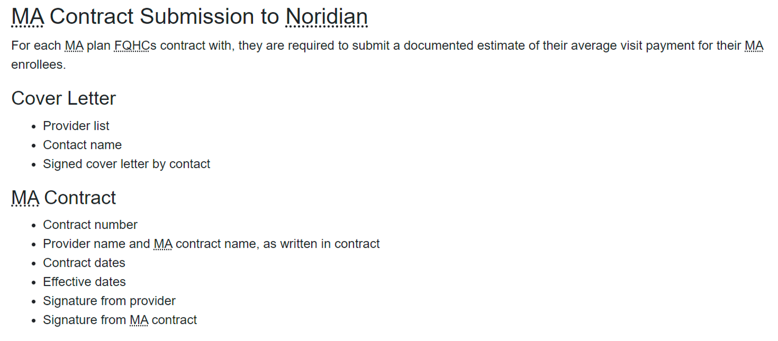
EXAMPLE FROM NORIDIAN (MAC)
Note: Submission requirements and forms vary by MAC — confirm the rules for your own MAC.
https://med.noridianmedicare.com/web/jea/provider-types/fqhc/medicare-advantage-wrap-around-payment

Slide 24
MEDICARE ADVANTAGE REVENUE MAXIMIZATION CHECKLIST
Ask your contracted MA plans to pay your Medicare PPS rate directly.
  Where a plan agrees, there is no wrap claim to chase.
File wrap claims with your MAC for every plan paying below Medicare PPS rates.
  File retroactively, back at least one year, and include any newly contracted plans.
  Keep backup for each plan’s average per-visit rate: EOB samples and rate worksheets.
Keep billing the wrap even if the underlying MA claim is rejected or denied.
NEXT STEPS: review your MA contracts and your MAC wrap set-up.

Slide 25
Adam J. Falcone
afalcone@feldesman.com
202.600.3512

