Slide 1

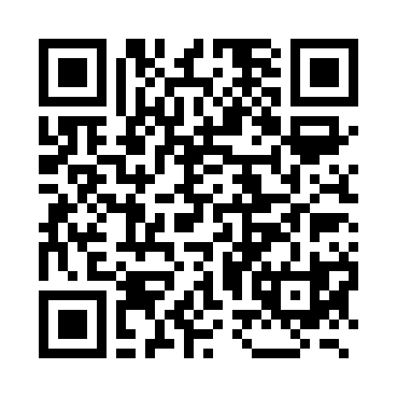
Aisles to Outcome: How AI Found Millions in Avoidable Claims
Email me here!
How embedded AI analytics can identify avoidable claims, validate underwriting assumptions, forecast risk and activate Rx/domestic care strategies. Illustrative board-ready model- Not client-identifying.
Nikki Petrazzuolo Whitaker, M.A., CHRS, CSFS
Vice President, Employee Benefits
Notes:
Change title, add more on domestic care, add notes- add QR code

Slide 2
Executive Summary: $2.0M Modeled Savings + Revenue Opportunity
Representative employer case study built from claims leakage, forecasting and Rx mitigation logic.
$2.0M
Y1 $1.15M
Y2 $850K
90 days
Total modeled annualized savings + revenue opportunity
Medical service provider: leakage + onsite care redirection
Medical service provider: leakage + domestic care + Rx
Initial roadmap to validate, prioritize and implement
AI finds claim patterns manual review misses: duplicate payments, eligibility gaps, miscoding, outlier providers and high-cost Rx variance.
Underwriters use AI to move from retrospective reports to forward-looking risk mitigation and renewal leverage.
Savings comes from corrected leakage, better steerage, domestic care plan routing, prior authorization validation and Rx contract transparency.

Slide 3

Key Questions / Considerations
AI Does not replace underwriting judgement. It prioritizes suspicious patterns for human validation.
AI Does not replace renewal negotiations. It changes the review from backward past performance to forward forecasting.
Have you been told you were “running hot”, as why the renewal increase was required?
Have you been shown that your experience period can be 12-18 months in arears with termed members and recovered patients?
Would you be shocked to know your renewal contract date is not your renewal (experience period)?
Are you aware that ASO’s/PBMs (even self-funded you “own”) as well as LF or FI contracts can not allow 3rd party audits?
Are you using AI to help forecast and stress test your program?
Have you considered domestic care?

Slide 4
Where Claims Leakage Hides
AI Does not replace auditors. It prioritizes suspicious patterns for human validation in minutes.
Duplicate / split claims
Eligibility leakage
Same episode, repeated payment signal
Termed members or dependents still generating cost
Coding / billing drift
Provider outliers
Upcoding, modifier variance, place-of-service mismatch
High unit cost, high utilization or unusual referral patterns
Rx leakage
Forecasting blind spots
Specialty, biosimilar, coupon, rebate and site-of-care gaps (*orphan drugs)
Emerging claimants not visible until renewal

Slide 5

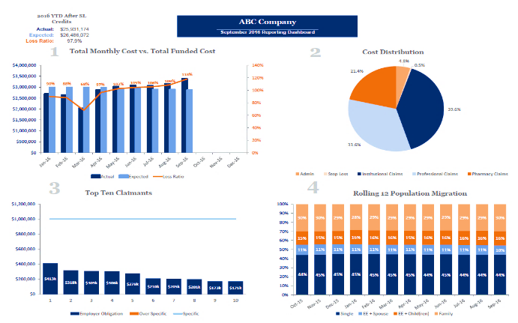
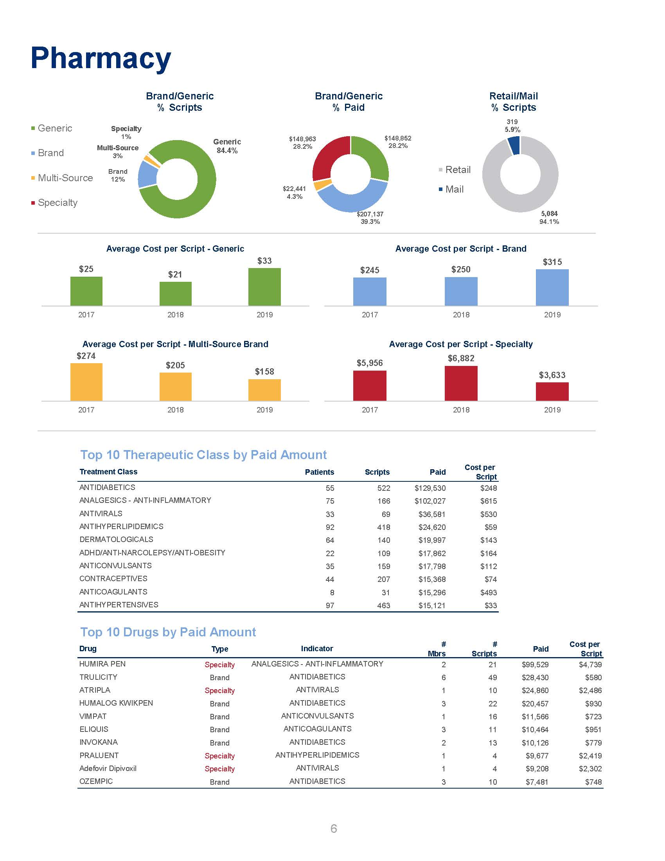

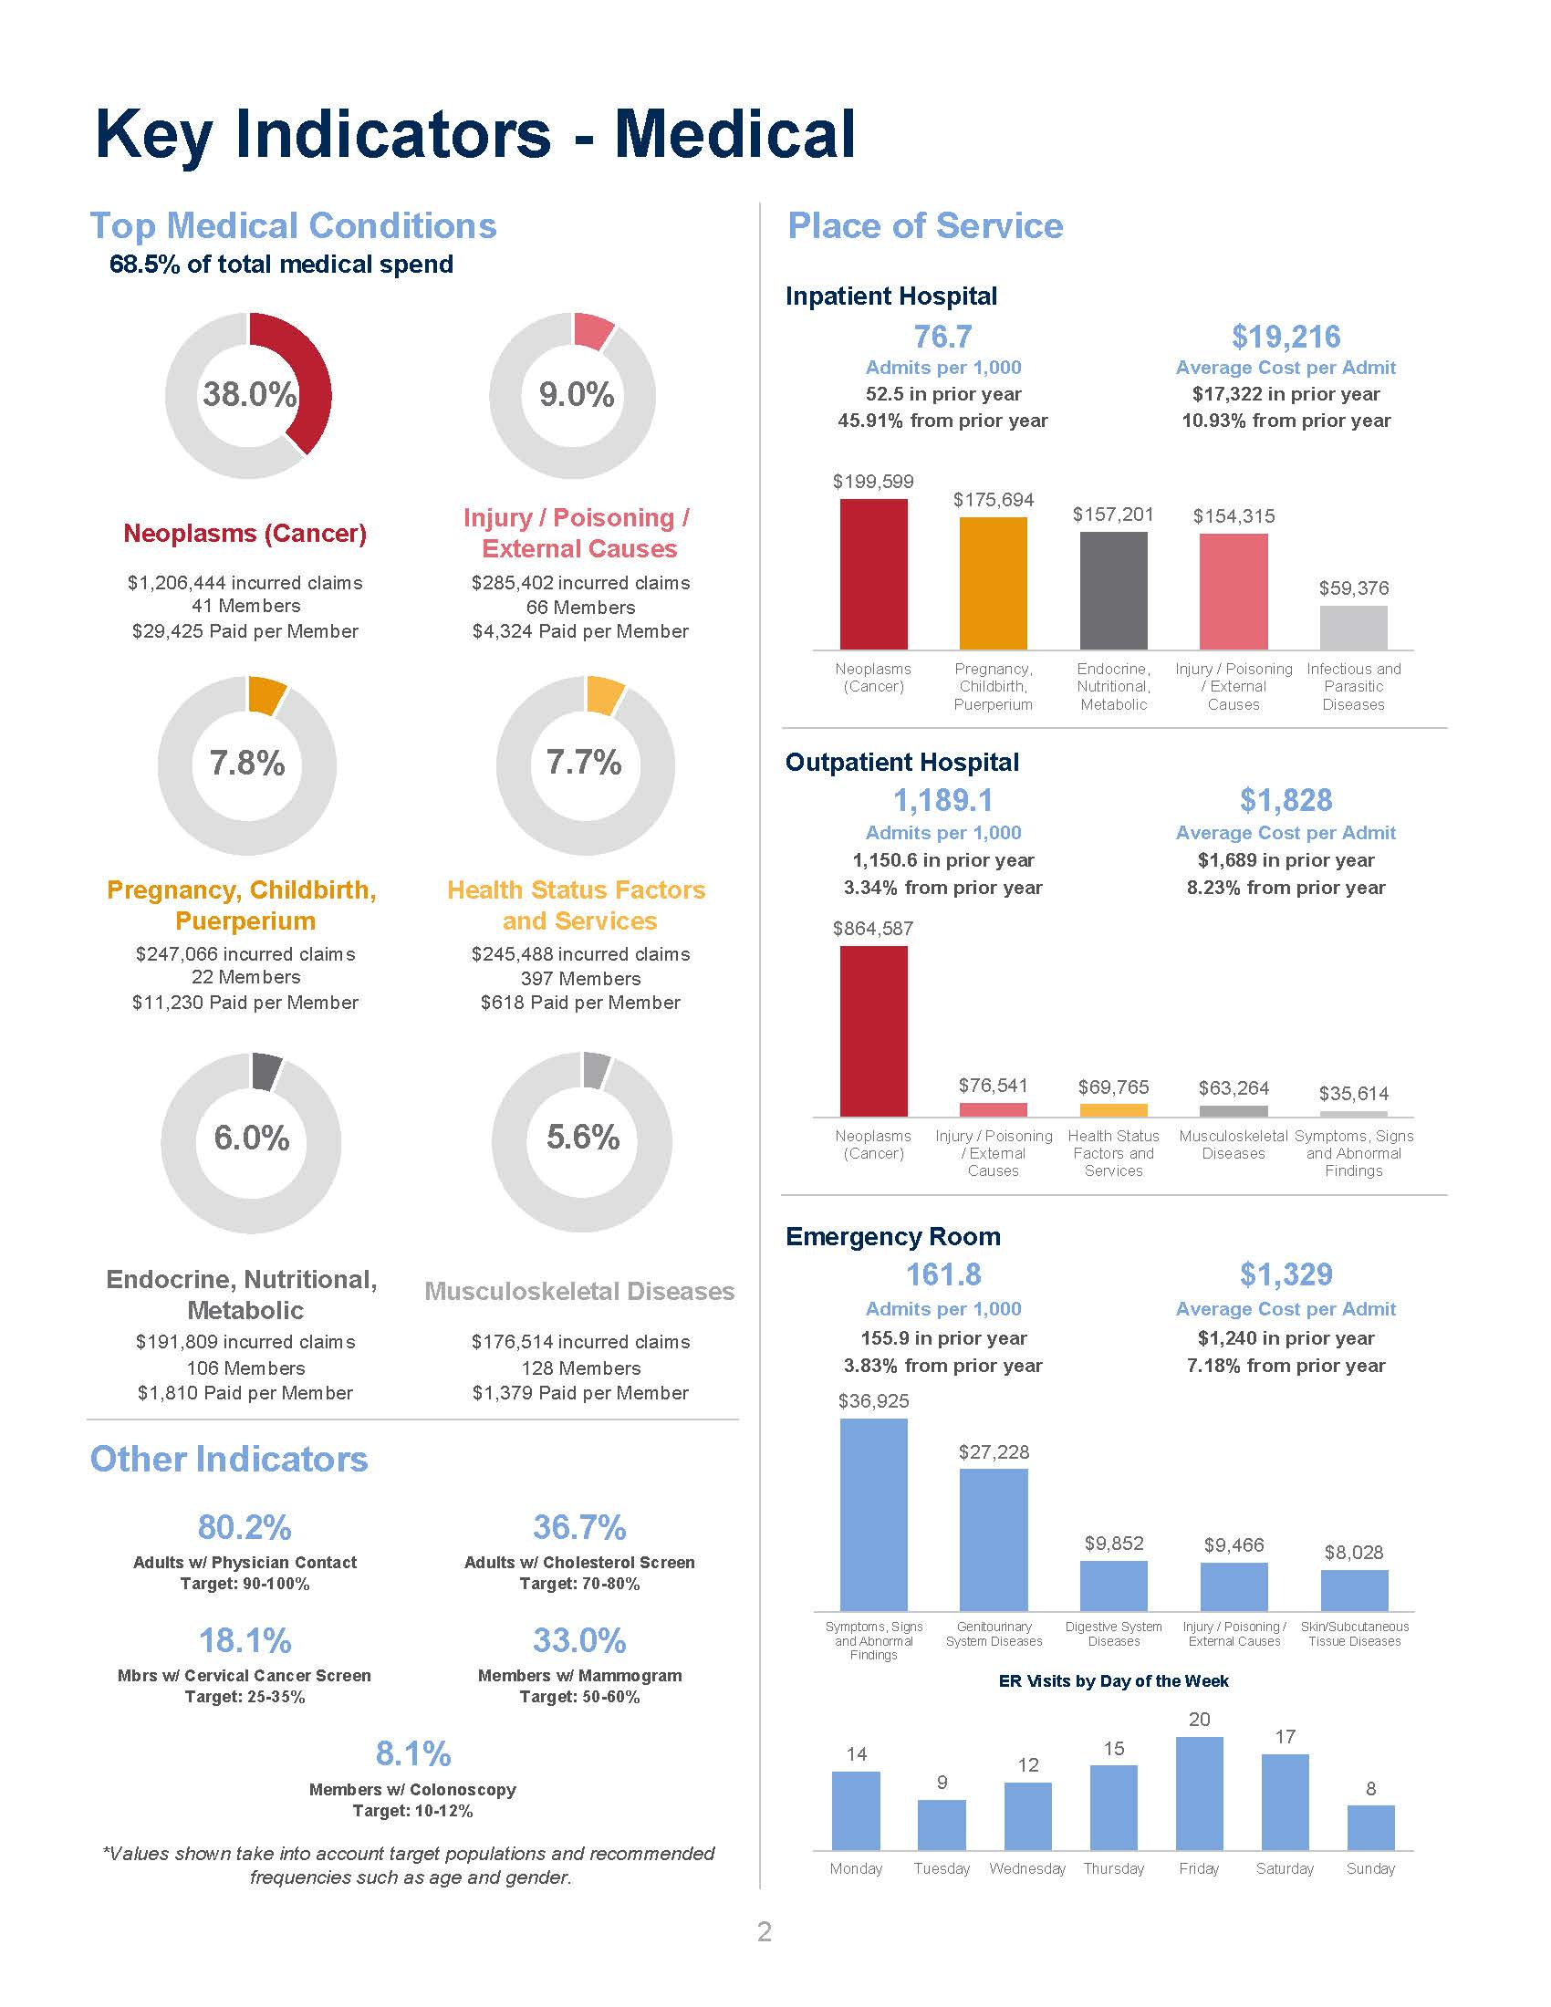
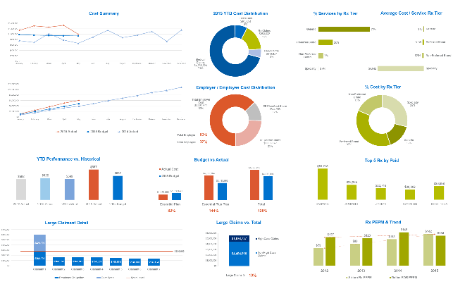
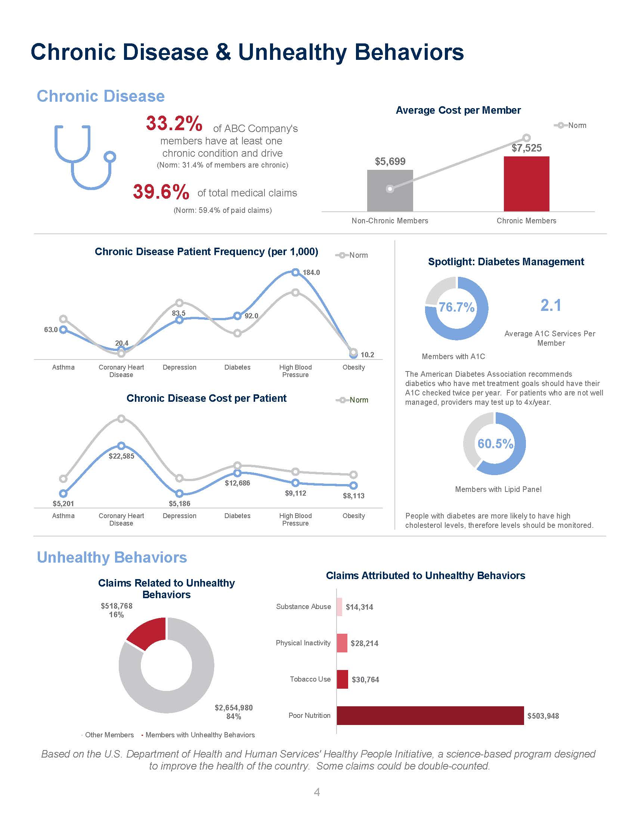
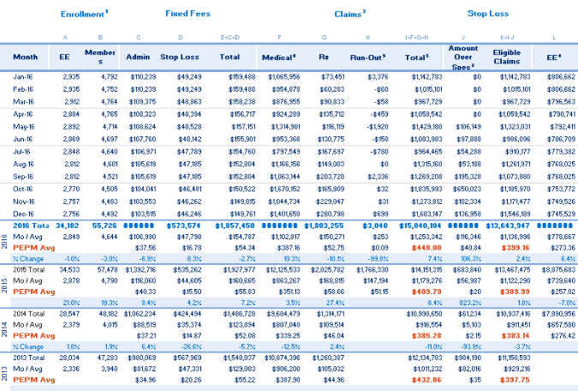
Brown & Brown Health & Welfare Analytics with Embedded AI
Executive Dashboards
Monthly Financial Reporting
IBNR Reserves
Renewal Projections
Data Benchmarking
Health Plan Intelligence (HPI)
Executive Dashboard
ABC Company

Slide 6
Brown & Brown Health & Welfare Analytics with Embedded AI
HPI Database*
1000+ Employer Groups
2.0+ Million Members
$20.9 Billion Medical Claim Volume
Average* Group Size of 990 Employees
HPI Dashboard
Performance benchmarking of key healthcare utilization categories, plan efficiency and impact of chronic diseases.
Insight into which health strategies to pursue and steer communications.
HPI Analytics
Powerful views of underlying data with multi-dimensional filters, revealing hidden problem areas and potential opportunities. Includes trending topics like GLP-1s, Specialty Rx, Coverage Tier utilization and more.
HPI BeneCalc
Model the financial and member impact of changes in plan design, medical inflation, network performance and employee contributions.
*Facts as of June 2024
Better Data = More Informed Decisions = Cost Effective, Efficient Health Plan

Slide 7
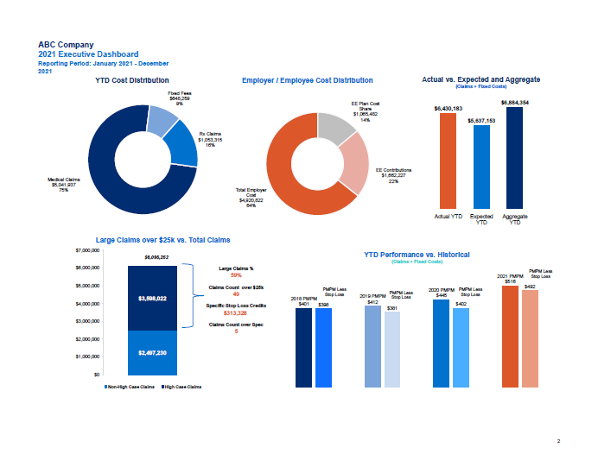
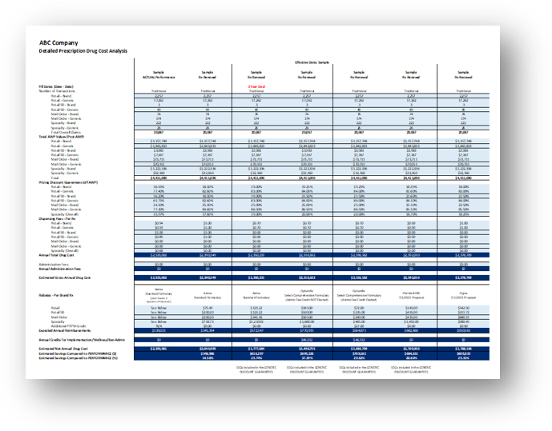
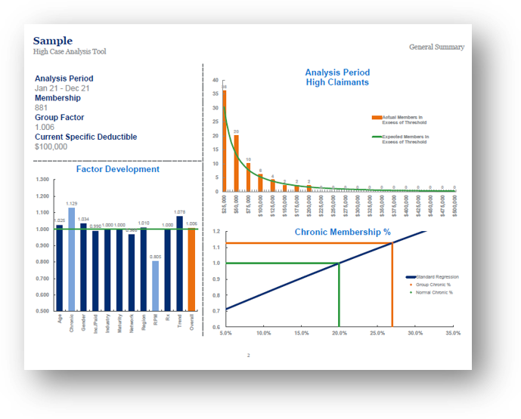
Transforming Data into Action
Plan Design Analysis and Modeling
Member Burden Measurement
Demographic Analysis
Actuarial Alignment and Tiering Analysis
High Case Analysis Tool (HCAT)
Risk Pool Management Opportunity Analysis
Pharmacy Plan Analysis

Slide 8
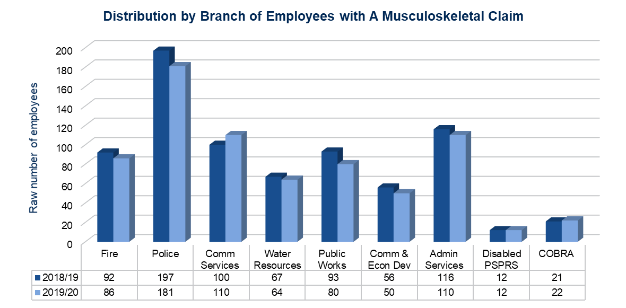
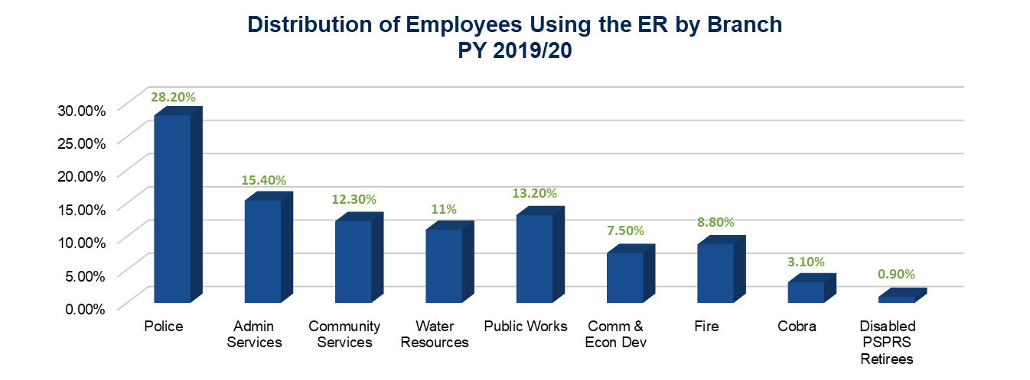
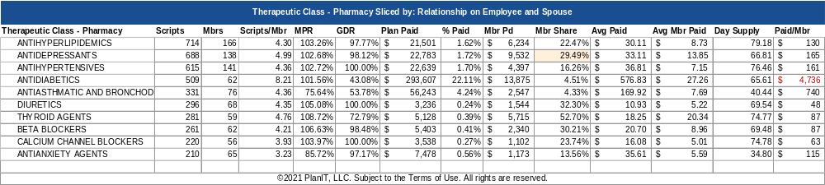
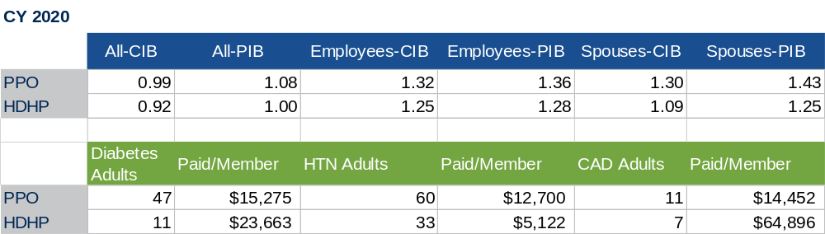
Understanding the Impact of Plan Design and that Plan Design is Not Insurance
Ex. Ever had the lowest cost HDHP get the highest % increase? Anyone thought a MERP or HRA could stop the increases?
Leverage key metrics to understand awareness about resources and engagement in managing one’s health and well-being
Detailed demographic information about conditions demonstrating risk to the health plan
Analyze preventive care, pharmaceutical utilization
What are the cost drivers for employees? Who’s driving these costs?
Are members with chronic conditions taking their medication consistently?

Slide 9
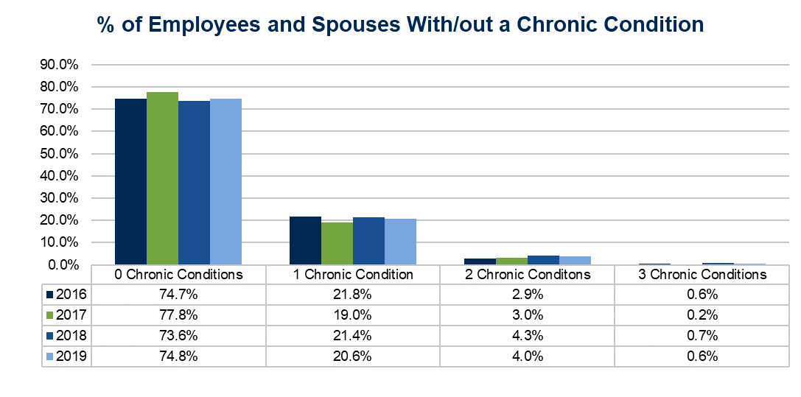
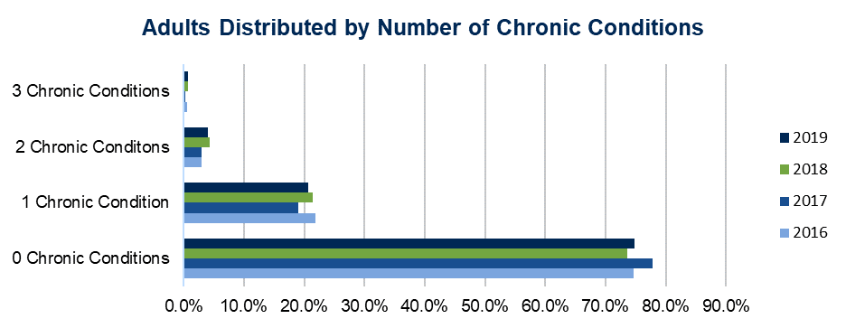
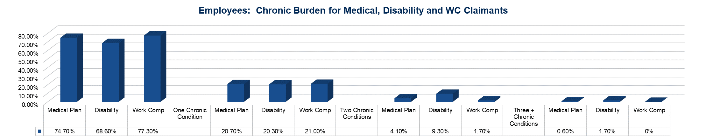
Understanding the Impact of Plan Design and that Plan Design is Not Insurance

Slide 10
How Underwriters Use Embedded AI
A repeatable workflow: ingest, score, validate, act and monitor in minutes vs. weeks or months!
1
2
3
4
5
Ingest
Detect
Validate
Act
Forecast
Claims, eligibility, Rx, plan design, provider contracts
Anomaly scoring, clustering, benchmarks, duplicate logic
Clinical, pharmacy and underwriting team review
Edit rules, care routing, Rx management, network steerage
Renewal projection, high-cost claimant probability, trend mitigation

Slide 11
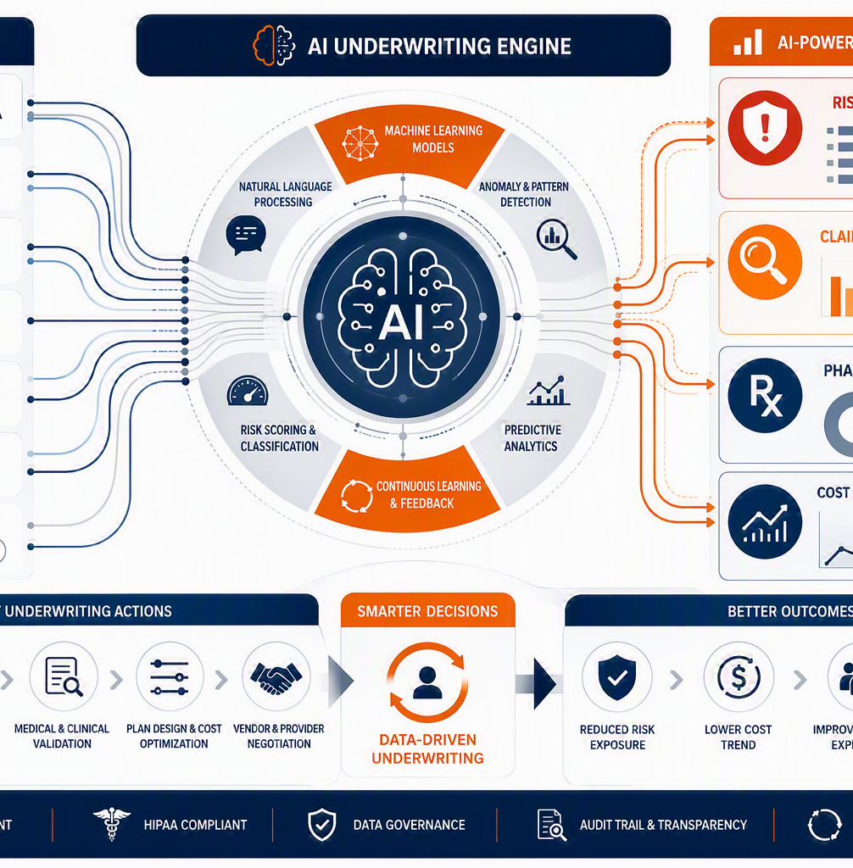
Case Study: Medical Service System
AI analytics + domestic care planning created an $850k modeled annual savings opportunity plus revenue stream.
Client Profile
Provider-heavy workforce with high plan familiarity but scattered care routing
Frequent avoidable out-of-network, imaging and specialist spend.
Pharmacy spend rising faster than medical trend.
AI Intervention
Mapped steerage leakage to domestic providers and preferred facilities.
Identified drugs and sites of care that needed pharmacy management overlay.
Forecasted high-cost claimant risk and mitigation timing before renewal.
Determined financial positive impact and assisted in development of Domestic Care Plan

Slide 12
Analytics Bridge: Y1 $1.15M Savings Stack
Savings was not one big lever. It was multiple validated leakage and mitigation levers.
Claims leakage correction
$375K
MSK/onsite care redirection
$310K
$1.15M
Modeled annualized Savings = Revenue opportunity
Provider outlier steerage
$225K
Rx optimization
$160K
Underwriting impact
A cleaner claim baseline creates stronger renewal negotiation leverage and a more defensible self-funded forecast.
Eligibility/COB recovery
$80K

Slide 13
Analytics Bridge: Y2 $850K Savings Stack
Savings was not one big lever. It was multiple validated leakage and mitigation levers.
Claims leakage correction
$270K
MSK/onsite care redirection
$200K
$850K
Modeled annualized Savings = Revenue opportunity
Provider outlier steerage
$180K
Rx optimization
$150K
Underwriting impact
A cleaner claim baseline creates stronger renewal negotiation leverage and a more defensible self-funded forecast.
Eligibility/COB recovery
$50K

Slide 14

Rx Management Overlay: Turning Pharmacy Data Into Action
AI highlights high-cost prescriptions, hidden PBM leakage and clinical alternatives for pharmacy review.
Specialty drug management: biosimilar review, site-of-care steerage and prior authorization auditing.
PBM contract review: rebate pass-through, spread pricing risk, specialty pharmacy steering and guarantees.
Member support: pharmacist-led navigation for adherence and lower-cost clinically appropriate alternatives.
Orphan drug risk assessments and financial impact monitoring.
Are orphan drugs included or excluded from rebate guarantees?
How do you define an orphan drug?
Can the PBM change that definition during the contract?
What orphan-drug management programs exist?
How many orphan-drug claimants are currently in our population?
What is the projected orphan-drug spend over the next 3 years?
Is gene therapy included in your orphan-drug strategy?
Condition examples: Hemophilia Muscular Dystrophy Cystic Fibrosis Huntington's Disease Spinal Muscular Atrophy (SMA)Certain rare cancers
$250K
Medical system Rx modeled opportunity
Notes:
Questions to Ask a PBM
Are orphan drugs included or excluded from rebate guarantees?
How do you define an orphan drug?
Can the PBM change that definition during the contract?
What orphan-drug management programs exist?
How many orphan-drug claimants are currently in our population?
What is the projected orphan-drug spend over the next 3 years?
Is gene therapy included in your orphan-drug strategy?

Slide 15

Domestic Care Plan for the Medical Service System
Keep appropriate care inside the system while protecting access, quality and member experience. AI is forecasting revenue potential, best care offerings and plan incentives, efficacy based on behavioral patterns and helping with employee privacy considerations.
Primary care anchor
Preferred imaging / labs
Lower unit cost when clinically appropriate
PCP first touch with same-day/next-day access standard
Specialist coordination
Rx + site-of-care
Closed-loop referral path and documentation
Integrated medication and infusion strategy
Member promise: easier access to the right confidential care, not just lower cost.

Slide 16
Forecasting for Claims Mitigation Before Renewal
The goal is to intervene early enough to change the renewal story.
Risk Forecast Dashboard
Predict high-cost claimant probability.
Model impact of steerage, Rx, medical management and eligibility fixes.
Re-run forecast monthly to show measurable movement before renewal.
Baseline trend
Mitigated trend
Renewal message: identified, validated and actively mitigated.

Slide 17


Embedded AI Timing: What the Underwriter Sees and When they see it
Affect your “experience period” impact on renewal justifications
Underwriting AI Review Flow= Real Time vs. Weeks
Rx Leakage + Forecasting Flow = Real Time vs. Weeks
Ingest claims • flag anomalies • assign reviewer • create action plan
Specialty drug review • PBM spread risk • clinical alternatives • forecast impact

Slide 18
90-Day Roadmap: From Claim File to Measurable Savings
A fast but controlled implementation path for CFO, CHRO and board visibility
Days 1-15
Days 16-35
Days 36-60
Days 61-90
Data intake + governance
AI scoring + leakage triage
Clinical + underwriter validation
Implementation + tracking
Eligibility, medical, Rx, contracts, notes, stop-loss and renewal history.
Run anomaly models, identify outliers and prioritize high-value review queues.
Validate savings categories and response actions with carrier/TPA/PBM.
Launch claim edits, Rx strategies, domestic plan routing and monthly dashboard.
Deliverable: executive scorecard with leakage findings, validated savings, forecast model and accountable action owners.

Slide 19
Appendix: Assumptions, Disclosures & Governance Controls
Use this slide too protect credibility and legal/compliance reviewers.
Savings values are modeled examples, not guarantees. They require claim-level validation and vendor acceptance.
AI output should be treated as a prioritization engine. Final decisions require human underwriting, clinical and pharmacy review.
Recommended controls: data use agreement, PHI minimization, audit trail, model bias monitoring, vendor documentation and fiduciary review.
Domestic care plan design must be reviewed for plan document alignment, access, quality, ERISA/ACA/MHPAEA considerations and state rules.
Rx strategies should document clinical appropriateness, member disruption impact and PBM contract economics.

Slide 20
Let’s chat.
Nikki Petrazzuolo Whitaker, M.A.
Cell: (571) 358-0608
Nikki.petrazzuolowhitaker@bbrown.com
Brown & Brown Insurance Services, Inc.
In CA: Brown & Brown Retail Insurance Services (CA Entity License #0F56560)
11220 Assett Loop Drive, Manassas VA 20109
Any solicitation or invitation to discuss insurance sales or servicing is being provided at the request of Brown & Brown Insurance Services, Inc., an owned subsidiary of Brown & Brown, Inc. Brown & Brown Insurance Services, Inc. only provides insurance related solicitations or services to insureds or insured risks in jurisdictions where it and its individual insurance professionals are properly licensed.
DISCLAIMER: Brown & Brown, Inc. and all its affiliates, do not provide legal, regulatory, tax guidance and/or advice. If legal advice, counsel or representation is needed, the services of a legal professional should be sought. The information in this document is intended to provide a general overview of the topics and services contained herein. Brown & Brown, Inc. and all its affiliates make no representation or warranty as to the accuracy or completeness of the document and undertakes no obligation to update or revise the document based upon new information or future changes.

