Slide 1
Integrated Care in Action
Integrated Care in a Community Health Setting
Prepared for the Virginia Community Healthcare Association

Slide 2


Today’s Presenters
Shannon Lea
Senior Program Manager
Primary Care Development Corporation
Angela Futrell
Chief Executive Officer
Southeastern Virginia Health System

Slide 3
Learning Objectives
Recognize the benefits of integrated care and how it positively impacts organizations and health outcomes.
Learn practical information and gain access to valuable tools for implementing an integrated care program.
Discover emerging and best practices for implementing integrated care in a Community Health Center setting.

Slide 4
Setting the Stage

Slide 5
Colonial Behavioral Health
Vision
Continuing to serve as a vital partner in a community system of care that promotes the highest possible quality of life.
Mission
To facilitate the recovery and resiliency of individuals and families affected by mental illness, developmental disabilities, and substance use disorders.
Values
Trustworthiness
Meaningful
Collaborative
Source: Colonial Behavioral Health (2024). Strategic Plan. https://www.colonialbh.org/media/5ewf0xzc/strategic-plan-april-2024.pdf

Slide 6
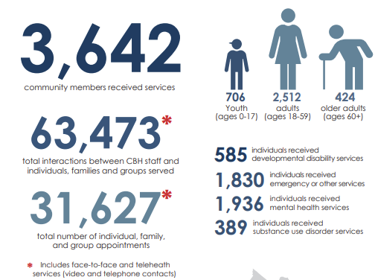
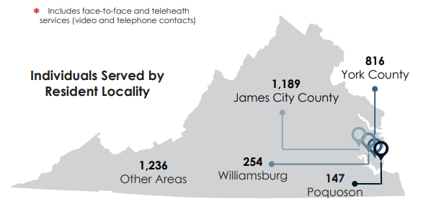

Colonial Behavioral Health
Source: Colonial Behavioral Health. FY2025 Annual Report. (n.d.) https://www.colonialbh.org/media/ib3ptxe0/cbh-fy2025-annual-report.pdf

Slide 7
Southeastern Virginia Health System
Southeastern Virginia Health System (SEVHS) provides high-quality, comprehensive, and affordable healthcare and wellness services to everyone.
For nearly 50 years, SEVHS has proudly served as a trusted healthcare partner throughout Southeastern Virginia. We are committed to improving the health and well-being of the individuals, families, and communities we serve by providing accessible, high-quality healthcare, promoting healthy lifestyles, and offering education and preventive services. Our dedication goes beyond medical care. We work to eliminate barriers to access, meet the unique needs of our diverse communities, and ensure that quality healthcare remains available and within reach for all.
Core Values
Quality Services
Professionalism
Compassion
Honesty
Respect
Patient-Centered Care
Source: Southeastern Virginia Health System (n.d.) Southeastern Virginia Health System: About Us. : https://sevhs.org/about-us/

Slide 8
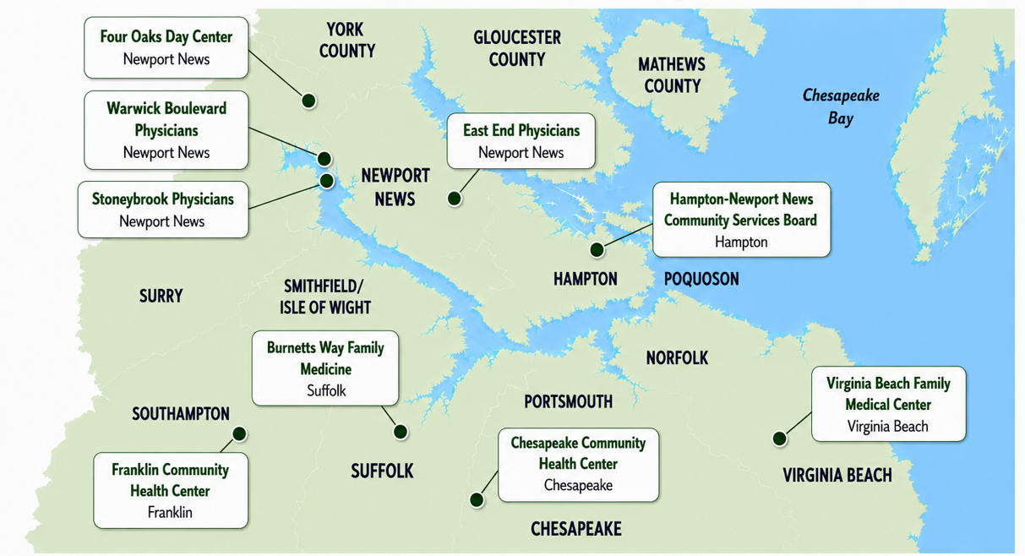
Southeastern Virginia Health System Sites
Source: Southeastern Virginia Health System: About Us. Southeastern Virginia Health System: https://sevhs.org/about-us/

Slide 9
Partnership at a Glance
Shared integrated vision: CBH + SEVHS are co‑creating a unified primary care & behavioral health model on donated land.
PCDC as strategic facilitator: Guiding partners from concept to operational reality through structured planning, training, and TA.
Ground‑up integration: Designing workflows, facility layout, and care delivery as one team rather than two co‑located organizations.
Responding to Virginia’s access gaps: This Partnership addresses statewide shortages in primary care and mental health providers.

Slide 10
Partnership at a Glance
Shared care model development: Joint workflows, integrated care training, and facility design aligned to whole‑person care.
Operational sustainability: Financial modeling + QI skill‑building to support long‑term viability.
Team mindset shift: Moving from “two organizations sharing space” to “one integrated team,” reflected in decisions like a shared waiting room.

Slide 11
Defining Integrated Care
Integrated care is defined as the provision and coordination by the treatment team of appropriately matched interventions for both physical health and behavioral health conditions in the setting in which the person is most naturally engaged.
All people served receive a comprehensive array of integrated services and interventions including primary and secondary prevention for their needs.
Integrated care improves:
  Patient experience
  Population health
  Costs
  Care team wellbeing
(National Council for Mental Wellbeing, 2025)
(National Council for Mental Wellbeing, 2025)

Slide 12
Integrated Care: Levels of Integration
Level 1 & 2
Key Element: Communication
Coordinated
  Primary Care and Behavioral Health work across healthcare settings to share information about a patient, facilitate access to care, and support care coordination.
Level 3 & 4
Key Element: Physical Proximity
Co-Located
  Behavioral health and primary care providers may share space in the same facility, but not necessarily the same practice space. Practice separately but collaborate for care delivery.
Level 5 & 6
Key Element: Transformation
Fully Integrated
  Whole-person integrated care with Behavioral Health, Mental Health, and/or Substance Use Disorder providers and Primary Care integrated into one setting. Care is coordinated as a single team, using a systematic method and care-delivery approach.
Source: Adapted from A Standard Framework for Levels of Integrated Healthcare, by B. Heath, P. Wise Romero, & K. Reynolds, 2013, SAMHSA-HRSA Center for Integrated Health Solutions. https://www.thenationalcouncil.org/wp-content/uploads/2020/01/CIHS_Framework_Final_charts.pdf

Slide 13
Co-Located Care: Level 3
Basic Collaboration Onsite
Core Descriptors
  Use separate systems
  In the same facility not necessarily the same offices
  Communication regularly about shared patients
Clinical Delivery & Patient Experience
  May agree on screening and assessment
  Separate service plans with some shared patient information with more formal referral system
  Patient treated separately at the same location
Practice/Organization & Business Model
  Supportive leadership in addressing barriers
  More buy-in to the concept of integration but not consistent across providers
  May share resources, funding sources, and facility expenses
Source: Adapted from A Standard Framework for Levels of Integrated Healthcare, by B. Heath, P. Wise Romero, & K. Reynolds, 2013, SAMHSA-HRSA Center for Integrated Health Solutions. https://www.thenationalcouncil.org/wp-content/uploads/2020/01/CIHS_Framework_Final_charts.pdf

Slide 14
Co-Located Care: Level 4
Close Collaboration Onsite with Some System Integration
Core Descriptors
  Share some systems--scheduling or medical records
  Collaborate, driven by a need for consultation and care coordination for patients
  Meet in-person regularly
Clinical Delivery & Patient Experience
  Agree on specific screening, based on ability to respond to results
  Collaborative treatment planning for specific patients
Practice/Organization & Business Model
  Patient needs are treated separately; collaboration might include warm hand-offs
  Patients are internally referred with better follow­ up
  May share office expenses, staffing costs, or infrastructure
Source: Adapted from A Standard Framework for Levels of Integrated Healthcare, by B. Heath, P. Wise Romero, & K. Reynolds, 2013, SAMHSA-HRSA Center for Integrated Health Solutions. https://www.thenationalcouncil.org/wp-content/uploads/2020/01/CIHS_Framework_Final_charts.pdf

Slide 15
Integrated Care: Level 5
Close Collaboration Onsite with Some System Integration
Core Descriptors
Actively seek system solutions together
Have an in-depth­ understanding of roles and culture
Clinical Delivery & Patient Experience
Collaborative treatment planning for all shared patients
Patient needs are treated as a team
Practice/Organization & Business Model
Organizational Leaders support integration if funding allows
Care is responsive to identified patient needs by a team
In the same space within the same facility
Communicate frequently in person
Blended funding based on contracts, grants, or agreements
Billing function combined or agreed upon process
Source: Adapted from A Standard Framework for Levels of Integrated Healthcare, by B. Heath, P. Wise Romero, & K. Reynolds, 2013, SAMHSA-HRSA Center for Integrated Health Solutions. https://www.thenationalcouncil.org/wp-content/uploads/2020/01/CIHS_Framework_Final_charts.pdf

Slide 16
Integrated Care: Level 6
Full Collaboration in a Transformed/ Merged Integrated Practice
Core Descriptors
Shared practice space
Clinical Delivery & Patient Experience
Population-based medical and behavioral health screening is standard practice
Practice/Organization & Business Model
Leaders strongly support integration as a practice model
Communicate consistently at the system, team
Have formal and informal meetings
All patient needs are treated by a cross-functional team
Seamless communication with patient about all healthcare
Integrated funding and shared resources across the whole practice
Integrated care embraced by all providers
Source: Adapted from A Standard Framework for Levels of Integrated Healthcare, by B. Heath, P. Wise Romero, & K. Reynolds, 2013, SAMHSA-HRSA Center for Integrated Health Solutions. https://www.thenationalcouncil.org/wp-content/uploads/2020/01/CIHS_Framework_Final_charts.pdf

Slide 17
Integrated Care Concept Planning
Together, CBH and SEVHS, seek to develop a highly integrated outpatient primary care/behavioral health practice in a newly developed facility.
To guide planning, consensus building, and implementation efforts, the organizations are participating in:
  Educational Sessions
  Strengths-Based Infrastructure Assessment
  Integrated and Team-Based Care Training
  Physical and Space Layout Strategy
  Policy, Script, and Workflow Development
  Business Operations, Accounting, and Revenue Cycle Analysis
  Quality Improvement Education and Activities
    Plan Do Study Act Cycles
  Program Piloting

Slide 18
Considerations and Lessons Learned

Slide 19

Key Themes
Readiness
Partnership
Visioning
Communication
Care Delivery
Looking to the Future

Slide 20
Readiness
Internal
Organizational Culture
Leadership
Staff
Technology
Communication
External
Payers
Regulatory Requirements
Funders
Financial
Expenses
Revenue
Debt
Cash Burn Rate
Cash on Hand
Projections and Forecasting
Source: Ternay, J. (2019). Roadmaps to Value-Based Profitability: A Practice Transformation Guide. Medical Group Management Association.

Slide 21

Partnership
Factors that influence partnership:
  Mission Alignment
  Value Alignment
  Accountability
  Organizational Culture
  Community Connection
Lessons learned:
  Foster formal and informal communication
  Explore existing workflows and service offerings
  Bring the team together

Slide 22

Visioning
What does integrated care mean to me?
  “It’s like Walmart. You can get everything you need in one place.”
  “It’s fluid, everything should flow seamlessly.”
  “It shouldn’t be disjointed.”
  “You can’t heal the body without healing the mind.”
What does integrated care mean to patients, clients, and our community?
  “Building relationships throughout a person’s life will ensure they get the help they need before they are in crisis.”
  “No wrong door, regardless of whether the person needs psychosocial supports or medical care.”
  “Allows you to think outside of the box.”
  “Everyone is coming from a position of healing.”
Lessons learned:
  Set clear expectations around integrated care and associated roles.

Slide 23
Communication
Factors that influence communication:
  Education + Training
  Geography
  Social Networks
  Roles
  Past Experiences
  Processing Style
Lessons learned:
  Center patients
  Lean into your organization’s vision for integrated care
    Say it loud, Say it often
  Create a formal feedback loop that engages leadership and team members
  Clearly outline expectations

Slide 24
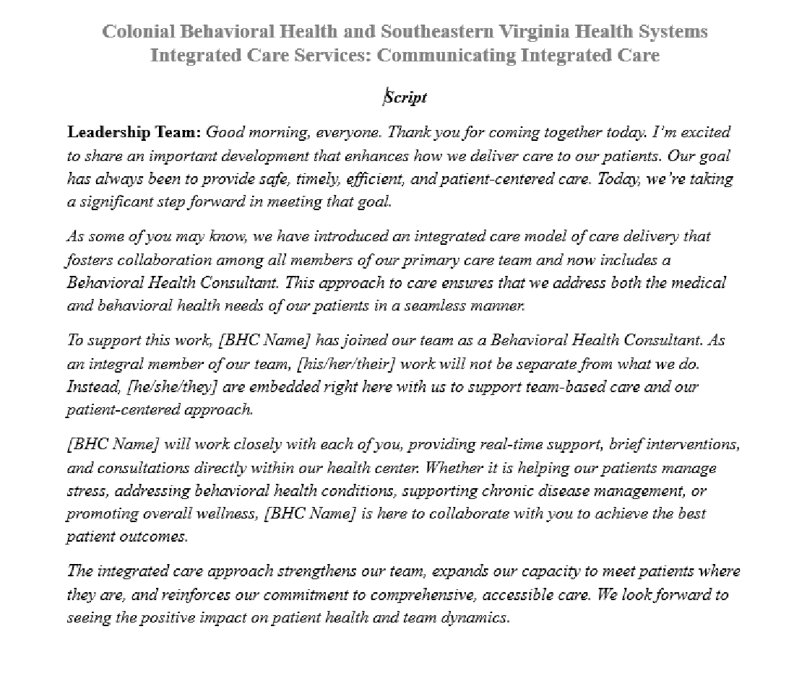
Communication - Scripting
Source: Primary Care Development Corporation, 2026, Communicating Integrated Care Script, Developed for CBH and SEVHS Integrated Concept Planning.

Slide 25
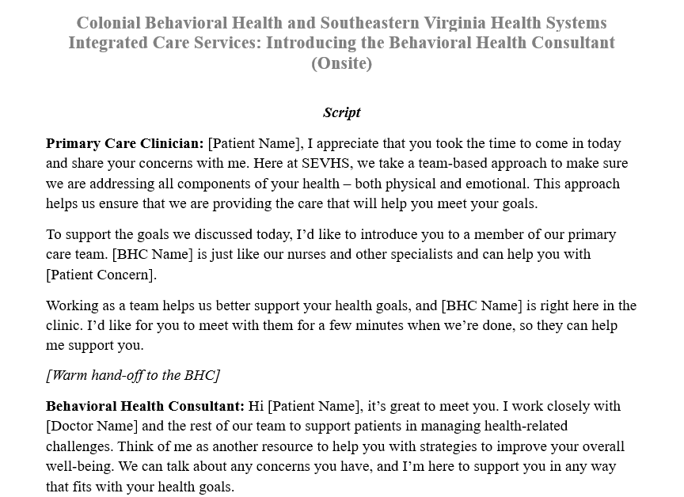
Communication - Scripting
Source: Primary Care Development Corporation, 2026, Introducing the Behavioral Health Consultant Script, Developed for CBH and SEVHS Integrated Concept Planning.

Slide 26
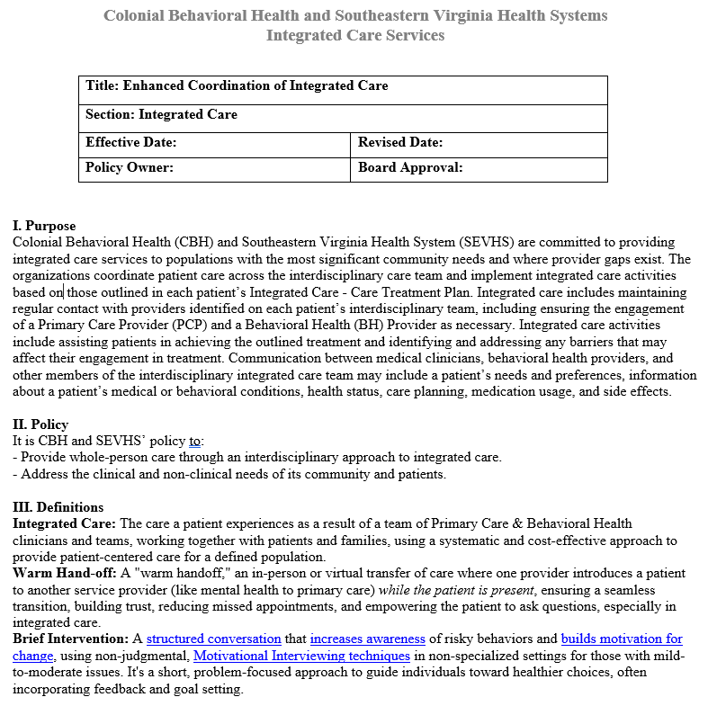
Integrated Care Delivery
Factors that influence integrated care delivery:
  Understanding integrated care and how it differs from current care models
    Brief Interventions v. Traditional Therapy
  Communication across disciplines
  Accessibility
  Ability to pivot
Lessons learned:
  Implement small tests of change
  Start small and scale up
  Role clarity is critical
    Setting expectations
    Impact on hiring
  Flexibility is key
Source: Primary Care Development Corporation, 2026, Integrated Care Services Policy, Developed for CBH and SEVHS Integrated Care Concept Planning.

Slide 27
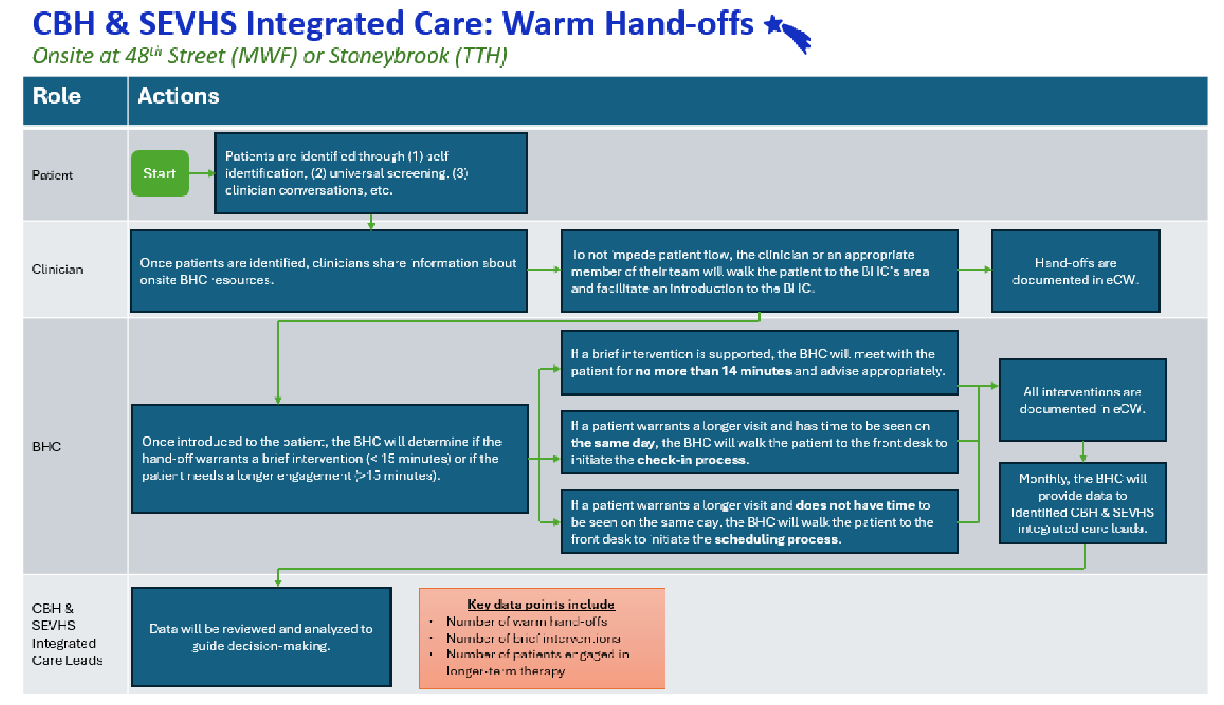
Integrated Care Delivery – Testing Change
Source: Primary Care Development Corporation, 2026, Warm Hand-off Workflow, Developed for CBH and SEVHS Integrated Concept Planning.

Slide 28

Information Sharing
The goal is not “one system at all costs,” but shared information that supports safe, coordinated care while honoring confidentiality and patient choice.
Consider operational trade-offs of dual vs. single system models
  Dual‑system setups protect privacy but create friction: more clicks, more documentation time, and more opportunities for care coordination gaps.
  Single‑system setups (like the site using one shared EHR) streamline workflows and support whole‑person care but require strong role‑based access controls and clear staff training to maintain trust.
Workflow + coordination impact
  Separate systems increase burden and risk for missed information
Role‑based access is evolving
  Consider whether the EHR allows granular permissions, segmented notes, and consent‑driven access.
Source: 42 CFR Part 2 (Final Rule, 2024)
Source: 42 CFR Part 2 (Final Rule, 2024)

Slide 29

How will CBH + SEVHS continue to come together?
They will:
  ideate,
  develop,
  test,
  revise,
  refine
  implement, and
  spread their care delivery model to provide services that link the physical, behavioral, and social needs of the individuals in their catchment areas.

Slide 30
Key Takeaways

Slide 31
Key Takeaways
Integrated care concept planning and implementation will ebb and flow.
Communication and formal feedback loops are critical to ensuring that team members are on the same page, and that pivoting can take place in real time when needed
Engage teams early, use excitement to identify champions, and lean into the work.
Implement Plan, Do, Study, Act cycles with the goal of starting small and scaling up.
One size doesn’t fit all; explore what works across organizations and teams.
Organizations will evolve over time.

Slide 32

Questions + Discussion

Slide 33
Contact Me
Shannon Lea
Senior Program Manager
Primary Care Development Corporation
slea@pcdc.org

Slide 34
Thank You!

Slide 35
References
Colonial Behavioral Health (2024, April). Strategic Plan. https://www.colonialbh.org/media/5ewf0xzc/strategic-plan-april-2024.pdf
Colonial Behavioral Health. FY2025 Annual Report. (n.d.) https://www.colonialbh.org/media/ib3ptxe0/cbh-fy2025-annual-report.pdf
National Council for Mental Wellbeing (n.d.) A Standard Framework for Levels of Integrated Healthcare, by B. Heath, P. Wise Romero, & K. Reynolds, 2013, SAMHSA-HRSA Center for Integrated Health Solutions. https://www.thenationalcouncil.org/wp-content/uploads/2020/01/CIHS_Framework_Final_charts.pdf
National Council for Mental Wellbeing. (2025). The comprehensive health integration framework. https://www.thenationalcouncil.org/resources/the-comprehensive-health-integration-framework/
Primary Care Development Corporation, 2026, Introducing the Behavioral Health Consultant Script, Developed for CBH and SEVHS Integrated Concept Planning
Primary Care Development Corporation, 2026, Warm Hand-off Workflow, Developed for CBH and SEVHS Integrated Concept Planning

Slide 36
References
Community Health Center of the New River Valley. (n.d.). About. https://chcnrv.org/about/
Heath, B., Wise Romero, P., & Reynolds, K. (2013). A standard framework for levels of integrated healthcare. SAMHSA-HRSA Center for Integrated Health Solutions. https://www.thenationalcouncil.org/wp-content/uploads/2020/01/CIHS_Framework_Final_charts.pdf
Lynn, K. (2025, May 22). New River Valley Health Center expands, promises affordable care for more patients. WSLS. https://www.wsls.com/news/local/2025/05/22/new-river-valley-health-center-expands-promises-affordable-care-for-more-patients/
National Council for Mental Wellbeing. (2025). The comprehensive health integration framework. https://www.thenationalcouncil.org/resources/the-comprehensive-health-integration-framework/

Slide 37
References
Colonial Behavioral Health (2024, April). Strategic Plan. https://www.colonialbh.org/media/5ewf0xzc/strategic-plan-april-2024.pdf
Colonial Behavioral Health. FY2025 Annual Report. (n.d.) https://www.colonialbh.org/media/ib3ptxe0/cbh-fy2025-annual-report.pdf
National Council for Mental Wellbeing (n.d.) A Standard Framework for Levels of Integrated Healthcare, by B. Heath, P. Wise Romero, & K. Reynolds, 2013, SAMHSA-HRSA Center for Integrated Health Solutions. https://www.thenationalcouncil.org/wp-content/uploads/2020/01/CIHS_Framework_Final_charts.pdf
Primary Care Development Corporation, 2026, Introducing the Behavioral Health Consultant Script, Developed for CBH and SEVHS Integrated Concept Planning
Primary Care Development Corporation, 2026, Warm Hand-off Workflow, Developed for CBH and SEVHS Integrated Concept Planning

Slide 38
References
(n.d.). Southeastern Virginia Health System: About Us. Southeastern Virginia Health System: https://sevhs.org/about-us/
Substance Abuse and Mental Health Services Administration. (2024). Confidentiality of substance use disorder patient records (42 CFR Part 2). U.S. Department of Health and Human Services.

