Slide 1

CRISIS COMMUNICATION & CONTINUITY OF CARE
Practical Tools for Small Health Centers Facing Real-World Disruptions
Scott Cormier | Virginia Hospital & Healthcare Association

Slide 2
Session Objectives
Communicate clearly with staff and patients during disruptions
Maintain patient trust when normal systems are unavailable
Identify and prioritize essential services
Plan realistically for continuity with limited resources

Slide 3
Why This Matters
Trust declines quickly when communication is delayed or inconsistent
Disruptions change where and how patients seek care
Small clinics often have limited staffing and technology redundancy
Patients rely on consistency, even in a crisis

Slide 4

Crisis Communication, Defined
Timely, accurate information
Reaches internal and external audiences
Consistent messaging across every channel
Action-oriented guidance, not just updates

Slide 5
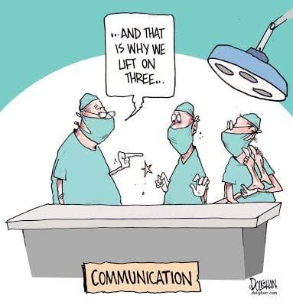
Common Communication Failures
Delayed messaging
Conflicting information from different sources
No clear spokesperson
Overreliance on a single piece of technology

Slide 6

Communication Priorities Under Pressure
1
2
3
4
Life Safety
Operational Status
Service Availability
Next Steps for Patients
Address immediate safety needs first
What's working, what isn't
What care is still accessible
Clear direction on what to do

Slide 7

Know Your Audiences
Staff – need direction and role clarity
Patients – need reassurance and next steps
Partners – need shared situational awareness
Public and media – need one consistent, accurate voice

Slide 8

Internal Communication
Rapid staff notification
Clear, specific instructions
Defined roles and responsibilities
Frequent, honest updates

Slide 9

External Communication
Patient notifications
Service changes
Alternate care options
Reassurance messaging

Slide 10
Low-Tech Communication Strategies
Phone Trees
Printed Contact Lists
Signage
In-Person Briefings
Use when digital tools are limited or unavailable
Use when digital tools are limited or unavailable
Use when digital tools are limited or unavailable
Use when digital tools are limited or unavailable

Slide 11
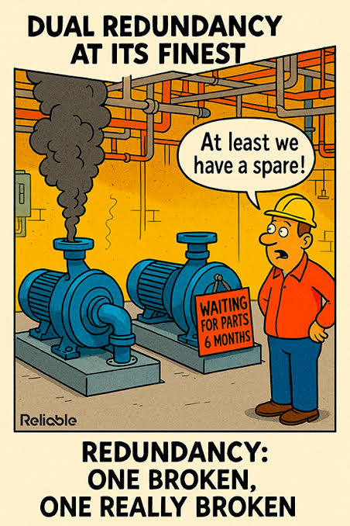
Build In Redundancy
Backup contact lists
Multiple communication methods
Manual, paper-based processes
Pre-scripted message templates

Slide 12



Designing the Message
Clear and concise
Actionable instructions
Consistent language across channels
Repeat key points

Slide 13

The Spokesperson Role
Single point of truth
Trained, designated representative
Consistent messaging, every time
Coordinates closely with leadership

Slide 14

From Communication to Continuity
Keeping essential care running when normal systems are unavailable

Slide 15
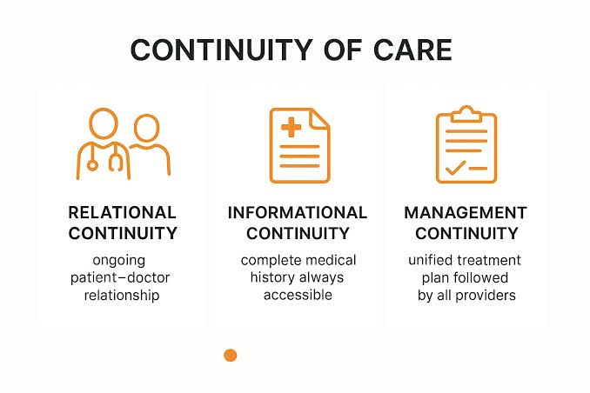
Continuity of Care, Defined
Maintain essential services
Minimize the impact of disruption
Adapt operations to available resources
Support ongoing patient needs

Slide 16
Identify & Prioritize Essential Services
1
2
3
4
Life-Saving Treatments
Critical Medications
Urgent Care Needs
High-Risk Patients
Highest priority, never paused
Ongoing prescriptions patients depend on
Time-sensitive but not life-threatening
Require closer monitoring or follow-up

Slide 17
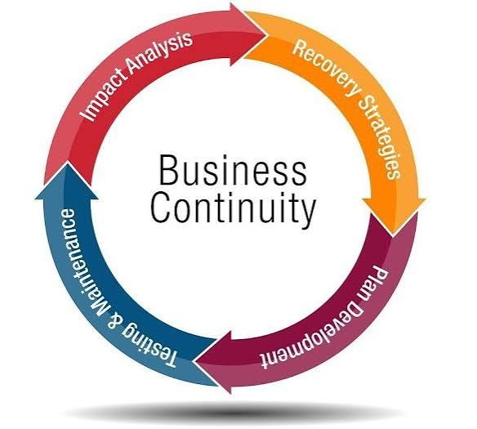
Continuity Planning Basics
Prioritize services in advance
Identify minimum staffing needs
Plan alternate workflows
Document simple, usable plans

Slide 18

Operating Under Disruption
Reduced staffing
Limited systems and technology
Supply constraints
Space limitations

Slide 19

Alternative Care Strategies
Reschedule non-urgent care
Refer or transfer patients when needed
Use partner and coalition resources
Expand hours if feasible

Slide 20
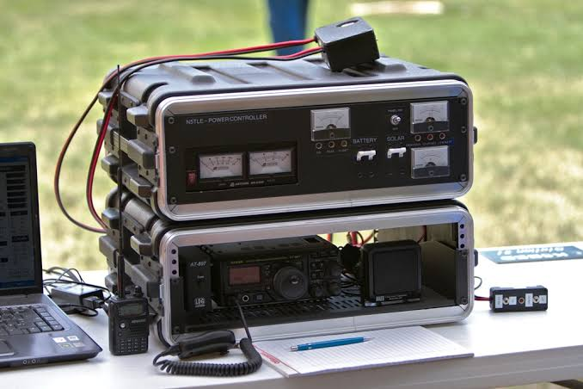
Patient Communication During Disruption
Status updates
Where to seek care
Expected delays
Reassurance

Slide 21

Coordination with Partners
Public health agencies
Hospitals and EMS
Regional healthcare coalitions
Shared awareness and clear referral pathways

Slide 22

Common Pitfalls to Avoid
No backup communication method
Trying to do too much at once
Unclear priorities under pressure
Poor documentation of decisions

Slide 23

Scenario Exercise
Scenario: IT outage or cyberattack – phones and EHR are down
Question 1: What’s your plan for the first 60 minutes?
Question 2: Which services keep running, and which pause?
Discuss in small groups, then report back

Slide 24

Key Takeaways
Keep communication simple and consistent
Plan for no-tech scenarios
Prioritize essential services in advance
Coordinate with partners early

Slide 25
Questions & Discussion
What are the current gaps in your communication plan?
What tools or resources do you still need?
What can you simplify right away?
What's your next step after today?

Slide 26


Thank You
Scott Cormier, VP Emergency Preparedness: scormier@vhha.com

