Slide 1
Food is Medicine
Addressing Patient Health-Related Social Needs through Food Pharmacy

Slide 2



Presenters
Maria Bowman, MPH
Blue Ridge Area Food Bank
Allison Hallberg, MHS
Feed More
Emily Lagerquist, MPH
Blue Ridge Medical Center
Notes:
Maria

Slide 3
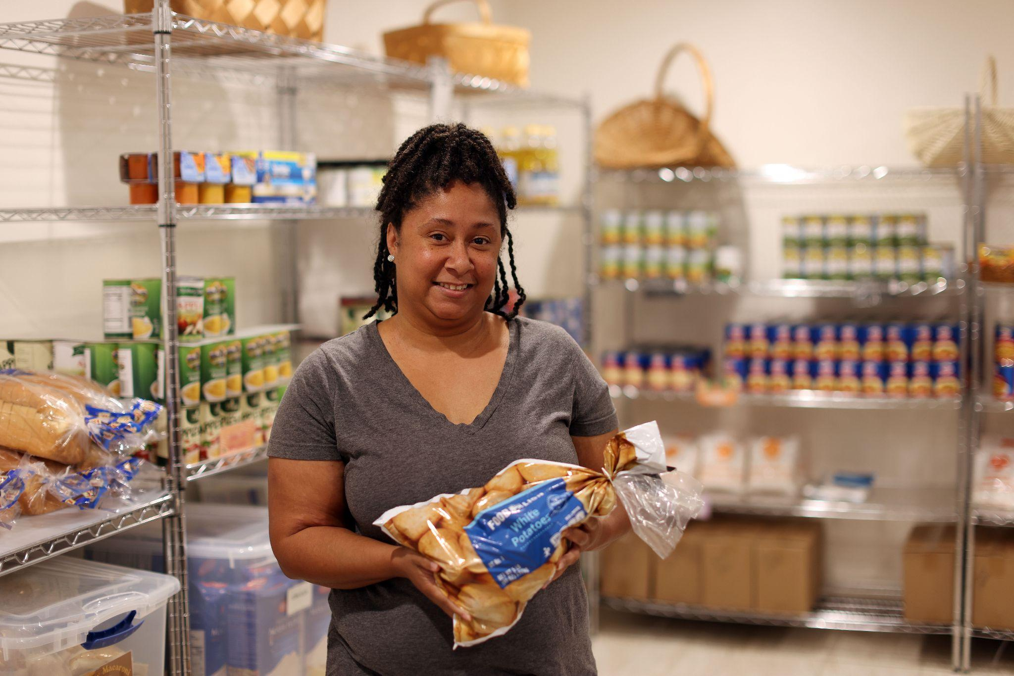
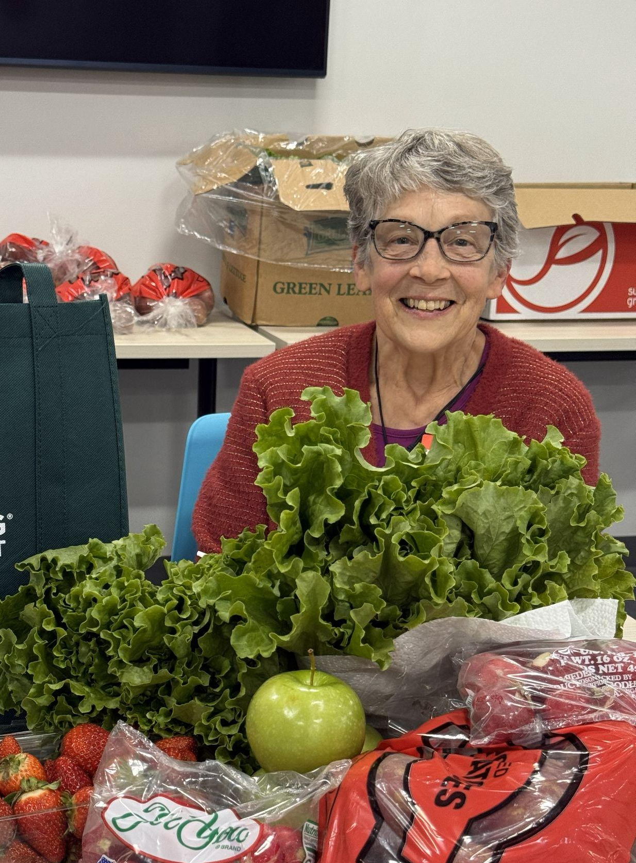
Our “Why”: Patients
“The Food Pharmacy is my blessing place.”
“Coming to the Food Pharmacy has encouraged me to cook more and try new recipes that I have enjoyed!”
“I have been able to reach my health goals and it is much easier for me to walk!”
“This is the best help I have received in a long time”
Notes:
Emily
Add animations
Add testimonials and narratives (5 min for patient stories total)
-Demographics
Elderly 65+
-Needs/challenges
Transportation, Illiterate, Health illiteracy, less pain
-Value of the program
One-stop shop, free choice pantry

Slide 4
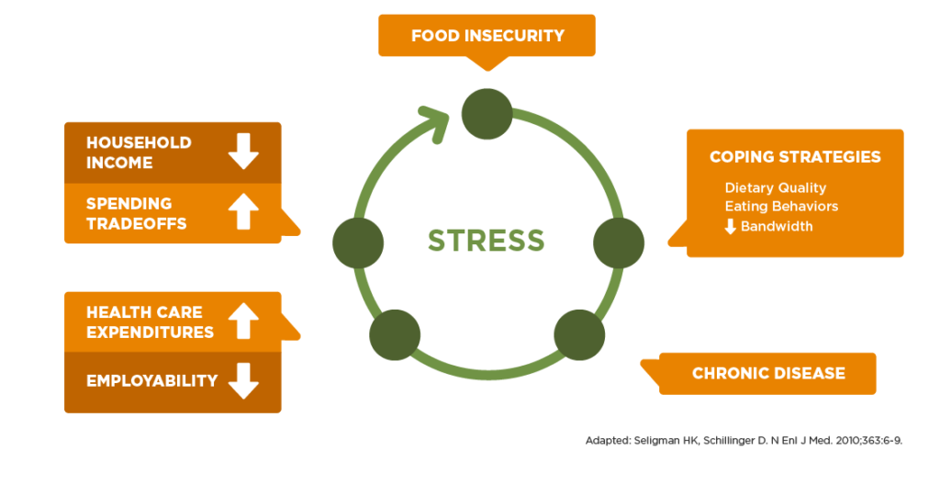
The Connection Between Food Insecurity and Health
Notes:
Maria
X% of Virginias are food insecure (use updated Hunger Study data if not embargoed)

Slide 5
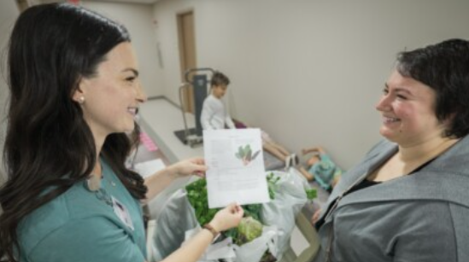
What is “Food is Medicine”?
Food is Medicine Interventions:
include a spectrum of programs and services that respond to the critical link between nutrition and health.
include food that both:
  supports health, such as medically tailored meals (MTMs) or groceries (MTGs), and
  Has a nexus to the healthcare system.
Notes:
Maria

Slide 6
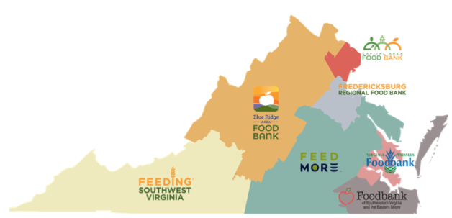
Federation of Virginia Food Banks
Mission​
Facilitate statewide collaboration among Virginia’s 7 food banks, community partners, and neighbors to improve nutrition security and empower strong, healthy communities.​
​
Vision​
A healthier, food secure Virginia.​
​
Impact​
700,000+ individuals served annually​
Through 2,000+ local distributing partners ​
Reaching 100% of Virginia zip codes
Notes:
Allison

Slide 7
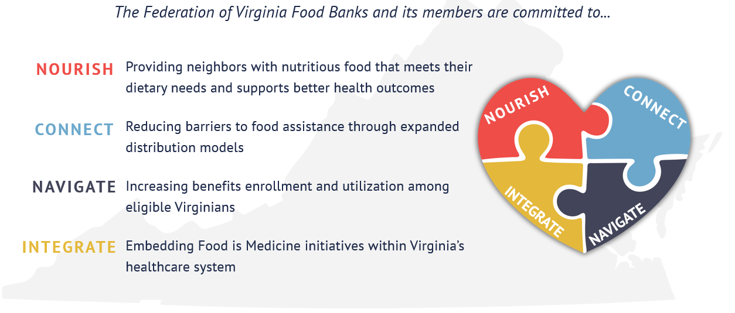
Federation Food is Medicine Strategy
Notes:
Allison

Slide 8
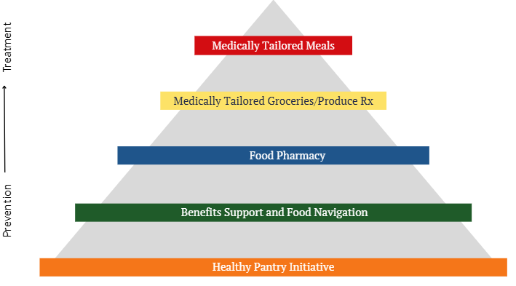
Food is Medicine Pyramid - Food Bank Offerings
Piloting - available in some regions
Piloting - available in some regions now and through RHTP Pilot 2026 & HRSN ENS
Offering Across State
Offering Across State
Offering Across State
Notes:
Allison
Key Virginia Food Bank FIM Progress
All food banks have at least 1 health-focused staff member
All food banks now have documented nutrition policies, outlining plans to source more “green” foods
Expanded Food Pharmacy program by nearly 100%, now 97 locations reaching >55,000 patients annually
Created statewide Healthy Pantry Initiative
Since then, 70% pantries opting into Healthy Pantry Initiative, committing to implement more health-focused practices, resulting in HPI practice implementation growth by 22% from 2023 - 2025.
28 total trainings now available for pantry partners in HPI Learning Center
All 7 food banks actively receive referrals from healthcare and use the Unite Virginia platform
5 food banks offer dedicated benefits support
4,631 neighbors served; 79% of needs resolved

Slide 9
Existing Food Bank + CHC Partnerships
Blue Ridge Medical Center
Capital Area Health Network
Clinch River Health Services
CVHS (5 sites)
Healthy Communities Health Center: Stone Port
Johnson Health Center (2 sites)
Tri-Area Community Health
Aligned Goals and Connected Care
Our Food Pharmacy programs brings together CHC clinicians, food banks, and community resources to treat the whole person, not just their symptoms, making healthy food a central part of healthcare.
Notes:
Allison

Slide 10
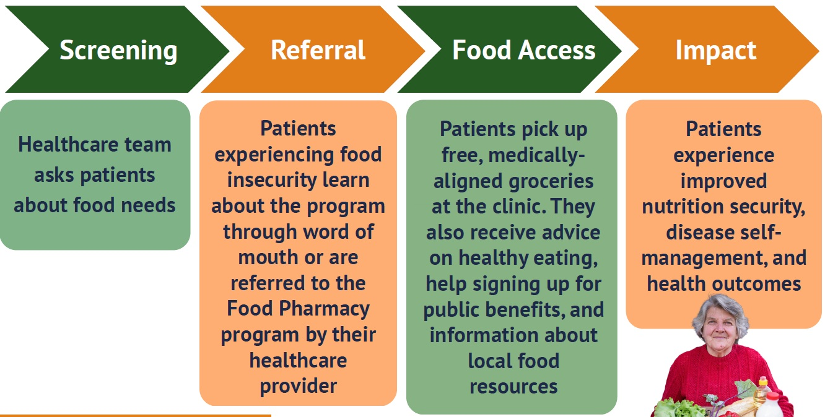
Food Pharmacy Overview
Across VA Food Banks:
102 clinic locations
  11 CHC sites
50,000+ patient visits annually
Notes:
Maria

Slide 11



Food Pharmacy: Win, Win, Win
Value to Patients
Value to Clinicians
Value to Healthcare
Better adherence to treatment plans​
Greater food & nutrition security​
Lower stress, anxiety & financial trade-offs​
Support managing long-term conditions​
More consistent SDOH screening & referral​
Easier to address food needs during visits​
Higher job satisfaction & retention​
Food is a top need in Community Health Assessments​
Lower healthcare costs & utilization​
Improved overall patient health​
*Based on evaluation conducted in Fall 2025 at 21 Food Pharmacy locations including 353 patients, 83 clinicians, and 7 healthcare leaders.
Notes:
Maria
•86% of patients recommend the program to other patients
•95% of clinicians recommend the program to other hospitals/ clinics

Slide 12

Food Insecurity Screening Best Practices
Screen:
When it makes sense within the clinical flow
Consistently; stick to a cadence
In a discrete location
Without assumption or judgement
Using a validated tool
Add a self-referral pathway
Notes:
Maria

Slide 13
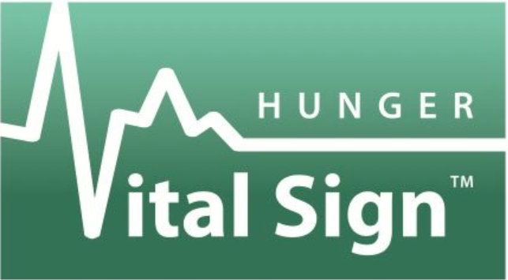
Validated Screening Tool: Hunger Vital Sign
Two-question tool:
“Within the past 12 months we worried whether our food would run out before we got money to buy more.” Often / Sometimes / Never True.
“Within the past 12 months the food we bought just didn’t last and we didn’t have money to get more.” Often / Sometimes / Never True.
*Patients are considered food insecure if they reply "Often" or "Sometimes" to one or both questions.
Notes:
Maria

Slide 14
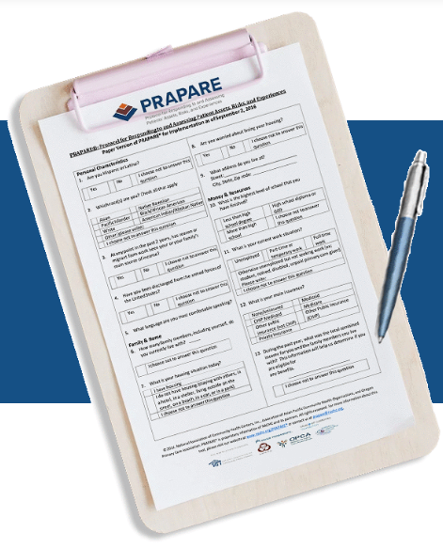
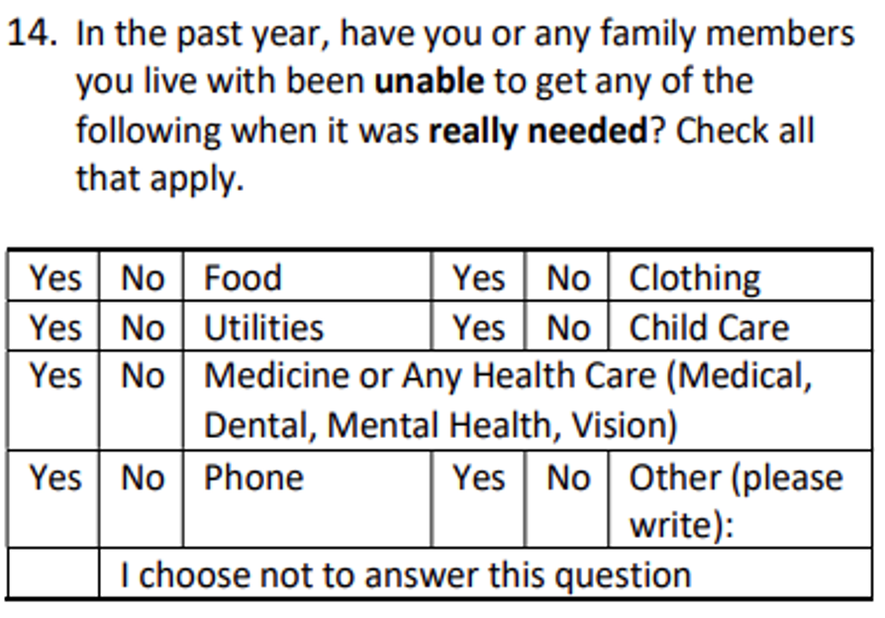
Validated Screening Tool: PRAPARE
Protocol for Responding to and Assessing Patients’ Assets, Risks and Experiences (PRAPARE)
Used to identify factors like housing instability, food insecurity, and lack of transportation, which can impact health outcomes.
Question 14 includes food
Notes:
Maria

Slide 15
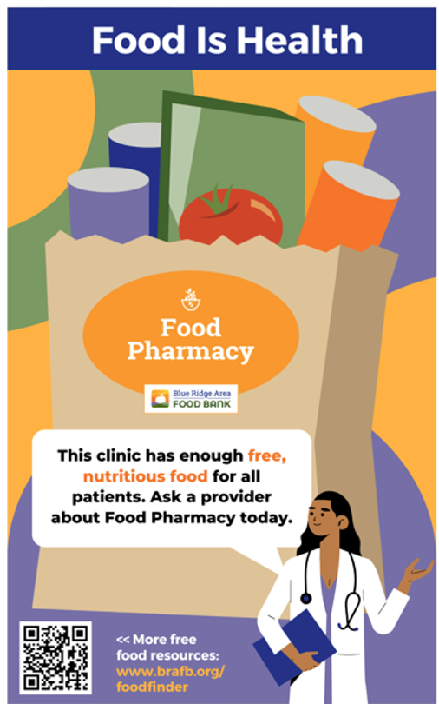
Food Insecurity Self-Referral
Self-Referral Benefits:
Increases self-determination and dignity
Simple to add to other screening systems
Identifies otherwise "missed" F.I. patients
Self-Referral Options:
Poster in waiting area or clinical room
Text a designated number
Form – give to provider or reception
Notes:
Maria

Slide 16

Food Referral Best Practices
Refer to Food Resources:
That are accessible for the patient
That accommodate the patient's' family and cultural needs
For today
For longer-term needs
You know and trust (ideal)
Examples:
On-site food program like Food Pharmacy
Community food pantries (use food bank website tools)
SNAP, WIC (most Food Banks offer support)
Notes:
Maria

Slide 17
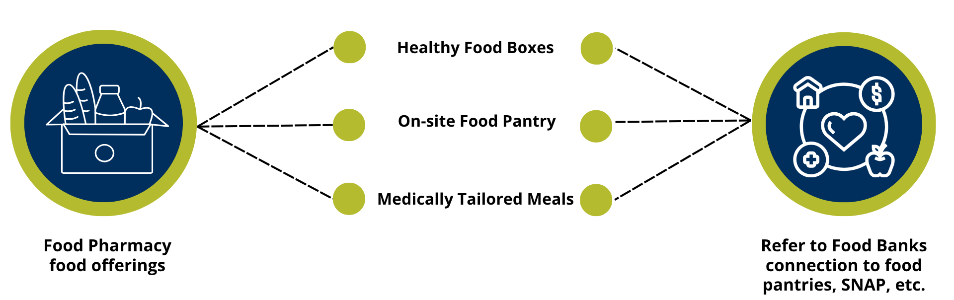
CHC + Food Bank Partnership Models
Each Food Pharmacy is unique based on the site’s available food program staff, space & time
Notes:
Allison

Slide 18
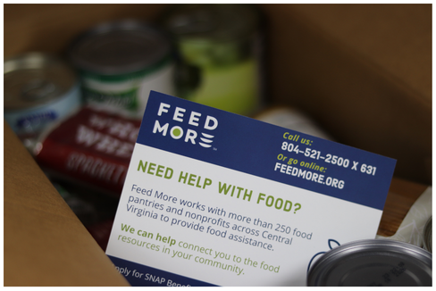


CHC + Food Bank Partnership Examples
Feed More’s Food is Medicine Program
Focused Food Pharmacy support in Tri-Cities and rural localities in Central Virginia
Healthy Food Box model:
  Pre-packed food boxes full of shelf-stable whole grains, lean proteins, and low/no-sodium and low/no-sugar fruits & vegetables
  3 menus curated with guidance from the Healthy Eating Research (HER) guidelines and a registered dietitian
Notes:
Allison

Slide 19
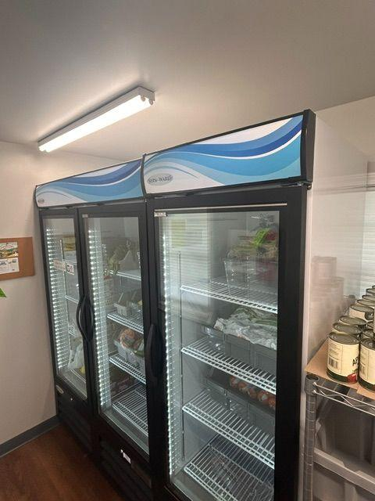
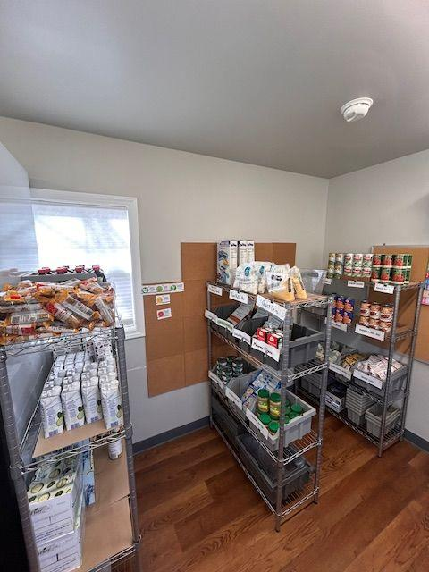
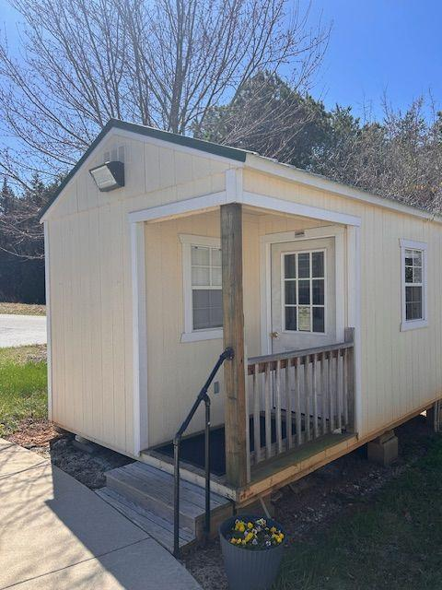
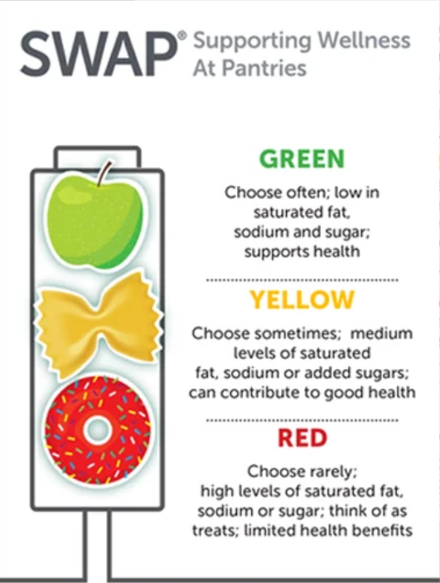
CHC + Food Bank Partnership Examples
Welcome to the Blue Ridge Medical Center Food Pharmacy Cottage!
Notes:
BRAFB + Blue Ridge Medical Center
Add stoplight system
BRMC Program Overview
partnership with humana, university of virginia, foodsmart, brafb, and brmc
free choice pantry for eligible patients
patients are identified through multiple avenues
in exam room during visits with provider, with our AmeriCorps team conduction social drivers of health assessments, and identifying patients in electronic health records following up with calling patients and sending letters
Stoplight system, healthy food choices, free choice pantry, SNAP, food finder

Slide 20
Firsthand CHC Food Pharmacy Insights
Key Considerations
Data
  Patient Demographics, Assess Community Needs, Patient Feedback, Reports, and Barriers to Care
Support
  Staff, Leadership, Stakeholders, and Strategic Partnerships
Collaboration
  Food Banks, Staff, Local Gardens, and Community Organizations
Operations
  Supplies, Equipment, Procedures, Food Items, and Systems
Workflow
  Attendance, Recruitment, Promotion, Deliverables, Internal, and External Communication
Support
Data
Collaboration
Workflow
Operations
Notes:
Emily
support, operations, workflow, recruitment, collaboration, and creativity
Key Considerations for food pharmacies
support from management and team
find what works for you and your organization! Work with BRAFB or FeedMore to tailor your program for the patients and your staff
supplies, staffing, workflow, and recruitment
Value to Patients and CHC
Patient testimonials, Nourishing Neighbors (nutrition classes), convenience for patients, trusted relationships, collaboration within departments and community, food Insecurity assistance through BRAFB boxes, and partnerships with local gardeners\
Continued collaboration
SNAP trainings, volunteering, IAC, attending forums, site visits, monitoring, and information sharing, staying in communication, honesty
Volunteer Opportunities
AmeriCorps Involvement, and serving at BRAFB
look out for grant opportunities

Slide 21
Future Reimbursement Potential: Medically Tailored Groceries
Goals:
A reimbursable food is medicine program that improves health outcomes and nutrition security, reduces healthcare utilization, and saves payers (including Medicaid) money
Leverage Rural Health Transformation funding for MTG infrastructure
MTG Model:
Eligibility: Food insecure + chronic condition (likely heart disease, hypertension and/or diabetes)
Referral: To centralized Virginia MTG Support Hub for enrollment
Participants Receive:
  6 months of medically tailored pantry stables + fresh produce (2x/mo.)
  Nutrition education
  “Offboarding”: SNAP support, pantry navigation
10 pilot sites beginning early 2027
Notes:
Maria
Next step - reach out to food bank to explore partnership. Food bank, VCHA???, or your CHC may have funding to support this work.

Slide 22
HRSA - Expanding Nutrition Services Grant
Overview:
357 CHC grants of up to $350,000 awarded over 2 years
Increase nutrition access to help to prevent, manage, and treat diseases and conditions through nutritional and food-based interventions
Increase the # of nutrition services patients or visits captured in the Uniform Data System
HRSA - ENS Model:
Funding to integrate FIM interventions into clinical supports and workflow, while capturing clinical outcomes
  Pairing food alongside a clinical visit when food insecurity is identified
  Pairing food alongside nutrition counseling and chronic disease management programs
  Pairing clinical services along with food distribution
  Incorporating delivery to address transportation and other food access barriers
Notes:
Maria
Next step - reach out to food bank to explore partnership. Food bank, VCHA???, or your CHC may have funding to support this work.

Slide 23
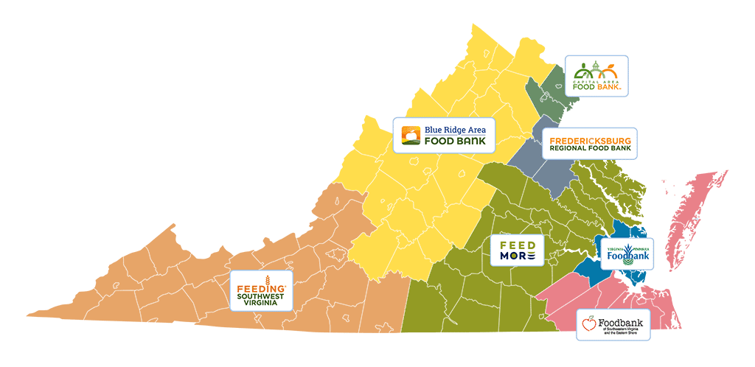

Connect with Your Local Food Bank
Visit: vafoodbanks.org/find-food/
Connect with the Health and Nutrition staff and express interest in partnership
Notes:
I (Maria) can kick us off with intros. I will intro myself and then ask you two to intro yourselves briefly. Name, role, org, and your key food is medicine responsibilities in your role. (2-3 min each)
Then, I can frame our conversation and do a little “show of hands if you are a…” activity to see who’s in the room. Raise your hand if you’re a: CHC administrator, CHC healthcare provided, CHC patient care or advocate role, CHC food or nutrition-focused role, not a CHC staffer at all :)... (3 min)

Slide 24
Contact Information
Maria Bowman, MPH
Blue Ridge Area Food Bank
mbowman@brafb.org
Allison Hallberg, MHS
Feed More
ahallberg@feedmore.org
Emily Lagerquist, MPH
Blue Ridge Medical Center
e.lagerquist@brmedical.com
Notes:
I (Maria) can kick us off with intros. I will intro myself and then ask you two to intro yourselves briefly. Name, role, org, and your key food is medicine responsibilities in your role. (2-3 min each)
Then, I can frame our conversation and do a little “show of hands if you are a…” activity to see who’s in the room. Raise your hand if you’re a: CHC administrator, CHC healthcare provided, CHC patient care or advocate role, CHC food or nutrition-focused role, not a CHC staffer at all :)... (3 min)

Slide 25
Q & A

Slide 26
Thank You!

