Slide 1


Slide 2


MEET THE PRESENTER
TEHRIM NASEER, DDS, MHA
CHIEF DENTAL OFFICER (CDO)
CAPITAL AREA HEALTH NETWORK
🦷 Licensed Dentist with 9+ years of clinical experience
🏥 CDO overseeing clinical operations, quality, compliance, and access initiatives within CAHN
🏆 Recipient of the Virginia Community Healthcare Association (VCHA) Dentist of the Year Award
Passionate about improving access to oral healthcare through leadership, innovation, operational excellence, and community partnerships.

Slide 3
YOU ARE THE DENTAL DIRECTOR?!
What Would You Do?
CURRENT CRISES
🔴 Dentist Resigned
🔴 2-Month Wait List
🔴 30% No-Shows
🔴 Hygienist Vacancy
🔴 Budget Constraints
🔴 CEO Deadline
📈INVESTMENT OPTIONS
Hire Dentist
Hire Hygienist
Expand Hours
Tele-dentistry
Outreach Programs
Patient Navigator
Appointment Reminders
Mobile Dental Services
$100,000 BUDGET
90 DAYS TO IMPROVE ACCESS
🟨 DISCUSSION: What are your TOP 3 choices and WHY? (2 Minutes)

Slide 4
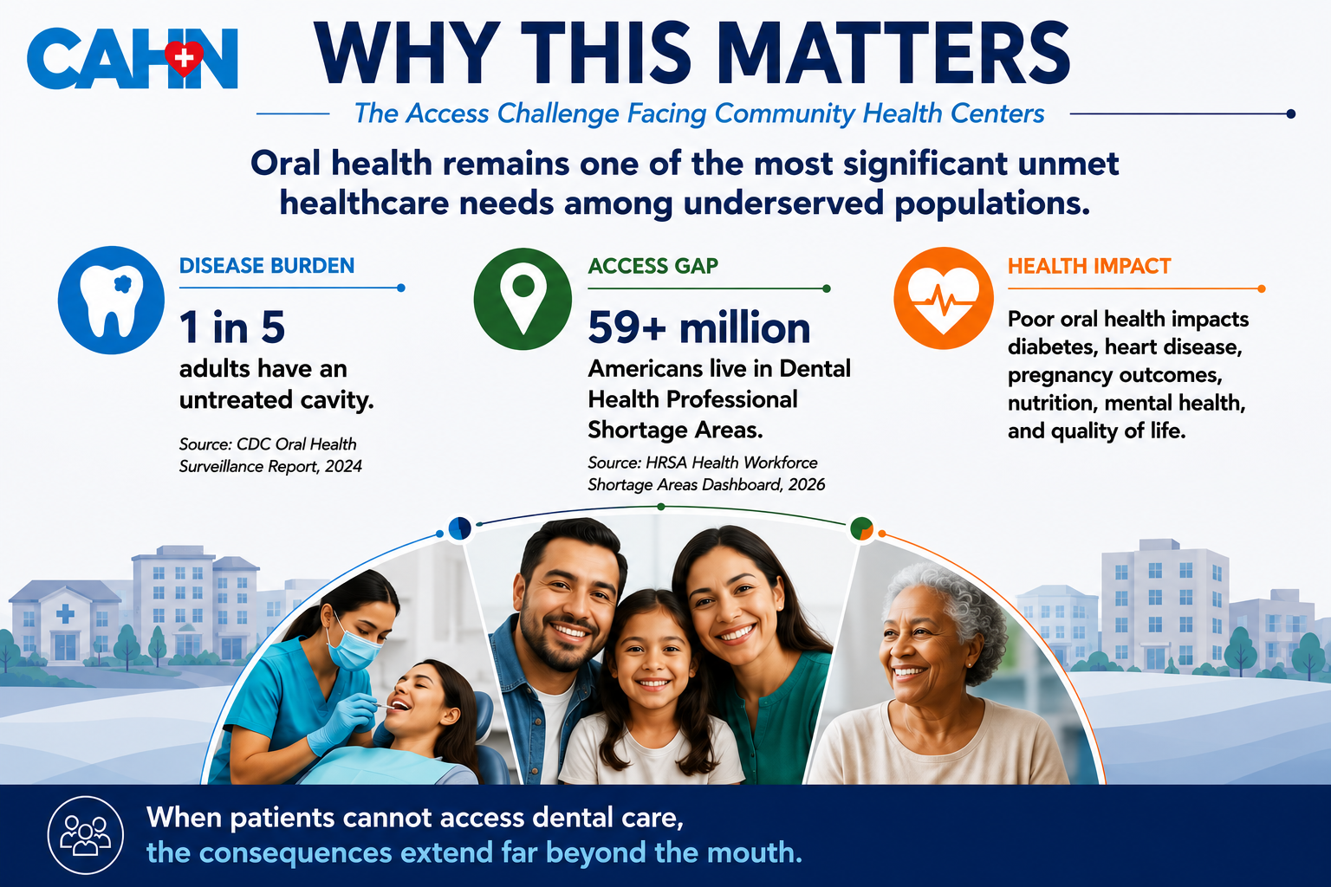

Slide 5
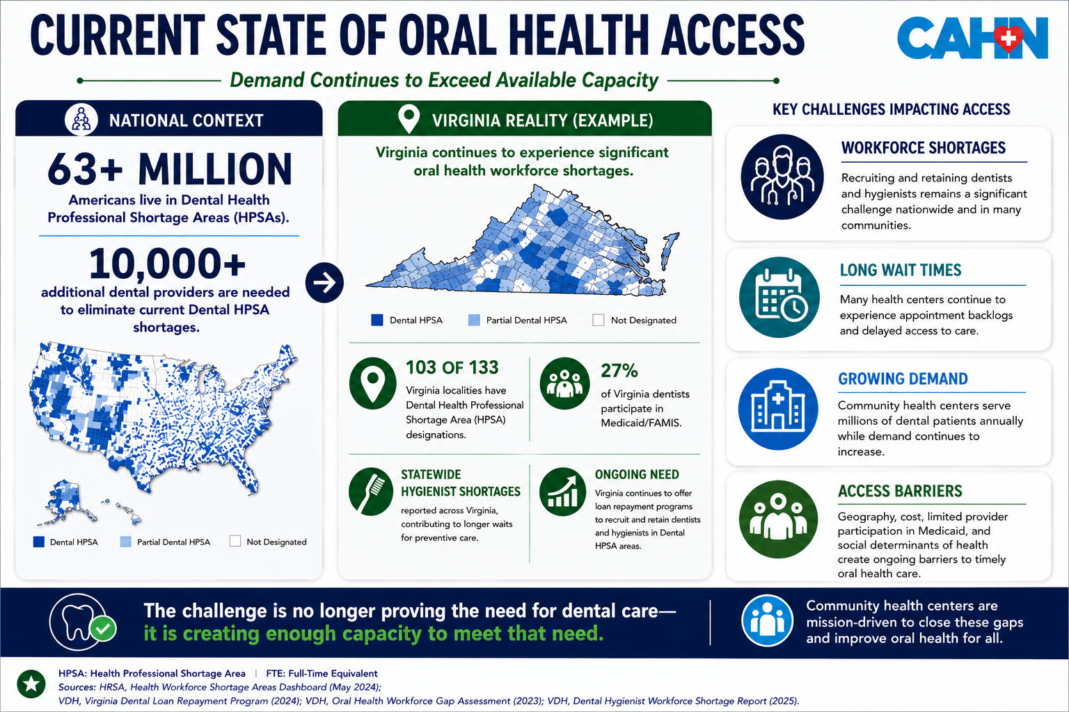

Slide 6

WHY EXPANDING ACCESS IS DIFFICULT?
THE CHALLENGE IS MULTIFACTORIAL
Workforce challenges
CAPACITY CHALLENGES
FINANCIAL CHALLENGES
ACCESS CHALLENGES
1,359 FQHCs Reported Dental Workforce Shortages in 2024
32.5 Million Patients Receive Care Through Health Centers
Average Dental School Debt Approaches $300,000
Transportation, Literacy, Language & Care-Seeking Barriers
🚨 Access is influenced by workforce, operational, financial, and patient-level barriers.
Based on HRSA and NACHC National data

Slide 7
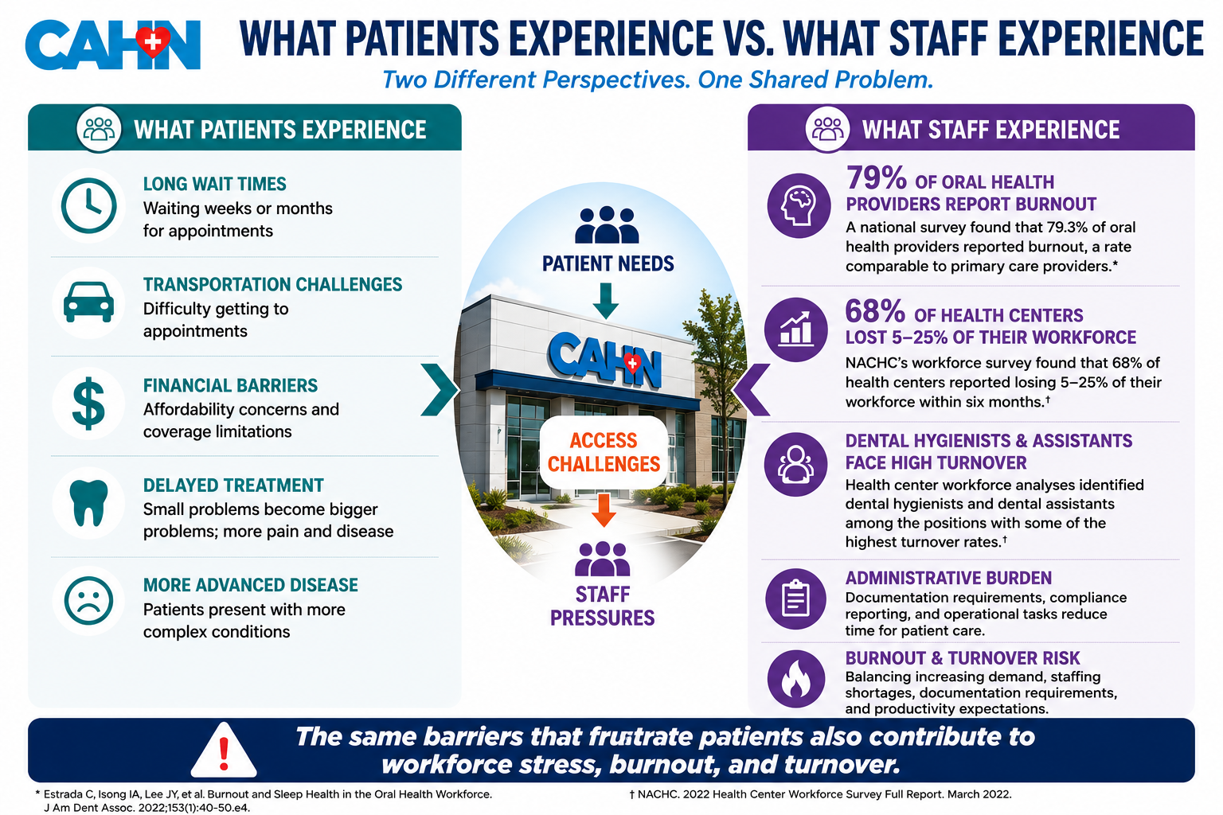

Slide 8
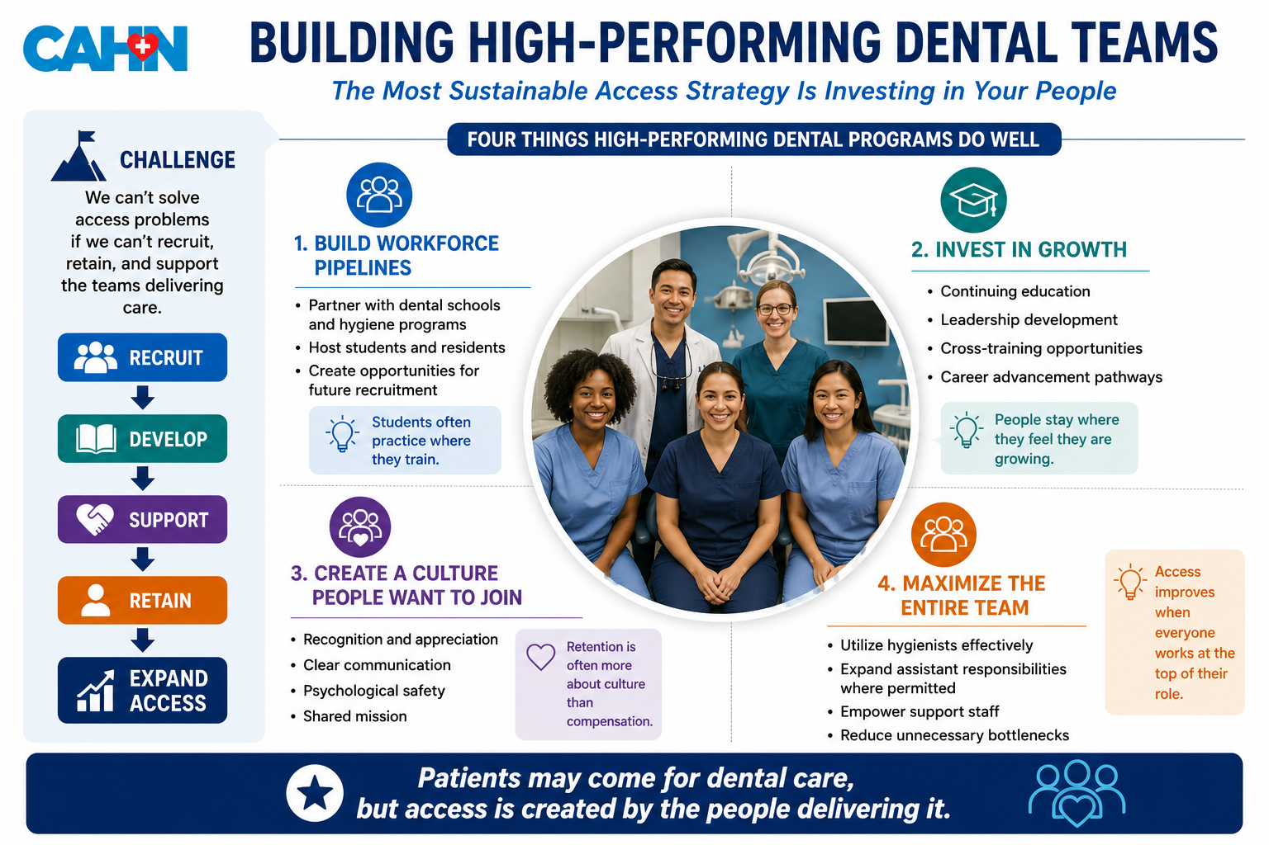

Slide 9
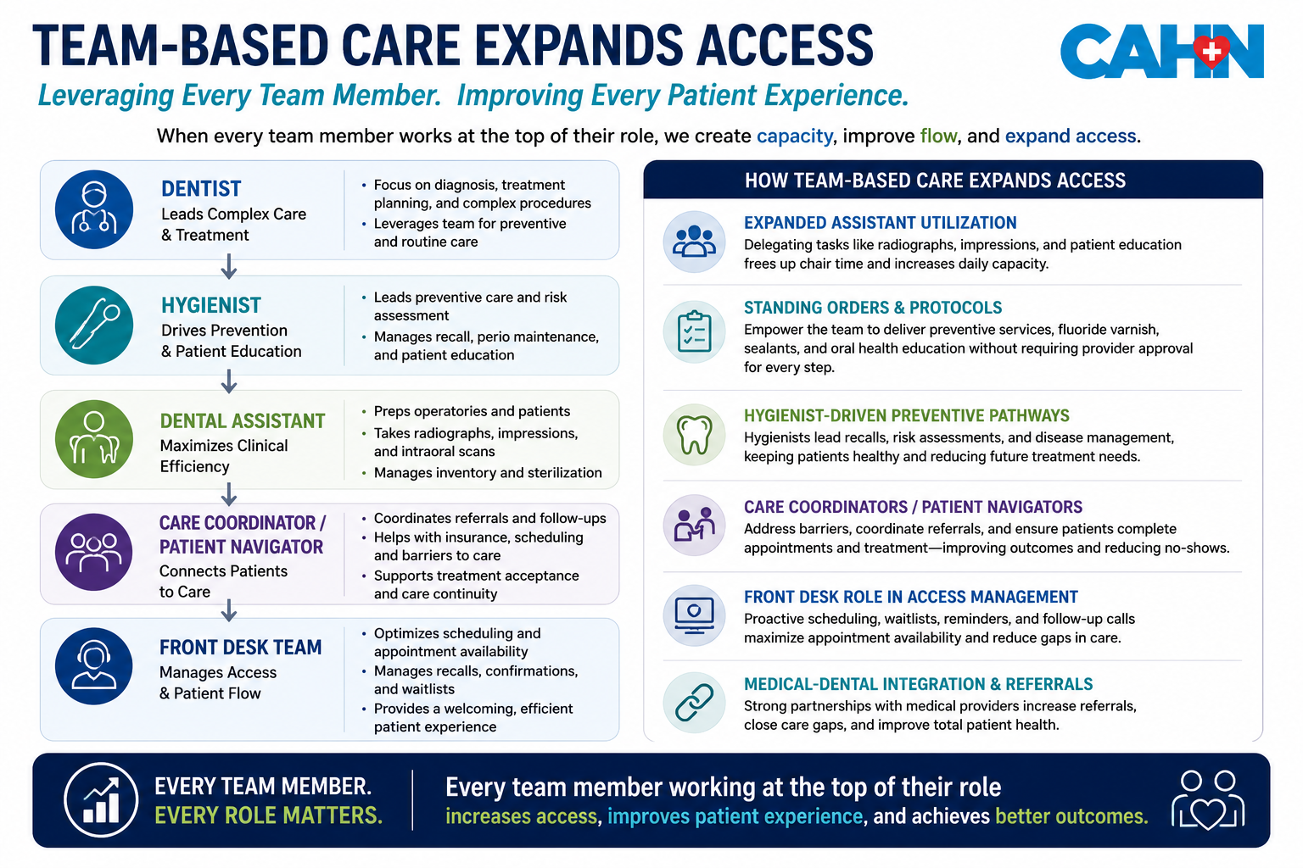

Slide 10
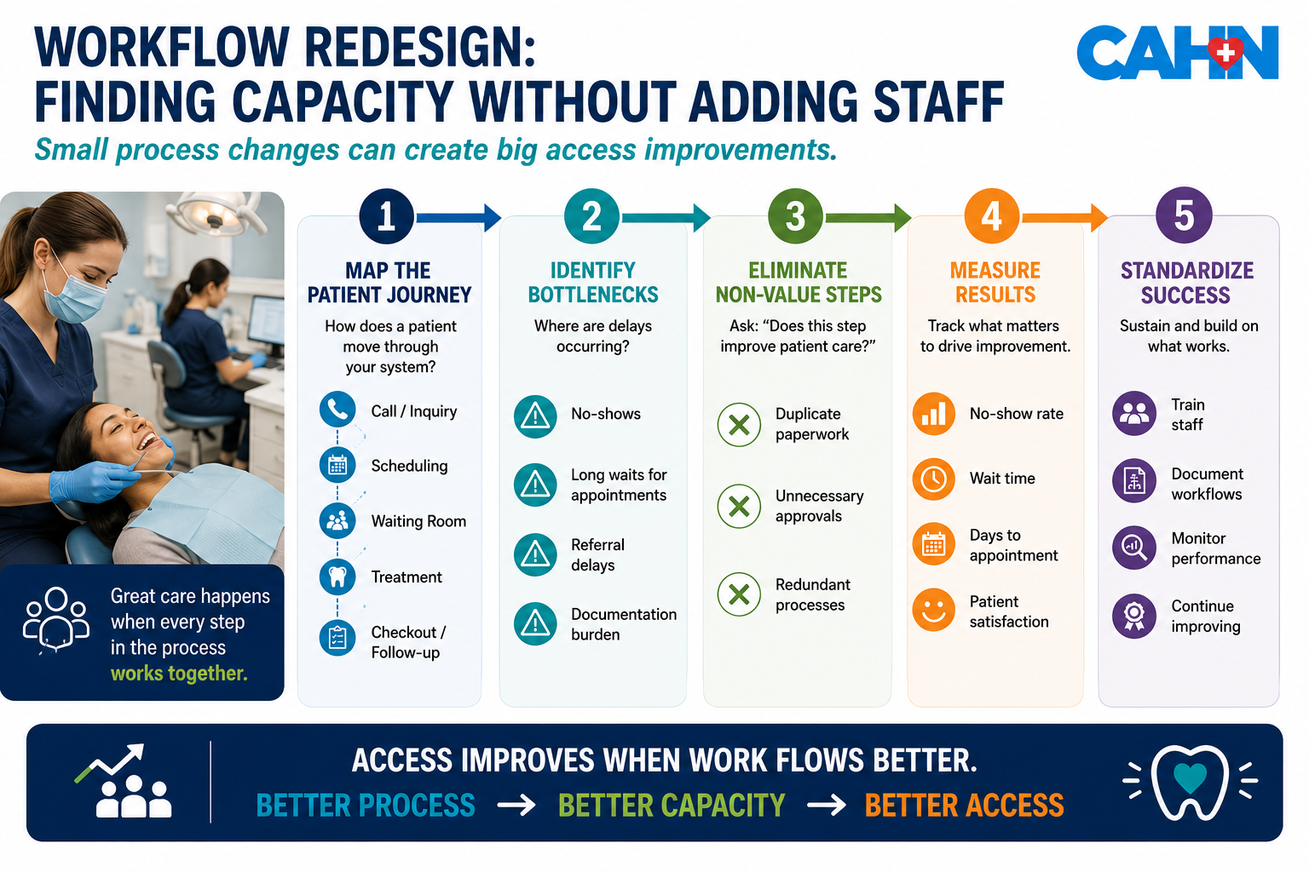

Slide 11
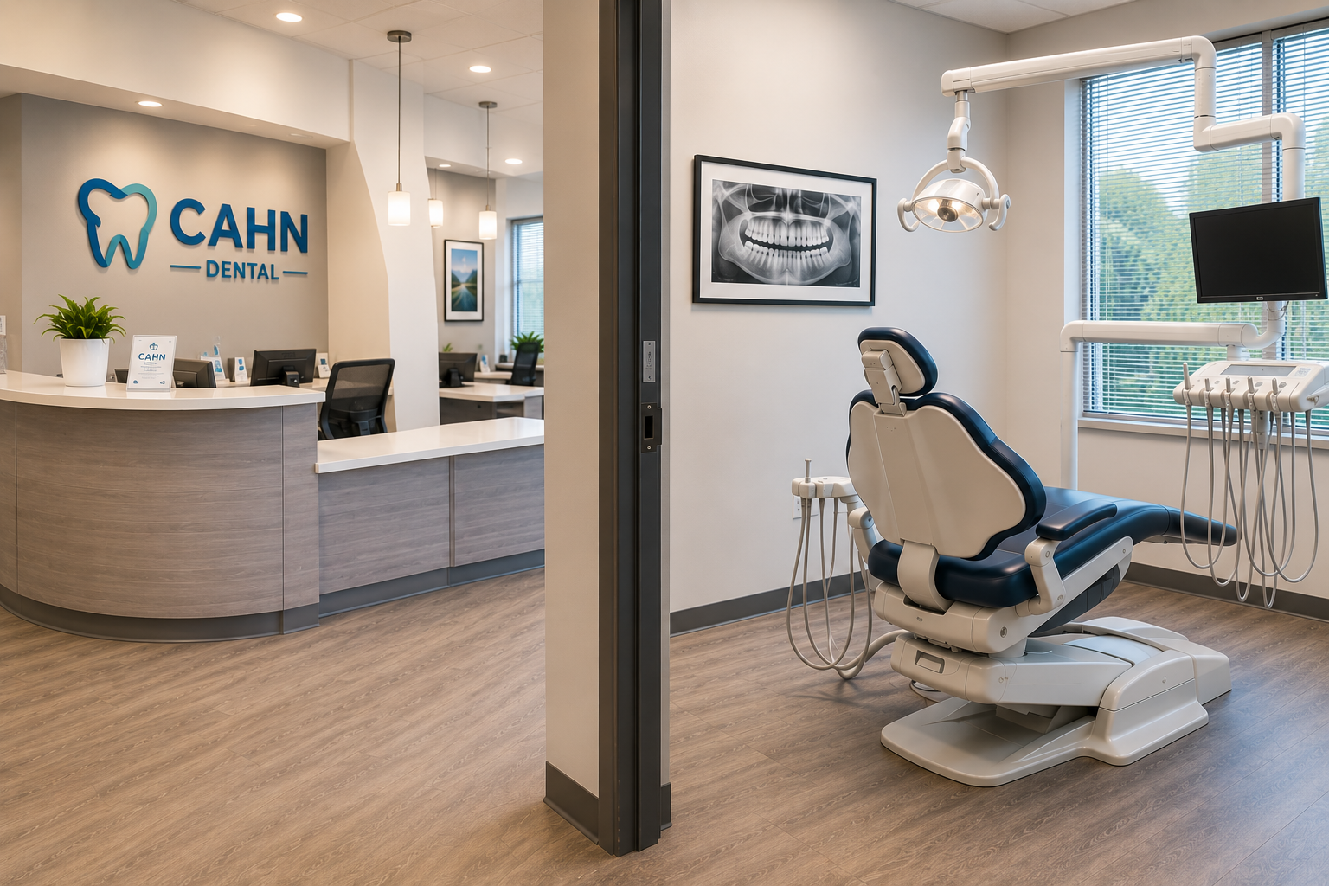
IMPROVE OPERATIONAL EFFICIENCY
WHAT IF YOU COULD ADD 25% MORE APPOINTMENTS...
...WITHOUT HIRING ANOTHER DENTIST?
CAHN EXAMPLE
Q1 2026 No-Show Rate:25%
That's:
🦷 1 out of every 4 appointments
📅 Empty chair time
🚪 A missed opportunity for another patient
Access Is Often Limited By:
Access Isn't Always Limited By
✅ No-shows
✅ Workflow bottlenecks
✅ Scheduling inefficiencies
✅ Underutilized capacity
❌ Number of operatories
❌ Number of providers
❌ Clinical skill
⚙️ Before adding resources, maximize the resources you already have.

Slide 12
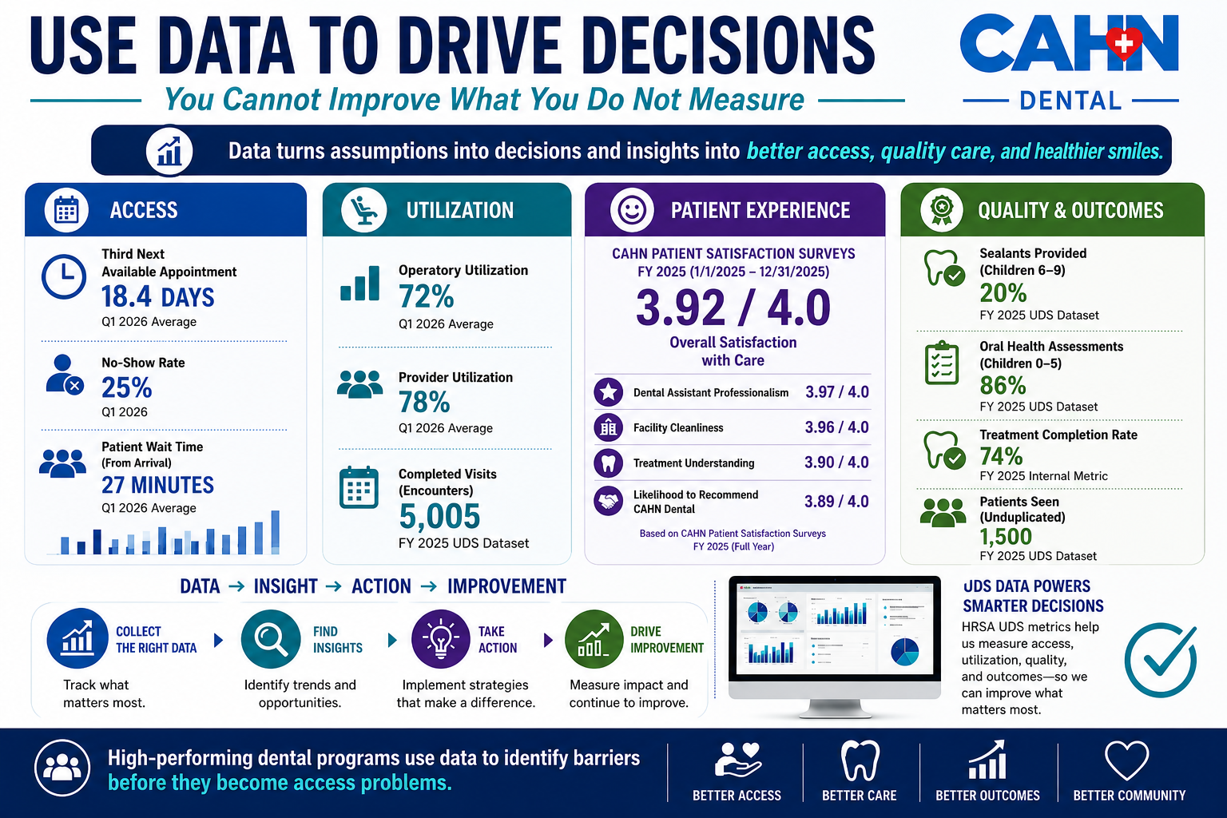

Slide 13

EXPANDING ACCESS THROUGH INNOVATION
🌎COMMUNITY OUTREACH
Removes
Awareness barriers
Geographic barriers
Access barriers
CAHN
✅ Expanding outreach initiatives
💻 TELE-DENTISTRY
Removes
Transportation barriers
Scheduling challenges
Long wait times
CAHN
✅ Recently launched
MEETING PATIENTS WHERE THEY ARE!
🤝INTEGRATED CARE
Removes
Care fragmentation
Missed referrals
Delayed treatment
CAHN + VCU Health Hub
✅ Collaborative model
INNOVATION ≠ MORE BUILDINGS
Innovation = Reaching More Patients in Different Ways
WHAT IF PATIENTS DIDN'T HAVE TO COME TO US?
🚀Innovation Isn't About Technology….
….It's About Removing Barriers

Slide 14
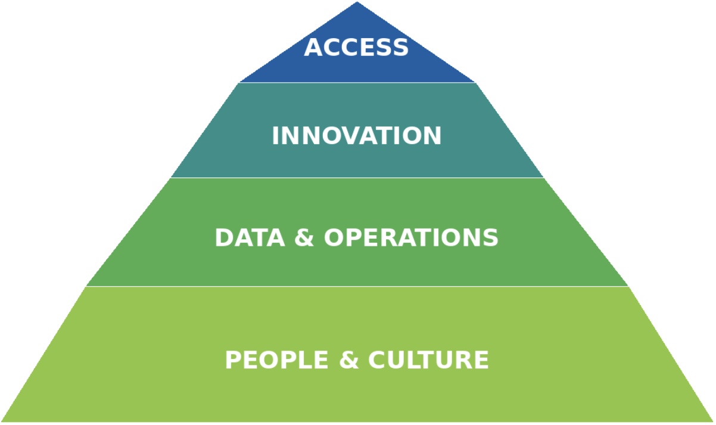
LEADERSHIP LESSONS FROM THE FIELD
👥 PEOPLE FIRST
🚀 PROGRESS OVER PERFECTION
Strong teams create sustainable access.
Small improvements consistently applied create lasting change.
🤝 PARTNERSHIPS MATTER
Collaboration expands impact faster than working alone.
📊 DATA GUIDES
Measure what matters and act on it.
Access doesn't improve because of a program.
Access improves because people commit to improving it.
⭐ Great leaders don't just manage clinics. They create environments where access, quality, and innovation can thrive.

Slide 15


Slide 16
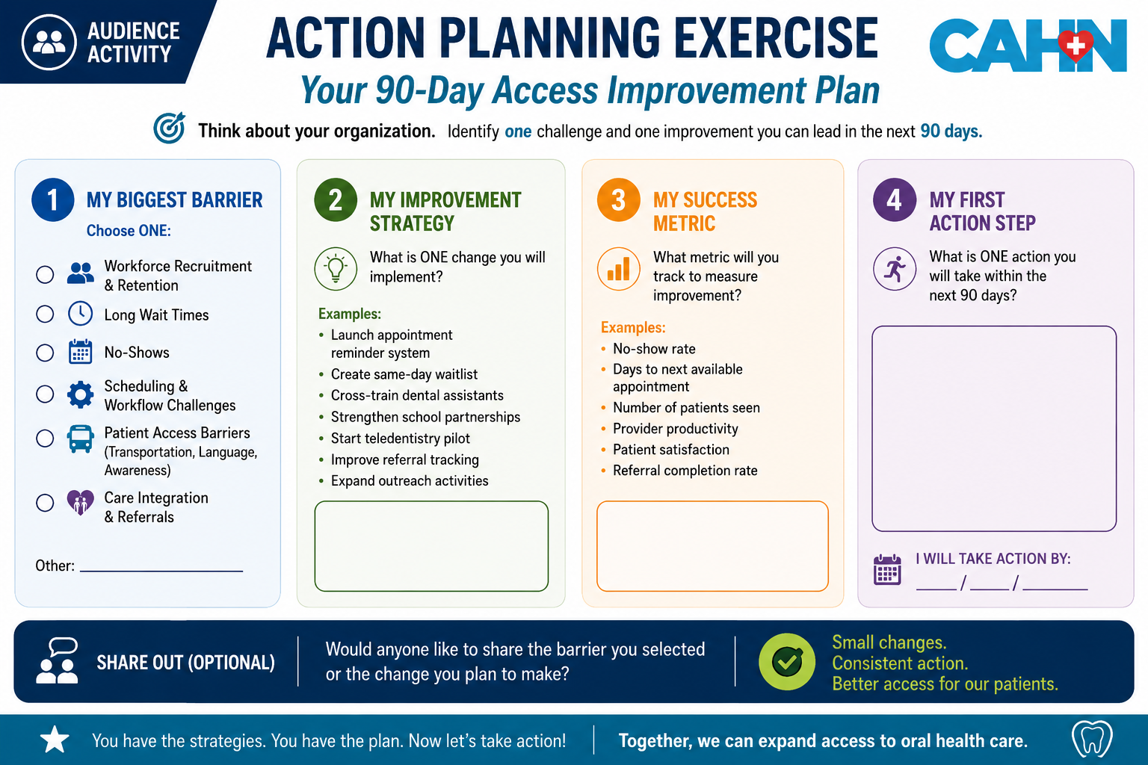

Slide 17
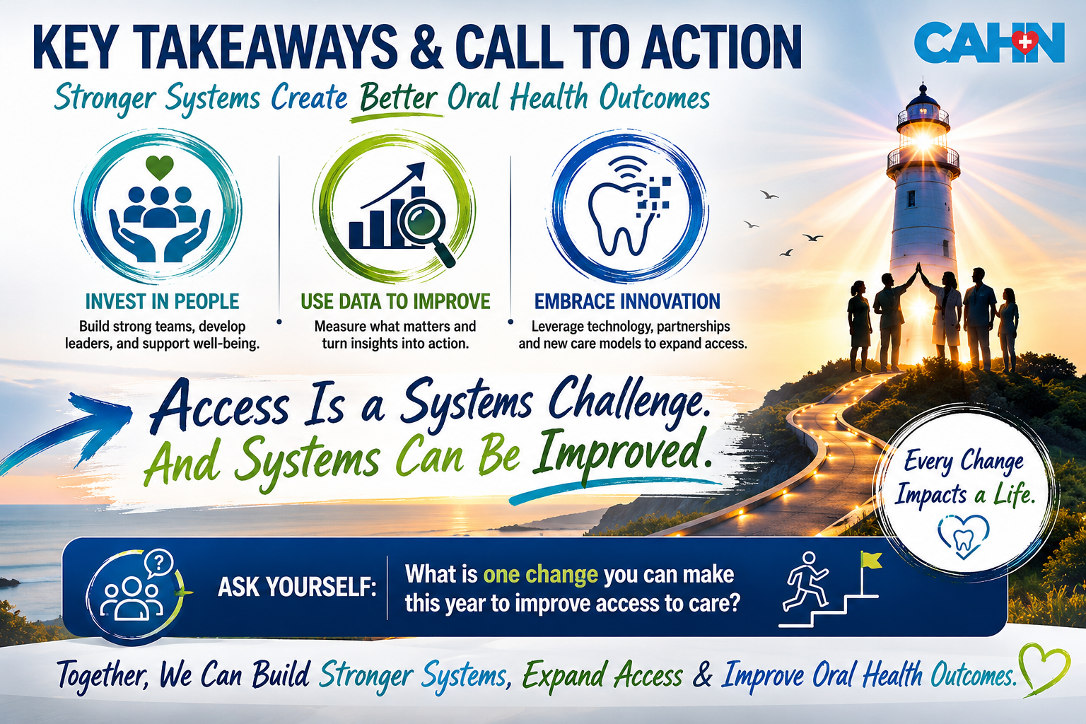

Slide 18
THANK YOU!!
CONTACT INFORMATION:
EMAIL: TNASEER@CAHEALTHNET.ORG
PH: 804-721-3757

