Slide 1

eConsult
Improving the Referral Process
VCHA Annual Meeting
September 17, 2026
Notes:
Section Divider – Light

Slide 2




Introductions
Tonya Adkins, MD, CEO
HealthWorks for Northern VA
Kim Grifasi, Sr Director
Aetna Better Health Virginia
Stephanie Puloka, MD, CMO
HealthWorks for Northern VAc
Victoria Varah
Client Success Sr Mgr, RubiconMD
Notes:
Joel prompts each panelist to introduce themselves and share their roles

Slide 3
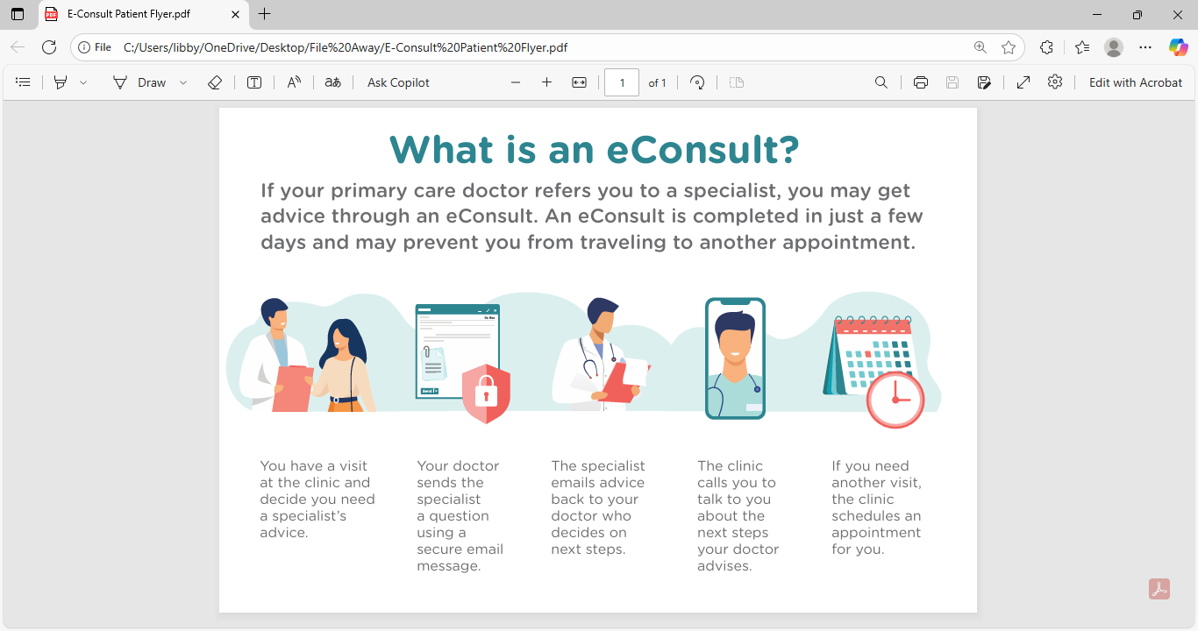
How do eConsults improve the referral process?
If your primary care provider refers you to a specialist, you may get advice through an eConsult. An eConsult is completed in just a few days and may prevent you from traveling to another appointment.
You have a visit at the clinic and decide you need a specialist’s advice.
Your doctor sends the specialist a question using a secure email message.
The specialist emails advice back to your doctor who decides on next steps.
The clinic calls you to talk about the next steps your doctor advises.
If you need another visit, the clinic schedules an appointment
for you.
eConsults are asynchronous, provider-to-provider communications allowing primary care
providers to consult with specialists, improving access and reducing patient wait times.

Slide 4



Benefits to Primary Care Providers and Patients
Reduced No-Shows and Travel
Per patient savings from $195 (Berk, 2024) to $655 (Anderson, 2018)
Secondary cost savings from reduction in no-shows at specialty appointments (Anderson, 2018)
Optimizes Referral Process
PCP satisfaction ranges from 70-95% (Vimalananda et al., 2015)
Majority of PCPs use e-Consult recommendations (Bifulco, 2023)
Keeps Patients in Primary Medical Home
In 82% of cases, PCPs do not recommend in-person referral (Tuot, 2018)
FQHCs found eConsult reduces in-person specialty visits by up to 80%.
“You don’t have to go somewhere else to have all those tests in another office” (Patient) (Bifulco et al., 2023)
“It really has increased communication, and it's also
been really good for my learning…getting direct recommendations from the specialists.” (PCP) (Lee, 2018)

Slide 5
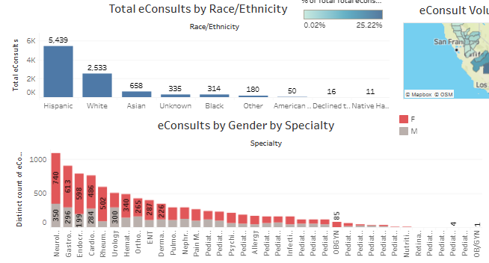
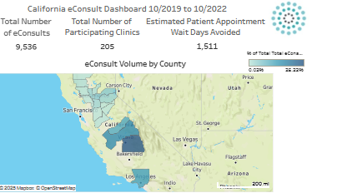
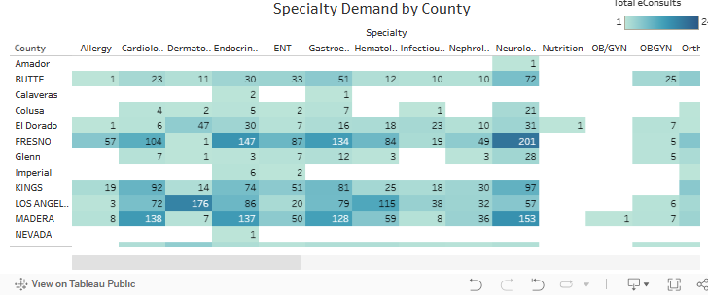
Improved Access to Care across All Specialties
State Medicaid
approved CPT codes
Treating Provider - 99452
Consulting Provider - 99451
https://public.tableau.com/app/profile/bluepath.health/viz/eConsultDashboard-HealthNet/MainDashboard

Slide 6





Virginia MCOs are collaborating to launch eConsult in clinics across the Commonwealth

Slide 7




Virginia eConsult Consortium Support for Clinics
 | Goal | Purpose
 | Multi-Payer Alignment | The Virginia eConsult Consortium ensures multi-payer alignment, supporting primary care providers so that insurance eligibility does not prevent providers from submitting eConsults
 | Technical Assistance | Ongoing support through trainings, practice change management initiatives and resources to make the most of eConsult to increase access to speciality care
 | Quality Metrics | Dashboard of metrics showing eConsult utilization by specialty, location and payer to support and monitor ongoing utilization
 | Policy Support | A unified payer voice advocating for eConsult reimbursement with Commonwealth leadership
Notes:
Libby to review

Slide 8

HealthWorks for Northern Virginia
Provider Experience
Tonya Adkins, MD, CEO
HealthWorks for Northern VA
Stephanie Puloka, MD, CMO
HealthWorks for Northern VA

Slide 9
How does eConsult work?
RubiconMD demonstration
August 2025 - August 2026

Slide 10
HealthWorks - Year in Review
August 2025 - August 2026

Slide 11

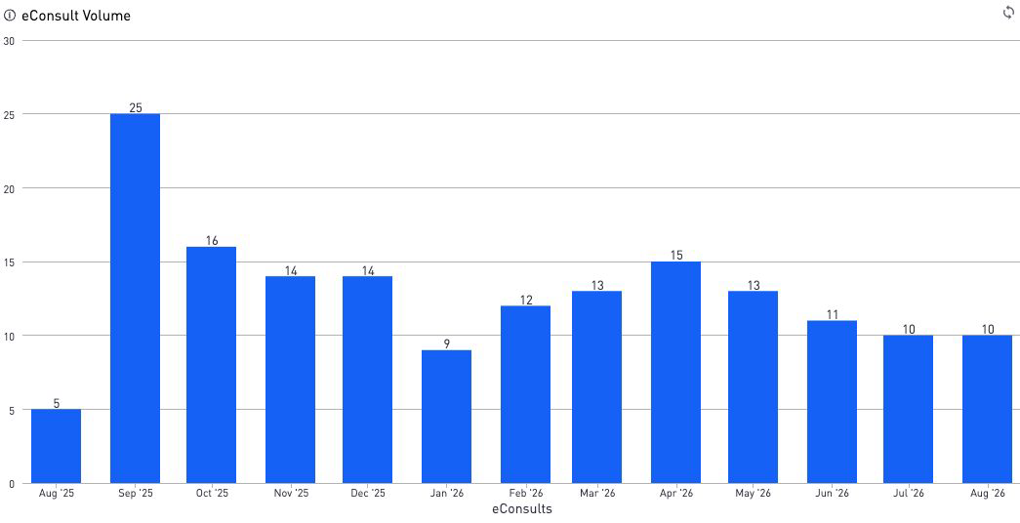

HealthWorks Data
Physician Reported Outcomes
Improved Care Plan - 80%
Avoided Referral - 43%
Avoided Delay in Care - 29%
Avoid dx/px - 8.9%
4.99/5 Rating
15
Active Clinician users
167
eConsult submissions
2 hour 28 min
Median specialist response time
*Data comes from the 67% of
eConsults that are rated

Slide 12
eConsult Volume by Speciality

Slide 13


HealthWorks Provider Testimonials
“Great answer, great follow up. Covered all of my questions and was very personable.” - 5 Star Dermatology (Hair & Nails) eConsult
“Thank you! The references were absolutely amazing and exactly what I was looking for. - 5 Star Urologic Oncology eConsult
“Thank you. This was exactly what I needed.” - 5 star Cardiology (Arrhythmia) eConsult
“Helpful feedback. Thanks!” - 5 Star General Hematology eConsult
“Prompt, excellent, concise, and clear response. Thank you very much” - 5 star Hem/Onc eConsult
- Direct feedback from HealthWorks Providers

Slide 14
Discussion
How has eConsult been incorporated into HealthWorks’ referral process?
What role does the clinical champion play in implementing eConsult?
What eConsult value and/or efficiency have you seen?
What clinic support is needed for ongoing eConsult sustainability?
What is needed from MCOs and the Commonwealth?
Participant Questions?

Slide 15
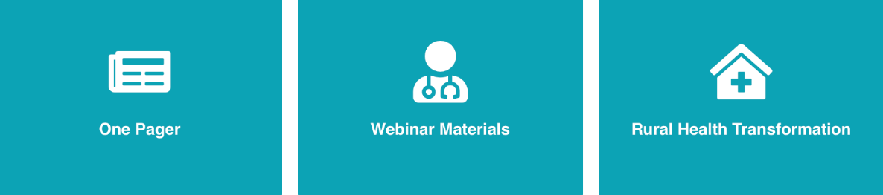
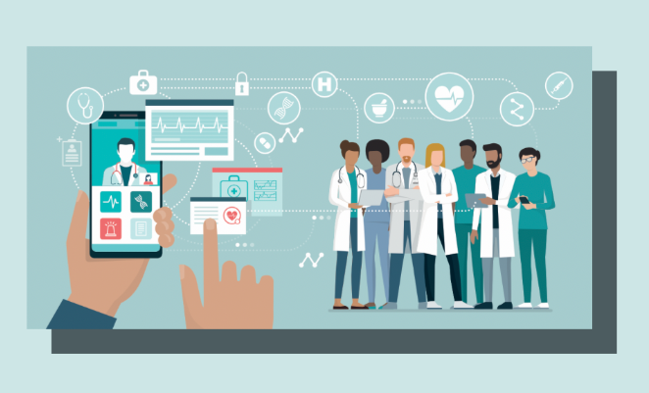
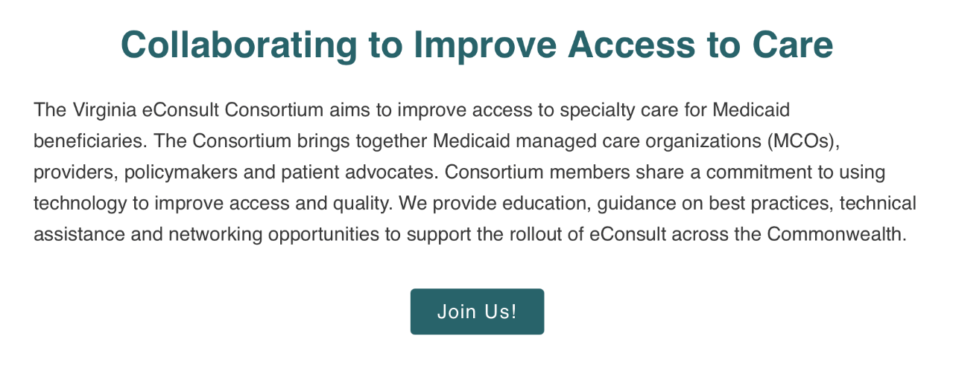
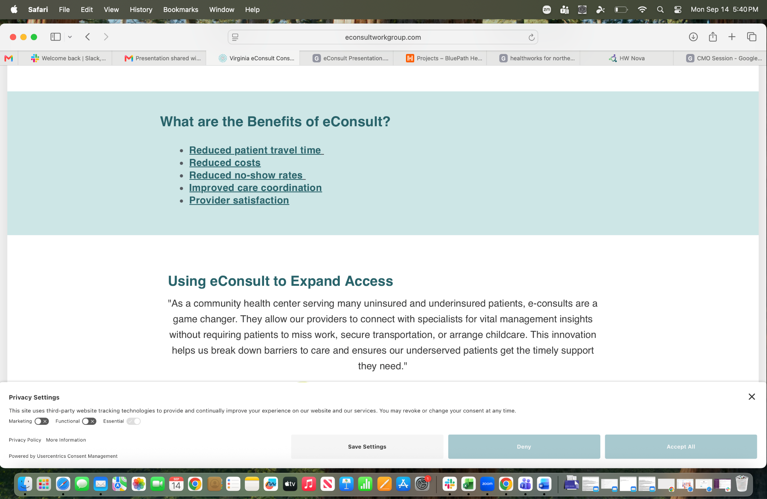
Consortium Resources
For Virginia Providers
https://econsultworkgroup.com/virginia/

Slide 16

Getting Your Clinic Involved
Interested in participating in the
Virginia eConsult Consortium?
libby.sagara@bluepathhealth.com
econsultworkgroup.com/virginia

Slide 17
References
Anderson, D., Villagra, V., Coman, E. N., Zlateva, I., Hutchinson, A., Villagra, J., & Olayiwola, J. N. (2018). A cost-effectiveness analysis of cardiology eConsults for Medicaid patients. The American Journal of Managed Care, 24(1), e9–e16. https://pubmed.ncbi.nlm.nih.gov/29350511
Berk, S., Mancino, M., & Pearson, C. (2024, August 15). Can eConsults reduce commercial health spending? Learnings from an Arkansas pilot study. Peterson-KFF Health System Tracker. https://www.healthsystemtracker.org/brief/can-econsults-reduce-commercial-health-spending-learnings-from-an-arkansas-pilot-study/
Bifulco, L., Grzejszczak, L., Velez, I., Angelocci, T., & Anderson, D. (2023). A qualitative investigation of uninsured patient and primary care provider perspectives on specialty care eConsults. BMC Health Services Research, 23, Article 1133. https://doi.org/10.1186/s12913-023-10086-6
Bifulco, L., Guidotti, O., Velez, I., Grzejszczak, L., Angelocci, T., Okunade, L., & Anderson, D. (2023). Impact of eConsults on clinical care in primary care: A cross-sectional analysis of primary care provider behavior. Journal of Primary Care & Community Health, 14, Article 21501319231202201. https://doi.org/10.1177/21501319231202201
Lee, M. S., Ray, K. N., Mehrotra, A., Giboney, P., Yee, H. F., Jr., & Barnett, M. L. (2018). Primary care practitioners’ perceptions of electronic consult systems: A qualitative analysis. JAMA Internal Medicine, 178(6), 782–789. https://doi.org/10.1001/jamainternmed.2018.073
Tuot, D. S., Liddy, C., Vimalananda, V. G., Pecina, J., Murphy, E. J., Keely, E., Simon, S. R., North, F., Orlander, J. D., & Chen, A. H. (2018). Evaluating diverse electronic consultation programs with a common framework. BMC Health Services Research, 18, Article 814. https://doi.org/10.1186/s12913-018-3626-
Vimalananda, V. G., Gupte, G., Seraj, S. M., Orlander, J., Berlowitz, D., Fincke, B. G., & Simon, S. R. (2015). Electronic consultations (e-consults) to improve access to specialty care: A systematic review and narrative synthesis. Journal of Telemedicine and Telecare, 21(6), 323–330. https://doi.org/10.1177/1357633X15582108

