Slide 1



Beyond the Clinic Walls:
How Home Visiting & Community Partnerships Support Maternal Health &
Family Well-Being
Jamara Knight
Caitlyn Berry
Kelley MacArthur
Kara Trahant
Notes:
JK Introduce ourselves and background
Introduce EIV - brief history of start at HV Consortium, evolution to HV Alliance, and now non-profit partnering with the Commonwealth to ensure equitable access to HV for families across VA

Slide 2


Strategic Leadership
Innovation
OUR MISSION
Advance the workforce, systems, and policies that make equitable access to home visiting possible so every family and young child can have the strongest start.
Demonstrate Impact
Collaboration
Advocate
Notes:
JK

Slide 3

  VIRGINIA MATERNAL HEALTH & CHILD WELL-BEING SNAPSHOT
INFANCY
ACCESS TO CARE
31% of counties lack OB hospitals
14% receive inadequate prenatal care
46% postpartum visit rate*
10% of all births are preterm
0.5% infant mortality rate
(544 infants)
644 substance exposed deliveries
*among Medicaid births
15 CASES
MATERNAL MORTALITY
(2024)
67
PREGNANCY ASSOCIATED DEATHS
(2022)
WELL-CHILD VISITS
4 in 10 babies on Medicaid are NOT receiving
recommended # of well-child visits
down from 47 (2021)
down from 82 (2020)
60% of children received 6+ rec’d visits 0-15mo
70% of children received 2+ rec’d visits 15-30mo
Notes:
JK

Slide 4
What is home visiting?
Home visiting is a free, voluntary program available to families across Virginia from pregnancy through kindergarten entry. It brings trained early childhood professionals—nurses, parent educators, and family support specialists—directly to families, meeting them where they are and building long‑term, trusting relationships.
Relationship Based Two-Generation Approach
Voluntary & Strengths-Based
Family Centered & Family Led
Parents as First Teachers
Notes:
JK

Slide 5





Jordan’s Journey
Referral & Intake
Jordan and her partner, Chris, are first‑time parents in Virginia who learn about home visiting during Jordan’s second trimester. She enrolls in the program and builds a supportive relationship with her home visitor, who walks alongside their family through pregnancy, birth, early parenting, and the transition to toddlerhood. Their journey highlights the wraparound support home visiting provides at each developmental stage.
Jordan learns about home visiting from her OB. She is assessed, found eligible, and enrolls in her local home visiting program at 24 weeks pregnant.
Developmental Milestone Tracking
Prenatal Visits
Jordan asks when Miles will begin waving like other babies she sees. Her HV reassures her and introduces the “Learn the Signs, Act Early” app empowering Jordan to track Miles’s developmental milestones.
Jordan’s Home Visitor (HV) helps her prepare for her baby teaching newborn basics like safe sleep. She helps Jordan get a free carseat and pack n’ play from her local health dept.
Screening & Referral
HV completes an ASQ at 18 months which reveals Miles may have a language delay. Jordan’s HV refers them to Early Intervention. Miles qualifies and begins receiving speech therapy at his childcare center.
Postpartum Mental Health
Jordan reports feeling “not herself” after her partner returns to work. Her HV screens for PMADs, which confirms postpartum anxiety. She connects Jordan with a behavioral health provider.
Career Planning & Childcare Navigation
Birth & Immediate Postpartum Support
Miles is turning 1 and Jordan feels ready to return to work! Her HV helps her set goals for her job search and find childcare
options.
When baby Miles arrives, Jordan’s HV is one of the first people to visit. She helps Jordan process his birth, understand newborn cues and get grounded in feeding and sleep routines.
Transition Planning
& Graduation
As Miles nears 2, Jordan’s HV helps them apply for Head Start. Jordan reflects on her home visiting journey and the ways she’s grown in her parenting confidence and self-efficacy. The family happily graduates.
Breastfeeding & Lactation Support
Support for Bonding, Play, & Early Learning
Jordan shares she’s struggling with breastfeeding. Her HV connects her with their program’s lactation consultant who helps Jordan feel more confident and comfortable feeding Miles.
Jordan worries that Miles cries every tummy time. Her HV introduces new strategies to help Miles and Jordan enjoy this developmental activity together.
Notes:
CB Jordan’s Journey: Jordan and her partner, Chris, are first‑time parents in Virginia who learn about home visiting during Jordan’s second trimester. She enrolls in the program and builds a supportive relationship with her home visitor, who walks alongside their family through pregnancy, birth, early parenting, and the transition to toddlerhood. Their journey highlights the wraparound support home visiting provides at each developmental stage.​
​
1. Prenatal Connection (22–24 weeks pregnant)​
During a routine OB appointment, Jordan learns about free home visiting services and discusses it with her partner, Chris. After completing the intake and being found eligible, she meets her home visitor at 24 weeks to begin planning for the baby.​
2. Prenatal Support Visits (2×/month)​
Throughout her prenatal visits, the home visitor helps Jordan learn bonding strategies, understand newborn basics, and prepare a safe sleep space. She also connects the family with a free car seat and crib through the local health department. Chris joins when he can, learning ways he can support Jordan and the baby in these early stages.​
3. Birth & Immediate Postpartum Support​
After Jordan and baby Miles return home, the home visitor is one of the first supportive faces to visit, especially meaningful since the couple doesn’t have nearby family. She helps Jordan process the birth, understand newborn cues, and get grounded in early feeding and soothing routines. Chris is present for the first visit, but soon returns to work.​
4. Breastfeeding Challenges & Lactation Support​
When Jordan struggles with latch and pain during feedings, the home visitor connects her with the program’s lactation consultant. With gentle coaching and new techniques, Jordan begins to feel more confident and comfortable, and Chris supports by helping with bottles, burping, and household tasks.​
5. Postpartum Mental Health (6–8 weeks postpartum)​
After Chris returns to work, the home visitor notices Jordan showing signs of increased anxiety and emotional strain during visits. Screening with the EPDS and GAD‑7 confirms postpartum anxiety, and the home visitor helps her connect with a behavioral health provider and plan for ongoing support.​
6. Support for Bonding, Play & Early Learning (0–6 months)​
Jordan worries about tummy time because Miles cries whenever he’s on his belly. The home visitor reassures her and demonstrates manageable alternatives, like tummy time on her chest or using a mirror and toys, which help Jordan build confidence and see small successes.​
7. Developmental Milestone Questions (6–12 months)​
When Jordan notices other babies waving and clapping, she wonders if Miles is falling behind. The home visitor reviews milestone ranges, uses the ASQ to check his development, and introduces the “Learn the Signs. Act Early.” app, reassuring Jordan that Miles is developing within expected limits and empowering her to continue to track Mile’s milestones.​
8. Career Planning & Childcare Navigation (around 12 months)​
As Miles approaches his first birthday, Jordan feels ready to return to work. Her home visitor helps her set job‑search goals and explore childcare options that accept subsidies. Jordan secures a medical assistant position, Miles begins attending childcare, and the home visitor shifts visits to once a month.​
9. Toddler Development Screening & Referral (18 months)​
During a routine ASQ screening at 18 months, the home visitor notices possible signs of a language delay and discusses them with Jordan, looping Chris in when he’s available. She supports the referral to Virginia Early Intervention, where Miles qualifies for services and begins speech therapy at his childcare center.​
10. Transition Planning & Graduation (24–30 months)​
As Miles nears age two, the home visitor helps Jordan and Chris apply for Head Start and reflect on their family’s progress. With steadier routines, stronger parenting confidence, and Jordan’s continued success at work, the family celebrates their growth. They happily graduate from home visiting as Miles transitions into Head Start.

Slide 6



Home Visiting Supports
Healthy Outcomes
prenatal care & postpartum
visits
breastfeeding
initiation &
duration
adherence to
well-child
visits
reduced low birth weights
fewer babies
born preterm
Notes:
CB

Slide 7









Virginia’s Home Visiting Continuum
State Designed Models
Evidence Informed Approaches
Evidence-Based Models
Targeted Supports
Notes:
CB

Slide 8
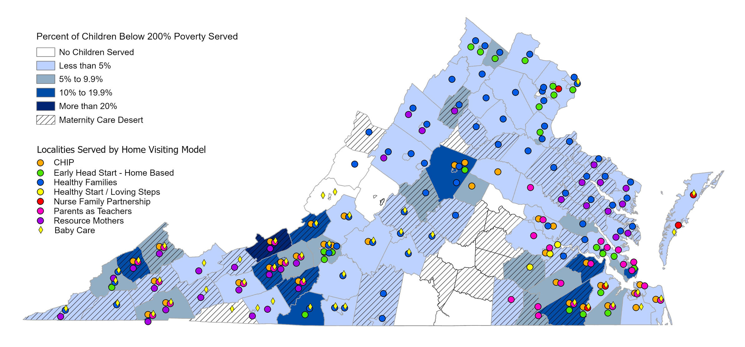
Where to find Home Visiting?
Notes:
CB VA Home Visiting Reach

Slide 9

Virginia Home Visiting Landscape:
77 programs in 117 localities
Community Nonprofits
Health Departments
County or City Services
Community Action Agencies
Hospital Systems
Universities
18
15
10
9
2
2
Notes:
CB

Slide 10




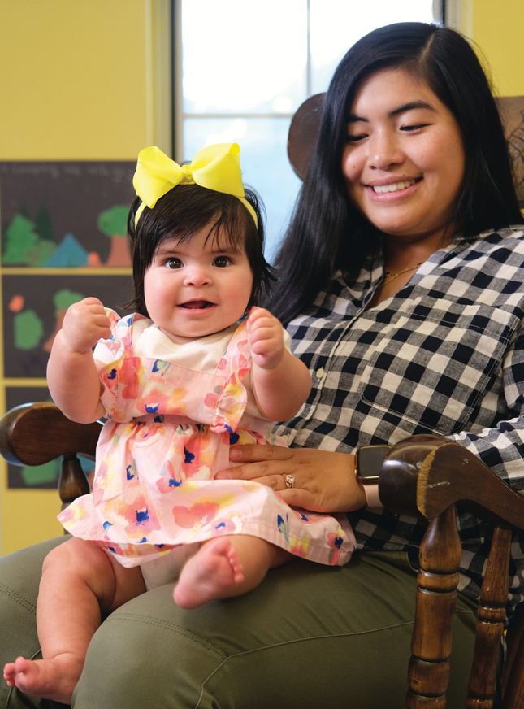
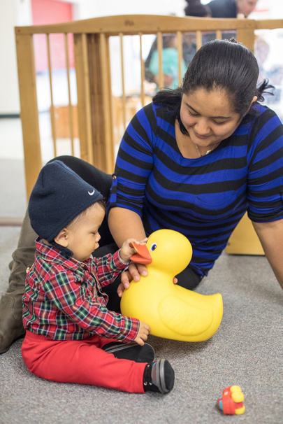
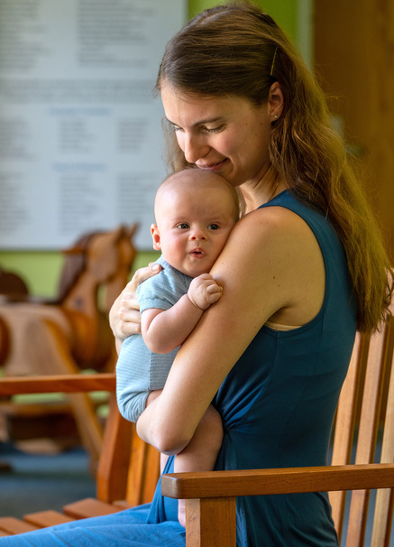

Lessons from
the
Motherhood
Program
at CDR
Maternal
Health
Beyond
the Clinic:
Motherhood
at Child Development
Resources

Slide 11
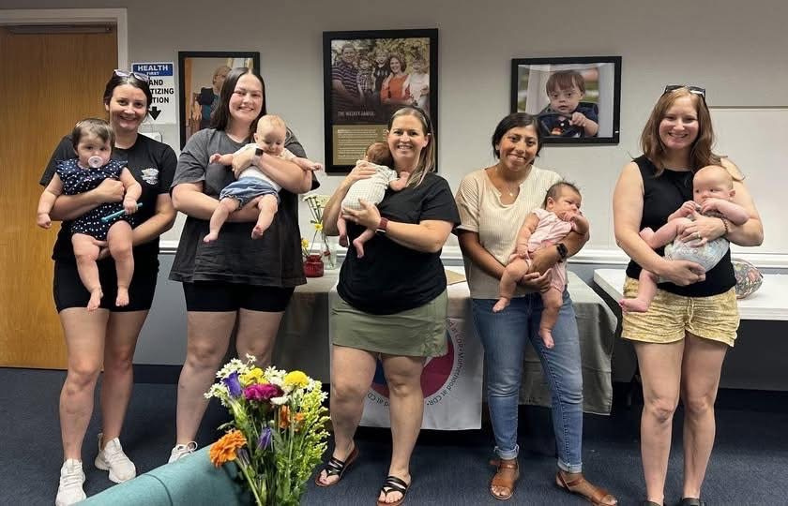
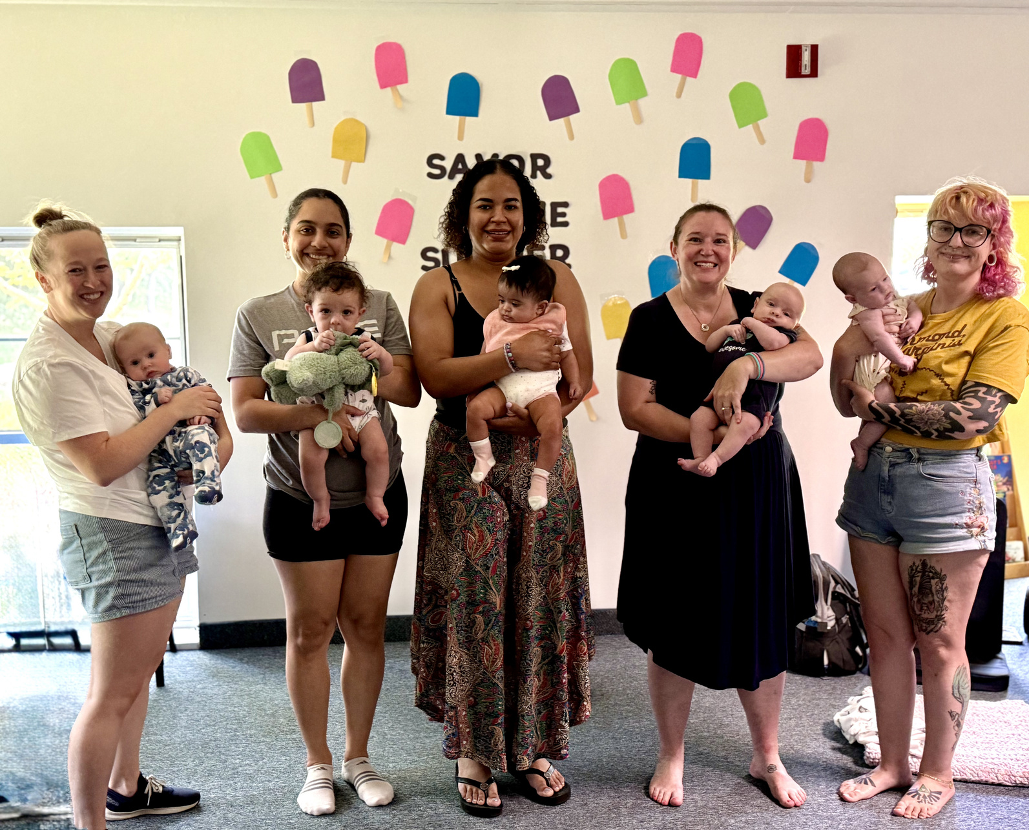
The breastfeeding class ended.
The need for connection did not.

Slide 12


Did you know?
1 in 5 mothers
experience a perinatal
mood or anxiety disorder
PMADs are among the
most common complications
of pregnancy and postpartum!

Slide 13
Prenatal
Classes
Breastfeeding
Support
Perinatal Health
Hub in Action
Maternal
Mental
Wellness
Healthcare happens in appointments.
Recovery, confidence, and parenting happen between appointments.
Infant
Massage
1-on-1
Consults
Connection

Slide 14
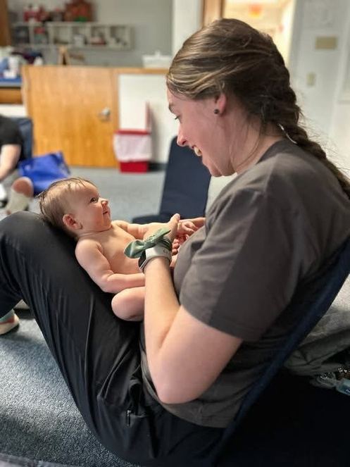
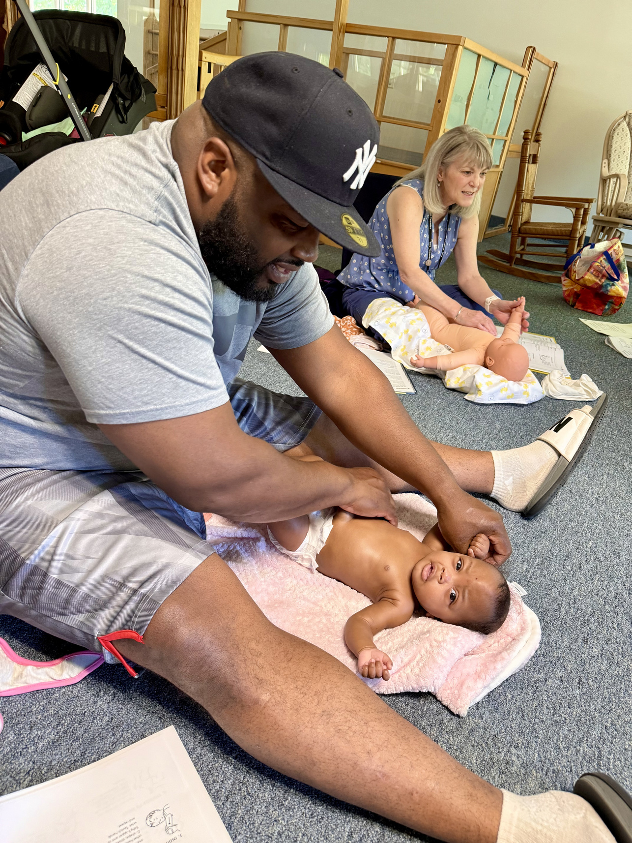
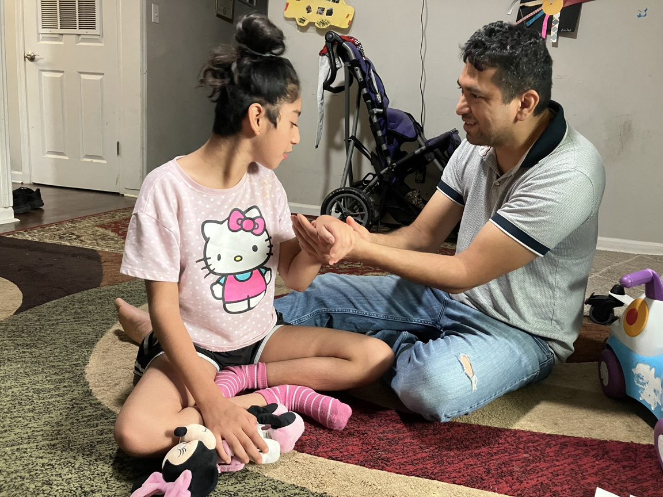
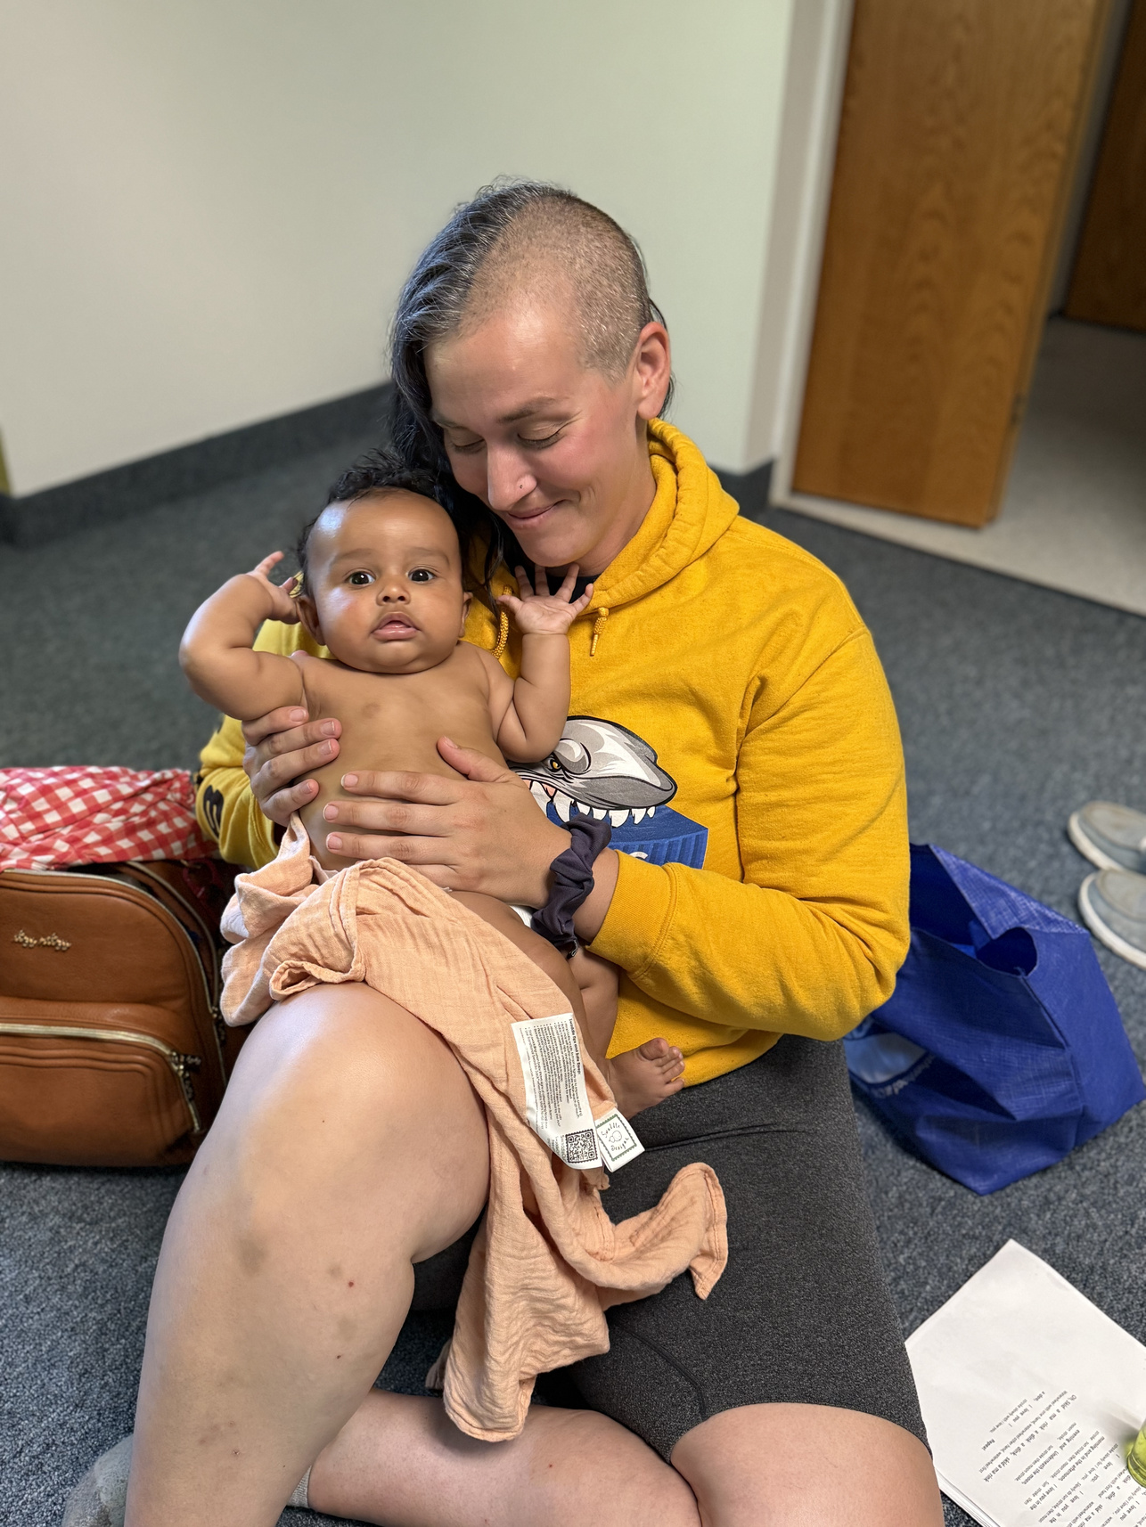
Infant Massage
Supports Mom and Baby
Great Home Visiting Tool!

Slide 15
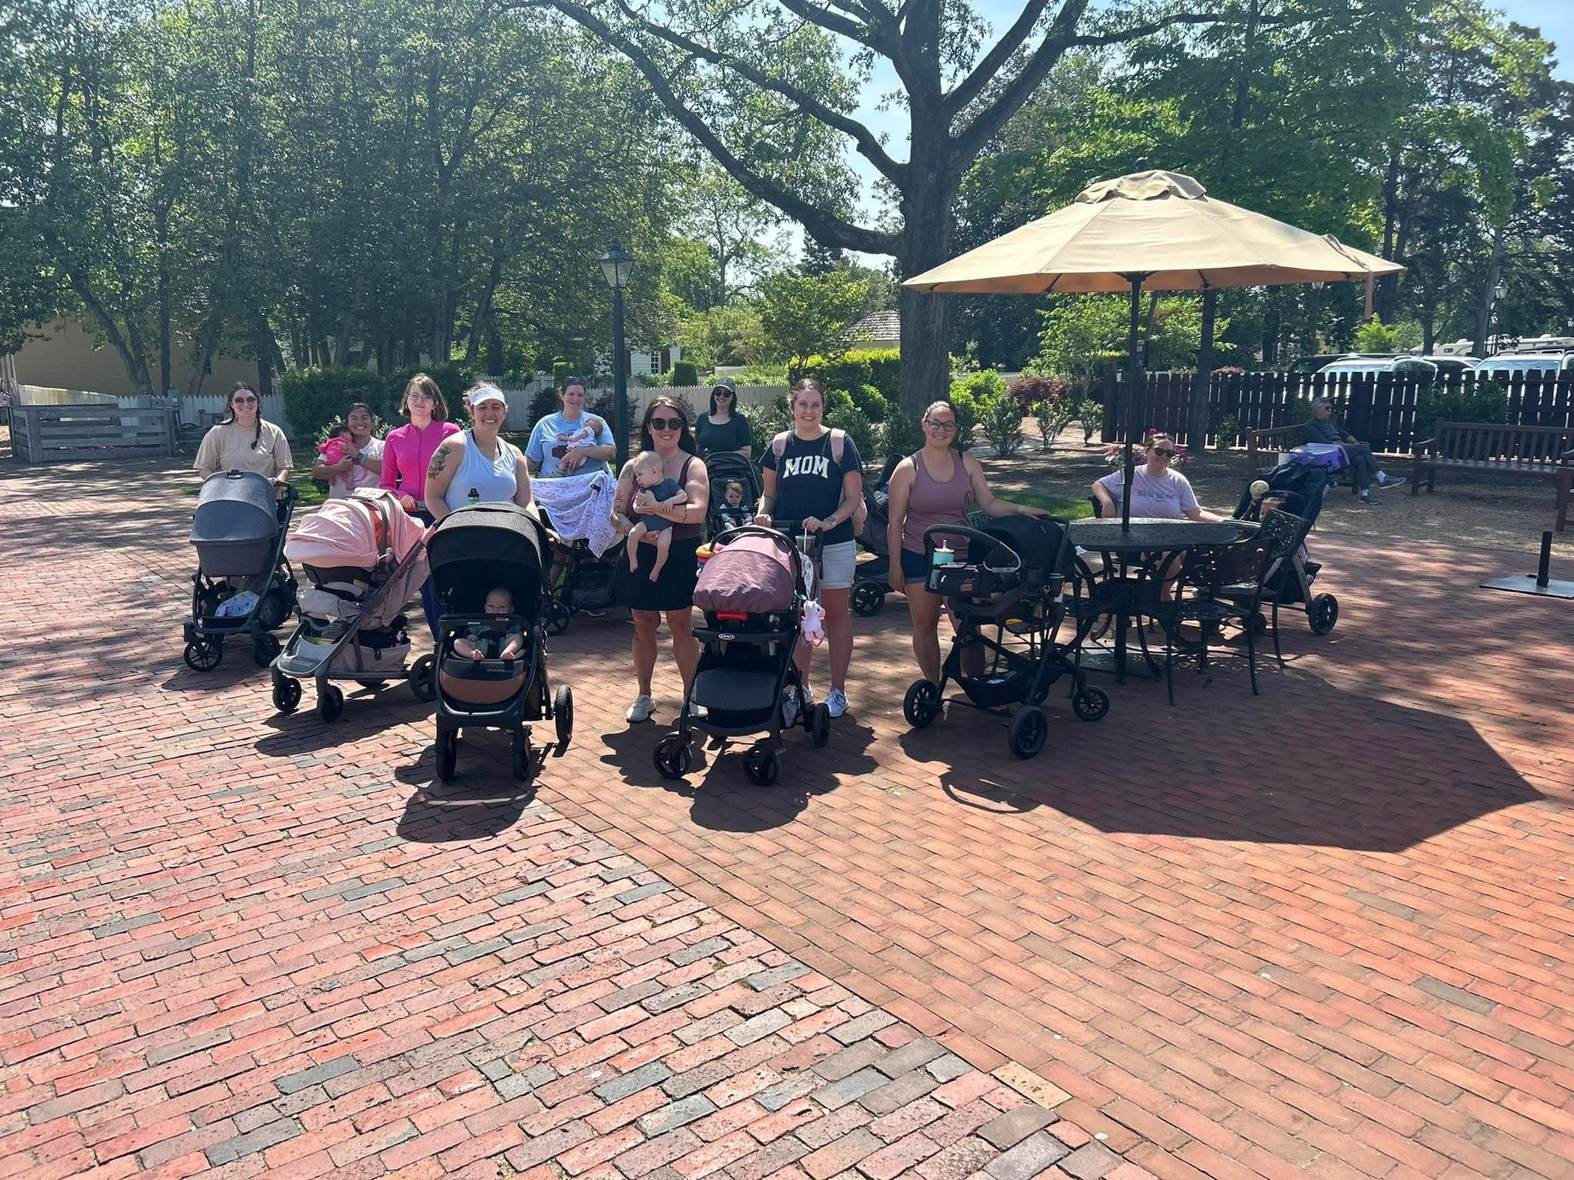

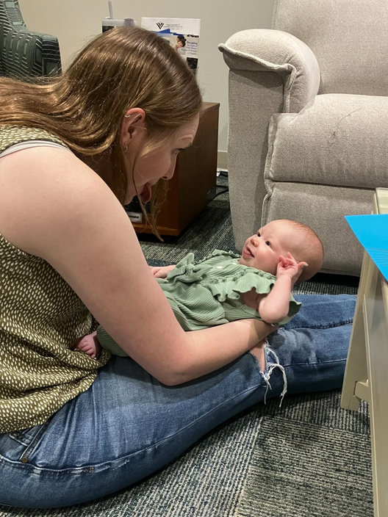
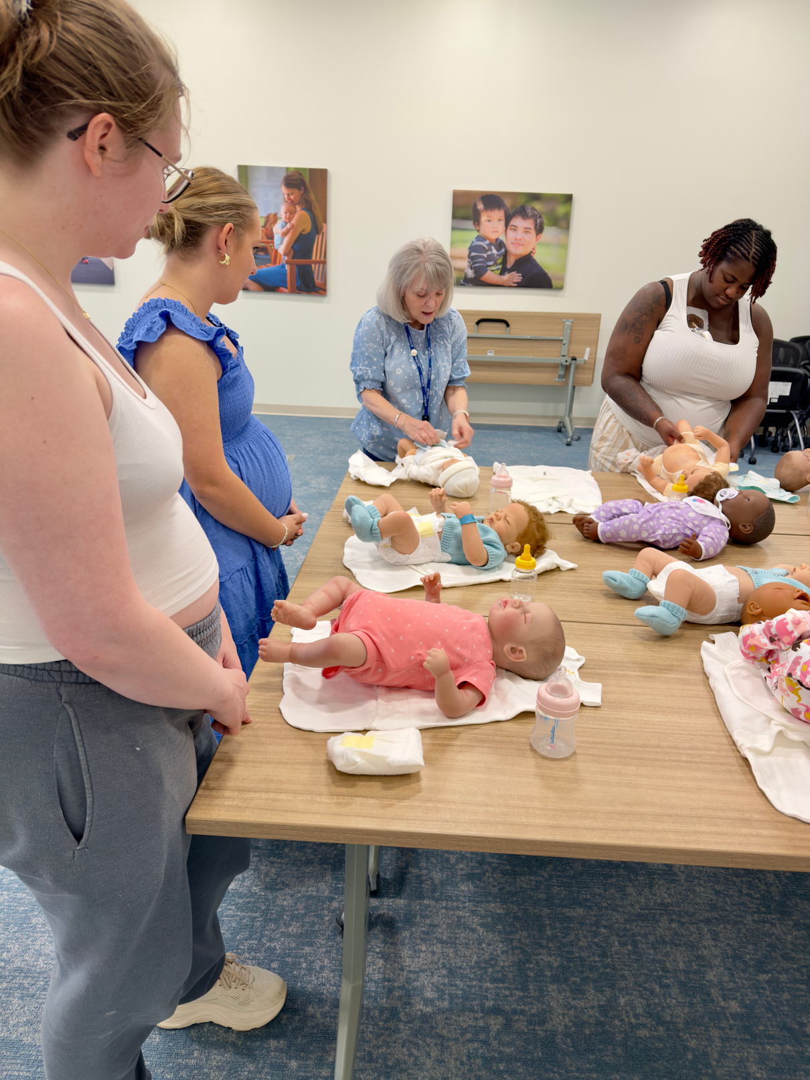
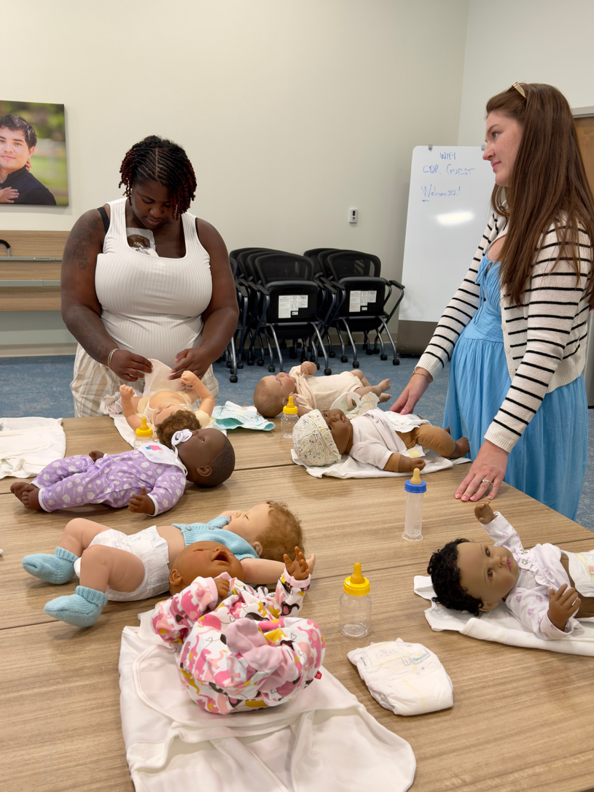
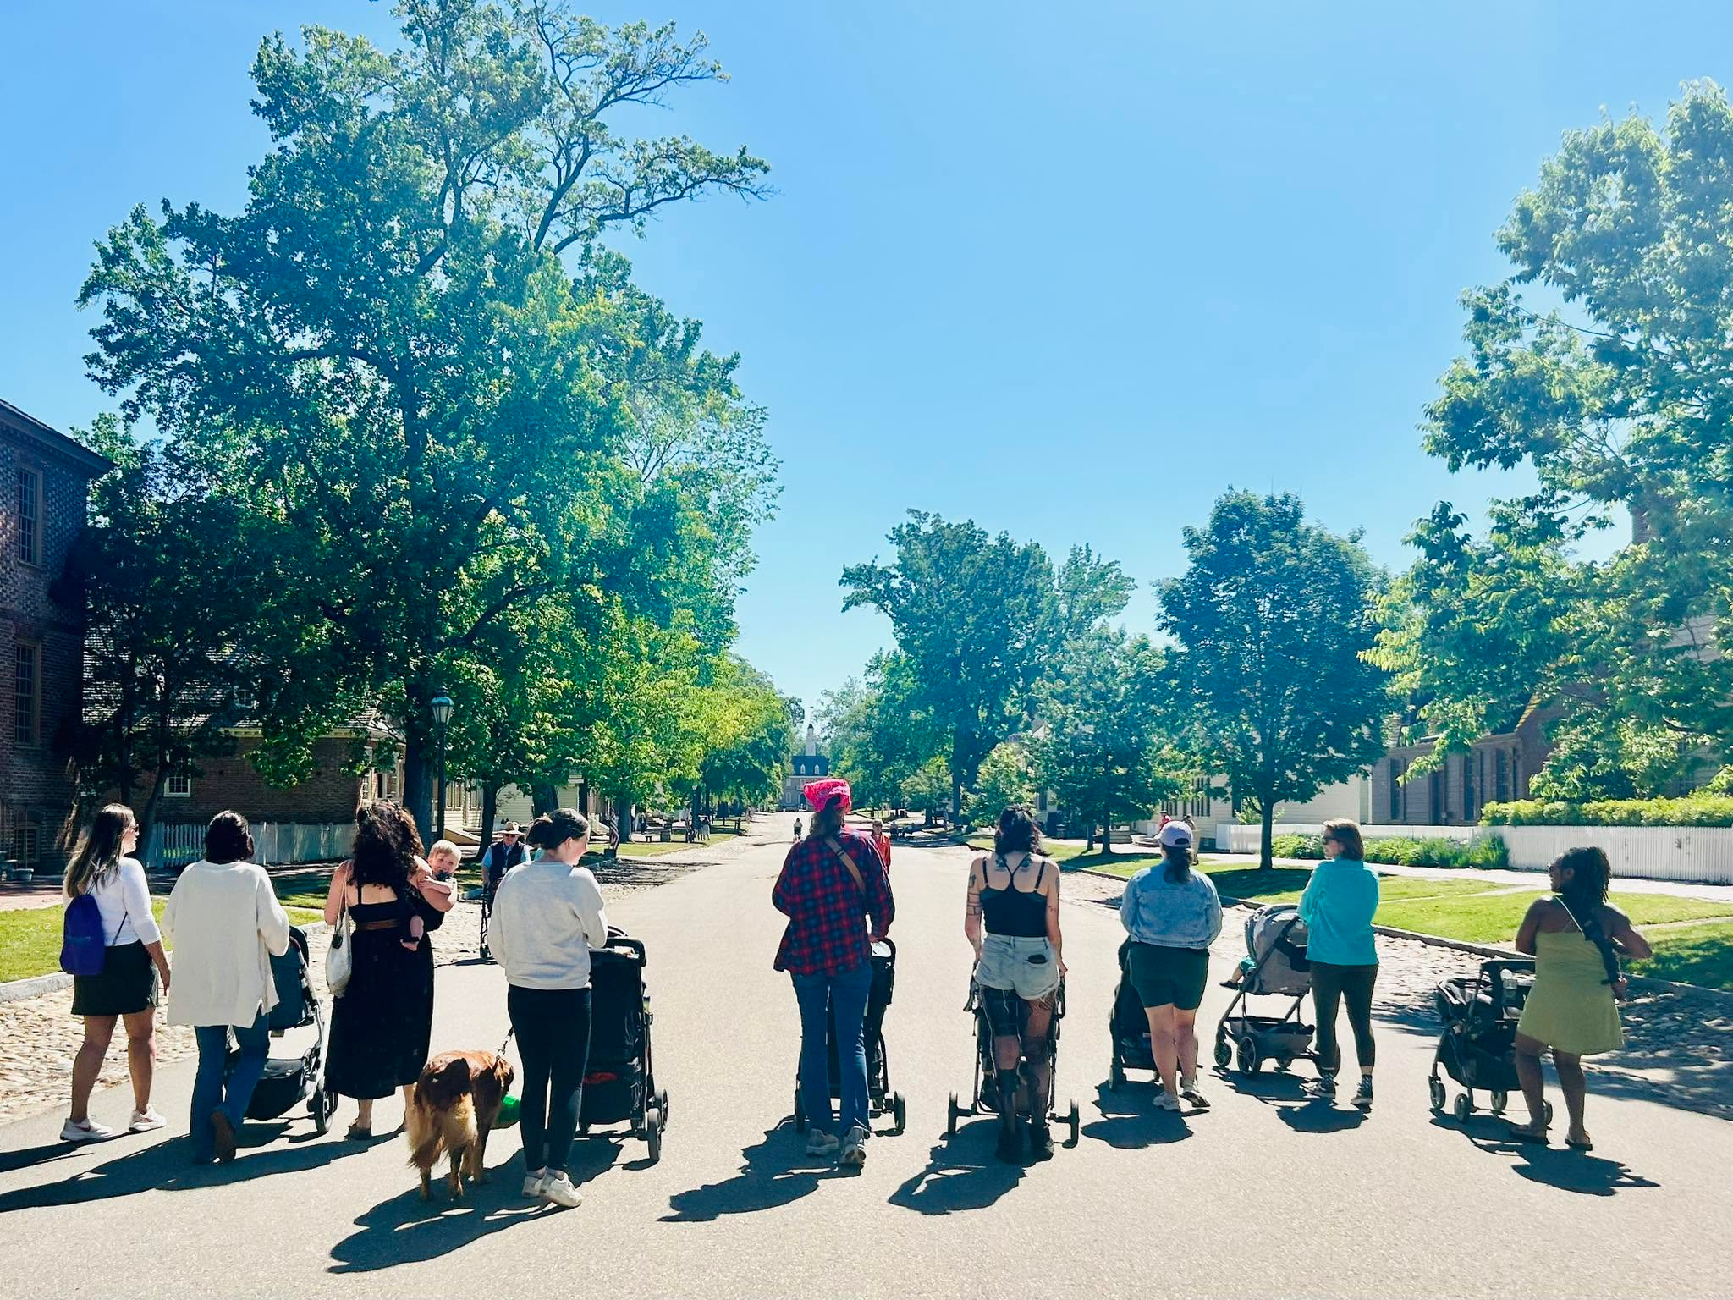
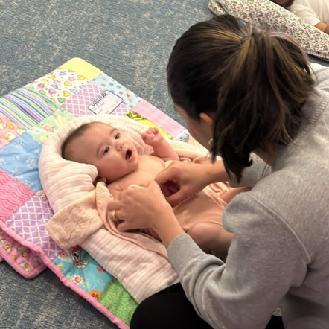
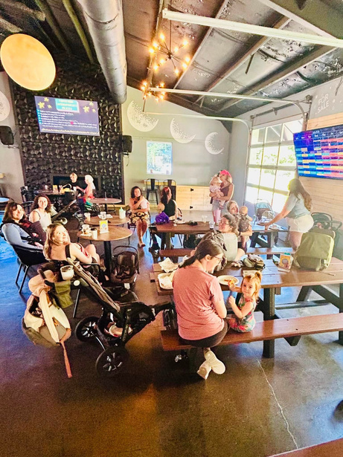
The strongest thing we
built wasn't a program.
It was a community.

Slide 16

Building Partnerships:
Between health centers and maternal health community programs
Notes:
JK - transition slides

Slide 17
Ways to Partner
Refer
Coordinate
Collaborate
Co-Create
  share information
  make referrals
  connect families to services
  Design solutions jointly
  Share leadership
  Build systems around families
  communicate regularly
  streamline handoffs
  reduce barriers
  Align goals
  Problem-solve together
  Use data to improve outcomes
Notes:
JK

Slide 18

How to find your local home visiting program and make referrals:
Connect directly with program(s) in your area
Utilize Coordinated Referral Systems
Notes:
CB

Slide 19
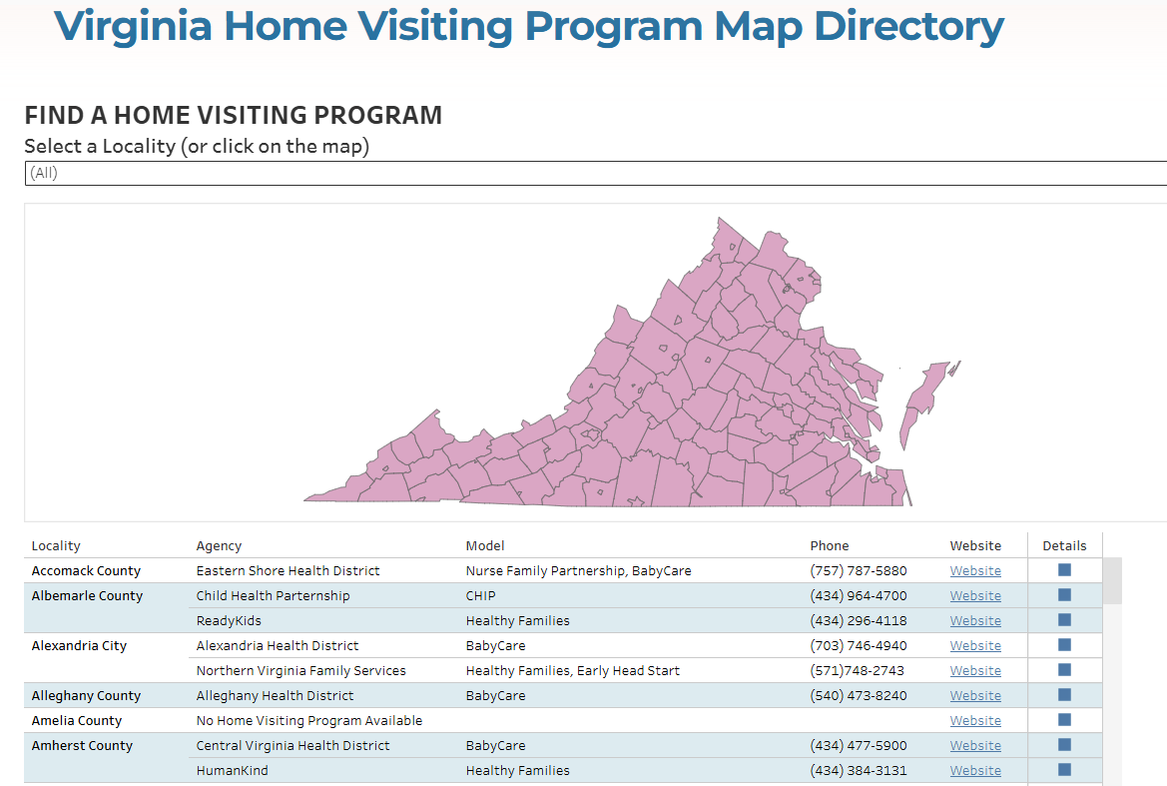
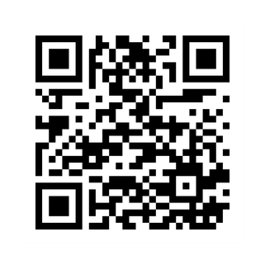

earlyimpactVA.org/Directory
Access HERE!
Notes:
CB

Slide 20
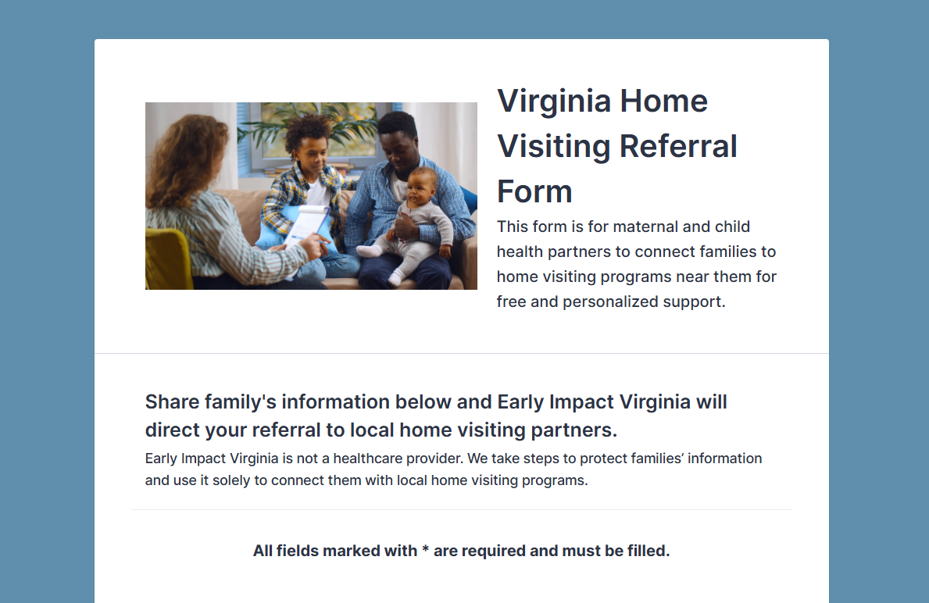
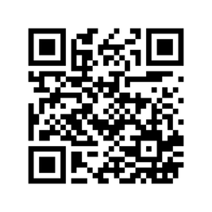
Access HERE!
Notes:
CB

Slide 21






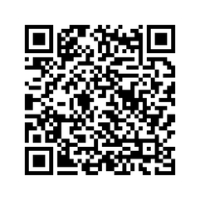

Home Visiting programs across Virginia have capacity to serve more families
Your partnership helps continue to expand our impact!
57,395
Home Visits*
11,721
5,692
Screenings*
Families Served
Including child developmental screening,
caregiver depression screening, intimate partner
violence screening and substance use screening
6,806
1,940
Children Served*
Pregnant
Women Served
$38M
591+
Partnership Interest Form
Total
Investment*
Dedicated
Professionals
FY2025
Notes:
JK

Slide 22
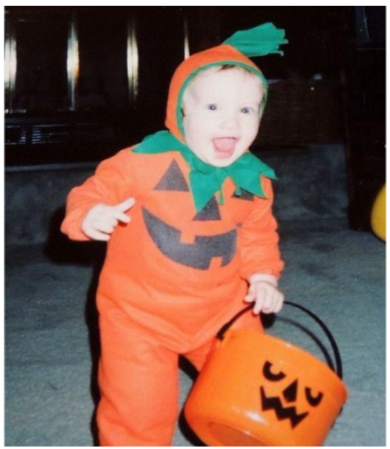

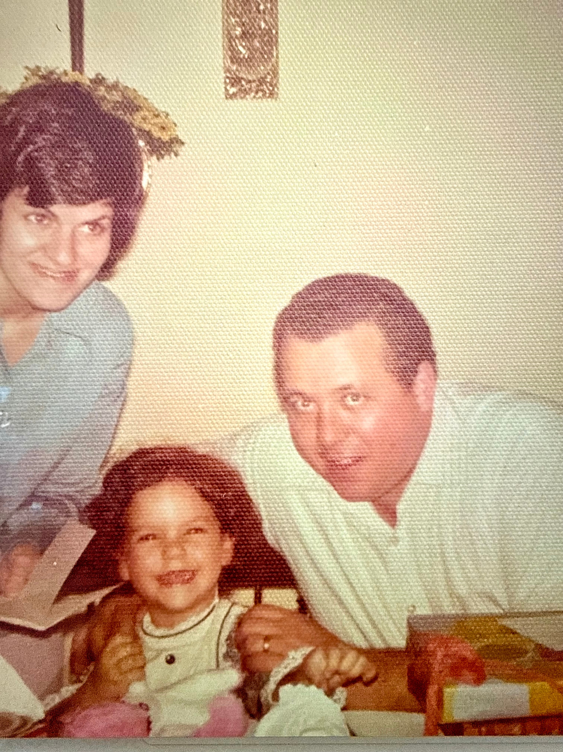

QUESTIONS?
Jamara
Kelley
Caitlyn
Kara
Thanks for joining us!
Notes:
JK

Slide 23
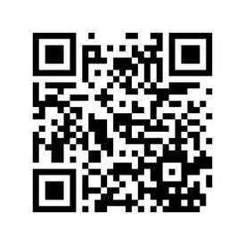
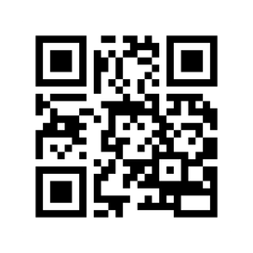
If you have any questions
or would additional information,
please reach out!
cdr.org
earlyimpactva.org
karat@cdr.org
kelleym@cdr.org
CBerry@earlyimpactva.org
JKnight@earlyimpactva.org
We look forward to partnering more with you!
Notes:
JK

Slide 24
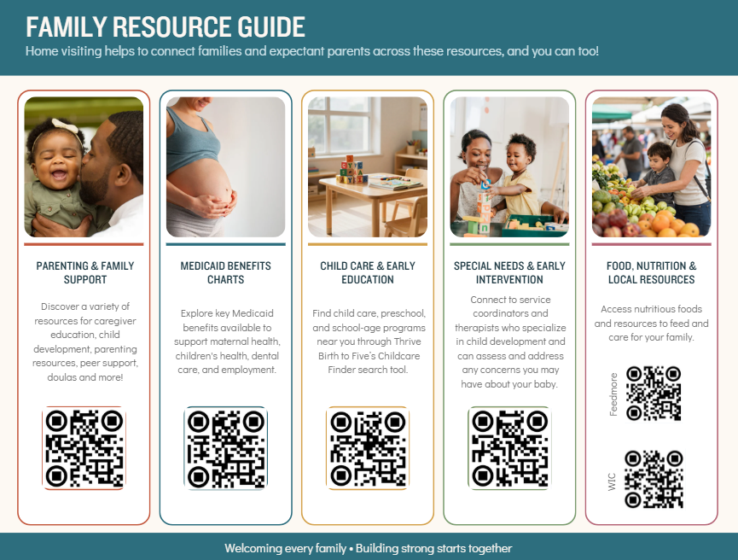
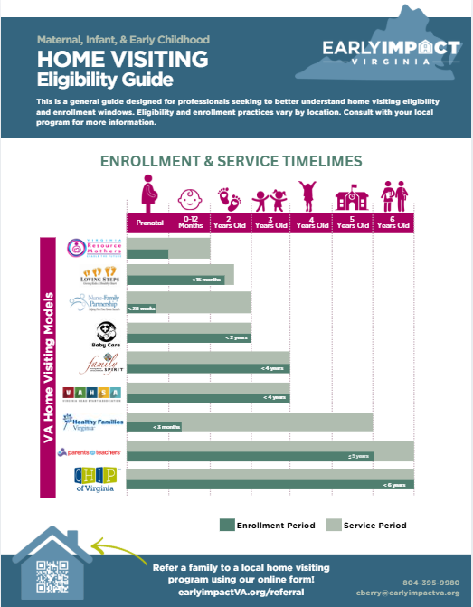

Need
resources?
We have posters, postcards, flyers, coloring sheets & more available!
Notes:
CB

Slide 25

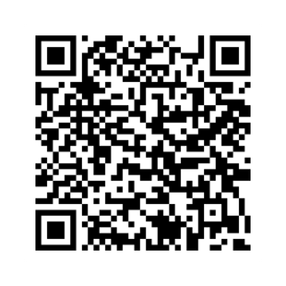
Join us for our upcoming webinar!

