Slide 1


How to Develop a
VISION + ACCESS + SUSTAINABILITY
Profitable and Sustainable
Optometry Program
in Your Community Health Center
chcoptometry.com
Virginia Community Healthcare Association
Dr. John Fusselman
Notes:
Open with the promise that this will be a practical conversation about creating access in a way the individual health center can sustain. The QR code links to https://chcoptometry.com.

Slide 2
INTRODUCTION
02
Dr. John Fusselman
Optometrist • Practice Developer • Healthcare Innovator
PRESIDENT
PRESIDENT
Community Health Optometry
Eyecare of Central Florida
BOARD MEMBER
DEVELOPER
Clinicians for the Underserved
Access Pod and EyePod
30+ years in optometry and practice development
Based in Sarasota, Florida
Notes:
Use this slide for a brief introduction. Keep the spoken biography short and transition quickly into why community health-center optometry matters.

Slide 3
03
OUR GOAL
Notes:
Pause, then advance to reveal the first goal.

Slide 4
04
OUR GOAL
PROFITABLE
Notes:
Pause, then advance to reveal the second goal.

Slide 5
05
OUR GOAL
PROFITABLE
SUSTAINABLE
Notes:
Explain that both profitability and sustainability are required. The model must be designed around the individual health center.

Slide 6
YOUR PRESENTER
06
I have spent my career building optometry practices.
Developed a chain of private clinics, including the first Spanish-based clinic
Developed 20 clinics in FQHCs in 5 states
Notes:
Briefly describe developing a chain of private practices, including the first Spanish-based clinic, followed by developing 20 community health center optometry clinics across five states.

Slide 7
WHAT I EXPECTED
07
I thought these clinics were about…
DIABETIC
RETINOPATHY
GLAUCOMA
EYE DISEASE
Notes:
Use the familiar Georgia opening. These are important services, but they are not the complete reason for bringing optometry into the health center.

Slide 8
THE REFRAME
08
But I was wrong.
Notes:
Pause here for approximately three seconds, then advance to the next build.

Slide 9
THE REFRAME
09
But I was wrong.
WHY > HOW
Notes:
Explain that the need comes first. Equipment, staffing, reimbursement and delivery models come later.

Slide 10
WHAT PATIENTS NEED
10
Comprehensive Optometry
Notes:
Pause here for approximately three seconds, then advance to reveal the second half of the idea.

Slide 11
WHAT PATIENTS NEED
11
Comprehensive Optometry
with Affordable Optical
Notes:
Expand verbally on why affordable optical completion is essential.

Slide 12
THE MINDSET
12
There are no problems.
Notes:
Pause, then advance to reveal the second line.

Slide 13
THE MINDSET
13
There are no problems.
I just need better thinking.
Notes:
Use the reveal for emphasis. Constraints do not always mean no; they may mean a different model.

Slide 14
PART OF THE PROBLEM
14
No optometry schools in:
VIRGINIA
Notes:
Pause, then advance to reveal the next state or district.

Slide 15
PART OF THE PROBLEM
15
No optometry schools in:
VIRGINIA
WEST VIRGINIA
Notes:
Pause, then advance to reveal the next state or district.

Slide 16
PART OF THE PROBLEM
16
No optometry schools in:
VIRGINIA
WEST VIRGINIA
MARYLAND
Notes:
Pause, then advance to reveal the next state or district.

Slide 17
PART OF THE PROBLEM
17
No optometry schools in:
VIRGINIA
WEST VIRGINIA
MARYLAND
NORTH CAROLINA
Notes:
Pause, then advance to reveal the next state or district.

Slide 18
PART OF THE PROBLEM
18
No optometry schools in:
VIRGINIA
WEST VIRGINIA
MARYLAND
NORTH CAROLINA
SOUTH CAROLINA
Notes:
Pause, then advance to reveal the next state or district.

Slide 19
PART OF THE PROBLEM
19
No optometry schools in:
VIRGINIA
WEST VIRGINIA
MARYLAND
NORTH CAROLINA
SOUTH CAROLINA
WASHINGTON, D.C.
Notes:
Use the completed list to frame the regional recruitment challenge. The list was supplied by the presenter.

Slide 20
FACT
20
Most health centers in Virginia do not offer optometry.
27
4
23
reviewed
with optometry
without optometry
Notes:
Use these as working counts from the presenter-maintained spreadsheet. The point is not an audit; it is the amount of room to improve access.
[Sources]
- VA Fqhc.xlsx — presenter-maintained Virginia health-center working list (2026)
[/Sources]

Slide 21
21
A DIVERSE STATE
A unique, customized approach for each FQHC.
Notes:
Discuss metropolitan, rural and very rural communities, and why each health center needs an approach designed around its own patients, geography, workforce and resources.

Slide 22
WHAT WE HAVE SEEN
22
A Proven, Reproducible Model.
Notes:
Tell the Florida and Tennessee growth stories verbally. Several programs began at one site or with limited days and expanded after the model was proven.

Slide 23
A PROVEN PROCESS
23
From plan to performance.
1 BUSINESS PLAN
2 SPACE
3 RECRUITMENT
4 CREDENTIALING
→
→
→
↓
8 MONITORING
7 BILLING / RCM
6 STAFF TRAINING
5 EQUIPMENT
←
←
←
Notes:
Walk through the sequence: business plan, space, recruitment, credentialing, equipment, staff training, billing and revenue-cycle management, and ongoing monitoring.

Slide 24
START WITH THE BUSINESS MODEL
24
Using proven projections based on:
PATIENT VOLUME
PAYER MIX
AVERAGE VIRGINIA MEDICAID
AND MEDICARE PPS RATES
Your health center should be able to add a valuable service line and a new income stream—even with a part-time clinic.
Notes:
Explain that the projections are customized. Patient volume, payer mix and the health center's Medicaid and Medicare PPS rates are used to determine whether a full-time or part-time clinic is appropriate.

Slide 25
SPACE
25
A practical clinical footprint.
1–2 EXAM ROOMS
PRETEST ROOM
OPTICAL
300–400 SQ. FT.
Notes:
Discuss a typical footprint: one or two exam rooms, a pretest room and optical, often within approximately 300 to 400 square feet.

Slide 26
BUILDING THE CLINIC
26
Support at every stage.
EQUIPMENT
Preferred vendor discounts
Notes:
Pause, then advance to reveal the next area of support.

Slide 27
BUILDING THE CLINIC
27
Support at every stage.
EQUIPMENT
Preferred vendor discounts
RECRUITMENT
Finding the right people
Notes:
Pause, then advance to reveal the next area of support.

Slide 28
BUILDING THE CLINIC
28
Support at every stage.
EQUIPMENT
Preferred vendor discounts
RECRUITMENT
Finding the right people
STAFF TRAINING
Structured training programs
Notes:
Pause, then advance to reveal the next area of support.

Slide 29
BUILDING THE CLINIC
29
Support at every stage.
EQUIPMENT
Preferred vendor discounts
RECRUITMENT
Finding the right people
STAFF TRAINING
Structured training programs
MONITORING
Ongoing performance support
Notes:
Explain the ongoing support provided through equipment purchasing, recruitment, staff training and program monitoring.

Slide 30
FULL IMPLEMENTATION
30
We take you from zero to a fully functioning clinic.
With ongoing performance metrics.
Notes:
Explain that the work continues beyond opening day. Ongoing metrics identify what is working and where adjustments are needed.

Slide 31
MARKET FORCES
31
The profession is changing.
LIMITED RURAL
RECRUITMENT
PRIVATE EQUITY
AGING POPULATION
Notes:
Discuss private-equity competition, increasing demand from an aging population and the limited number of optometrists seeking rural practices.

Slide 32
A NEEDS-BASED ANALYSIS
32
The right model for every clinic.
FULL-TIME OR
PART-TIME OD
RETINAL IMAGING
PROGRAM
TELE-OPTOMETRY /
REMOTE EYE EXAM
HYBRID PROGRAM
Notes:
The recommendation may be a full-time or part-time optometrist, retinal imaging, tele-optometry or a remote eye exam, or a hybrid program. The clinic's need determines the model.

Slide 33
ONE MORE PROBLEM
33
What if there is no space?
Or the need for multi-site care?
Notes:
This sets up the Pod concept as a response to a real operating problem rather than an advertisement.

Slide 34
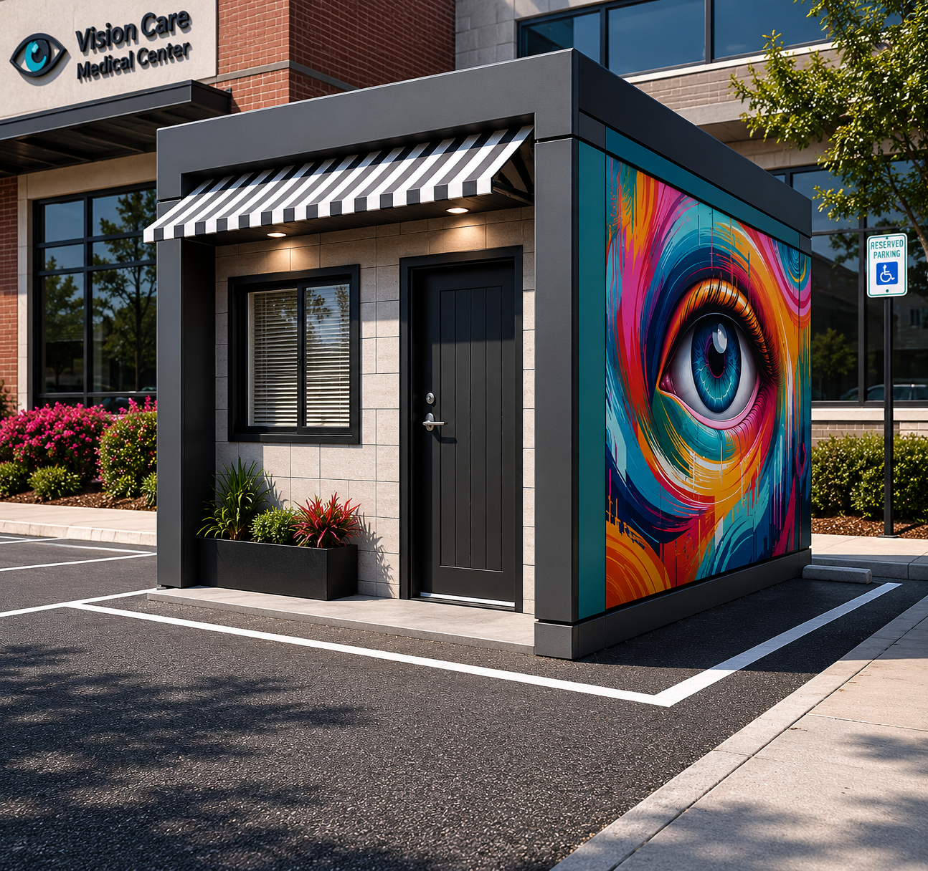
EyePod
A vision clinic where the community needs it.
PLUG & PLAY
Better access. Smarter solutions. Healthier communities.
Notes:
Present EyePod as a plug-and-play vision clinic. Explain the possible uses verbally: dedicated site, moving among locations, school-based or hybrid.
[Sources]
- EyePod concept image supplied by presenter
[/Sources]

Slide 35
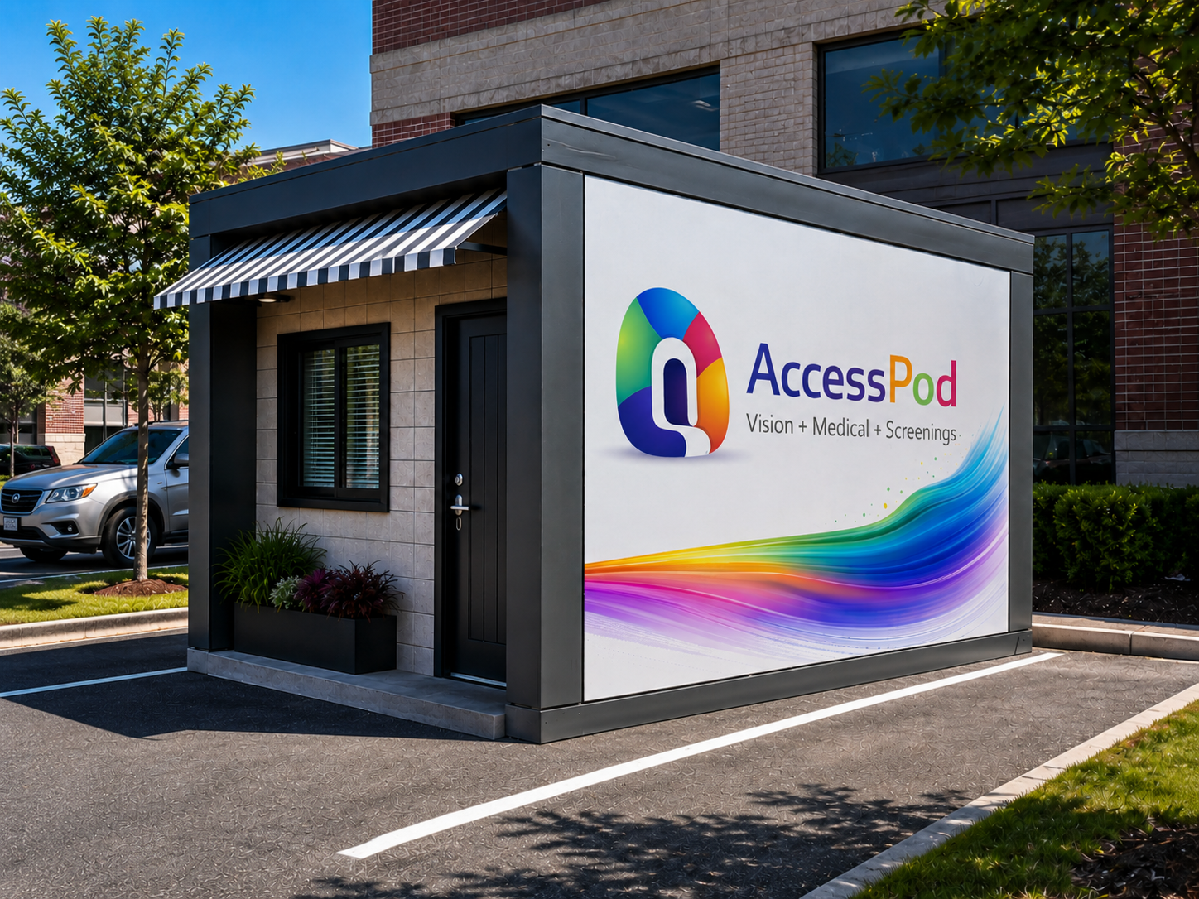
ACCESS POD
35
Access Pod
VISION • MEDICAL • SCREENINGS
Care beyond clinic walls.
NO BUILD-OUT
EASY TO RELOCATE
BUY • LEASE
SUPPORT HYBRID CARE
Notes:
Present Access Pod as a clinical space that is easy to relocate, can serve one location or move among several, and can support vision, medical and screening services. It reduces the need for an interior building project.
[Sources]
- Access Pod concept image supplied by presenter
[/Sources]

Slide 36
Any Questions?
Dr. John Fusselman
407-620-5356
chcoptometry.com
CommunityHealthOptometry@gmail.com
SCAN TO CONNECT
Better access. Smarter solutions. Healthier communities.
Notes:
Invite questions and leave this contact slide visible. The QR code opens chcoptometry.com.

