Slide 1







We Will All Hang Together or We Will Hang Separately - Why CHC’s Must Lead the Primary Care Movement in the US
April 24, 2023
Virginia Community Healthcare Association
September 17, 2026
Christopher Koller
WWW.MILBANK.ORG

Slide 2
Agenda
Introductions
Not just a Movement but a Revolution
Acts of Tyranny
Why the CHC’s Need to Lead
What is Your Declaration of Independence?
Finding Your Battles

Slide 3
Introductions
(no financial arrangements to disclose)

Slide 4

About Ariadne Labs
4

Slide 5

Vision and Mission
OUR VISION
Our vision is that health systems equitably deliver the best possible care for every person, everywhere, every time.
OUR MISSION
Our mission is to save lives and reduce
suffering for people everywhere by creating scalable solutions that address system failures to improve health.
5

Slide 6
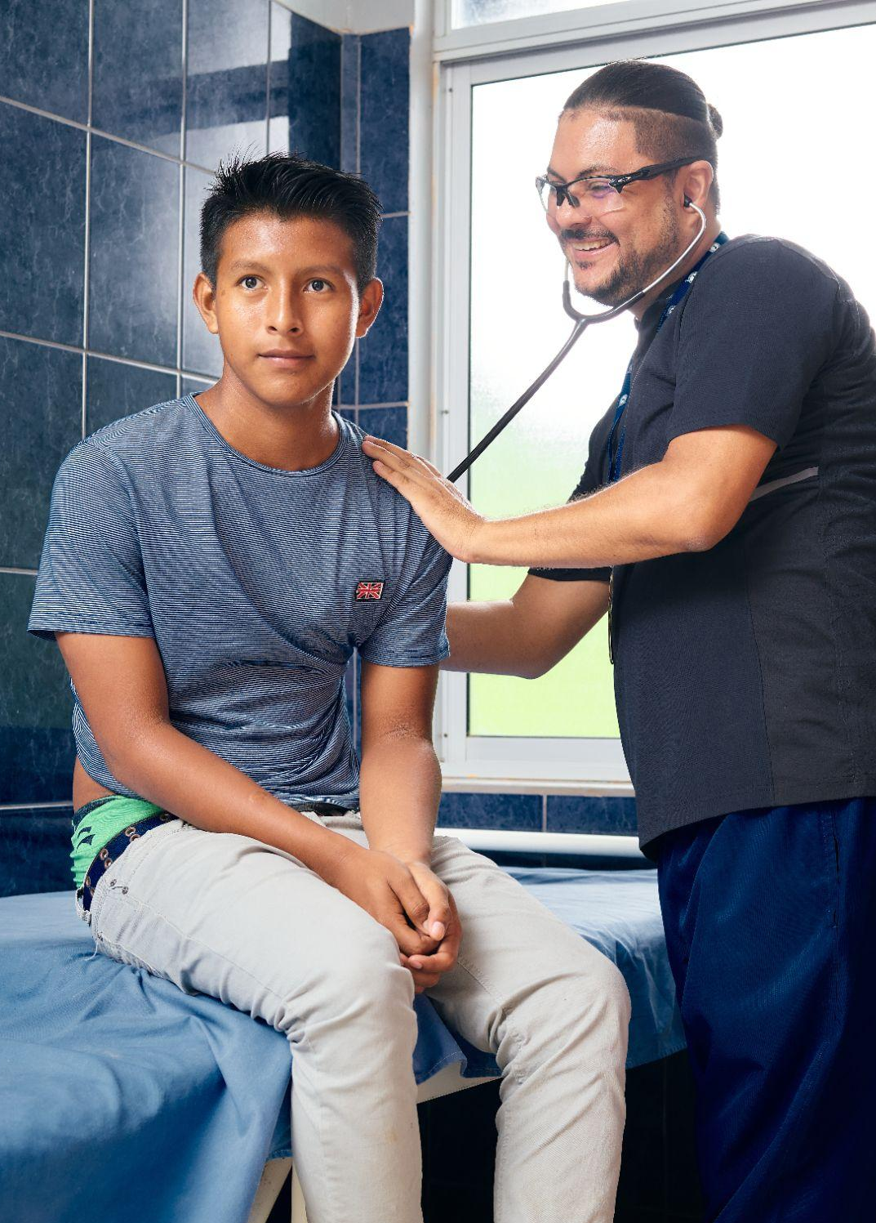
We have the breakthroughs to save countless lives around the world.
We need follow-through innovations to ensure these innovations reach every patient, everywhere.
6

Slide 7

Happy Birthday USA

Slide 8

It is Not Easy Being a A Community Health Center
Medicaid Cuts
Workforce
Rate Adequacy
340B

Slide 9
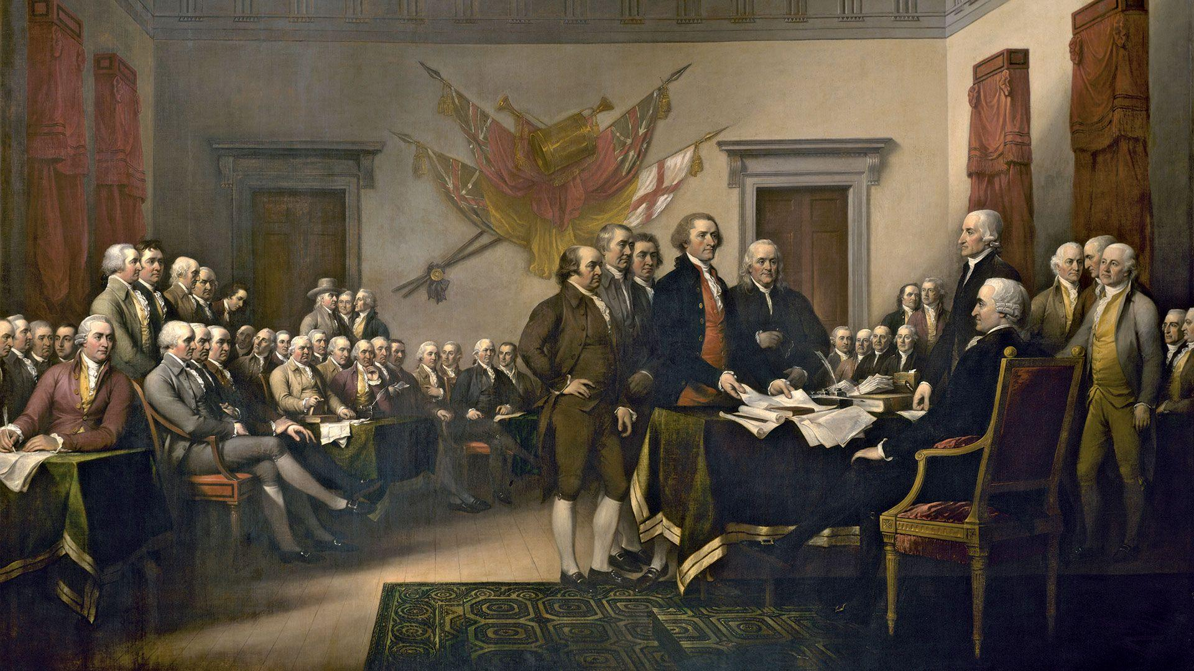
Not Just a CHC Movement …a Primary Care Revolt
John Trumbull: Declaration of Independence

Slide 10
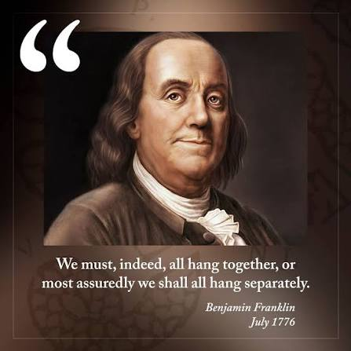

Slide 11
The State of the Colonies

Slide 12
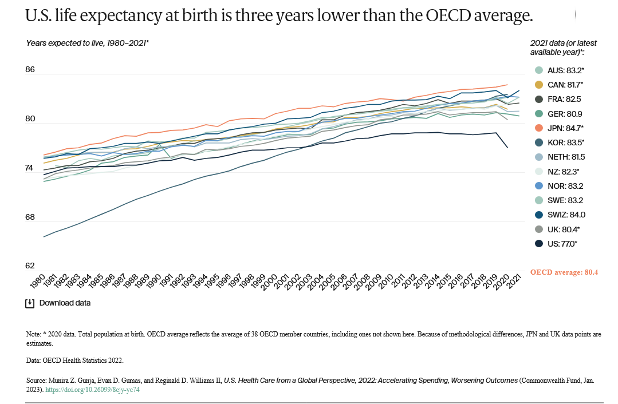

Slide 13
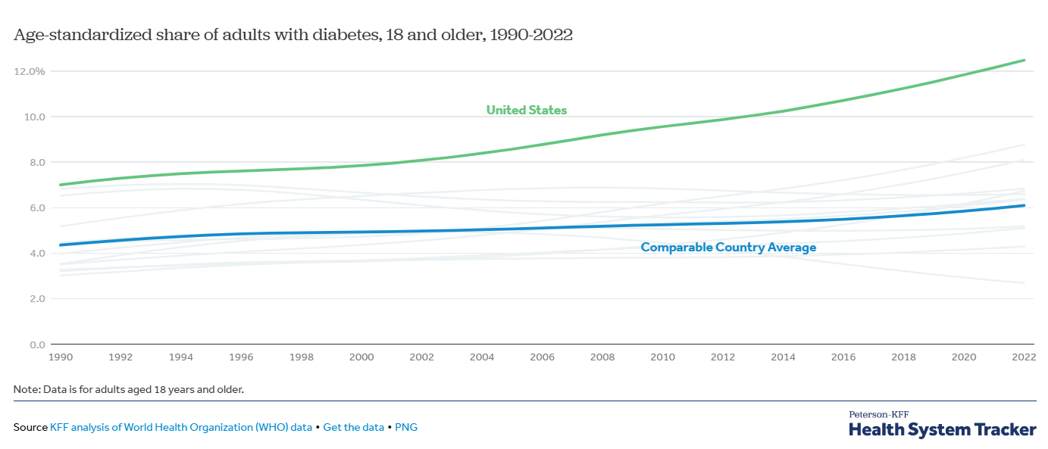
The rate of chronic diseases like diabetes rising faster in the U.S. than in peer countries

Slide 14
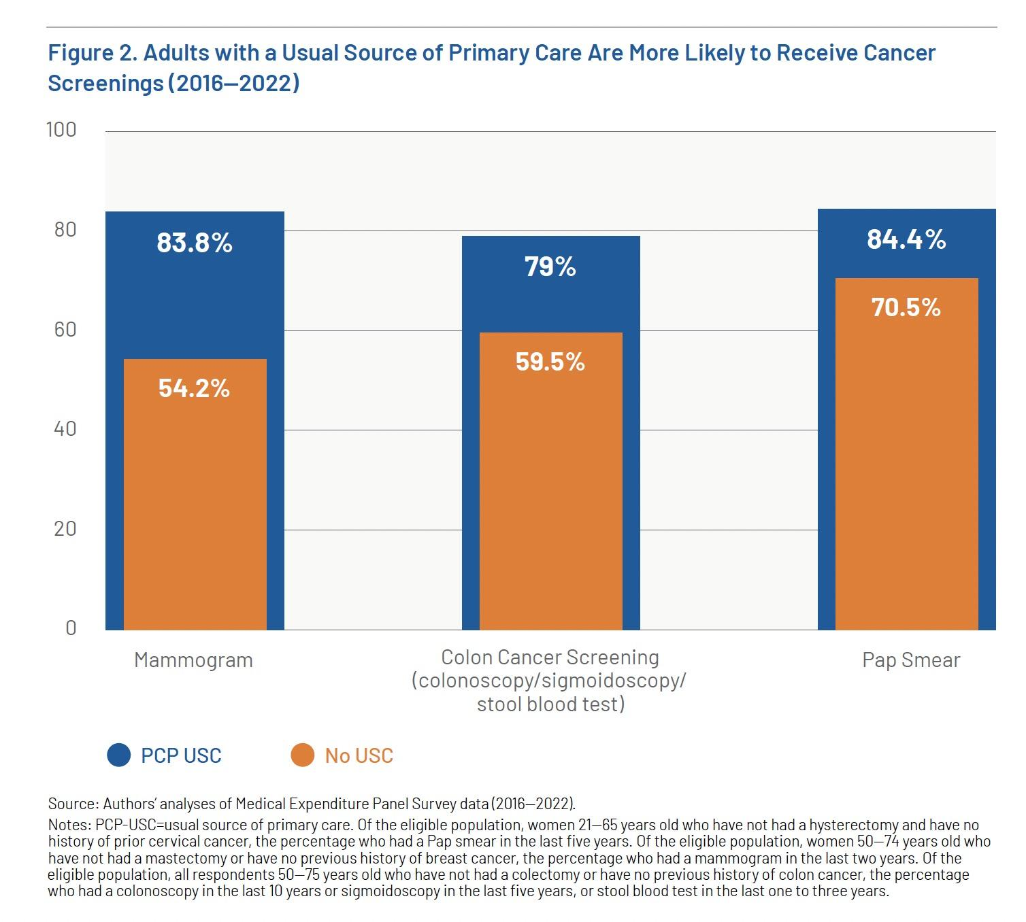
  Having a usual source of primary care = better prevention of chronic conditions:
30% more mammograms
20% more colon cancer screenings
14% more Pap smears
28% more blood pressure checks
33% more cholesterol screenings
26% more tobacco screenings

Slide 15
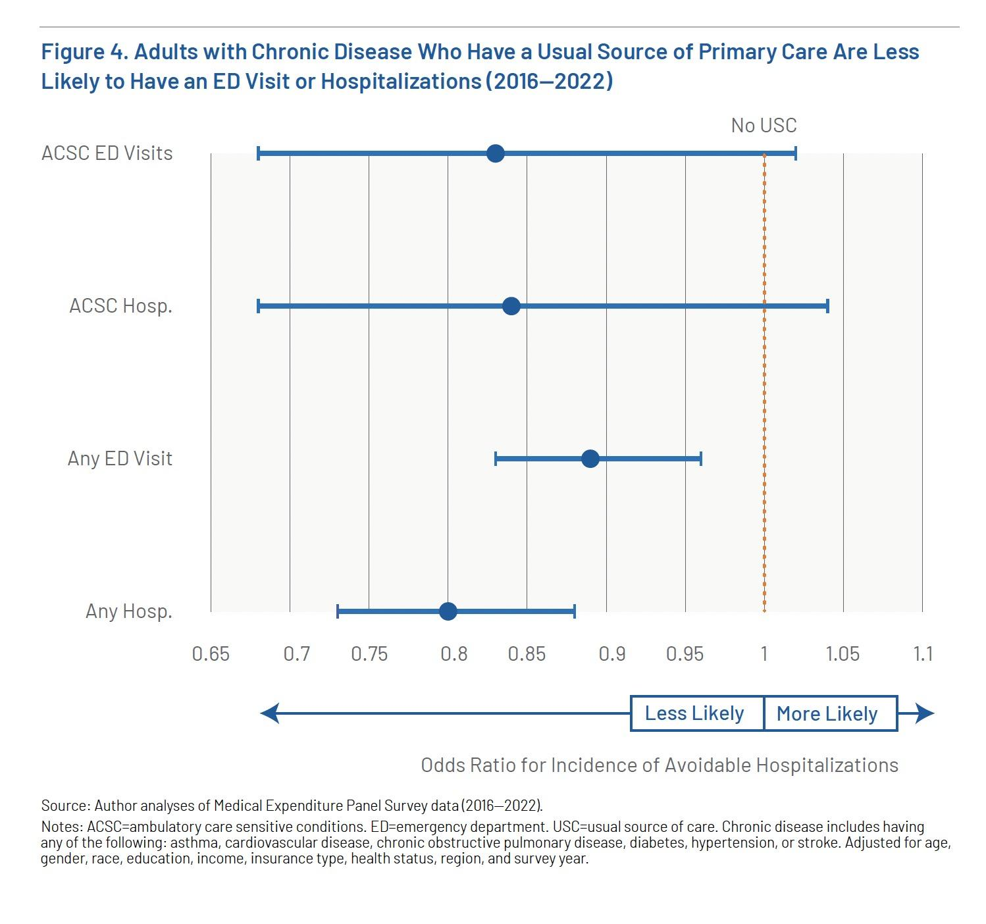
  Not just prevention but treatment: Adults with chronic disease and a usual source of primary care are…
20% less likely to have a hospitalization
11% less likely to have an ED visit
Similar results for kids

Slide 16
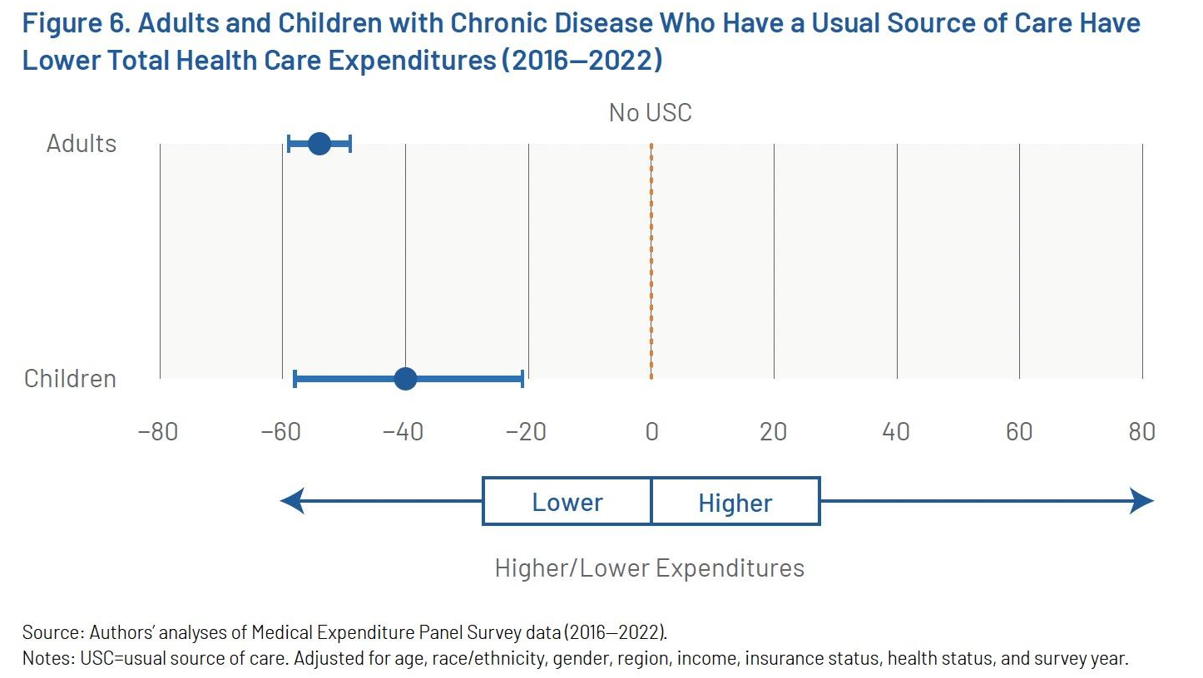
A usual source of primary care lowers total health care costs by 54% for adults and
40% for children

Slide 17
Continuity → Trust → Health:
Keeping the Same Source of
Primary Care Is Essential to
Prevent the Progression of Chronic Disease, with reductions in …
Avoidable hospitalizations
ED visits
Health care costs
See Appendix for Evidence

Slide 18
Acts of Tyranny
(2026 National Scorecard Data Dashboard on milbank.org and Virginia at vahealthinnovation.org)

Slide 19
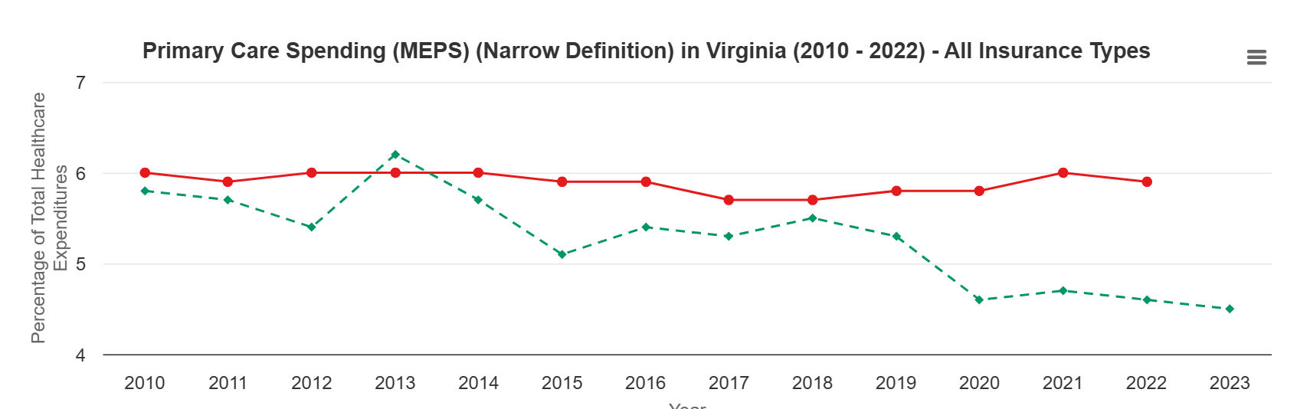
Tyranny 1: Primary Care Spending is Low & Decreasing

Slide 20
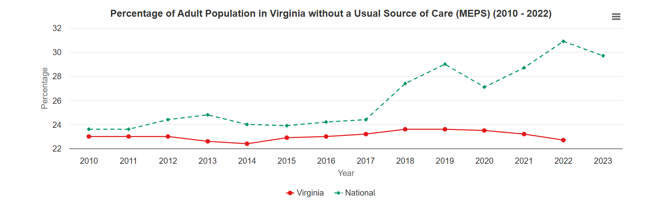
Tyranny 2: Access is Worsening

Slide 21
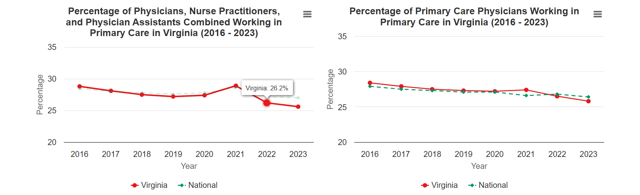
Tyranny 3: # of Primary Care Clinicians is Decreasing

Slide 22
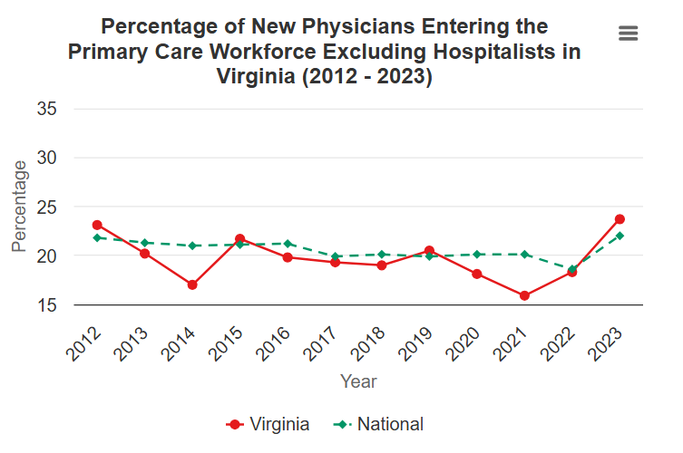
Tyranny 3 (continued)..and We are
Not Training New Primary Care Clinicians

Slide 23
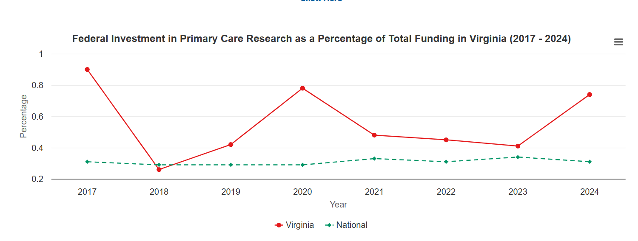
Tyranny 4: No Federal Research Money for Primary Care

Slide 24
This Did Not Happen by Accident: How Did We Get Here?
(The Tyrants of Primary Care)
Fee for Service Medicine and Physician Specialty Culture
  Medicare Fee Schedule
  Resistance to national health insurance
Hospitals
  Commercial Price Deregulation
  Health System Consolidation
  Vertical Integration
Pharma
  No Cost Effectiveness Review
(Citizen’s United Decision)

Slide 25
Technical and Narrow Fixes Are Not Enough
Fix | Problem
Increased CHC funding | Does not get you workforce
340 B | Does not get you workforce
Protect Medicaid eligibility | Does not get you workforce
Improved Productivity (AI) | See EHRs - technology is additive
More advanced practitioners | Subject to same financial pressures as MDs

Slide 26
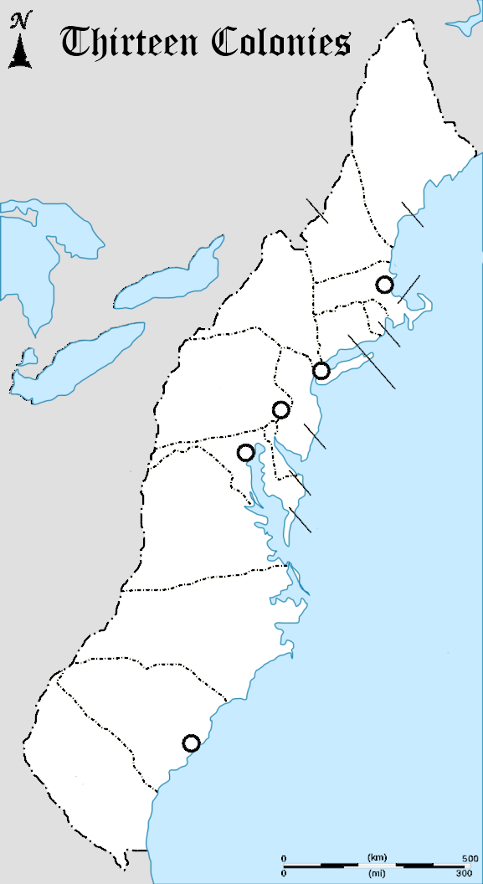
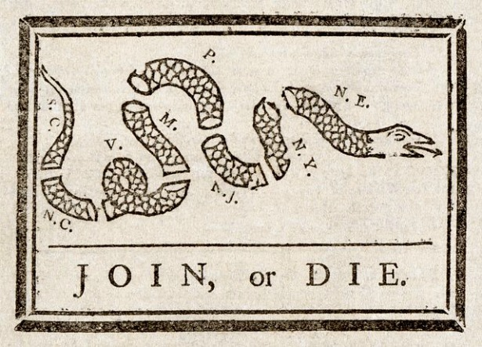
It’s Not Just CHC’s That Have Been Harmed by These Tyrannies
Rural Communities
Moms and Kids
CHC's
Low Income and Underrepresented
Elderly
Primary Care Specialties
Employers

Slide 27

The Fight For Stronger Primary Care:
CHC’s Must Take The Lead
Emmanuel Leutze

Slide 28

Reason 1: Self Interest:
Protecting PPS, 340B and Medicaid Eligibility Mean Nothing If You have No Workforce
Your “We” Must Be More Than the Health Center Movement

Slide 29
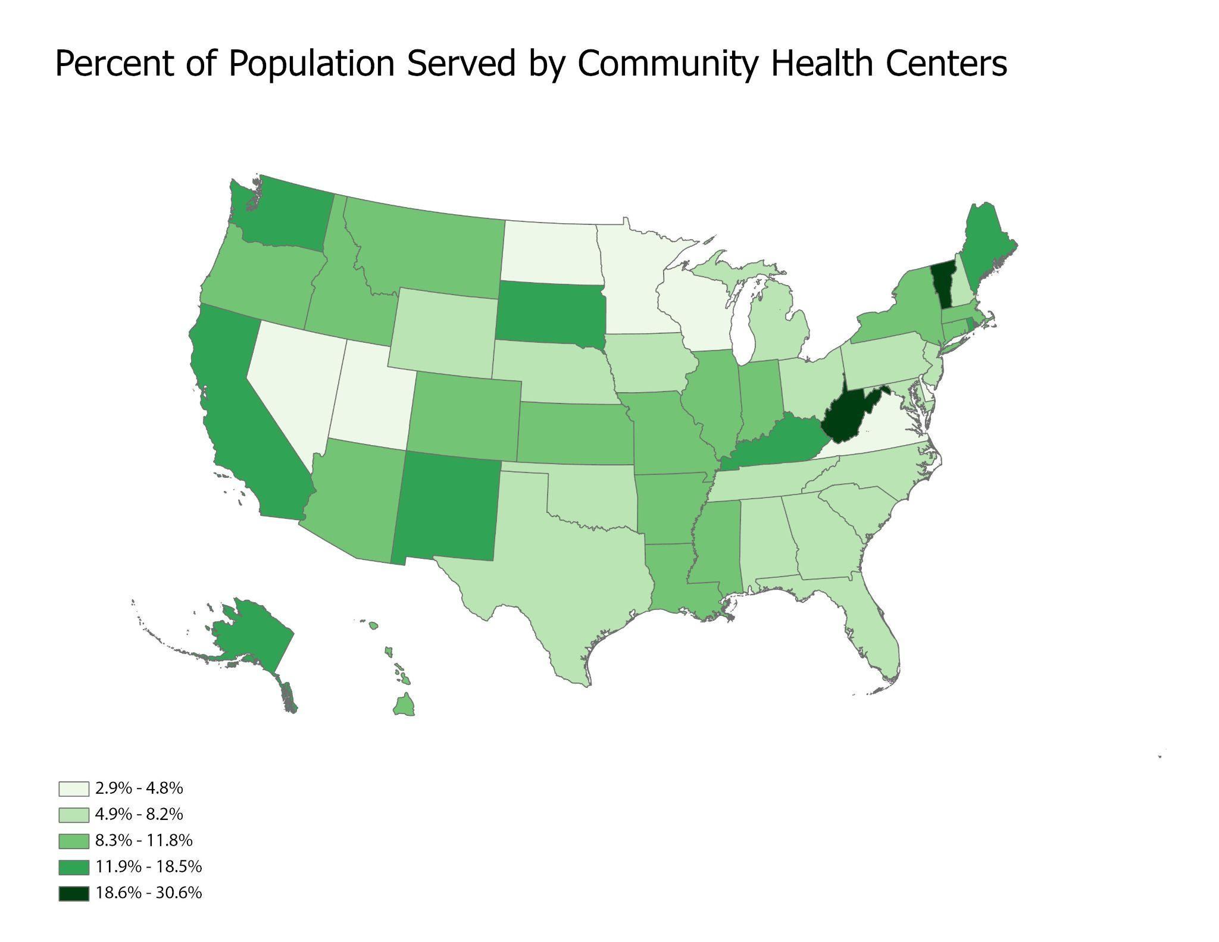
Reason #2 Largest System of Primary Care in the Country; Bipartisan Political Support
Robert Graham Center analysis of UDS data

Slide 30

Reason Three: You are Needed
Health systems employ about half of all primary care physicians but have fundamental financial conflicts with stronger primary care

Slide 31
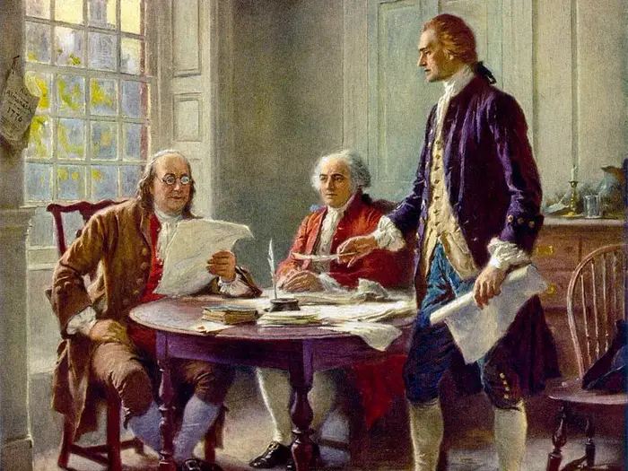
What is Your Declaration of Independence?
Jean Leon Gerome Ferris

Slide 32
What would it take to strengthen primary care in the US?
5% →
10%
Double the investment in primary care
Not just the level — also the form and the flow of spending
10% →
20%
Double the reach of primary care, starting with CHCs
Ensuring more patients have a usual source of trusted primary care
20% → 40%
Double the next generation primary care workforce
Training primary care clinicians and care teams in community-based settings

Slide 33
A Look at Virginia’s Performance
Goal 1: Primary Care Spend
The cited Milbank report uses a different data set and primary care definition than our Virginia scorecard. Using their 2022 data and definition, Virginia primary care spending as a percentage of total healthcare spending is at 4.6%. This is less than half of the proposed 2030 goal of 10%.
Using our 2023 Virginia APCD data and VTFPC narrow definition, we would need to increase primary care spend from 2.1% to 10% to meet the national goal. Using our broad definition, we would need to increase from 3.9% to 10%.

Slide 34
A Look at Virginia’s Performance
Goal 2: Share of Virginians Served Annually by Community Health Centers
Using data from the Uniform Data System (2022) and the United States Census, Virginia community health centers currently serve 4.4% of the state’s population, making it the third lowest percentage in the country (only MN and NV provide less community health center access).
Virginia is very, very far from the goal of 20% of the population being served annually by a community health center.

Slide 35
A Look at Virginia’s Performance
Goal 3: Proportion of Post-Graduate Physicians Choosing Primary Care
According to the data cited from the AMA Masterfile, 25.09% of Virginia’s post-graduate physicians chose primary care in 2022. This places Virginia in the bottom quartile of states.
Net Performance:
Looking collectively at Virginia’s performance on these three measures, our state is ranked 45/51 in its current progress toward addressing the proposed triple double.

Slide 36
The Battles are at both the Federal and the State Levels
 | Federal Opportunities
Double Investment | Medicare Valuation and New Primary Care Payment Models Accountable Care
Double Primary Care Penetration Starting With CHCs | 330 grants 340b Benefit plans focusing on primary care
Double Primary Care Workforce | Medicare GME reform Expansion of Teaching Health Centers

Slide 37

The Battles are at both the Federal and the State Levels
 | State Opportunities
Build Will and Accountability | State Primary Care Commission State Scorecard
Double Investment | Medicaid Rates Primary Care Spend Requirements in Commercial and Medicaid
Double Primary Care Penetration Starting With CHCs | PPS rules 340b Benefit plans focusing on primary care Health System Consolidation Decisions
Double Primary Care Workforce | Healthcare Workforce Information and Planning Medicaid GME reform Expansion of Teaching Health Centers Loan Forgiveness

Slide 38
Where Have CHC’s Led Primary Care Strengthening Efforts in Other States?
Primary Care Spending:
  Primary Care Development Corporation is spearheading legislation in NY to increase primary care spending
  CHCANYS (NY PCA ) is major partner and individual CHC’s have signed on to the coalition
Workforce:
  Michigan PCA sits on advisory council for MIDOCS, successful state primary care residency development project
Comprehensive Primary Care Legislation:
  PCAs in MI and MA are part of broad coalition supporting

Slide 39
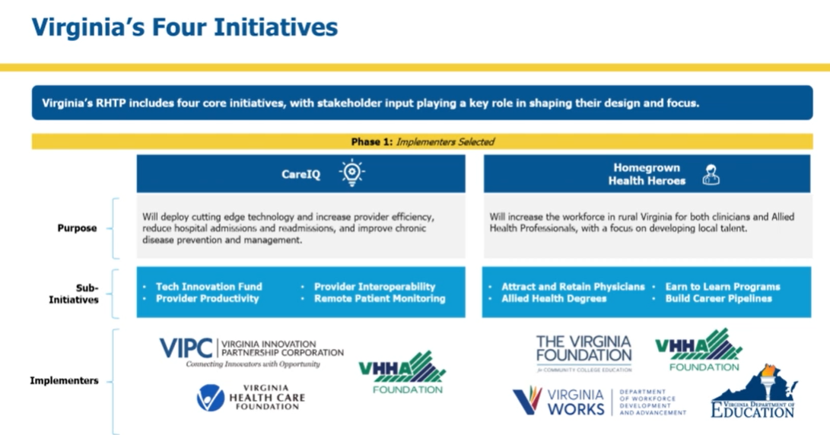
Rural Health Transformation Funds: Rose Among the Thorns of HR1
$189.5 Million to VA in Year One of Five
RFPs out on all three of these
Notes:
Areas of Focus for PC Delivery (based on application overview)
website
#1 - Care IQ - aka Innovation
Provider Productivity Fund – Supports adoption of AI-driven decision-support and workflow tools to reduce administrative burden and ease provider burnout. (administered by VA Health Care Foundation)
Provider Interoperability Fund – Helps rural providers modernize EHR systems, strengthen cybersecurity, and advance data exchange to improve coordination. (administered by VA Health Care Foundation)
Remote Patient Monitoring (RPM) Fund – Expands use of continuous monitoring technologies to track patient outcomes in facilities and at home. (administered by Virginia Hospital Research and Education Foundation)
Areas of Focus for PC Workforce
#2 - Homegrown Health Heroes ($132.0M) (aka Workforce)
Attract and Retain Physicians – Expands rural residency slots in high-priority specialties and supports long-term retention through wraparound programs.

Slide 40
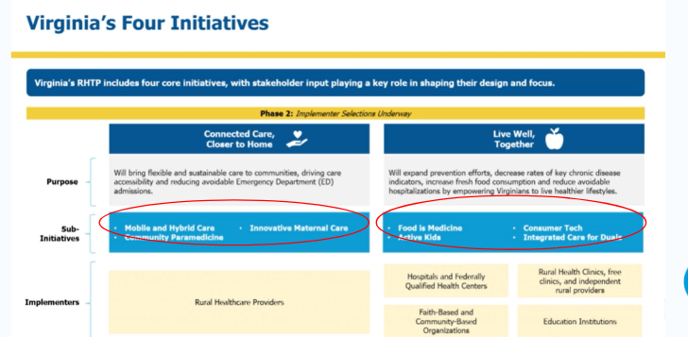
Rural Health Transformation Funds (cont’d):
Phase Two Work
Notes:
Areas of Focus for PC Delivery (based on application overview)
website
#1 - Care IQ - aka Innovation
Provider Productivity Fund – Supports adoption of AI-driven decision-support and workflow tools to reduce administrative burden and ease provider burnout. (administered by VA Health Care Foundation)
Provider Interoperability Fund – Helps rural providers modernize EHR systems, strengthen cybersecurity, and advance data exchange to improve coordination. (administered by VA Health Care Foundation)
Remote Patient Monitoring (RPM) Fund – Expands use of continuous monitoring technologies to track patient outcomes in facilities and at home. (administered by Virginia Hospital Research and Education Foundation)
Areas of Focus for PC Workforce
#2 - Homegrown Health Heroes ($132.0M) (aka Workforce)
Attract and Retain Physicians – Expands rural residency slots in high-priority specialties and supports long-term retention through wraparound programs.

Slide 41
What Role do individual CHCs Play in a Primary Care Revolt?
Support your PCA as a leading voice for primary care (not just CHC’s) in your state
  Scorecards, primary care taskforce, investment, workforce, legislation etc.
Educate your stakeholders - board and local politicians - on the value of CHC’s and a regular source of care - with stories and data
Show the success of your own workforce training programs

Slide 42
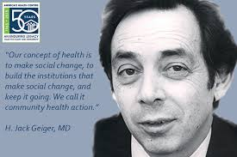

Hanging Together
The Work is Hard but the (Electric) Strength of the CHC Movement
is also the Strength of Primary Care:
The Ability to Build Trusting Relationships and Communities

Slide 43
Appendix

Slide 44
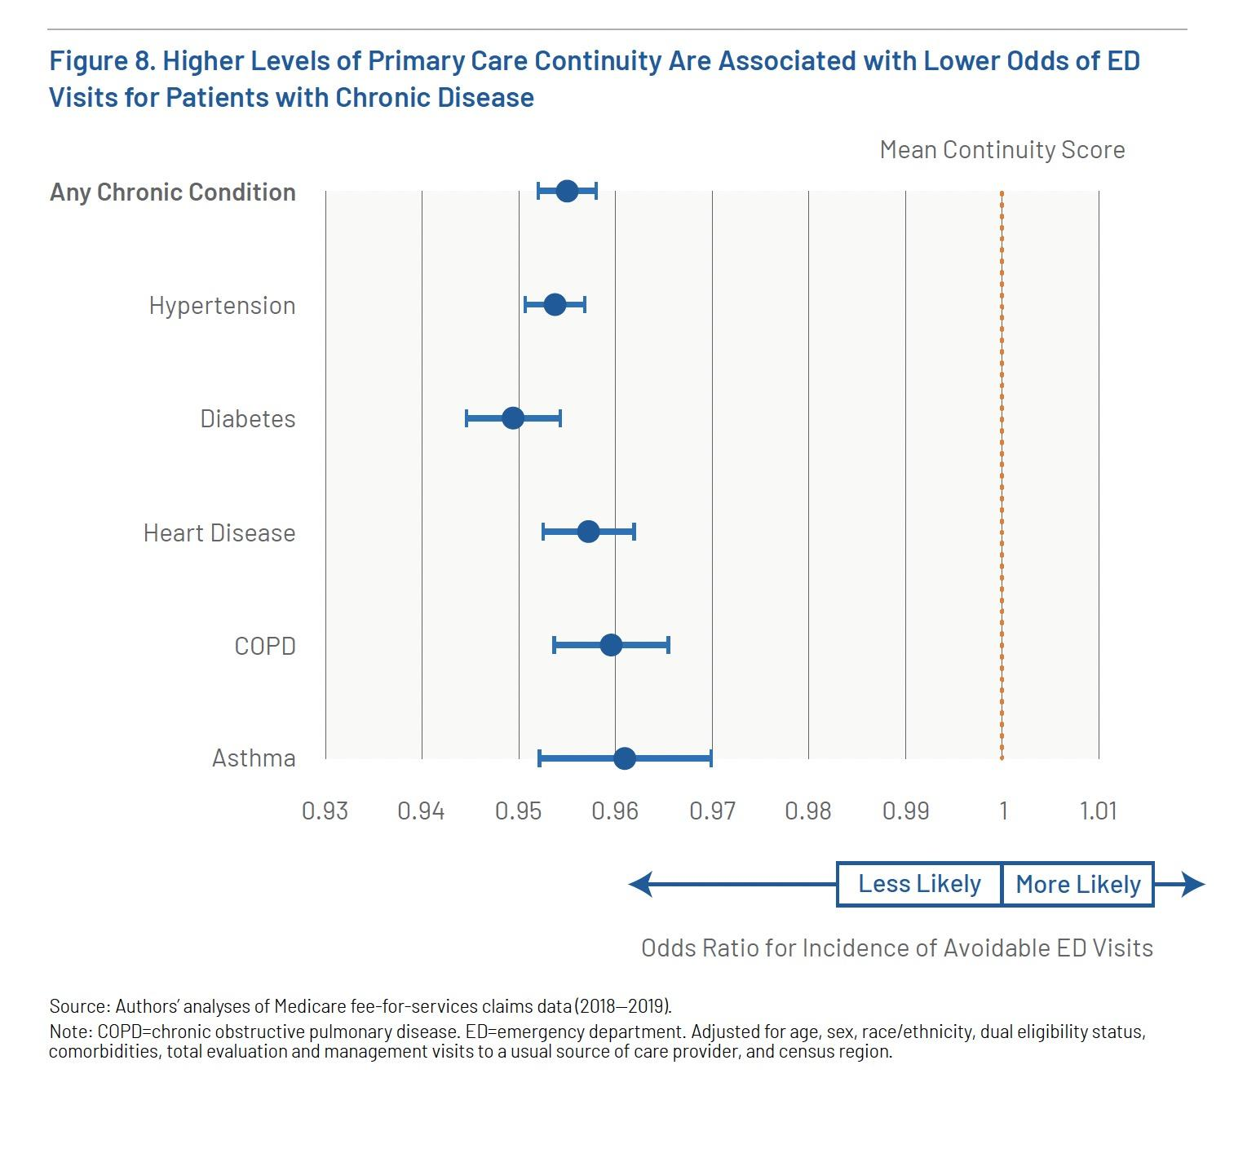
More continuity of care with a primary care clinician means…
4-5% lower likelihood of ED visits for:
  Any chronic condition
  Hypertension
  Diabetes
  Heart disease
…for every 10% increase in continuity scores

Slide 45
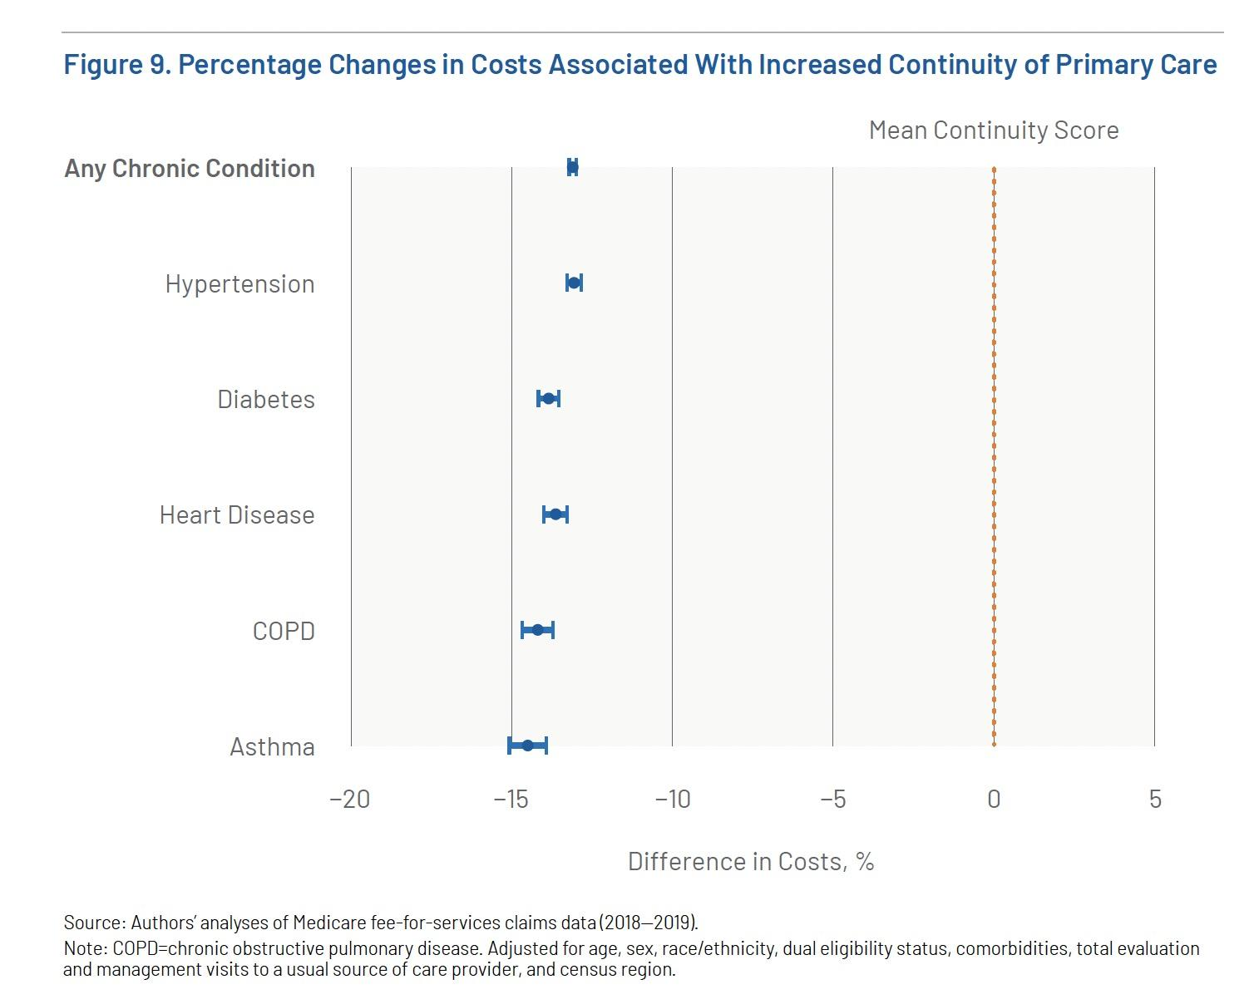
Health care costs decreased 15% for every
10% increase in continuity score

