Slide 1
Ethics In Leadership and Society
How Ethical Healthcare Leaders Can Improve Organizational Outcomes and Impact Public Policy

Slide 2
VCHA’s Mission
Advocate on behalf of member health centers
Educate member health centers
Elevate our member health centers, enhancing their ability to provide affordable, accessible, quality healthcare to the communities they serve regardless of their ability to pay.​

Slide 3
Advocacy
What does advocacy look like in an environment where there is disagreement over whether equity is a core value?
How does advocacy work where there is organized hostility toward people who have been and are patients at community health centers?

Slide 4
Effective Advocacy
Trust, Respect, and Ethics are at the heart of effective advocacy
Relationships matter
Credibility is everything
To craft your message, know your audience
Play the long game while addressing immediate needs

Slide 5
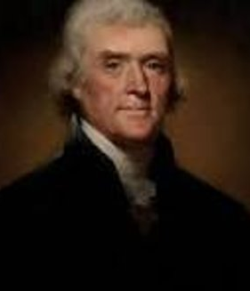
Why Focus on Ethics?
“Whenever the people are well-informed, they can be trusted with their own government.”– Thomas Jefferson​
“Public service must be more than doing a job efficiently and honestly. It must be a complete dedication to the people and to the nation.”- Margaret Chase Smith​
​
“By its very definition, civic responsibility means taking a healthy role in the life of one’s community.” – John Glenn​
​
Our focus today is on the practical application of ethics​

Slide 6

Key Ethical Concepts
Freedom of action is a key human trait
When choosing how to act, we could have made a different choice
Ethics allows us to judge what should happen

Slide 7
How to Think About Ethics
Taking Responsibility for Our Beliefs
Living a Virtuous and Authentic Life
Shapes What We Believe is Right and Wrong

Slide 8
Ethics = A Set of Behavioral Standards
What is the best course of action?
Advancing your own goals and interests?
The greatest monetary profit?
The most popular choice / Going along with the crowd?
Advancing your community’s goals/interests?

Slide 9

Can Ethics Be Taught and Learned?
“Ethical principles usually come naturally, but can also be practiced over time”
Bob Helbig: Media Partnerships Director at Energage (Employee Survey Firm)

Slide 10
Ethical Principles Can Be Learned
Accountability
Fairness
Honesty
Respectfulness
Trustworthiness
The “Golden Rule”

Slide 11
How to Practice Ethical Principles
Ask Tough Questions
Be a Great Role Model
Communicate Openly
Don’t Tolerate Meaningful Violations
Mediate Disagreements with Respect and Loyalty

Slide 12
Can Ethics Provide a Competitive Edge?
A solid moral compass helps companies flourish
Customers want to engage with ethical organizations
Ethical leadership improves daily operations
Ethical leadership powers brands and attracts/retains talent

Slide 13

Applying Ethical Principles
Must Not Do
(Right vs. Wrong)
Free To Do
(No Ethical Question)

Slide 14
Ethical Dilemma: Values in Conflict
The 8 a.m. call​
It’s a standard weekend at school. You, your roommate, and their significant other (they consider themselves in a serious relationship) and a group of friends have spent the evening watching a movie. It’s around midnight and your roommate leaves with the significant other, indicating that they will not be back that night. You go to bed and are sleeping peacefully. At 8 the next morning, you’re woken up by your phone buzzing. You answer it and find your roommate’s mother on the other end of the line. She asks a simple question: “I’ve been trying to reach Alex's cell phone, but Alex isn't responding. Do you know where Alex is?”​
What do you say?​ What values are at play or in conflict?

Slide 15
Why Does This Matter for Public Policy?​
Thinking as civic leaders, what kind of state do you want to live in?
What kind of civic leaders do you think it will take for us to have that kind of state?
What do you think the public’s perception is of Virginia’s civic leaders?

Slide 16

Consider an Ideal Leader
What characteristics/values/qualities does the ideal leader exhibit?​
Think about the ideal civic leader. Recall the qualities we want our civic leaders to have.
List five important values you think a civic leader should have​.

Slide 17
Important Values: Small Group Discussion​
A leader wants to put a plaque on the wall outside his/her office that reflects their most important values. What values ought to be on the plaque?
Develop a list of 5 words for the plaque that your group agrees would characterize an ideal leader. The plaque should read "My most important values are..."​
Compare your personal list versus what your group decides​
Select a spokesperson to report group's five values​
Ethical test using your five words: “Is a leader unethical if they are not ______________?”​

Slide 18
Commonly-Chosen Values (2006)​
Compassionate
Honest
Fair
Responsible
Respectful
Loyal
Tolerant
Trustworthy

Slide 19
Commonly-Chosen Values (2025)
Trustworthy
Honest
Hard-Working
Ethical
Loyal
Self-Aware
Respectful
Compassionate
Visionary
Communicative

Slide 20
Practical Impact:
How Do We Employ Ethics and Values to Solve Problems and Advocate Effectively?

Slide 21
The Values-Tactics Pyramid
Tactics
Strategies
Goals
Values

Slide 22
Example: Environmental Sustainability
Values: Environmental stewardship; Respect for nature and ecosystems; Intergenerational justice; Economic prosperity reliant on environmental factors; Resiliency
Goals: Reduce single-use plastic consumption globally; Increase public awareness and behavior change toward sustainable consumption; Increased reliance on sustainable materials; preserve habitats for sportsmen
Strategies: Policy advocacy and legislative reform; Public education and awareness campaigns; Corporate partnerships; pressure campaigns; social media influence
Tactics: Organizing a global “Plastic-Free July” campaign; Lobbying local governments to pass plastic bag bans or taxes; Partnering with schools to run zero-waste lunch programs; sustainable hunting regulations

Slide 23
Apply the Pyramid to Health Care Centers
What are some examples?
Values
Goals
Strategies
Tactics

Slide 24
Remember This?
Must Not Do
(Right vs. Wrong)
Ought to Do”
(Right vs. Right)
Free To Do
(no question)

Slide 25
Five Ethical Tests
1) Legal: Comply with all relevant laws and regulations?​
​2) Professional Standards: Align with established ethical​ standards of your profession?​
​3) Gut Feeling: Feel intuitively right or wrong based on your personal moral compass?​
​4) Front Page: Would you be comfortable if your action were publicly disclosed?​
​5) Role Model: Would you want your action emulated by​ someone you admire or a mentee?

Slide 26
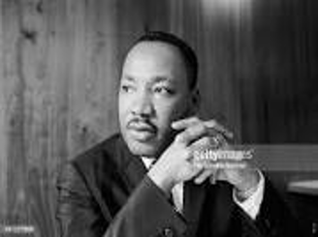
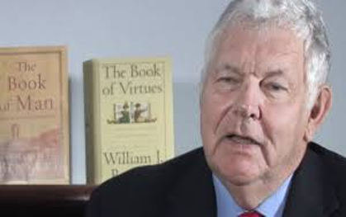
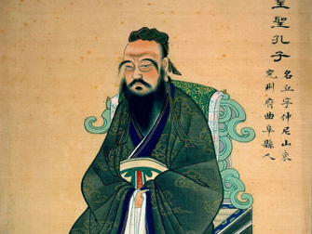
Examples of Ethical Principles
Kant's Ethical Imperatives (Duty Ethics): Right is Right, No Matter What​
Utilitarianism (Greatest Good for the Greatest Number): Right is What Helps the Most People​
Altruism: Right is Putting Others First​
​
Pragmatism: Right is What Works in Practice​
​
Rawls' Veil of Ignorance: Right is What's Fair to All, Preventing Self-interested Bias​
​
Golden Rule: Right is Doing Unto Others as You Would Have Them Do Unto You​

Slide 27
What is an Ethical Dilemma?
Right vs. Wrong is not a dilemma​
Wrong vs. Wrong can be a dilemma​
Right vs. Right is likely a dilemma​
​
If you can say truthfully: "It is right to do X" and "It is right to do the opposite of X” they you are likely facing a high-level ethical dilemma because you must prioritize one ethical choice over another. ​

Slide 28
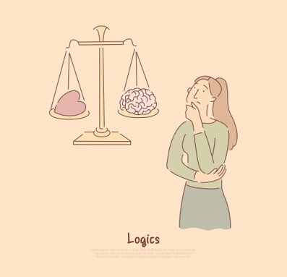
Some Types of Ethical Dilemmas​
Truth vs. Loyalty: Honesty vs. Obligations to Others​
​
Individual vs. Community: Rights of the Individual vs. Interests of Society​
​
Short Term vs. Long Term: Immediate Needs vs Long Term Impacts​
​
Justice vs. Mercy: Equal Application of Rules and Fairness to the Group vs. Compassion and Exceptions Based on Individual Circumstances​

Slide 29

Ethical Trilemma: Integrity, Duty, and Utility
Integrity can seem indifferent to broader harms; Duty can demand actions that feel cold or inhuman; Utility can alienate us from our integrity…
Integrity vs. Duty: Is compassionate lying ok or is lying always wrong (Kantian)?
Duty vs. Utility: Does killing one person to save five lives violate the prohibition against killing innocents​?
Utility vs. Integrity: Does increasing net welfare justify betraying your personal convictions?

Slide 30
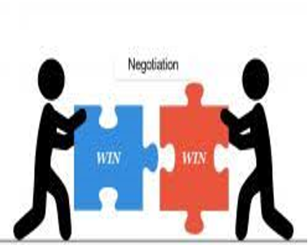
Ethical Win-Win Situations
An ethical win-win situation is an outcome to a conflict, negotiation, or partnership where all parties involved benefit, feel satisfied, and nothing unfair or immoral is required to achieve that result. It is a collaborative approach based on trust, integrity, and the belief that success does not require someone else to lose.​

Slide 31
Core Principles of an Ethical Win-Win​
Mutual Gain: Both parties feel they gained value.​
Focus on Interests, Not Positions: Instead of arguing over "I want X," parties explore "Why do I want X?" This allows for creative solutions that meet underlying needs for each party.​
Integrity and Trust: The solution does not rely on manipulation, deception, or coercion.​
Sustainability: Because it is fair, it often leads to better long-term relationships and future collaboration.​
Win-Win or No Deal: If a fair solution cannot be found that benefits both, the parties agree to walk away voluntarily rather than forcing a harmful deal.​

Slide 32
Is the Win-Win Situation Unethical?
An unethical "win-win" might seem like both sides benefit, but can involve hidden costs, such as exploiting a third party (e.g., child labor to lower prices) or using dishonest tactics.​
"If you are not at the table, you may be on the menu."​
​
Are both the process and outcome ethical?

Slide 33
Other Important Factors​
IS IT YOUR dilemma OR someone else’s?
Are other people involved?
Did someone else’s unethical behavior place you in a dilemma?

Slide 34
A Useful Process to Follow
Recognize Ethical Issue(s)
Consider the Parties Involved
Gather Relevant Information
Formulate Actions / Consider Alternatives
Consider the Consequences
Make a Decision
Act
Reflect on the Outcome

Slide 35
Steps in Ethical Decisions​ #1
Is there an ethical issue? ​Is it my problem?​ Gather relevant facts​

Slide 36
Steps in Ethical Decisions #2​
​Test for right vs. wrong​ Test for right vs. right Apply Ethical Principles​
paradigms​

Slide 37
Steps in Ethical Decisions​ #3
Is There a Win-Win Make the Decision​ Revisit and Reflect on
Scenario​? the Decision​

Slide 38
Quotes to Consider​
On Leadership By Example: "Ethics must begin at the top of an organization. It is a leadership issue, and the chief executive must set the example." Edward Hennessy.​
​
On Scientific Progress: "As our own species is in the process of proving, one cannot have superior science and inferior morals. The combination is unstable and self-destroying." Arthur C. Clarke. ​

Slide 39
Quotes to Consider​
On Government Responsibility: "No responsibility of government is more fundamental than the responsibility of maintaining the highest standard of ethical behavior for those who conduct the public business." John F. Kennedy​
On Personal Integrity: "Ethical behavior is doing the right thing when no one else is watching—even when doing the wrong thing is legal." Aldo Leopold​
On Personal Integrity: "Real integrity is doing the right thing, knowing that nobody's going to know whether you did it or not." Oprah Winfrey​

Slide 40
What to Take Back to Your Organization
Maintain an Ethics-Driven Perspective
Don’t Preach It—Practice It
Be Courageous
Serve as an Ethics Role Model and Mentor

Slide 41
Thank You!

