Slide 1
Building the Road to Coordinated Care
How Virginia’s Health IT Infrastructure Supports Vulnerable Populations
Melissa Blackmon: Account Manager, Aledade
Kelly Richards: Director, HIT, Virginia Health Information
September 16, 2026

Slide 2


Speaker Introduction
Kelly Richards, PMP, CCSA, CSM
Director of Health Information Technology, VHI
Melissa Blackmon
Account Manager,
Virginia Field Team at Aledade

Slide 3

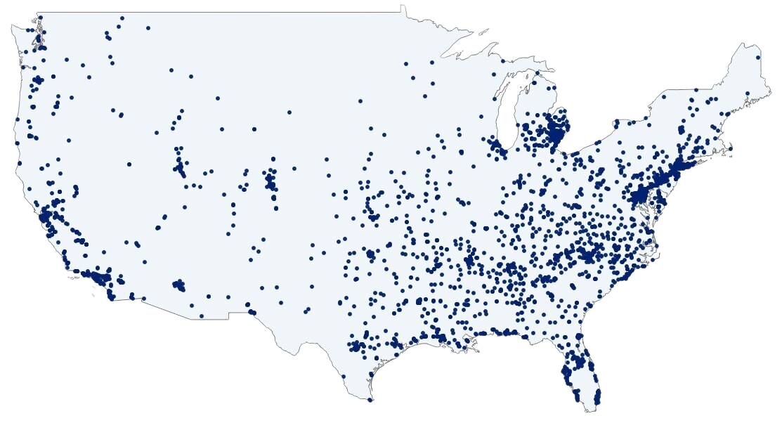
Aledade PBC
Our mission, as a physician-led public benefit corporation, is to deliver better health, better care and lower costs, creating a healthcare system that is good for patients, practices and society.
3M+ Patients
3K+ Partners
46 States
Farzad Mostashari
Co-founder & CEO
Mat Kendall
Co-founder & President
2014
Aledade founded
2022
PBC designation
2024
ACOs save $1B+
Scale as of 3/31/2026
Notes:
Aleade is a mission oriented organization committed to better outcomes for patients and creating a health care system that good for patients, practices and health centers, and society.
As a public benefit corporation, we are fiduciarly responsible to all partners, including over 300 CHCs nationwide, and 24 in VA, and their patients, along with shareholders.

Slide 4
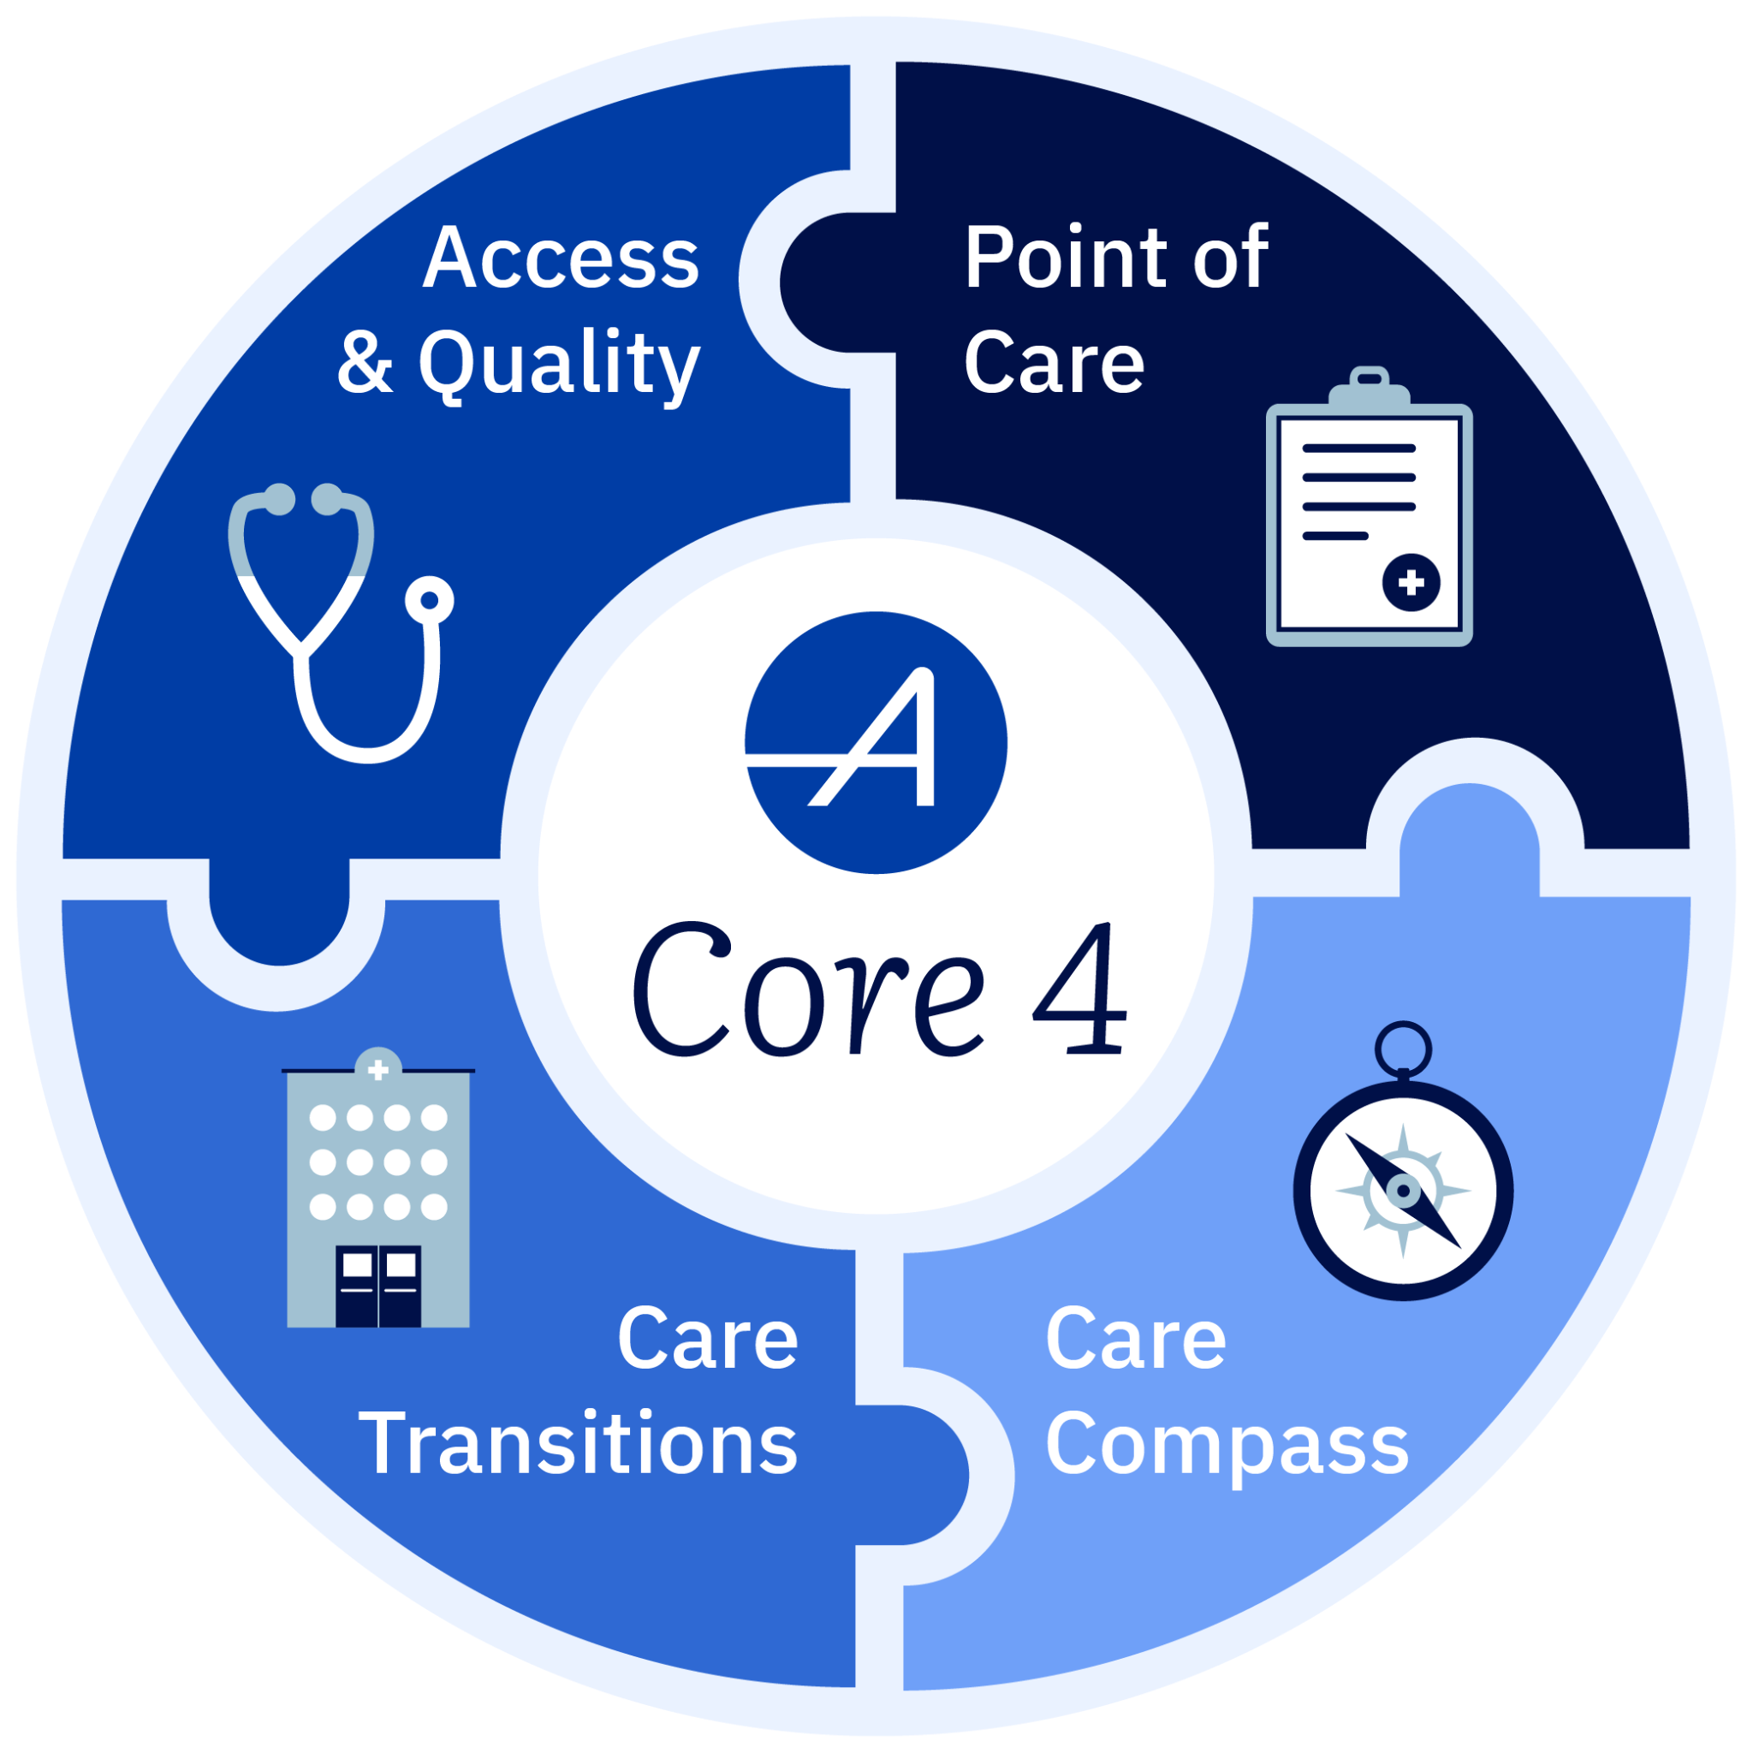
Supporting Effective Transitional Care Management
The Blueprint
The Core 4 is Aledade’s framework to achieve success in health outcomes and financial shared savings.
Care Transitions
Focus on care transitions ensures patients receive timely care following an ED visit or hospital discharge.
Preventing Readmissions
In the 2025 Patient Impact Report, Aledade primary care partners completed more than 60,000 TCMs. These interventional efforts potentially prevented more than 4,000 costly hospital readmissions.^{(1,2)}
Transition of Care Support
Aledade equips practices with timely ADT event alerts, population health dashboards, and EHR-integrated tools to streamline post-discharge tracking, care coordination and follow-up planning.
1. Based on Aledade internal practice performance data the period ending 12/31/2025, across all attributed patients. CACP enrollment is sourced separately — see note 11.
2. Based on differences in likelihood of 30-day readmission for inpatient discharges with and without TCM visits in an Aledade analysis of 2016-2019 data.
Notes:
https://docs.google.com/presentation/d/1GDMLt20CzJ7fjqeJbeYmVUmuhww4YkTaHSx6O5kaKYk/edit?usp=sharing
Aledade partners with FQHCS. We are NOT a vendor, but a partner aligned in outcomes.
To improve population health and increase shared savings for our partners, we focus on 4 core 4 areas. There will be other presentations at the VCHA conference that talk about other core 4 areas, such as access and quality in our BP control session, and point of care in our diagnosis documentation session.
For this session, tag teaming with VHI, we will be focusing on the care transitions piece of our core 4—
Then speak for a minute or so explaining HOW this works in the App, overlay, etc. === hit on how we get timely twice a day notifications, etc.
Slide 5: https://docs.google.com/presentation/d/15DmCENeTdJtmz3hZ479Vo5sldvxASA32TBWDwy75Zfg/edit?usp=sharing
Slide 43: https://chcams.org/wp-content/uploads/2022/08/CHCAMS-Annual-Conference-Aledade-Presentation-2022.pdf
https://docs.google.com/document/d/1zI3G0lMXMmSChHzwO8sAo6cLsfZj7hGNN-C0ceUPeIA/edit?usp=sharing
**Source: September 2019 Aledade analysis of TCM eligible inpatient visits between 1/1/2016 and 3/31/2019 among MSSP beneficiaries. Propensity score matching as used to balance baseline characteristics between intervention and control (no intervention) groups.

Slide 5
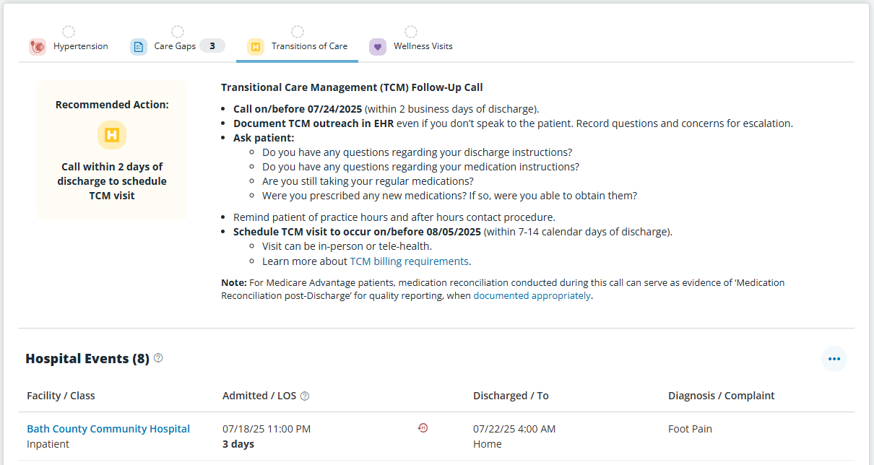
Outreach and Scheduling Dates for TOC Patients
Doe, Jane
01/01/1950
(000)123-456
Users can customize text/email reminders for patient events
(ED and inpatient admissions, discharges)
Data shown is for illustrative purposes only and not representative of actual patient data.
Notes:
Go into more details here about the App and notifications and how this ties into TCMs and ED follow ups, including a calendar to help with making sure they can bill for a TCM, etc.
May also want to touch on how we can help with outreach support through A+ here at a high level

Slide 6





TEFCA: For Healthcare Data Beyond State Lines
With your permission, we can utilize a national health data network, TEFCA, to inform App insights.
Built on Fast Healthcare Interoperability Resources (FHIR) and a secure, HIPAA-compliant framework
Strict data security controls include identity verification, consent management and auditability to protect patient records
300M¹
Of U.S population covered
Nationwide clinical data connecting providers, health plans, diagnostic laboratories and other medical organizations.
Each insight informs better patient care through a whole, patient-centered approach, enabling quality reporting and value-based care workflows
https://ehealthexchange.org/providers/
Notes:
Source: https://docs.google.com/presentation/d/11PxKBJoiSrsW0jrg8SMcrQQ47eli3C8y98ueYrk1ytI/edit?slide=id.g3941b65bdf8_1_119#slide=id.g3941b65bdf8_1_119
Talk at a very high level on what’s next on the horizon—how very excited we are ab out TEFCA and making these data even more robust and complementing what we're getting from VHI….potentially hit on an example of non standardized data like discharge summaries which we are NOT currently able to get from VHI but we can get from TEFCA….
https://docs.google.com/presentation/d/13VG0qeTEuCuJcRpOU_wujhuaFZwNj_WZLXml1LjsJNI/edit?usp=sharing
Source: Aledade internal analysis, Prez_TEFCA_A0725, “Early signals from TEFCA connectivity,” July 2026

Slide 7




Virginia’s Health Coordination Network (HCN)
Established in 2017
Founded within the Virginia Department of Health to lay the groundwork for statewide integration.
Statewide Secure Portal
Seamlessly connects providers across hospitals, post-acute care facilities, and primary care offices.
Real-Time Care Coordination
Enables live notifications and critical patient data access to improve coordination and quality metrics.
Notes:
What HCN is, why it is valuable to primary care partners (Kevin)

Slide 8

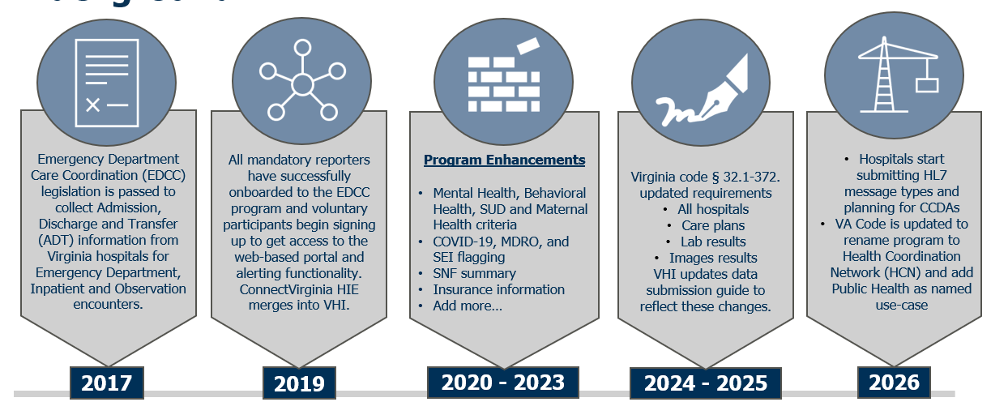
Health Coordination Network (HCN) Background

Slide 9
Unique Benefits for Each Tool
Aledade
VHI’s HCN
Predictive AI to identify at risk patients, suspected diagnoses alerts, pharmacy refills, TOC worklists, EHR integration
State level and public health information, infectious disease tracking, controlled substance prescription history
Near real-time ADT encounter notifications and facility visit histories across care settings
Notes:
Tag team with VHI on tihs slide / Venn diagram

Slide 10
Partner Interview
Notes:
How long has your office been utilizing Virginia’s HCN?
Tell us about your overall transitions of care processes at your health center? When throughout the day are you using the HCN or how have your incorporate it into your daily clinic workflows?
How does the HCN work overlap with the work you’re doing with Aledade? For example in the Aledade App or the Aledade Assist EHR overlay?
How has the use of the HCN data (either in the portal and / or Aledade App or Assist) improved care for your patient population?
What is on your wish list for future enhancements to either the HCN and/or the Aledade App / Aledade Assist Overlay?
What are you most interested in getting in terms of additional information from TEFCA?

Slide 11
Audience Q&A

Slide 12



T hank You

