Slide 1
Beyond Orientation: Developing an Onboarding Program That Sticks
Suzanne Speer, ACU

Slide 2



Beyond Orientation: Developing an Onboarding Program That Sticks
VACHA Annual Membership Meeting and Conference
HR Networking Workgroup
September 16, 2026
Suzanne Speer, VP of Workforce Development

Slide 3

Learn More About ACU
National Health Service Corps
Resources
Training
Networking
Recruitment & Retention
Access to Care & Clinician Support
www.clinicians.org
Notes:
National Center for Workforce Development and Training – Director, April Lewis

Slide 4

Who We Are
Comprehensive training, technical assistance, and consultation in all aspects of healthcare workforce development
Serves as the hub for a variety of ongoing ACU workforce initiatives
Notes:
Launched in April 2024 by the Association of Clinicians for the Underserved (ACU), the National Center consolidates and expands ACU's workforce programs into a single, authoritative source of training, technical assistance, and consultation.

Slide 5

What is onboarding?
“the process in which new employees gain the knowledge and skills they need to become effective members of an organization ”
Source: Cambridge Dictionary
Notes:
the process in which new employees gain the knowledge and skills they need to become effective members of an organization

Slide 6
ONBOARDING IS THE BRIDGE
Recruitment
Retention

Slide 7
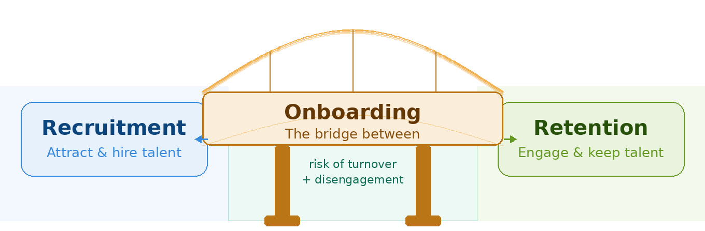

Slide 8
Why Onboarding?
Approximately 30% of new hires quit their job within the first 90 days of employment.
Sources: Jobvite

Slide 9
Why Onboarding?
Turnover is expensive!
The cost of replacing an employee ranges from 50% to 200% of an employee’s annual salary, depending on their role.
Source: Staffing Support Specialists
Notes:
Entry-level roles: 30-50% of salary
Clerical/Admin positions: 50-80%
Skilled hourly workers: 75-100%
Technical/professional positions: 100-150%
Supervisory roles: 100-150%

Slide 10
Why Onboarding?
Increases Employee Engagement
Sets clear expectations
Productivity occurs more quickly
Increases Retention
Notes:
According to SHRM:
Increased retention: A Click Boarding study found employees are 58 percent more likely to stay with a company for three years if they have a structured onboarding experience.
Increased productivity: The same study found new hires are 50 percent more productive when they go through standardized onboarding.
Higher employee engagement: A Gallup report found employees who had a great onboarding experience are 2.6 times more likely to be "extremely satisfied" at work.
Shorter time-to-productivity: Effective onboarding can shave months off a new hire's time-to-productivity, according to a SHRM Foundation guide.

Slide 11

ORIENTATION
ONBOARDING

Slide 12

The 4 C’s of Onboarding
Compliance
        Teaching basic legal and policy related rules and regulations
Clarification
  Understanding expectations, roles and responsibilities
Company (Organizational Work Environment)
  Vision, mission statement
Connection
  Interpersonal relationships, community connection
Source: SHRM Onboarding New Employees: Maximizing Success

Slide 13
Challenges of the 4 C’s
Compliance
Tracking compliance can be a challenge when the organization is large and across many different locations.
Clarification
Connecting staff across locations or those in virtual setting can be challenging. Facilitating meaningful relationships should ensure that there are opportunities for social interaction.
Culture
Connection
Challenges may arise when roles are evolving, requiring ongoing clarification between individual roles and goals.
Culture is caught, not just taught. Create genuine opportunities for new employees to experience your values in action, rather than simply presenting them on a slide.
Notes:
*compliance, beginning with creating accessible training material that effectively communicates company policies, procedures, and legal requirements to new hires can be challenging, as you ensure they understand and adhere to the regulations.
*Clarification, the challenge lies with the new hire understanding their role and responsibilities in a clear and concise way. The new hire must have consistent communication from their direct supervisor to succeed.
*For culture, introducing the company’s values and customs can be challenging, especially in a remote environment. Maintaining a strong company culture during periods of growth and organization change requires intentional l efforts from leadership. A common challenge here is failing to expand on these common aspects on the organizations culture.
*When an organization is fostering connections, there are the barriers to forming meaningful relationships such as geographical differences, time zones, and transparency.

Slide 14
Onboarding Activities
May involve:
  Building relationships with administration, leadership, direct reports, and other staff
  Understanding organizational environment/structure
  Orienting to facilities, computer system, EMR, policies and procedures, etc.
  Introducing new hire to the community
  Credentialing, licensing, etc. (for providers)

Slide 15
Onboarding: Ask Yourself
What impression do you want a new hire to walk away with after the first day?
What do new employees need to know?
How are you going to introduce your new hire to the organization’s work environment?
What is everyone’s role (HR, managers, co-workers)?
What are the goals for your new hire?
How long will onboarding last?
How will you assess and measure the effectiveness of your onboarding program?
Source: SHRM New Employee Onboarding Guide

Slide 16
Creating an Onboarding Plan
Preparatory
Orientation
Integration
Upon Hiring Decision
Prior to Start Date
First Days
First Weeks
First Three Months
First Six Months
First Year
Notes:
Preparatory – Before start date
Email to Staff about new hire
Welcome email
Orientation:
Onboarding agenda

Slide 17
Creating an Onboarding Plan
Provide a structure and a process for welcoming new hires to your organization
Create a checklist for all staff, as well as sections for additional considerations for specific clinical staff
When crafting your plan, consider the following questions for each onboarding activity:
  Who will be responsible for ensuring this component of your new hire’s onboarding is completed?
  When should the planning for this onboarding activity take place? Before the new employee’s start date? Within their first two weeks?
  When should the new hire or responsible staff person aim to complete this activity?
Be thorough – more detail is better than less!
Be clear about expectations – what constitutes success?

Slide 18
Preparatory
Process Monitor/Mentor/ Responsible Staff | Upon Hire Decision | Completed (date and by whom) | Prior to Start Date | Completed (date and by whom)
Manager | Create new hire schedule |  | Add/invite to existing meetings
 | Designate coworker resource |  | Call to confirm start date and time, include first day expectations
 | Discuss relocation, if applicable |  | Create welcome packet
 | Identify HR point of contact |  | Inform department, HR, and IT
 |  |  | Schedule pertinent training
 |  |  | Email existing staff to introduce new hire, include professional background, hobbies, and interests if the new employee agrees
Office Administrator | Submit technology requests |  | Secure work area/station
 | Order passkeys, IDs, etc. |  | Designate space
 |  |  | Furniture, supplies, etc.
 |  |  | Phone setup
 |  |  | Obtain nameplate, business cards, etc.
Human Resources | Create personnel file |  | Confirm receipt of all recruitment docs
 |  |  | Confirm offer letter reception/acceptance
 |  |  | Confirm background check completion
 |  |  | Communicate organizational practices
 |  |  | Communicate organizational policies
 |  |  | Enroll in new hire briefing, webinar, etc. if applicable. Otherwise, schedule new hire briefing
Technology |  |  | Passkey order form
 |  |  | Temporary access for new hire
 |  |  | Software acquisition
 |  |  | Mobile device(s), if applicable
 |  |  | Hardware setup
 |  |  | Network setup

Slide 19
Orientation
Process Monitor/Mentor/ Responsible Staff | First Day(s) | Completed (date and by whom) | First Week(s) | Completed (date and by whom)
Manager | Welcome upon arrival |  | Ask how first weeks went
 | Guide to work station/office |  | Provide support to guide the new employee through questions and challenges
 | Deliver prepared welcome packet |  | Review training schedule
 | Discuss break/meal policies |  | Review all technology functionality
 | Discuss trial period, if applicable |  | Touch base with coworker/colleague resource
 | Introduce to designated coworker/colleague resource |  | Discuss current projects
 | Explain role/position in team-based care model |  | Go over HC Standard Operating Procedures (SOP)
 | Explain roles/positions of others on the care team and how to coordinate across the care team
 | Introduce Health Center Program & history
 | Discuss the health center's mission statement and patient population
 | Set up regular check-in meetings
Office Administrator | Provide company structure sheet
 | Provide company contact list access
 | Provide any maps, parking passes, etc.
Human Resources | Connect to complete any paperwork |  | Review company policies
 | Review portal |  | Ask employee how first weeks went
 | Sign offer letter, if necessary |  | Ask manager how first weeks went
 | Enroll in any benefits/services
 | Discuss organizational environment and work style
 | Discuss organizational expectations
Technology | Review software, hardware, printers, etc.
 | Confirm email setup
 | Confirm phone setup
 | Review tech acceptable use policies
 | Assist with online directory setup
 | Provide access to company software programs
Designated Coworker/Peer Resource | Conduct tours |  | Periodic check-ins
 | Answer any questions
 | Offer to take to lunch
 | Make peer introductions

Slide 20
Integration
Process Monitor/Mentor/ Responsible Staff | End of First Three Months | Completed (date and by whom) | End of First Six Months | Completed (date and by whom)
Manager | Assess progress |  | Performance review
 | Make any further introductions |  | Review short and long-term goals
 | Identify and address learning needs |  | Answer any questions
 | Make any responsibility adjustments |  | Schedule ongoing professional development
 | Performance check-in |  | Celebrate end of trial period status if applicable
 | Review short and long-term goals |  | Schedule annual performance review
 | Answer any questions |  | Answer any questions
 | Continue regular check-ins based on employee need |  | Reassess goals
 |  |  | Stay Interview (if not conducted by HR)
Human Resources | Performance check-in |  | Stay Interview (if not conducted by supervisor)
Notes:
Preparatory – Before start date
Email to Staff about new hire
Welcome email
Orientation:
Onboarding agenda

Slide 21

What is the biggest gap with your onboarding program?

Slide 22
Does your organization use the same onboarding process for everyone?
Is it customized for each role or department?

Slide 23
Role-Specific Onboarding
Consider the new staff person’s role as you plan their onboarding process
Some elements of the onboarding process will be universal to all employees, while other elements may only be relevant for certain positions
Create onboarding programs that are tailored to meet the needs of new hires
  Customization strengthens retention and ensures individuals succeed in their new roles

Slide 24
Role-Specific Onboarding: Providers
Orientation
First Day(s)
Manager
  Discuss workflows - Review current workflows related to role for clarity or in the case that they have recently changed
  Discuss role-specific Standing Orders (Medical Director or Clinical Supervisor to go over)
  Coding and documentation - Specialty specific, EHR/EMR, tools
  Compliance
  Revenue Cycle Accountability (if applicable)
First Week(s)
Manager
  Explain internal and external referrals within the integrated care model of the HC
  Train on warm handoffs
Integration
End of First Six Months
Manager
  Check in on continuing competency training/certifications

Slide 25
Final Thoughts

Slide 26
Creating an Onboarding Plan
Designate a coworker to support new hires through the onboarding process
  Someone who has been at the organization for at least a year (preferably)
  Someone who is not in a managerial or leadership position over the person being onboarded
  Serve as a buddy and guide to introduce the new hire to the social fabric of the organization
  If you have a robust mentorship program, the coworker/colleague can be the new hire’s mentor
Defining your organizational work environment can help ensure everyone is on the same page

Slide 27
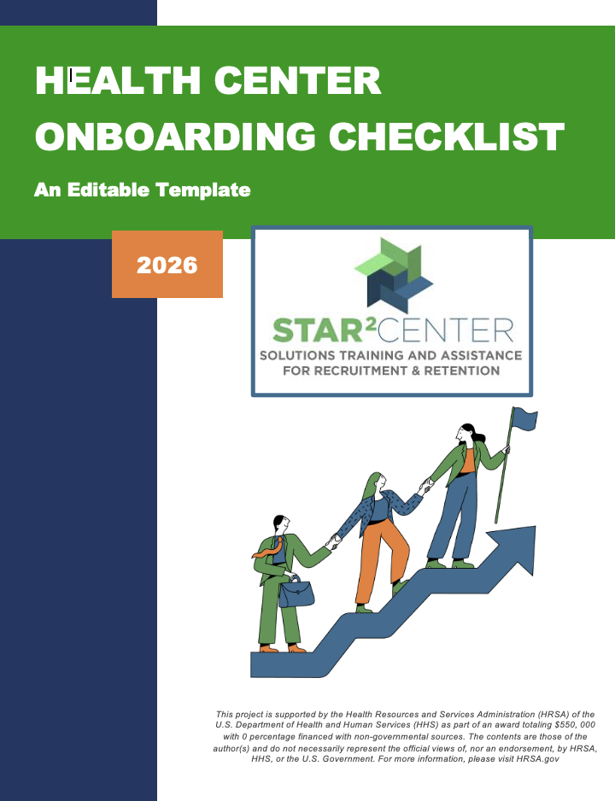
Onboarding Resource
Newly Updated!
Fully Customizable
Checklist for Preparatory, Orientation and Integration Phases
Source: clinicians.org/nationalcenter/health-center-onboarding-checklist/

Slide 28
Upcoming Trainings: Registration Open!
October: Manager Training Series
Monthly Leadership Labs

Slide 29
Upcoming Trainings: Registration Coming Soon!
Mentoring and Coaching Toolkit Intro Webinar
Mentoring and Coaching Cohort
Onboarding Cohort
Workforce Symposium: March 16-17, 2027

Slide 30

questions

Slide 31

We’d love to hear from you!
Suzanne Speer
Vice President of Workforce Development
sspeer@clinicians.org
clinicians.org/national center

